Slide 1
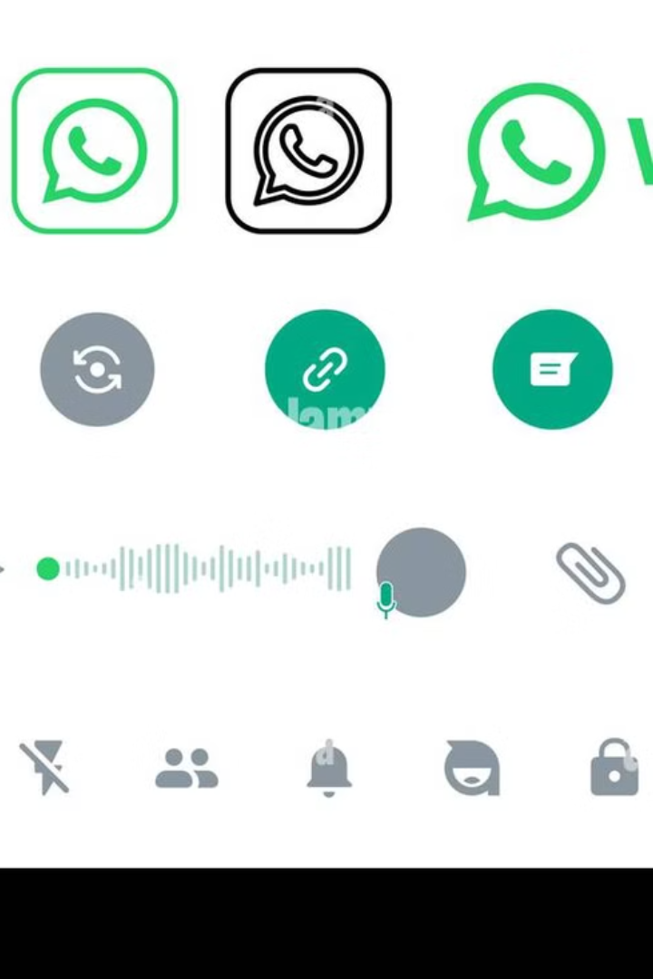

WhatsApp System Design Explained for Beginners
Let's break down how WhatsApp works behind the scenes in simple and easy-to-understand terms.
What is WhatsApp?
WhatsApp is a messaging app that allows you to send
text messages, make voice and video calls, share media files, and create groups. It needs to handle billions of users worldwide in real-time, which requires a solid system design.
by Ram N Java

Slide 2
Key Components of WhatsApp's System Design
Client-Server Architecture
End-to-End Encryption
Messaging Queue
WhatsApp uses a client-server model, where your phone (the client) communicates with WhatsApp's servers.
WhatsApp messages are protected by end-to-end encryption.
Messages are temporarily stored on WhatsApp's servers in a message queue if the recipient is offline.
What does this mean? Only the sender and receiver can read the messages. Even WhatsApp's servers can't see the content of your chats.
Why this approach? It ensures all devices stay synchronized. For example, if you send a message on your phone, it will still show up on WhatsApp Web.
Once the recipient comes online, the message is delivered, and it is deleted from the server.

Slide 3
More Key Components of WhatsApp's System Design
Real-Time Communication
Media Storage and Delivery
Notifications
WhatsApp uses the XMPP (Extensible Messaging and Presence Protocol) for real-time messaging.
Media files (like photos, videos, and voice notes) are stored on WhatsApp servers temporarily.
WhatsApp uses push notifications to alert users when a new message arrives.
Once the recipient downloads the file, it is deleted from the server to save storage space.
On Android and iOS, this is managed by services like Google Firebase and Apple Push Notification Service (APNS).
This protocol helps in maintaining a constant connection between users and the server to send messages instantly.

Slide 4
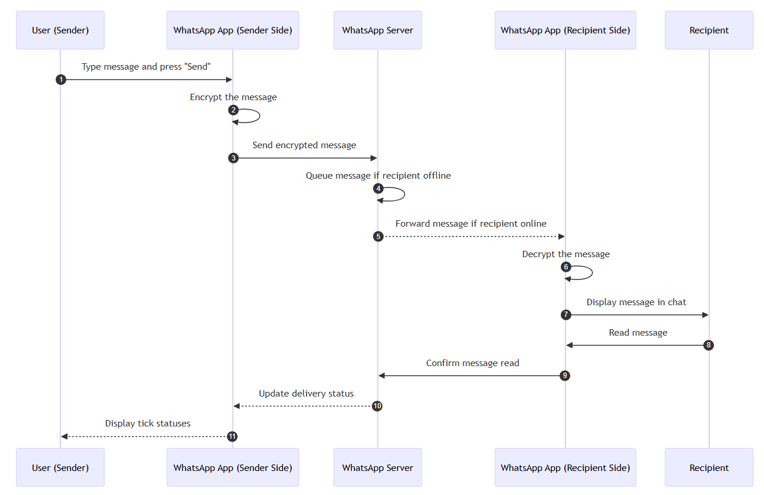

Slide 5
How Does WhatsApp Work?
1
Step 1: User Sends a Message
When you type a message and hit "Send," it is first encrypted on your phone.
The encrypted message is sent to WhatsApp's server.
2
Step 2: Message Queuing
If the recipient is online, the message is instantly forwarded to their device.
If they are offline, the message stays in the server's queue until their phone reconnects.
3
Step 3: Recipient Receives the Message
Once the recipient's phone receives the message, it decrypts it and
displays it in their chat window.
4
Step 4: Message Delivery Confirmation
WhatsApp shows delivery statuses using ticks:
One tick: Message sent to the server.
Two ticks: Message delivered to the recipient.
Blue ticks: Message read by the recipient.

Slide 6
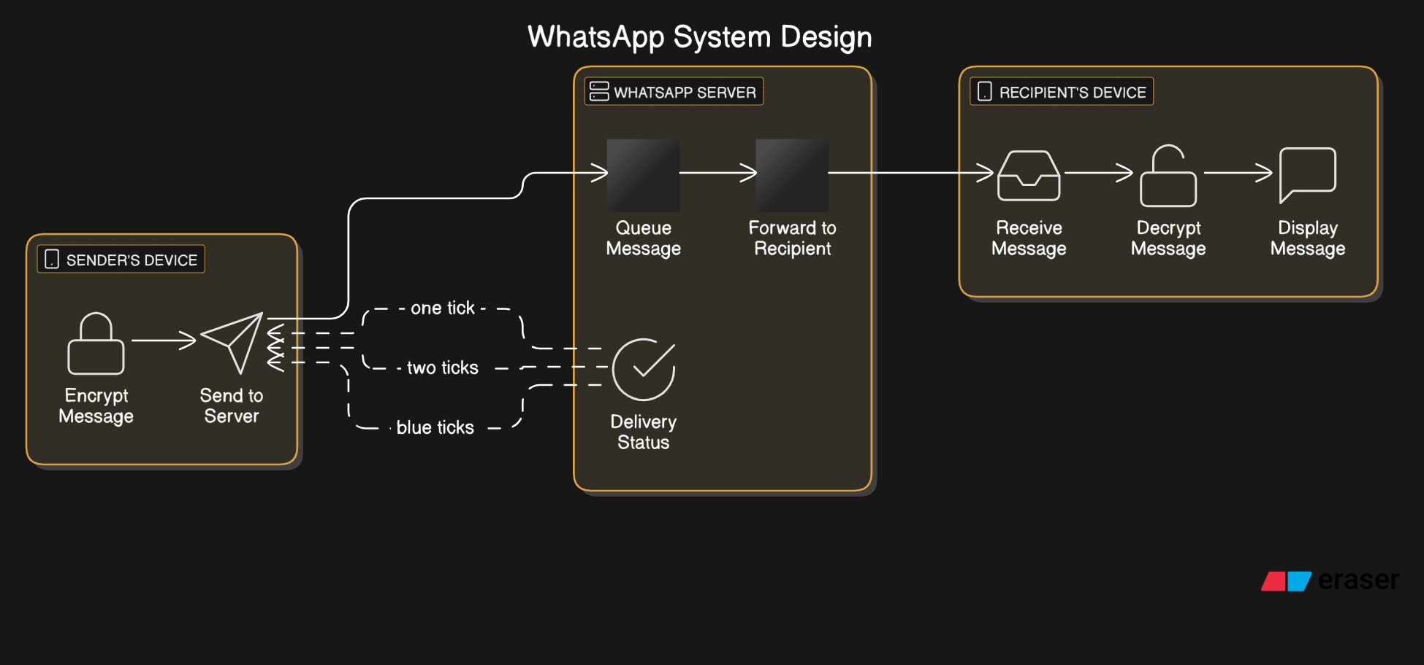
WhatsApp System Design Explained for Beginners

Slide 7
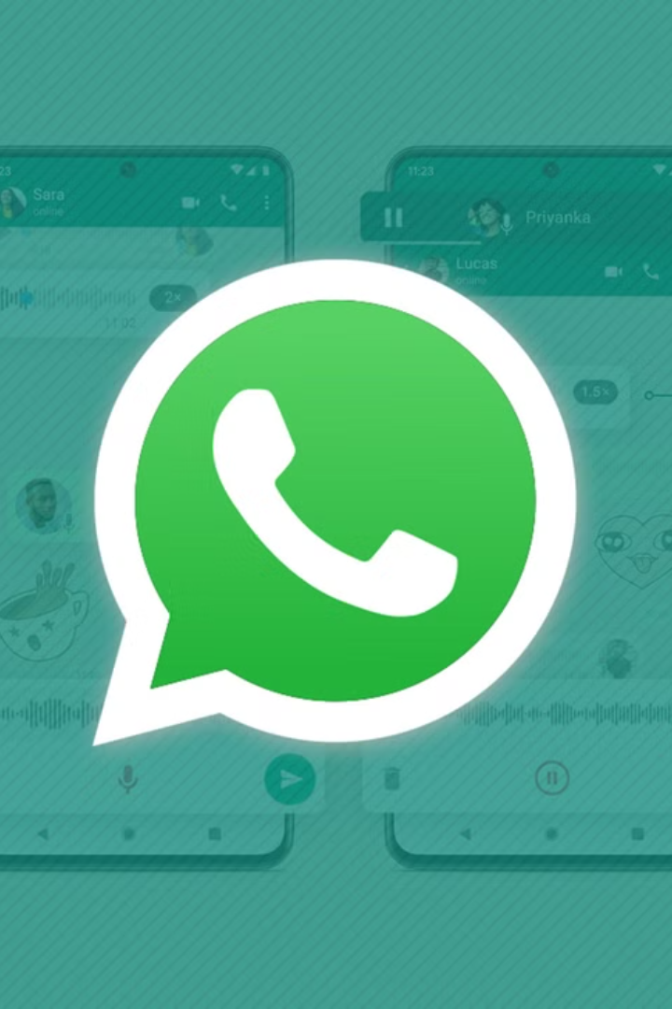
WhatsApp Features and
Their Design
Real-Time Messaging
Media Sharing
WhatsApp uses push notifications to deliver messages instantly.
When you share photos, videos, or files, they are compressed to reduce size and uploaded to WhatsApp's server.
It relies on protocols like XMPP (Extensible Messaging and Presence Protocol) for efficient message exchange.
The recipient downloads the media once it's available.
Group Chats
Messages sent to a group are delivered to all members individually.
The server handles message distribution efficiently.

Slide 8
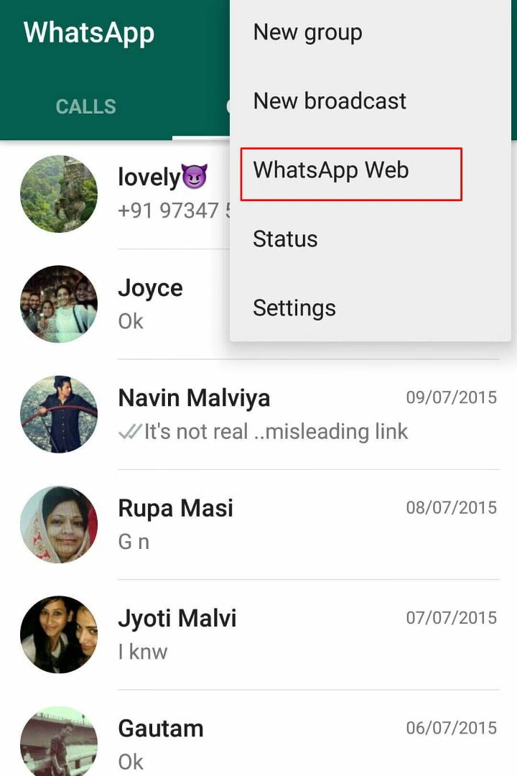


More WhatsApp Features and Their Design
Voice and Video Calls
WhatsApp Web
WhatsApp uses VoIP (Voice over IP) technology to handle calls.
The web interface connects to your phone using a QR code.
Calls are encrypted for security and use peer-to-peer connections whenever possible.
Messages are still sent and received through your phone.

Slide 9






Key Technologies Used
Erlang
XMPP
WebRTC
Firebase/APNS
For building a scalable and fault-tolerant system.
For real-time messaging.
For voice and video calls.
For sending push notifications.
NoSQL databases like Cassandra
Redis
It uses Redis for caching to improve speed.
WhatsApp uses NoSQL databases like Cassandra to store user information and chat history efficiently.

