Slide 1


What is AWS S3 Select?
Imagine you have a huge bucket of files (like spreadsheets,
text files, or logs) stored in Amazon S3, but you only need a small piece of data from one of those files. Normally, you'd download the whole file and then search through it, which takes time, effort, and bandwidth. AWS S3 Select is like a smart tool that helps you grab only the specific data you need directly from the file in S3, without downloading the entire file.
by Ram N Java

Slide 2
Simple Example of AWS S3 Select
Without S3 Select
With S3 Select
You would download the entire file, open it, and then search for the required rows.
You tell AWS what specific data you want, and it pulls only the relevant rows for you, saving time and resources.
Let's say you have a huge spreadsheet (CSV file) with thousands of rows about customers, and you only want the names of customers from a particular city.

Slide 3
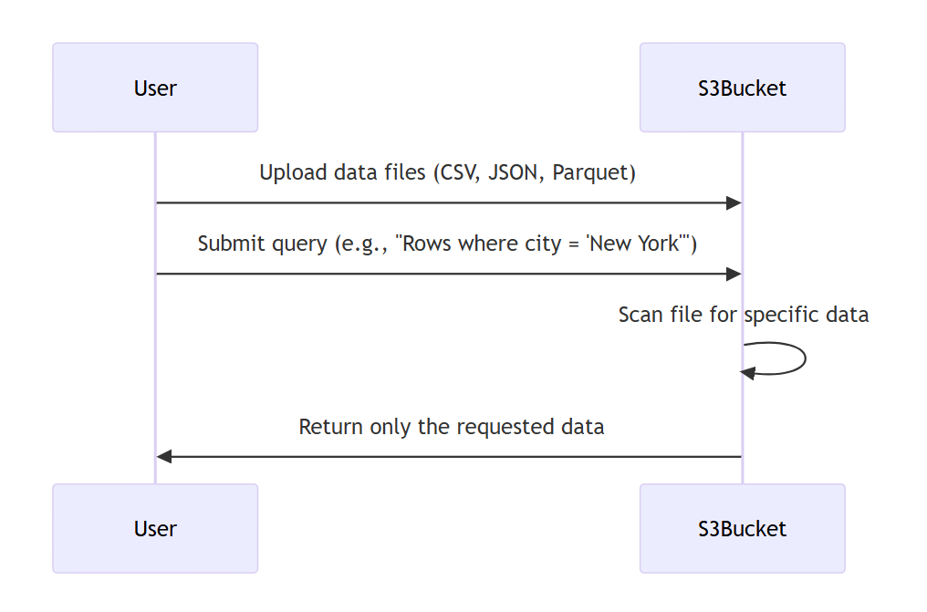
How Does AWS S3 Select Work?

Slide 4

How Does AWS S3 Select Work?
1
Store Files in S3
Upload your data files (like CSV, JSON, or Parquet) to Amazon S3.
2
Ask for Specific Data
Use a simple query (like asking a question) to specify what data you need. For example:
"Give me all rows where the city is 'New York'."
"Show me records where the price is above $100."
3
Get Only What You Need
AWS S3 Select will scan the file, pick out the specific data you asked for, and send back
just that part—without downloading the whole file.

Slide 5

Why is AWS S3 Select Useful?
Saves Time
Saves Money
You don't need to download large files to find what you're looking for.
Reduces bandwidth and processing costs since you only get the data you need.
Easy to Use
Fast
Works with simple queries (like SQL) that anyone can learn quickly.
AWS does the searching for you and gives you results much quicker.

Slide 6





Key Use Cases for S3 Select
Analyzing Data
Filtering Logs
Pull only specific rows from a large data file for analysis.
Extract errors or warnings from big server logs.
Working with Large Datasets
Cost Efficiency
Avoid unnecessary data transfer costs when working with large files.
Grab small portions of data for testing or reporting.

Slide 7

AWS S3 Select in Layman's Terms
Think of AWS S3 Select as asking a librarian to fetch only the specific pages you need from a very thick book, instead of handing you the entire book. It makes working with large files much faster and easier!

