Slide 1
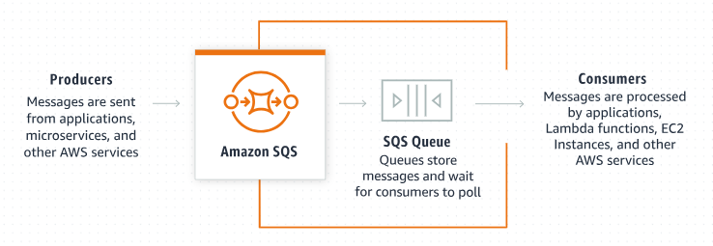
Amazon SQS: The Secret Weapon for Building Decoupled Applications (Beginners Guide)
What is Amazon SQS?
Amazon SQS (Simple Queue Service) is a fully managed message queuing service provided by Amazon Web Services (AWS).
Amazon SQS is designed to help you build scalable, reliable, and decoupled applications by facilitating communication between different parts of your system through messages.

Slide 2
Amazon SQS: The Secret Weapon for Building Decoupled Applications (Beginners Guide)
What is Amazon SQS?
Imagine you're building a complex application with multiple components that need to talk to each other. For instance, you have a web application that accepts user orders and a separate service that processes those orders.
You need a way for the web app to send order information to the processing service without both having to be active at the same time or tightly linked. Amazon SQS helps you do just that by acting as a middleman that holds the messages (orders in this case) until the receiving service is ready to process them.
Queue holds Orders
Accept Orders
Process Orders
Order
Web Application
(Producer)
Order Processing Service
(Consumer)

Slide 3
Amazon SQS: The Secret Weapon for Building Decoupled Applications (Beginners Guide)
Key Concepts
Queue: A queue is like a waiting line where messages are stored until they are processed. You can think of it as a buffer between different parts of your application.
Message: A message is the data that you want to send from one part of your application to another. In our example, a message could be an order detail.
Queue holds Orders
Accept Orders
Process Orders
Order
Web Application
(Producer)
Order Processing Service
(Consumer)

Slide 4
Amazon SQS: The Secret Weapon for Building Decoupled Applications (Beginners Guide)
Key Concepts
Producer: The part of your application that sends messages to the queue. For instance, the web application that receives orders.
Consumer: The part of your application that retrieves and processes messages from the queue. For example, the order processing service.
Queue holds Orders
Accept Orders
Process Orders
Order
Web Application
(Producer)
Order Processing Service
(Consumer)

Slide 5
Amazon SQS: The Secret Weapon for Building Decoupled Applications (Beginners Guide)
How Does Amazon SQS Work?
Send Messages: The producer sends messages to the SQS queue.
Store Messages: Amazon SQS stores the messages in the queue. These messages are retained until they are processed and deleted by the consumer.
Receive Messages: The consumer retrieves messages from the queue when it’s ready to process them.
Delete Messages: After processing a message, the consumer deletes it from the queue to prevent it from being processed again.
Queue holds Orders
Accept Orders
Process Orders
Order
Web Application
(Producer)
Order Processing Service
(Consumer)

Slide 6
Amazon SQS: The Secret Weapon for Building Decoupled Applications (Beginners Guide)
Types of Queues
Amazon SQS offers two types of queues:
Standard Queue:
High Throughput: Can handle a large number of transactions per second.
At-Least-Once Delivery: Messages might be delivered more than once.
Best-Effort Ordering: Messages are generally delivered in the order they are sent, but occasionally they might be delivered out of order.
FIFO Queue (First-In-First-Out):
Exact-Once Processing: Ensures that each message is delivered and processed exactly once.
Preserved Order: Messages are delivered in the exact order they are sent.

Slide 7
Amazon SQS: The Secret Weapon for Building Decoupled Applications (Beginners Guide)
Benefits of Amazon SQS
Scalability: Automatically scales to handle any amount of messages.
Reliability: Ensures that messages are not lost and can be processed reliably.
Decoupling: Allows different parts of your application to communicate without being directly connected, improving flexibility and fault tolerance.
Cost-Effective: Pay-as-you-go pricing means you only pay for the resources you use.

Slide 8
Amazon SQS: The Secret Weapon for Building Decoupled Applications (Beginners Guide)
Common Use Cases
Order Processing: Decoupling the front-end order-taking system from the back-end order processing system.
Job Scheduling: Managing background tasks such as batch processing or scheduled jobs.
Message Buffering: Handling spikes in traffic by buffering messages to be processed later.

Slide 9
Amazon SQS: The Secret Weapon for Building Decoupled Applications (Beginners Guide)
Summary
Amazon SQS is a powerful service for building scalable and decoupled applications.
Amazon SQS uses queues to store and manage messages
Amazon SQS allows different parts of your application to communicate efficiently and reliably.
Using Amazon SQS we can process orders, manage background tasks, or buffer messages during traffic spikes. Amazon SQS provides the tools you need to ensure your application runs smoothly.

