Slide 1
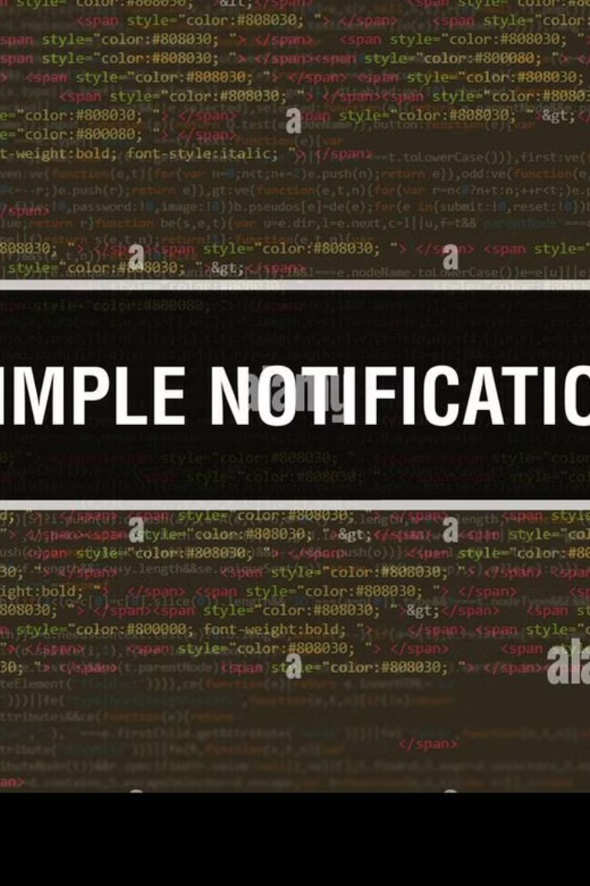

AWS SNS
Delivery Status Logging:
Simple Explanation
Amazon Simple Notification Service (SNS) is a messaging service that sends notifications to different types of recipients, such as mobile devices, email, and other services.
What is Delivery Status Logging?
Delivery Status Logging in AWS SNS helps you track whether messages are successfully delivered or if they fail. It records detailed information about message delivery, so you know what happened after SNS sent the notification.
by Ram N Java

Slide 2
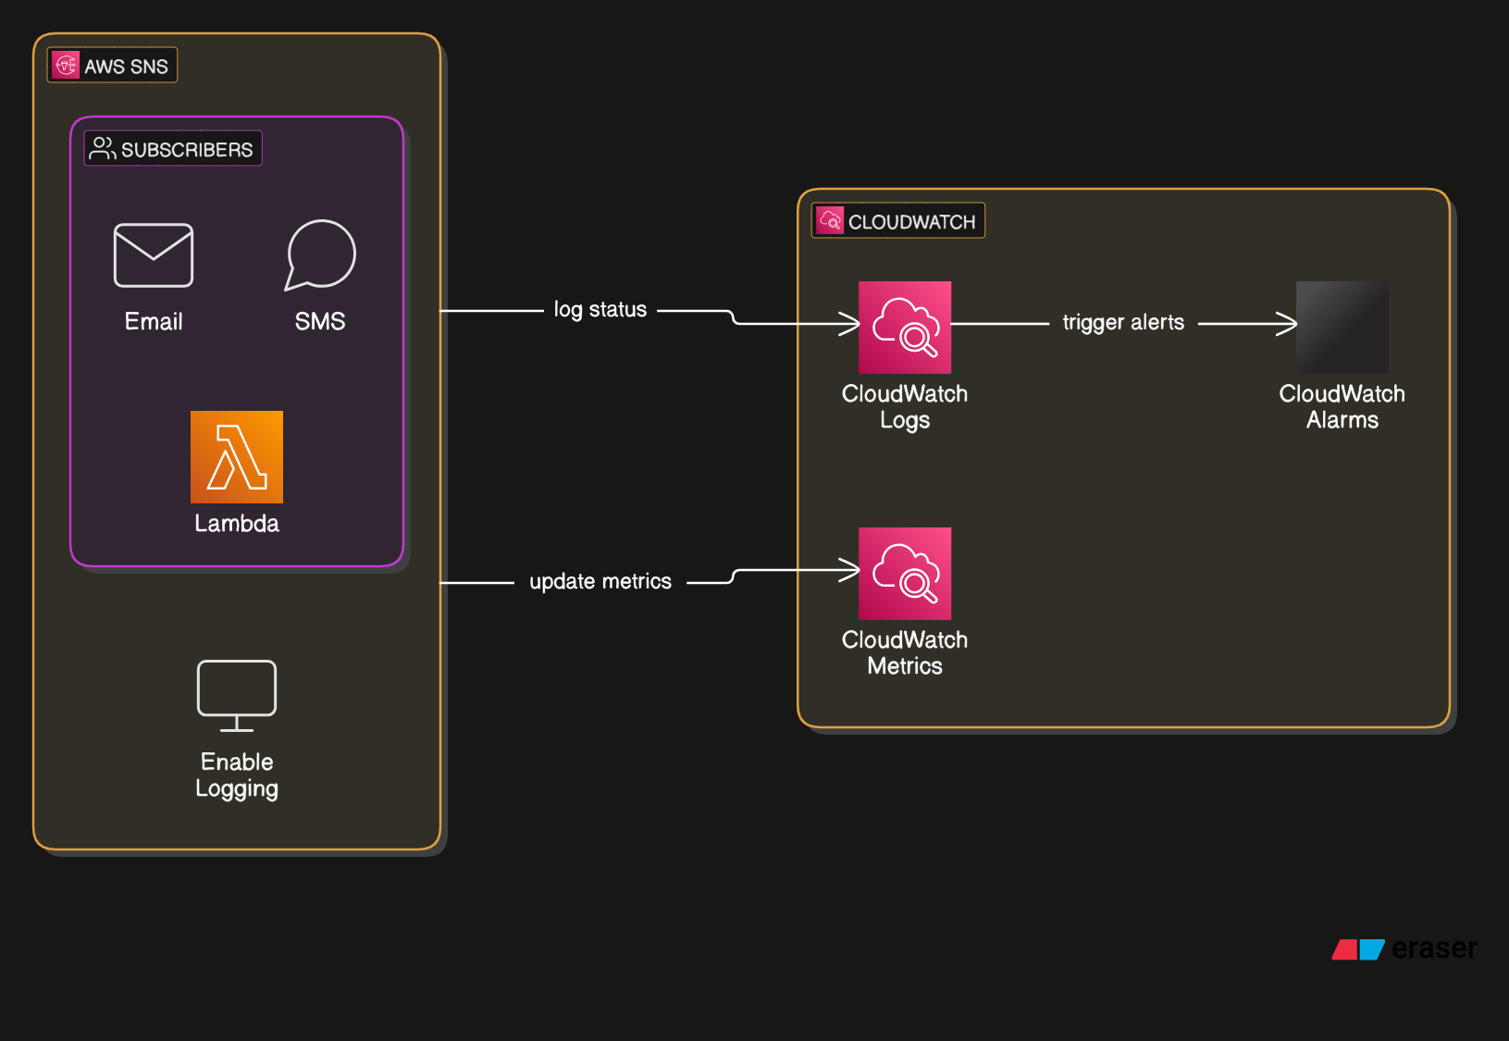

Slide 3
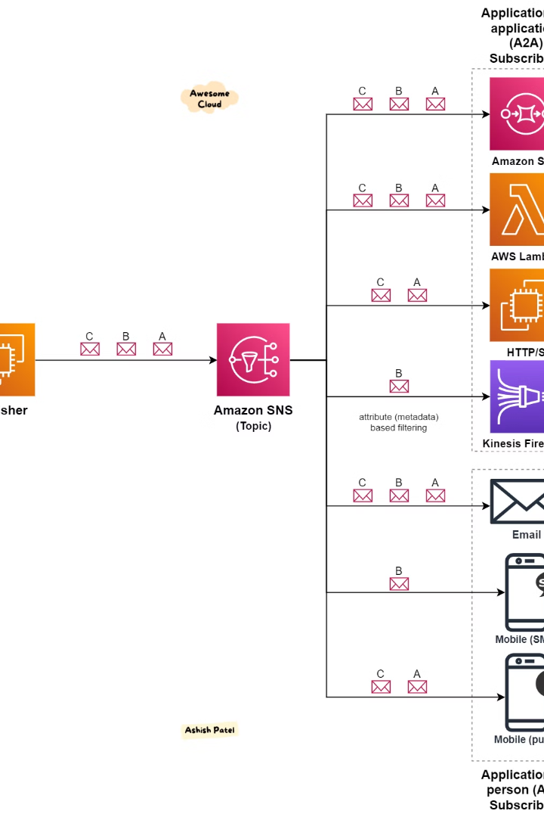
How Does Delivery Status Logging Work?
Enable Logging
You turn on delivery status logging in SNS settings.
Message Sent
SNS tries to deliver your message to the subscriber (e.g., email, SMS, Lambda, etc.).
Logging the Status
AWS SNS records whether the message was successful, delayed, or failed.
View Logs
You can check the logs in Amazon CloudWatch, which stores the delivery details.

Slide 4





Types of Delivery Statuses
Success
Failure
Throttled
The message was delivered successfully.
The message was not delivered (e.g., invalid email, phone number, or blocked SMS).
The receiving service is overloaded, so SNS slows down delivery.
Temporary Failure
Delivery failed but might be retried later (e.g., email inbox full).

Slide 5
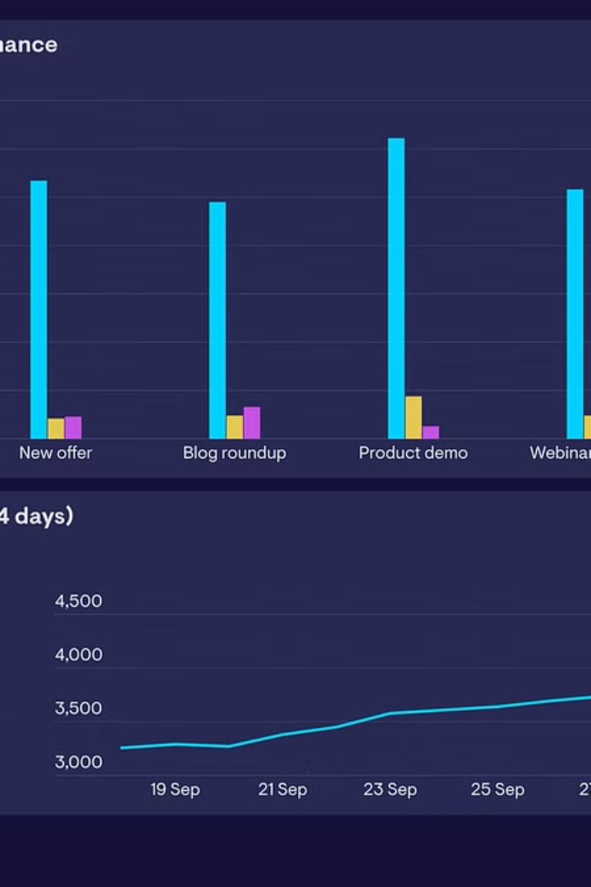
Why is Delivery Status Logging Important?
1
Monitor Message Delivery
2
Identify Failures
Identifies failures (e.g., wrong phone number, email issues)
Helps you monitor if messages are reaching the recipients
3
Improve Reliability
Useful for debugging and improving message reliability

Slide 6
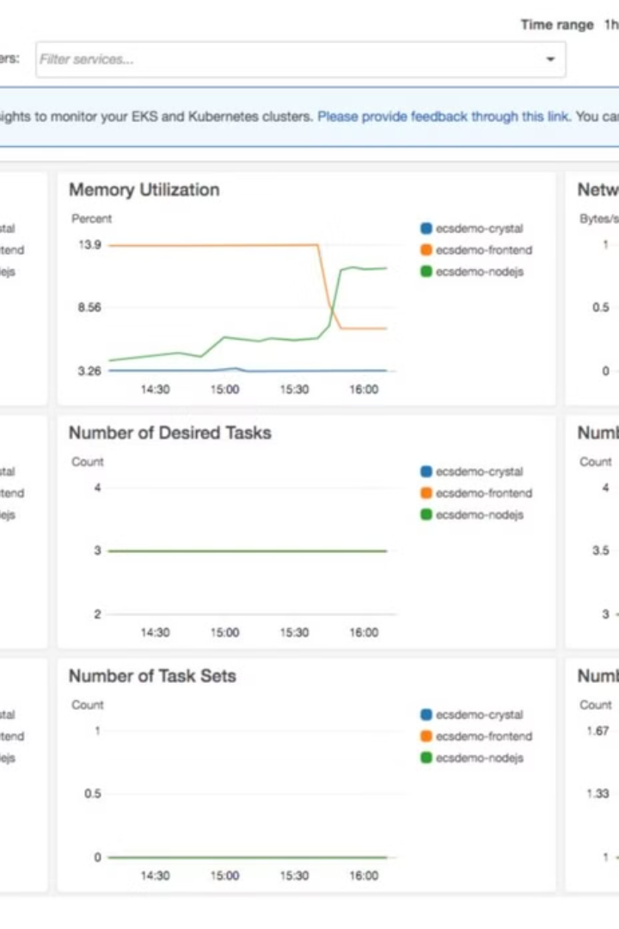
Where Can You View Logs?
Amazon CloudWatch Logs
Amazon CloudWatch Metrics
Stores detailed delivery information.
Provides statistics (e.g., how many messages failed).
Amazon CloudWatch Alarms
Sends alerts when delivery issues occur.

Slide 7



Example Use Cases
E-Commerce Notifications
IoT Devices
Ensures order confirmation SMS/emails reach customers.
Banking Alerts
Monitors alerts sent to smart devices.
Verifies OTP (One-Time Password) messages are delivered.

Slide 8
How to Enable SNS Delivery Status Logging
Go to AWS SNS Console
1
2
Select the SNS Topic
Choose the topic you want to track.
Click on Delivery Status Logging
3
4
Enable Logging
Choose a CloudWatch Log Group.
Save the Settings
5

Slide 9





In Summary
Fix Issues
Track Message Delivery
2
Identify and resolve delivery problems
AWS SNS Delivery Status Logging helps you track message delivery
1
Improve Reliability
3
Enhance overall message delivery reliability
5
Ensure Delivery
Ensure your messages reach the intended recipients
4
Use CloudWatch
Utilize CloudWatch logs and metrics

