Slide 1


How to Uninstall JDK 11 from Windows 11:
A Beginner's Guide
Uninstalling software from your computer can sometimes be tricky, especially for beginners. This guide will walk you through the process of removing JDK 11 from your Windows 11 system step-by-step. Whether you're looking to free up space, resolve conflicts, or simply no longer need this version of Java, we'll cover everything you need to know to successfully uninstall JDK 11.
by Ram N Java

Slide 2
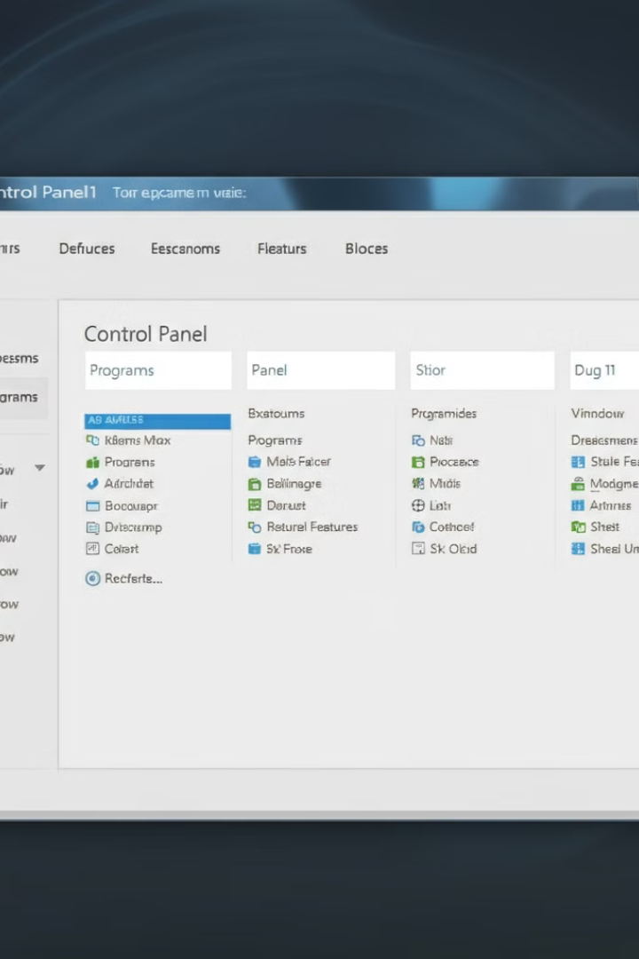
Accessing Control Panel and Programs
1
Step 1: Open Control Panel
1.Search for Control Panel: Click on the Start menu (Windows icon) and type "Control Panel" in the search bar.
2.Open Control Panel: Select Control Panel from the search results.
2
Step 2: Navigate to Programs and Features
In the Control Panel, under Programs, click on Uninstall a Program. (If you're viewing by Category, this will be under Programs > Uninstall a Program. If you're viewing by icons, just click Programs and Features.)
3
Step 3: Find JDK 11
1.You will see a list of all installed programs on your computer.
2.Scroll through the list and look for Java SE Development Kit 11
or JDK 11.

Slide 3
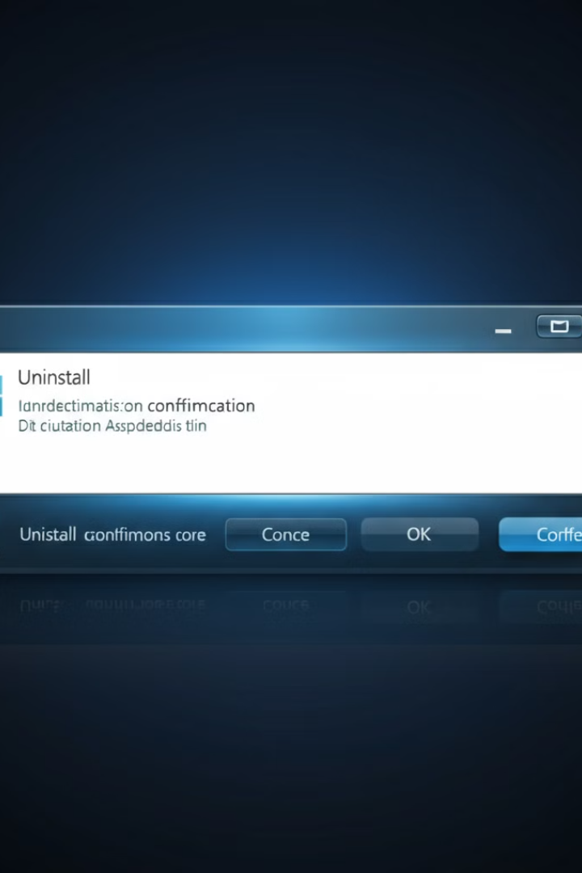




Uninstalling JDK 11
Select JDK 11
Click on Java SE Development Kit 11 from the list of programs.
Click Uninstall
At the top of the list, click the Uninstall button.
Confirm Uninstallation
A pop-up window may ask you to confirm the uninstallation. Click Yes to proceed.
Wait for Completion
The uninstallation process will take a few moments. Once it's done, JDK 11 will be removed from your system.

Slide 4
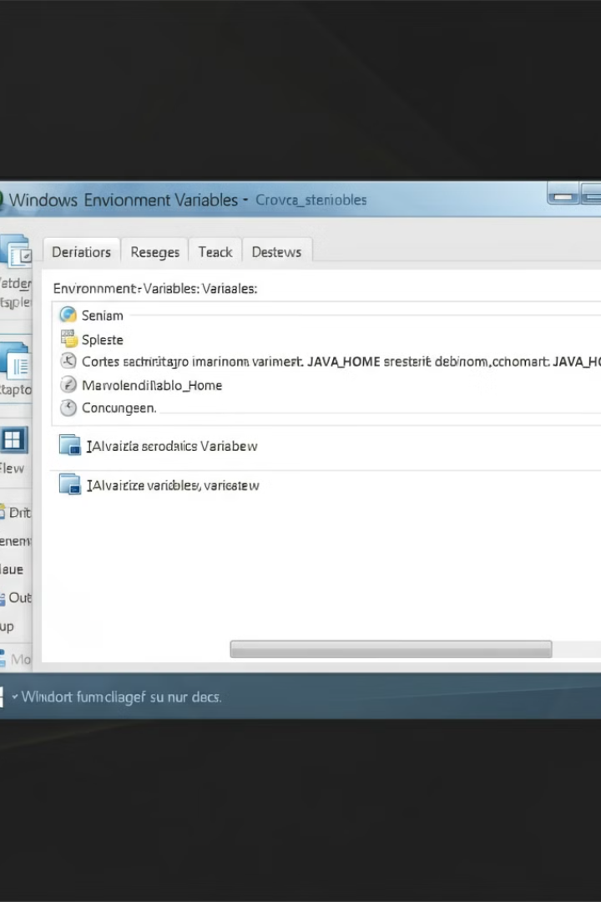
Removing JAVA_HOME Environment Variable
Open Environment Variables
Press the Windows key, type "Environment Variables", and select Edit the system environment variables.
Edit Environment Variables
In the System Properties window, click on Environment Variables.
Delete JAVA_HOME
Under System Variables, find the variable called JAVA_HOME. Select it and click Delete, then click OK.

Slide 5
Verifying Uninstallation and Conclusion
Verify JDK 11 is Uninstalled
Conclusion
1.Open Command Prompt: Press the Windows key and type cmd, then press Enter.
2.Check Java Version: In the Command Prompt window, type: “java –version”. If JDK 11 is successfully uninstalled, it will either show a different version or say that Java is not recognized, depending on whether other versions are installed.
You've successfully uninstalled JDK 11 from your
Windows 11 computer! If needed, you can now install a new version of the JDK or continue without Java.

