Slide 1
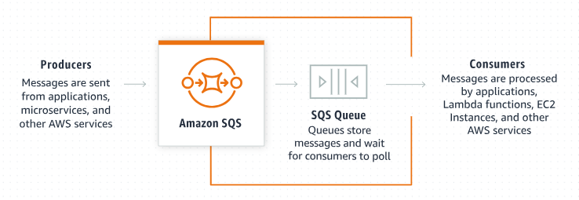
Explaining Amazon SQS Receive Message Wait Time: A Beginner's Guide
What is Amazon SQS?
Amazon Simple Queue Service (SQS) is a service that allows you to send, store, and receive messages between different parts of your applications.
Amazon SQS is like a messaging system where one part of your application can send a message to a queue, and another part can receive that message from the queue.

Slide 2
Explaining Amazon SQS Receive Message Wait Time: A Beginner's Guide
What is Receive Message Wait Time?
The "Receive Message Wait Time" is a setting in Amazon SQS that affects how your application receives messages from the queue. It determines how long your application should wait for a message to become available in the queue before moving on.

Slide 3
Explaining Amazon SQS Receive Message Wait Time: A Beginner's Guide
Key Concepts:
Short Polling:
By default, when your application asks SQS for a message, it immediately returns any available messages. If there are no messages, it returns an empty response. This is called short polling
Short polling can result in your application repeatedly checking for messages, even if none are available, which can be inefficient.
Long Polling:
Long polling is an alternative to short polling.
With long polling, your application tells SQS to wait for a specified amount of time (up to 20 seconds) before returning a response.
If a message becomes available during that wait time, SQS immediately returns it.
If no messages are available by the end of the wait time, SQS returns an empty response.

Slide 4
Explaining Amazon SQS Receive Message Wait Time: A Beginner's Guide
How Does It Work?
Short Polling Example:
Your application asks SQS for a message.
SQS immediately checks and finds no messages.
SQS returns an empty response.
Your application might repeatedly make these requests, using resources inefficiently.
Long Polling Example:
Your application asks SQS for a message and specifies a wait time (e.g., 10 seconds).
SQS waits up to 10 seconds to see if a message becomes available.
If a message arrives within those 10 seconds, SQS returns the message immediately.
If no message arrives, SQS waits the full 10 seconds before returning an empty response.

Slide 5
Explaining Amazon SQS Receive Message Wait Time: A Beginner's Guide
Benefits of Long Polling:
Efficiency:
Reduces the number of empty responses and the number of times your application needs to check for messages.
Saves on the cost associated with making frequent API requests.
Resource Saving:
Decreases the CPU usage and network traffic, as your application is not continuously polling the queue.
Cost Saving:
Reduces the number of API calls made to SQS, potentially lowering costs.

Slide 6
Explaining Amazon SQS Receive Message Wait Time: A Beginner's Guide
How to Set Receive Message Wait Time:
You can configure the Receive Message Wait Time in the following ways:
Queue Level: Set a default wait time for all receive message calls on a specific queue.
Request Level: Specify a wait time for individual receive message requests.

Slide 7
Explaining Amazon SQS Receive Message Wait Time: A Beginner's Guide
Summary:
The "Receive Message Wait Time" in Amazon SQS is a setting that determines how long your application will wait for a message to become available in the queue before returning a response.
Using long polling with a longer wait time can make your application more efficient and cost-effective by reducing unnecessary checks and resource usage.

