Slide 1

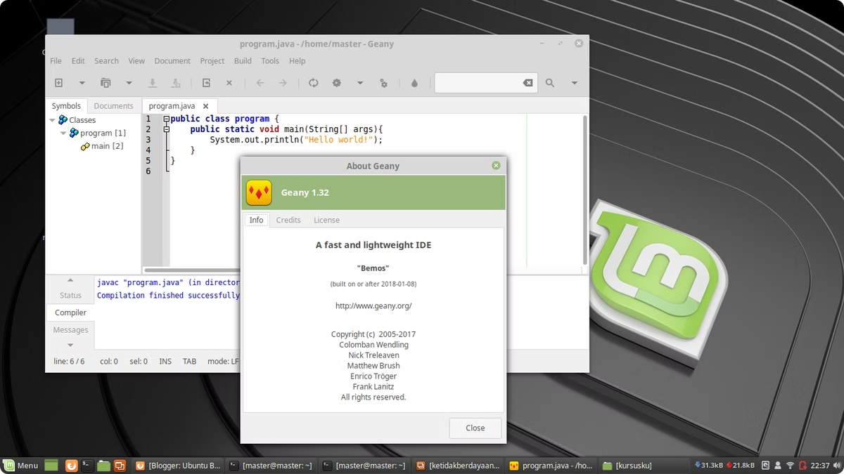

Installing Java JDK 23 on Amazon EC2 Instance or Linux Operating System
This guide provides step-by-step instructions for
beginners on how to install Java JDK 23 on a
Linux Operating System (like Ubuntu, Debian, Fedora, etc.). Follow these steps to get Java up and running on your Linux server.
by Ram N Java

Slide 2

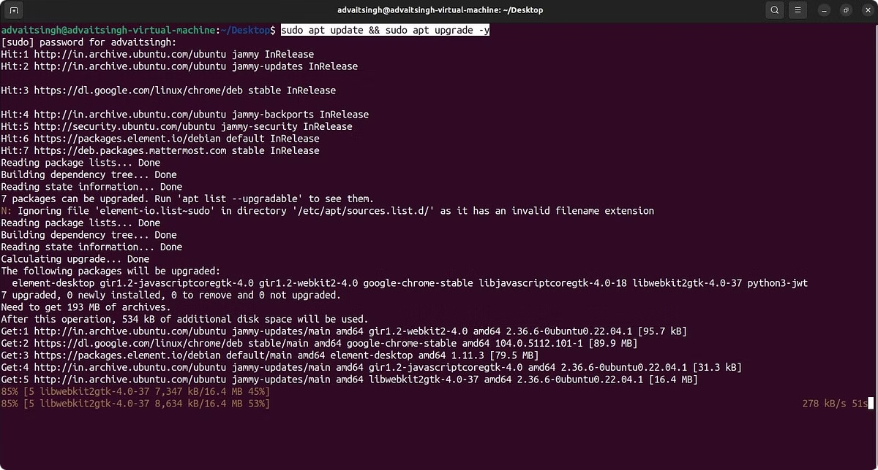
Step 1: Update Your Linux System
1
Open Terminal
Before installing JDK 23, it's always good to update your system packages to ensure everything is up-to-date. Open a terminal on your Linux server.
2
Update Packages
Run the following command to update your package list:
sudo yum update
3
Upgrade Packages
Run the following command to upgrade your packages:
sudo yum upgrade

Slide 3

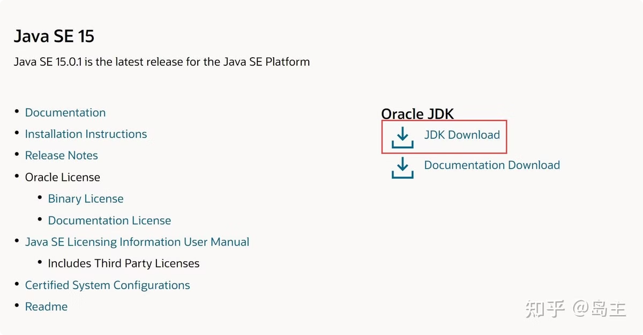
Step 2: Download JDK 23
1
Visit Oracle JDK Download Page
Go to the official Oracle JDK download page: https://www.oracle.com/java/technologies/javase/jdk23-archive-downloads.html
2
Find Linux x64 Compressed Archive
Look for the Linux x64 Compressed Archive option.
3
Download Using wget
Copy the download link for the .tar.gz file and use wget to download it directly onto your Linux server. In the terminal, run:
wget https://download.oracle.com/java/23/latest/jdk-23_linux-x64_bin.tar.gz
(Ensure the link matches the one provided on the Oracle website, as this link may change.)

Slide 4

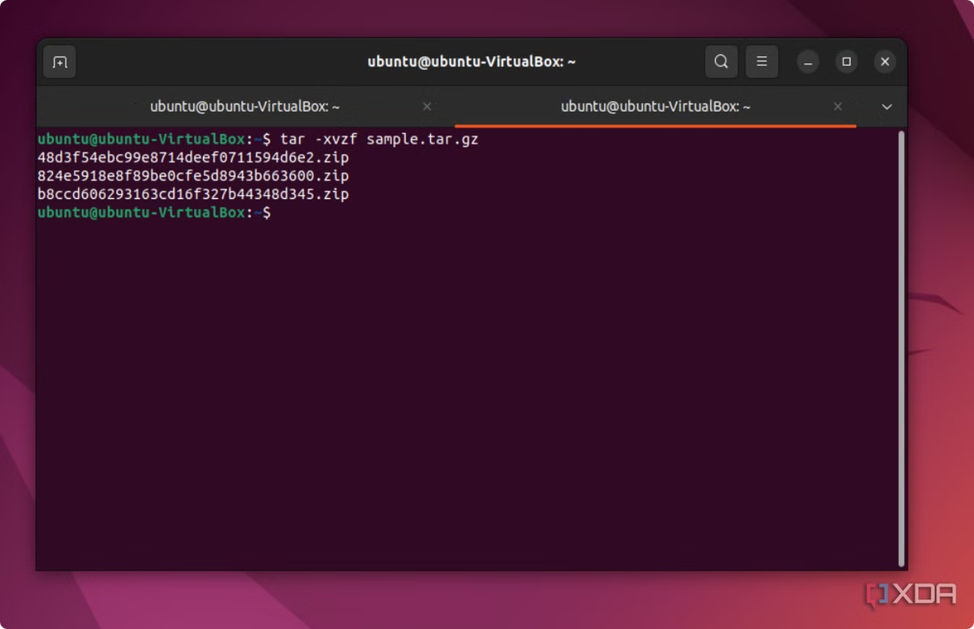
Step 3: Extract the JDK Archive
1
Extract to /opt/ Directory
After downloading the .tar.gz file, extract it to the /opt/ directory using the following command:
sudo tar -xvzf jdk-23_linux-x64_bin.tar.gz -C /opt/
2
Verify Extraction
Verify that the JDK folder has been extracted by listing the contents of the /opt/ directory:
ls /opt/
3
Confirm JDK Folder
You should see a folder like jdk-23.

Slide 5


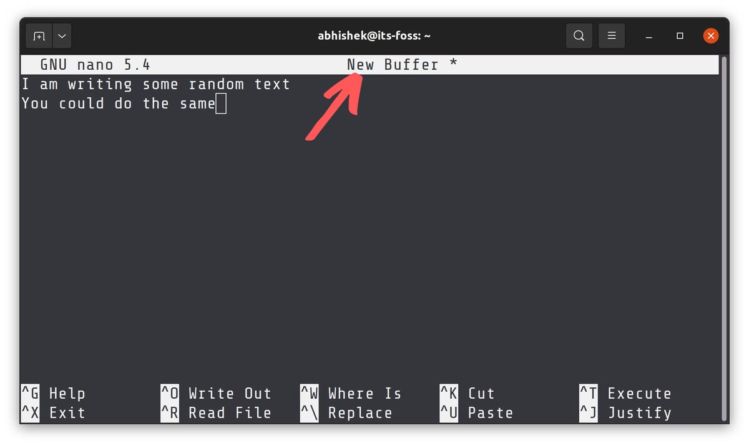



Step 4: Set Environment Variables
Open Profile File
To make the JDK available system-wide, set up environment variables. Open the profile file to edit the environment variables:
sudo nano /etc/profile
Add Environment Variables
Add the following lines at the bottom of the file to set the JAVA_HOME variable and update the PATH:
export JAVA_HOME=/opt/jdk-23
export PATH=$PATH:$JAVA_HOME/bin
Save and Exit
Press CTRL + X to exit the editor, then press Y to confirm the changes
and Enter to save.
Apply Changes
Apply the changes to your current session by running:
source /etc/profile

Slide 6
Step 5: Verify the Installation
Check Java Version
Check Java Compiler Version
To ensure that Java JDK 23 has been successfully installed, run the following command to check the Java version:
Also, check the Java compiler (javac) version by running:
javac -version
java -version
You should see output similar to:
java version “23"
Java(TM) SE Runtime Environment (build 23)
Java HotSpot(TM) 64-Bit Server VM (build 23)

Slide 7

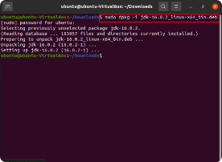
Step 6: (Optional) Set JDK 23 as Default
1
Add to Alternatives System
If you have multiple versions of Java installed and want to set JDK 23 as the default, use the
following commands:
sudo update-alternatives --install /usr/bin/java java /opt/jdk-23/bin/java 1
sudo update-alternatives --install /usr/bin/javac javac /opt/jdk-23/bin/javac 1
2
Set Default Java Version
Then set JDK 23 as the default Java version:
sudo update-alternatives --config java
sudo update-alternatives --config javac
3
Choose JDK 23
Choose the JDK 23 option from the list that appears.

Slide 8

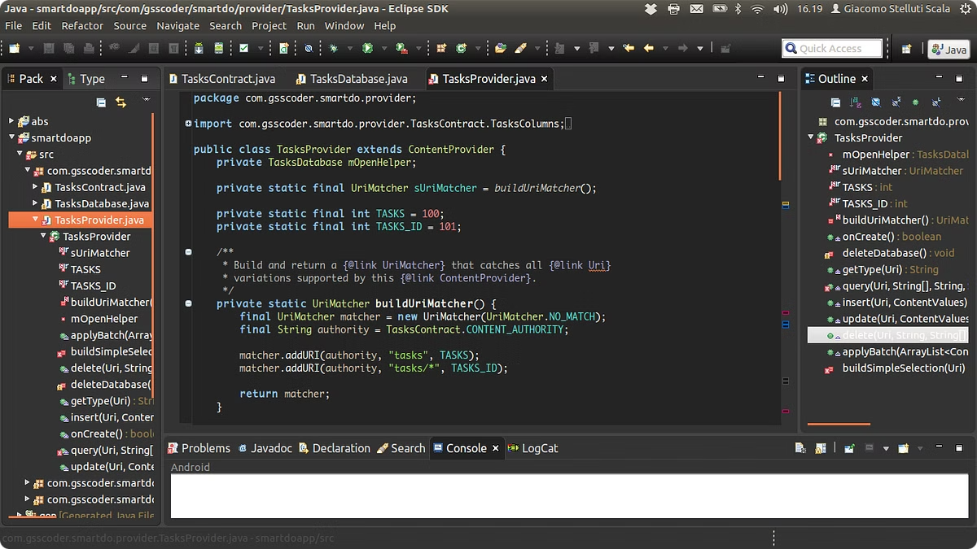
Conclusion
Installation Complete
You've now successfully installed Java JDK 23
on your Linux server!
Ready for Development
You're ready to start developing or running
Java applications using this version of the JDK.

