Slide 1
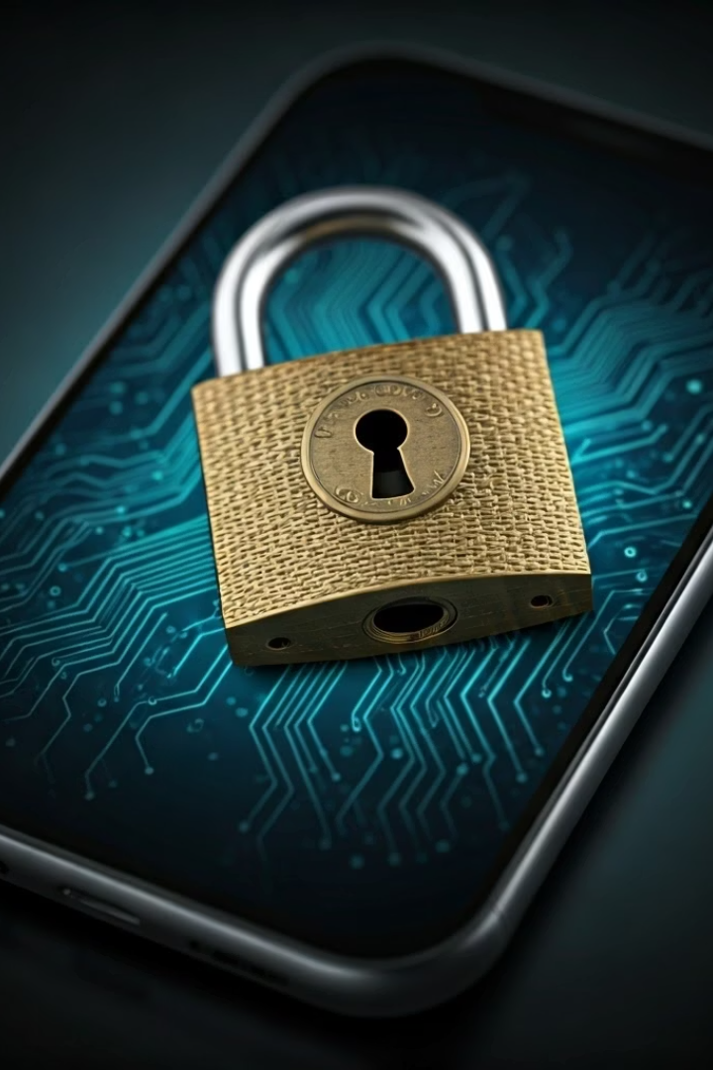

Two-Factor Authentication (2FA)
1
What is Two-Factor Authentication?
2
How it works
It means you need to use two things to log in safely:
Two-Factor Authentication (2FA) is an extra layer of security for your online accounts. It helps protect your account even if someone knows your password.
Something you know – like your password
Something you have – like a code sent to your phone or an app notification
3
The Benefit
This makes it harder for hackers to break into your account, even if they know your password.
by Ram N Java

Slide 2

Why is 2FA Important?
Password Vulnerability
Second Layer Protection
Passwords can be stolen or guessed.
But with 2FA, even if someone knows your password, they cannot log in without the second step (the code or confirmation).
Enhanced Security
It gives your account stronger protection.

Slide 3
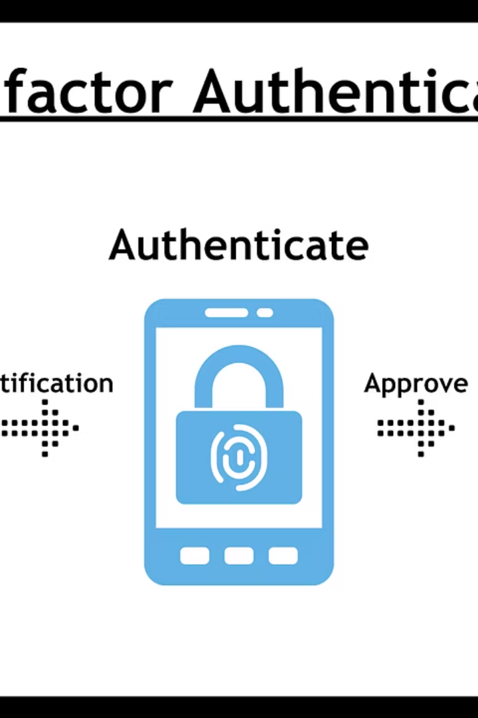



How Does 2FA Work?
Enter Credentials
You enter your username and password (just like normal).
Second Factor Request
The website asks for a second step, like:
A code sent to your mobile phone by SMS
A code is sent to your email instead of your phone.
A code from an authenticator app (like Google Authenticator)
A push notification you approve on your phone
Biometric Verification: Using your fingerprint or face scan (on phones and some computers).
Verification Complete
After entering the correct code, you're logged in.

Slide 4
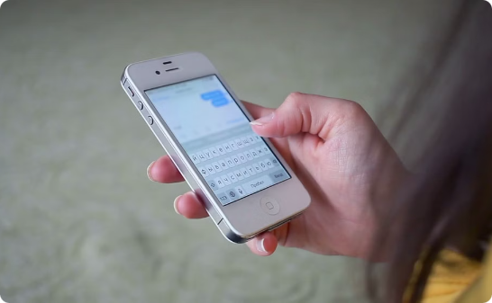
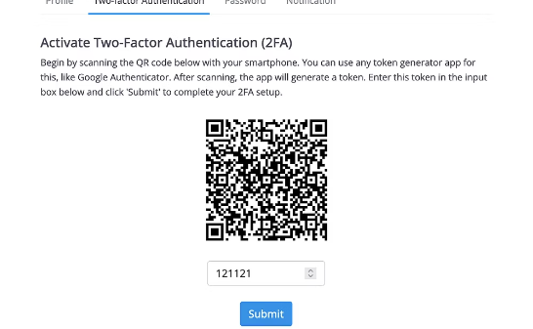
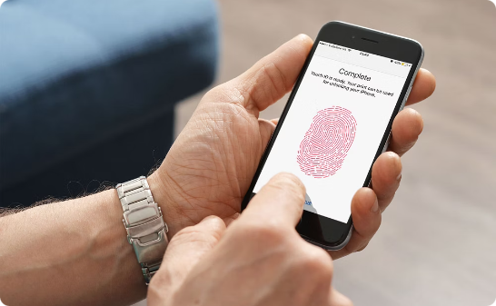
Examples of 2FA in Daily Life
Email and Banking
Authenticator Apps
Biometric Authentication
When you log in to your email or bank account and they send a code to your phone
When you use an app that gives you a temporary 6-digit code
When your phone asks for a fingerprint or face scan after you enter a password

Slide 5








Common Ways to Get the Second Factor
Authenticator App
SMS Code
An app that shows changing codes every 30 seconds
A text message with a number
Biometric
Email Code
Fingerprint or face scan (on some devices)
A one-time code sent to your email

Slide 6
Why is 2FA Important?
Account Protection
How to Turn On 2FA
It protects your account from hackers
Go to the security settings of your account (e.g., Google, Facebook, Bank).
Even if someone knows your password, they can't log in without the second factor
Look for "Two-Factor Authentication" or "2FA".
Choose your method (text, app, or email).
It keeps your email, social media, bank, and other accounts safer
Follow the steps to verify your phone or email.
Now, every time you log in, you'll need both your password and the extra code.

Slide 7





Tips for Using 2FA
Enable for Important Accounts
Keep Codes Private
Always turn on 2FA for important accounts like email, bank, and social media
Don't share your 2FA codes with anyone
Secure Your Devices
Use Trusted Applications
Keep your phone safe, as it's often needed for 2FA
Use trusted apps like Google Authenticator, Microsoft Authenticator, or Authy
Have Backup Options
Avoid SMS When Possible
Keep backup codes in case you lose your phone.
Avoid using SMS if possible (an authenticator app is safer).

Slide 8


Conclusion
Enhanced Security
1
Adds a critical layer of protection
Simple Implementation
Easy to set up on most accounts
Peace of Mind
Stronger protection against threats
Two-Factor Authentication helps keep your accounts safe and secure. It adds a simple step but gives you strong protection against online threats.

