Slide 1
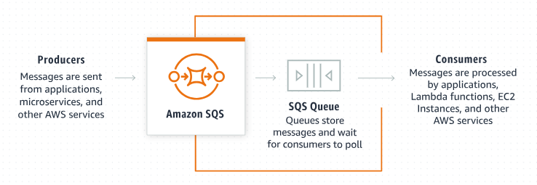
Amazon SQS Access Policies: A Beginner's Guide
What is Amazon SQS Access Policy?
Amazon Simple Queue Service (SQS) access policy is a way to control who can send messages to and receive messages from your SQS queues. Think of it as a set of rules that define what actions are allowed and who can perform these actions on your SQS queues

Slide 2
Amazon SQS Access Policies: A Beginner's Guide
Key Concepts
SQS Queue: This is a temporary storage for messages that are waiting to be processed. Think of it as a line at a store where messages wait their turn.
Access Policy: These are rules that determine who can access the queue and what they can do with it. It’s like having a bouncer at the line deciding who can join or leave the line.
Actions: These are operations that can be performed on the queue, like sending messages, receiving messages, or deleting messages.

Slide 3
Amazon SQS Access Policies: A Beginner's Guide
Basic Components of an Access Policy
Statements: Policies are made up of one or more statements. Each statement allows or denies a specific action.
Effect: This can be either "Allow" or "Deny." It specifies whether the action is permitted or not.
Principal: This indicates the user, account, service, or entity that is allowed or denied permission to the action. It’s like specifying who the rules apply to.
Action: This is what actions are being allowed or denied, such as SendMessage, ReceiveMessage, DeleteMessage, etc.
Resource: This specifies which SQS queue the policy applies to.
Condition: Optional additional criteria that must be met for the policy to apply, such as IP address ranges or request times.

Slide 4
Amazon SQS Access Policies: A Beginner's Guide
Example Scenario
Imagine you have an online store, and you use SQS to handle order processing.
You have different systems that need to send order information to the SQS queue and other systems that need to retrieve and process these orders.
You want to make sure that only authorized systems can send and receive messages from your queue.

Slide 5
Amazon SQS Access Policies: A Beginner's Guide
Example Access Policy
Explanation
{
"Version": "2012-10-17",
"Id": "example-ID",
"Statement": [
{
"Effect": "Allow",
"Principal": "*",
"Action": "sqs:SendMessage",
"Resource": "arn:aws:sqs:region:account-id:queue-name"
},
{
"Effect": "Deny",
"Principal": "*",
"Action": "sqs:ReceiveMessage",
"Resource": "arn:aws:sqs:region:account-id:queue-name",
"Condition": {
"StringNotEquals": {
"aws:PrincipalArn": "arn:aws:iam::account-id:user/authorized-user"
}
}
}
]
}
1. Version: The version of the policy language.
2. Id: An identifier for the policy.
3. Statement: Contains multiple rules.
Effect: The first statement allows anyone ("Principal": "*") to send messages to the queue ("Action": "sqs:SendMessage").
Effect: The second statement denies anyone from receiving messages from the queue, unless they are the authorized user ("Condition": {"StringNotEquals": {"aws:PrincipalArn": "arn:aws:iam::account-id:user/authorized-user"}}).

Slide 6
Amazon SQS Access Policies: A Beginner's Guide
Why Use Access Policies?
Security: Ensure only authorized users or systems can access your queues.
Control: Fine-tune what actions are permitted on your queues.
Compliance: Meet regulatory requirements by controlling data access.

Slide 7
Amazon SQS Access Policies: A Beginner's Guide
Summary
In summary, Amazon SQS access policies help you manage who can do what with your queues, ensuring security and control over your messaging system.

