Slide 1

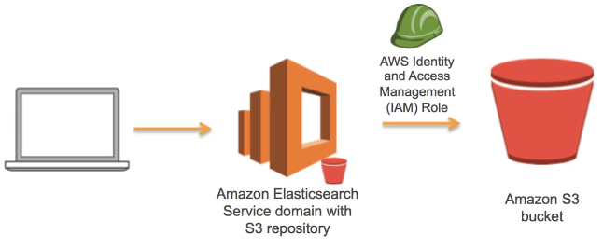

Making Your
AWS S3 Bucket Public:
A Beginner's Guide
Amazon Web Services (AWS) Simple Storage Service (S3) is a powerful cloud storage solution. This guide will walk you through the process of making your S3 bucket and its objects publicly accessible, allowing anyone on the internet to view and download your files.
by Ram N Java

Slide 2

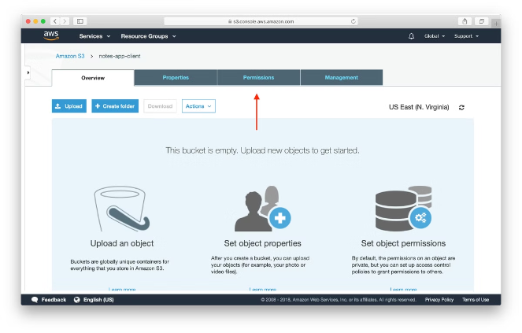
Making the Entire Bucket Public
1
Access Permissions Tab
Go to the Permissions tab of your bucket in the S3 console.
2
Edit Block Public Access
Under "Block Public Access (bucket settings)", click Edit.
3
Allow Public Access
Uncheck the box next to "Block all public access". This option blocks all public access to the bucket and objects by default.
4
Confirm Changes
Click "Save changes" to confirm and apply the new settings.

Slide 3

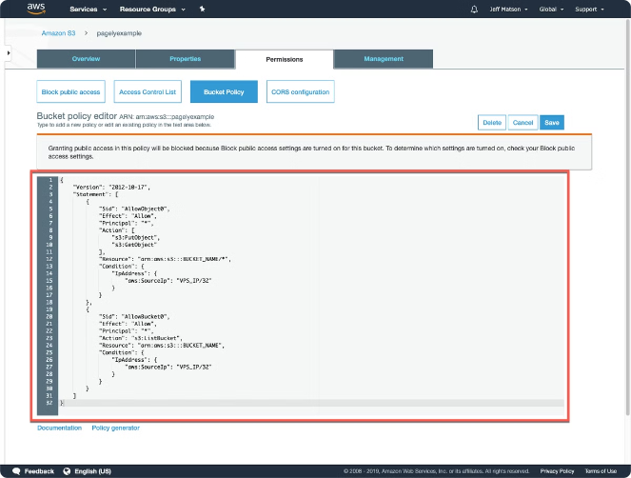
Setting a Bucket Policy
Access Bucket Policy
In the Permissions tab, scroll down to Bucket Policy and click on Edit to open the bucket policy editor.
Add & Save Policy JSON
Add the following policy to allow public access to all objects, Replace
"your-bucket-name" with the actual name of your bucket in the policy JSON.
{ "Version": "2012-10-17", "Statement": [ { "Effect": "Allow", "Principal": "*", "Action": "s3:GetObject", "Resource": "arn:aws:s3:::your-bucket-name/*" } ] }

Slide 4

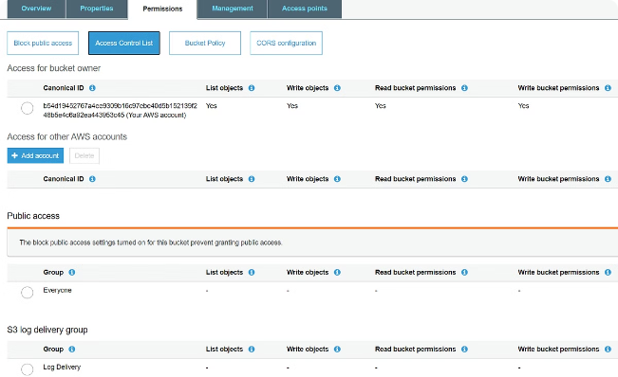
Making Individual Objects Public
1
Navigate to Objects
Go to the Objects tab in your S3 bucket.
2
Select Objects
Select the specific object(s) you want to make public.
3
Change Permissions
Click on the Actions button and select "Make public" from the dropdown menu.
4
Confirm Action
Confirm the action to change the permissions of the
selected objects.

Slide 5

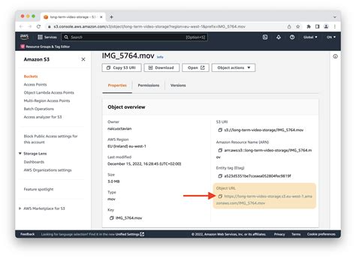
Verifying Public Access
1
Locate Object URL
Copy the Object URL for any object you made public in your S3 bucket.
2
Test Access
Open the URL in a web browser to verify public accessibility.
3
Confirm Success
If set correctly, the object should be accessible without any authentication.

Slide 6
Security Considerations
Data Sensitivity
Access Control
Regular Audits
Making a bucket or its objects public can expose sensitive data. Carefully consider the nature of the information you're making accessible.
Ensure you understand the implications of public access. Consider alternative options like presigned URLs if full public access is not necessary.
Regularly review your bucket and object permissions to ensure they align with your security requirements and best practices.

Slide 7

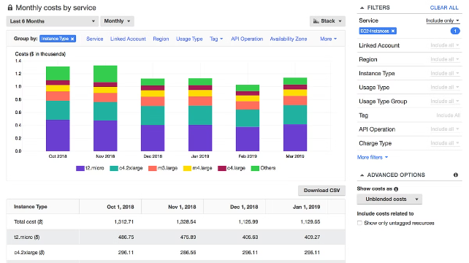
Cost Considerations
Data Transfer Costs
Publicly accessible objects can be downloaded by anyone, which may result in higher costs for data transfer.
Usage Monitoring
Keep an eye on your S3 usage and costs, especially after making objects public.
Bandwidth Limits
Consider implementing bandwidth limits or request quotas to control costs if necessary.

