Slide 1
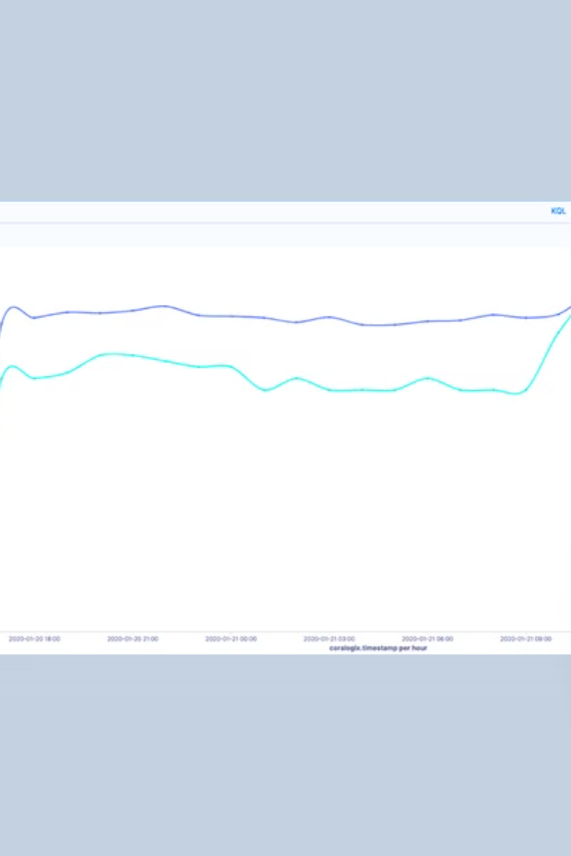

AWS S3 Access Logs - Explained for Beginners
AWS S3 Access Logs help track and record every request made to your Amazon S3 bucket. This means you can see who accessed your bucket, what actions they performed, and when it happened.
by Ram N Java

Slide 2
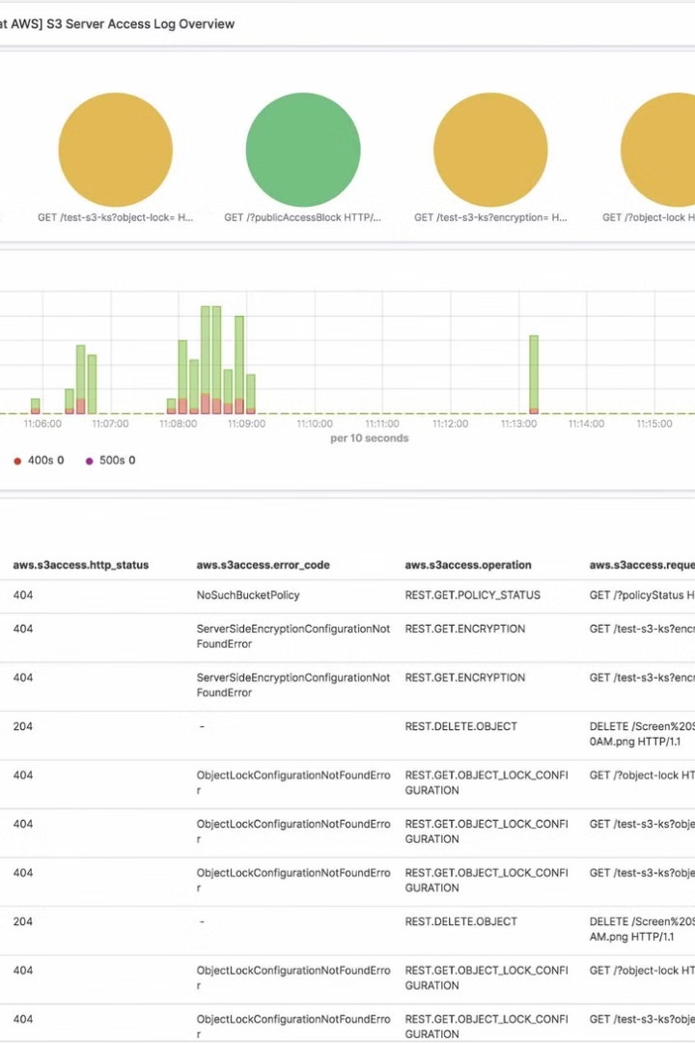




Why Are S3 Access Logs Important?
Security Monitoring 🛡️
Troubleshooting Issues 🛠️
Billing and Cost Analysis 💰
Helps identify any unauthorized access attempts.
If something goes wrong, you can check the logs to understand what happened.
Helps track data usage and request patterns.
Compliance & Auditing ✅
Useful for companies needing to follow security rules.

Slide 3
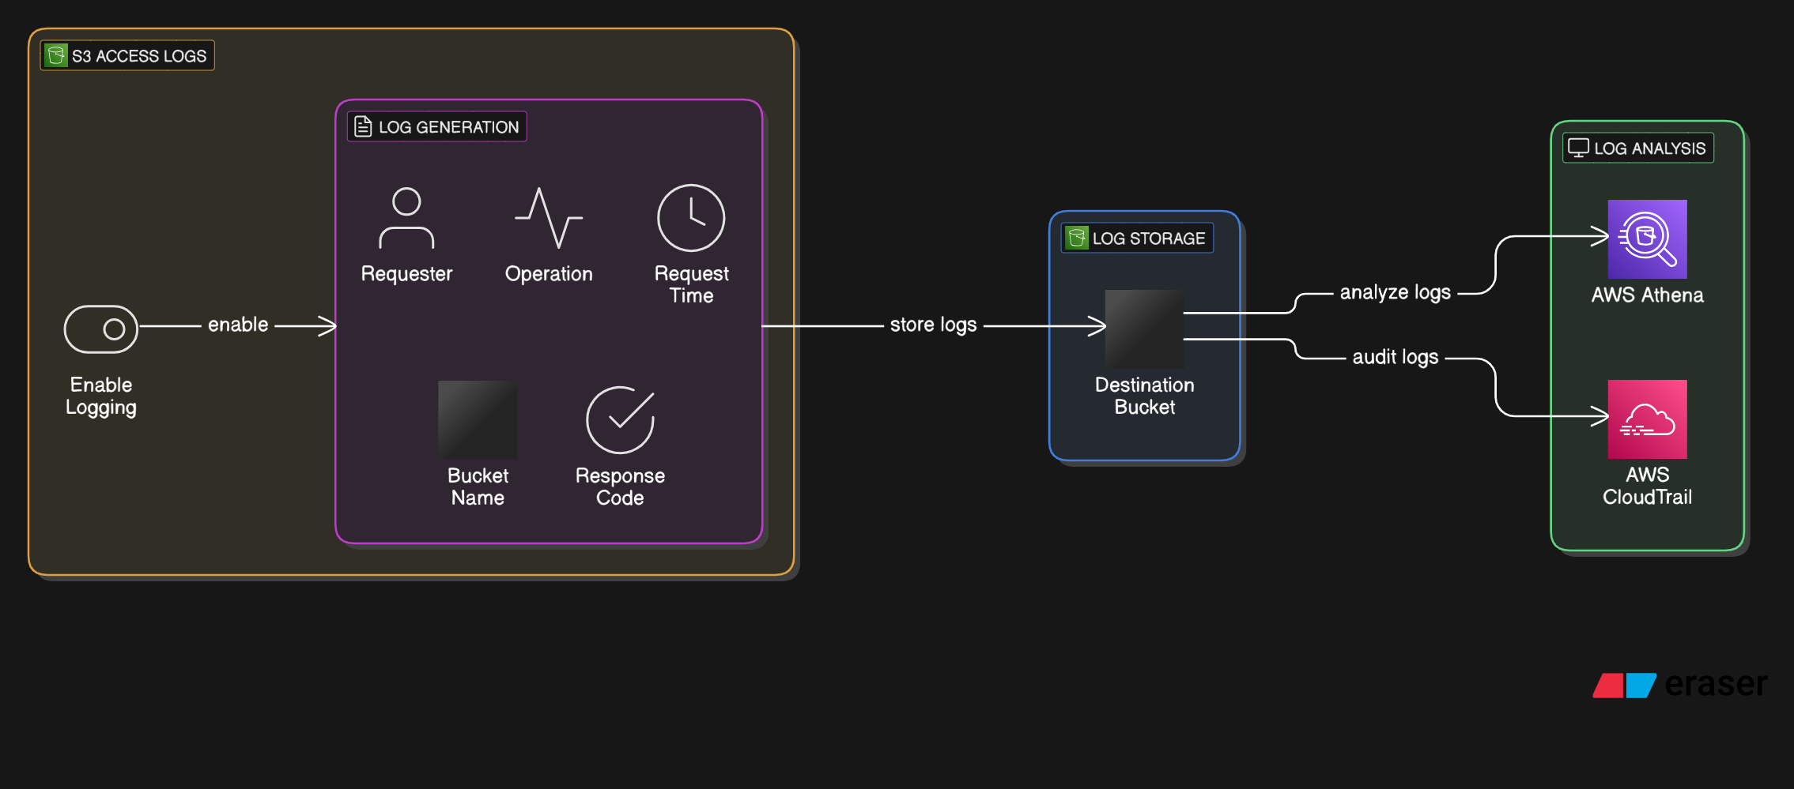

Slide 4
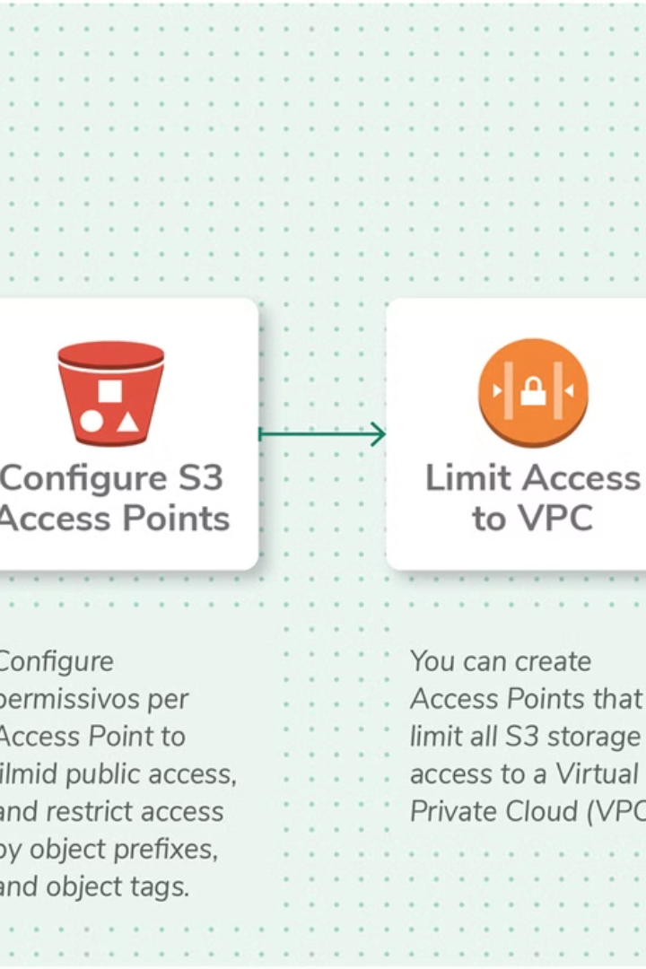
How S3 Access Logs Work?
Enable Logging
You need to turn on access logging for your S3 bucket.
Log Destination
AWS will store the logs in another S3 bucket of your choice.
Log Format
Each log file contains detailed information about requests, like:
Request Time – When the request was made.
Requester – Who made the request (AWS account, IAM user, or anonymous).
Operation – What action was performed (e.g., GET, PUT, DELETE).
Bucket Name – Which bucket was accessed.
Response Code – If the request was successful or failed.

Slide 5

Things to Keep in Mind
✅ Log Storage Costs
✅ Not Real-Time
✅ Analyze Logs with AWS Tools
Logs are stored in an S3 bucket, so they take up space and may increase costs.
Logs may take a few minutes to appear after a request is made.
You can use AWS Athena, AWS CloudTrail, or other log analysis tools to understand the data better.

Slide 6

Example of an S3 Access Log Entry
79a2b8 EXAMPLE_BUCKET [10/Feb/2025:12:34:56 +0000] 192.168.1.1 - 200 REST.GET.OBJECT "sample-file.txt"
📌 This means:
The request came from IP 192.168.1.1
A request was made to the EXAMPLE_BUCKET
The request was to GET (read) the file "sample-file.txt"
The request was successful (200 response code)

Slide 7
How to Enable S3 Access Logging?
Go to the AWS S3 Console
1
2
Select the S3 Bucket you want to monitor.
Go to "Properties" → "Server access logging"
3
4
Enable Logging and select a target bucket where logs will be stored.
Click Save.
5

Slide 8
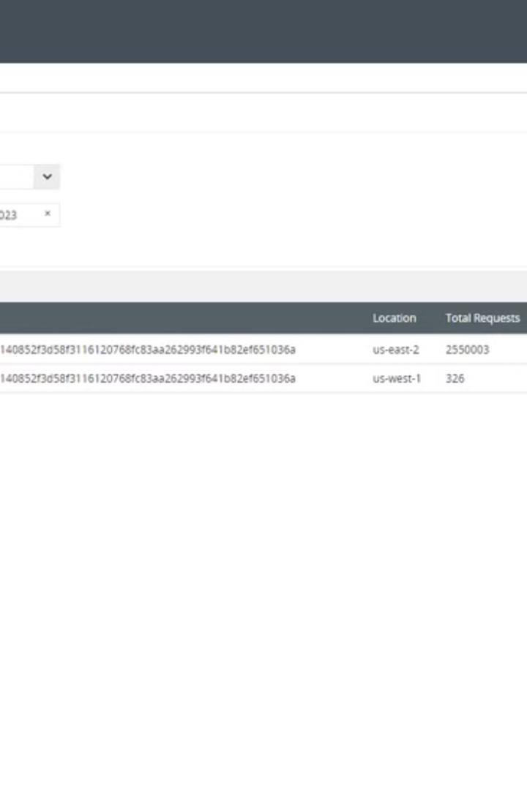
Final Thoughts
AWS S3 Access Logs are useful for monitoring activity, improving security, and troubleshooting. However, they can also generate large amounts of data, so use them wisely! 🚀

