Slide 1
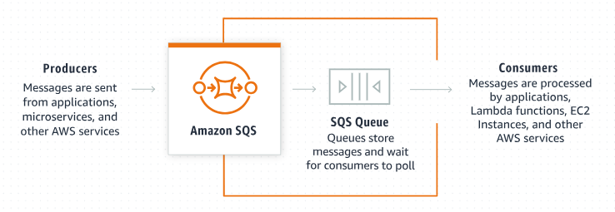
Amazon SQS Redrive Allow Policy Explained for Beginners
What is Amazon SQS?
Amazon SQS is a fully managed message queuing service that allows different parts of a system to communicate and coordinate by sending messages between them.

Slide 2


Amazon SQS Redrive Allow Policy Explained for Beginners
What is a Dead-letter Queue (DLQ) & Redrive Allow Policy?
A DLQ is a queue that stores messages that can't be processed successfully after a specified number of attempts. This helps in isolating problematic messages for further analysis and handling.
The "Amazon SQS Redrive Allow Policy" is a feature that controls which source queues can send messages to a specific Dead-letter queue (DLQ).
A Redrive Allow Policy is a set of permissions that you apply to a Dead-letter queue (DLQ) in Amazon SQS. This policy specifies which queues are allowed to move messages to this DLQ.
Order Queue
(Maximum Receives = 3)
Stores messages that could not be processed successfully
DLQ
User Queue
(Maximum Receives = 5)

Slide 3
Amazon SQS Redrive Allow Policy Explained for Beginners
Why is it Important?
Redrive Allow Policy ensures that only authorized queues can send their unprocessed messages to the DLQ, providing better control and security over message handling.
Order Queue
(Maximum Receives = 3)
Stores messages that could not be processed successfully
DLQ
User Queue
(Maximum Receives = 5)

Slide 4
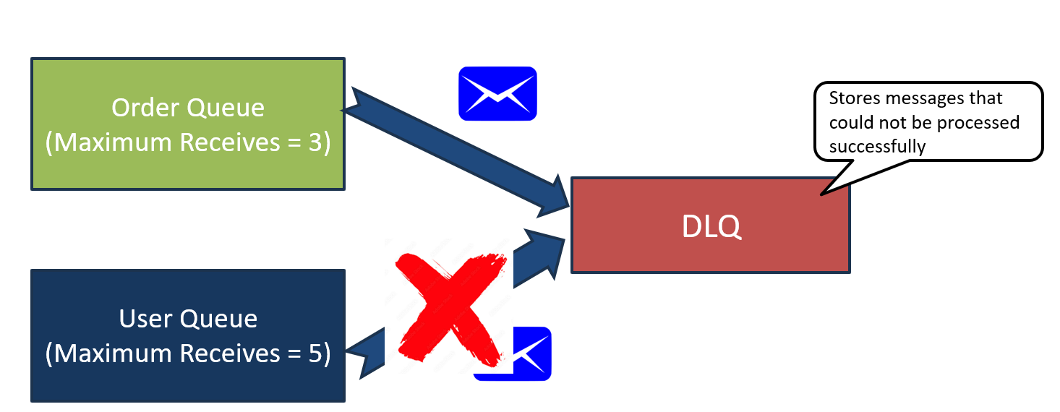
Amazon SQS Redrive Allow Policy Explained for Beginners
How Does It Work?
Primary Queue: You have one or more primary queues where messages are initially sent and processed.
Processing Failures: If a message can't be processed successfully after a certain number of attempts, it needs to be moved to a DLQ.
DLQ Association: Each primary queue can be associated with a DLQ.
Redrive Allow Policy: You create a policy on the DLQ to specify which primary queues are allowed to send their unprocessed messages to this DLQ.

Slide 5
Amazon SQS Redrive Allow Policy Explained for Beginners
Example Scenario
Imagine you have multiple application components, each with its own SQS queue, but all of them use a single DLQ for storing unprocessable messages. You don’t want just any queue to send messages to this DLQ; only specific, trusted queues should be allowed.
Primary Queues: Different queues (e.g., Order Queue, Payment Queue, Notification Queue, User Queue).
DLQ: A single DLQ (e.g., Error Queue) where failed messages from the primary queues will go.
Redrive Allow Policy: You define a policy on the Error Queue that allows only Order Queue, Payment Queue, and Notification Queue to send messages to it.
Payment Queue
(Maximum Receives = 3)
Error Queue(DLQ)
Notification Queue
(Maximum Receives = 3)

Slide 6
Amazon SQS Redrive Allow Policy Explained for Beginners
Steps to Set a Redrive Allow Policy
Create a DLQ: Create a Dead-letter queue, such as Error Queue (DLQ).
Set Redrive Policy on Primary Queues: Configure Order Queue. Payment Queue and Notification Queue with a redrive policy that points to Error Queue (DLQ).
Define Redrive Allow Policy: Apply a redrive allow policy to Error Queue (DLQ) that specifies Order Queue, Payment Queue and Notification Queue as allowed sources.

Slide 7
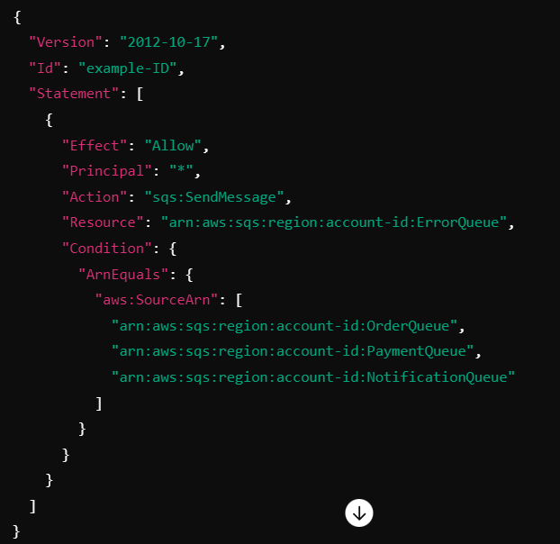
Amazon SQS Redrive Allow Policy Explained for Beginners
Simple Policy Example
In this example, the policy allows messages to be redriven from OrderQueue, PaymentQueue and NotificationQueue to the specified DLQ (ErrorQueue).
By using a Redrive Allow Policy, you ensure that your DLQs are used correctly and securely, making your message processing system more reliable and easier to manage.

Slide 8
Amazon SQS Redrive Allow Policy Explained for Beginners
Benefits of Using Redrive Allow Policy
Control: You control which queues can use the DLQ, preventing unauthorized queues from filling it with messages.
Security: Adds an extra layer of security by ensuring only specific queues can interact with the DLQ.
Organization: Helps in keeping the DLQ organized by only allowing certain queues to send messages.

Slide 9
Amazon SQS Redrive Allow Policy Explained for Beginners
Summary
In summary, a redrive allow policy helps you control and secure which SQS queues can move unprocessable messages to a specific DLQ, ensuring better organization, security, and management of your message processing system.

