Slide 1
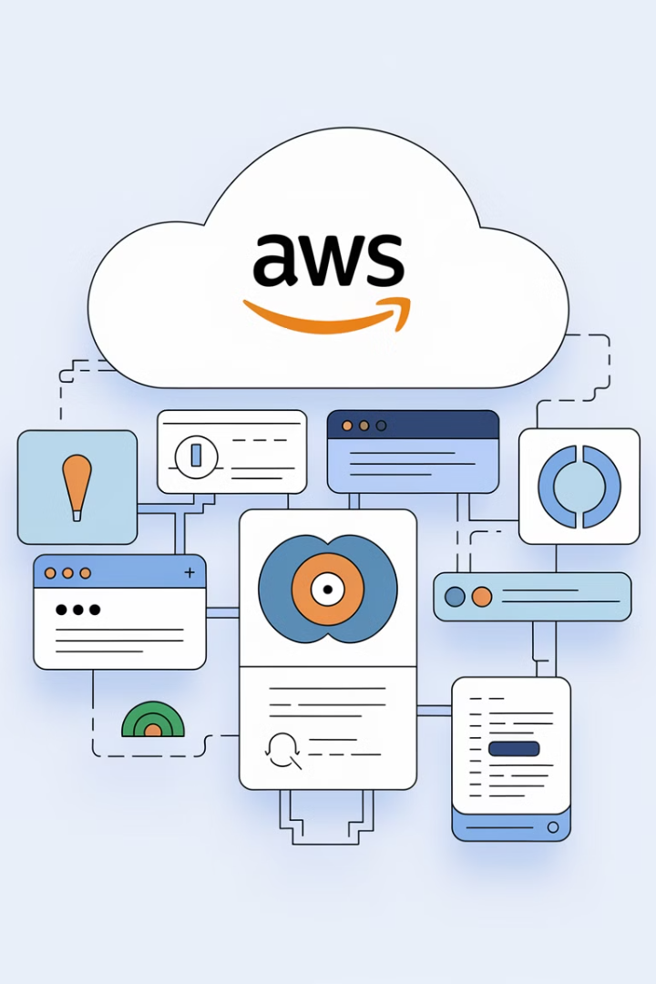

AWS Simple Notification Service (SNS) - Explained for Beginners
AWS SNS (Simple Notification Service) is a fully managed messaging service that allows applications, microservices, and users to communicate using publish-subscribe messaging. It helps send notifications, alerts, and messages to multiple recipients instantly.
by Ram N Java

Slide 2
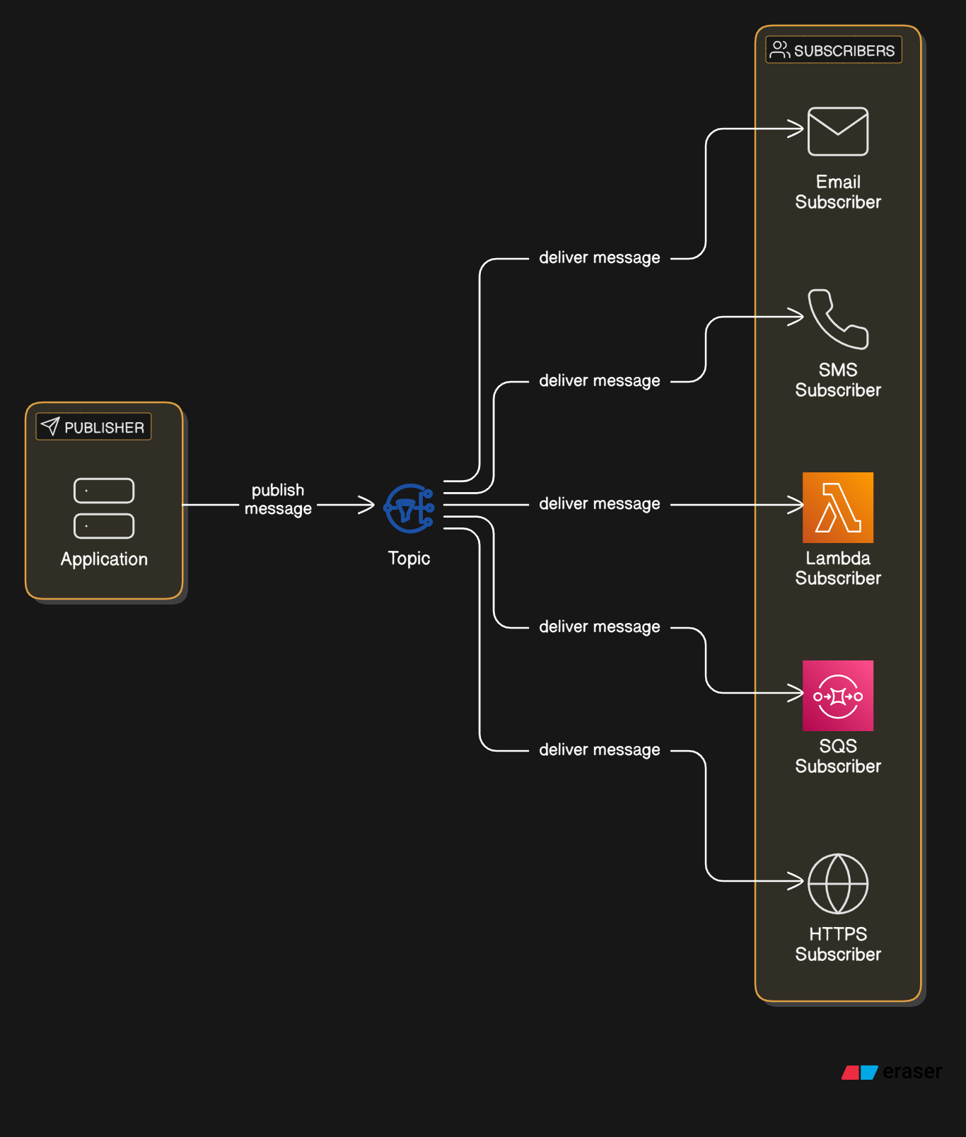

Slide 3
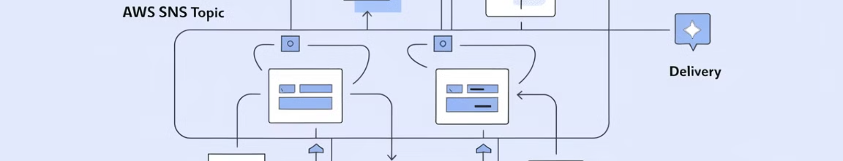
How AWS SNS Works?
Message Delivery
Publish Messages
SNS delivers the message to all subscribers of that topic.
Add Subscribers
A publisher (application or service) sends a message to the topic.
Create a Topic
Subscribers can be email, SMS, AWS Lambda, Amazon SQS, or HTTPS endpoints.
A topic is a messaging channel where notifications are sent.

Slide 4
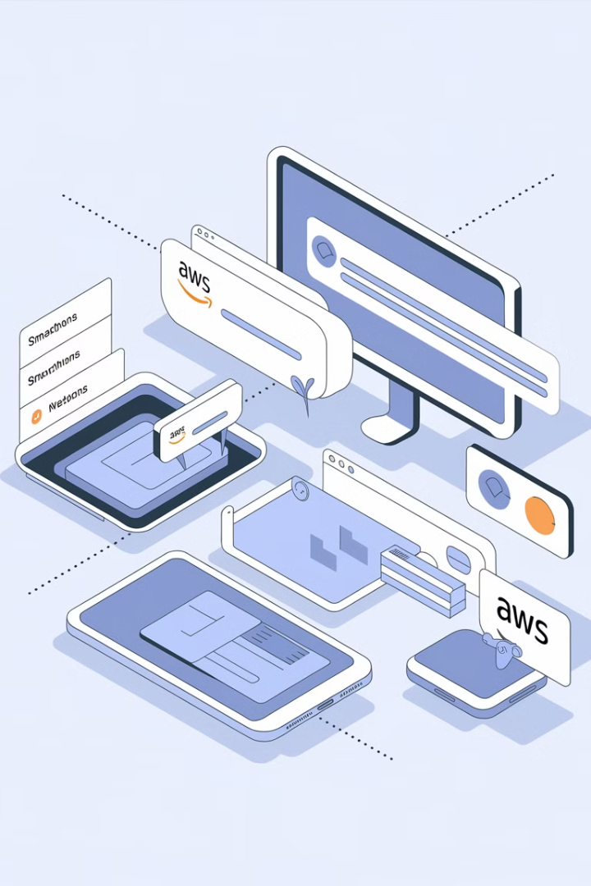




Where is AWS SNS Used?
Application Notifications
System Alerts
AWS Service Integration
Get alerts for system failures or security breaches.
Send real-time notifications in mobile or web applications.
Notify AWS Lambda, SQS, or CloudWatch about events.
Marketing and Messaging
Send bulk messages via email or SMS.

Slide 5

Types of SNS Topic
Standard SNS Topic
FIFO SNS Topic
Used for general notifications, supports unlimited messages per second.
Ensures messages are delivered in the exact order they are sent and only once.

Slide 6

Key Features of AWS SNS
1
Multiple Message Formats
2
Scalability
3
Message Filtering
Send messages as raw text or structured JSON.
Handles millions of messages per second.
Deliver messages only to relevant subscribers.
4
Security
5
Delivery Retries
Encrypt messages and control access using IAM policies.
Automatically retries failed messages.

Slide 7

Pros and Cons of AWS SNS
Pros of AWS SNS
Cons of AWS SNS
Fast and Reliable – Delivers messages in real-time.
Limited Message Customization – Basic formatting options.
Low Cost – Pay only for what you use.
Easy Integration – Works with many AWS services.
No Message Persistence – Messages are not stored after delivery.

Slide 8
How to Set Up AWS SNS?
Go to AWS SNS Console
1
2
Create a Topic (e.g., "SystemAlerts")
Add Subscribers (Email, SMS, AWS Lambda, etc.)
3
4
Publish a Message to the topic
Subscribers Receive the Notification
5

Slide 9

Final Thoughts
AWS SNS is a powerful notification service that helps applications communicate efficiently. It is widely used for alerts, notifications, and automation in AWS environments. By integrating it with AWS Lambda, SQS, and CloudWatch, you can automate workflows and improve system reliability.

