Slide 1
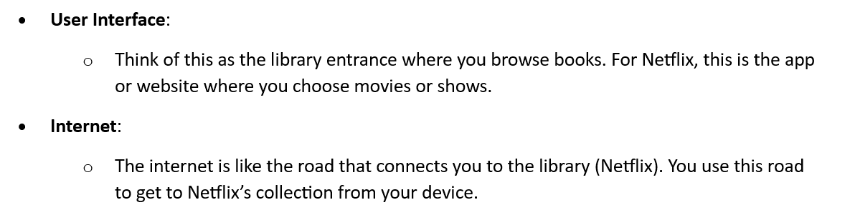
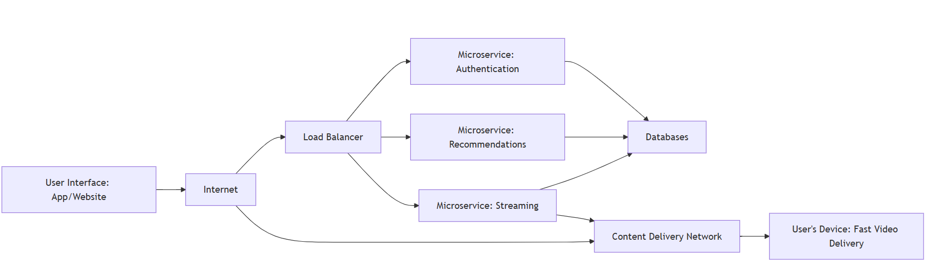
The Netflix System Design: Key Components and Architecture

Slide 2
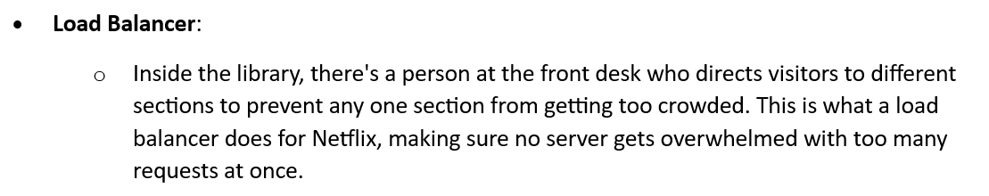
The Netflix System Design: Key Components and Architecture

Slide 3
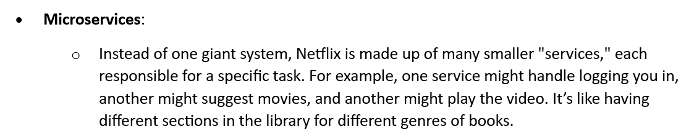
The Netflix System Design: Key Components and Architecture

Slide 4
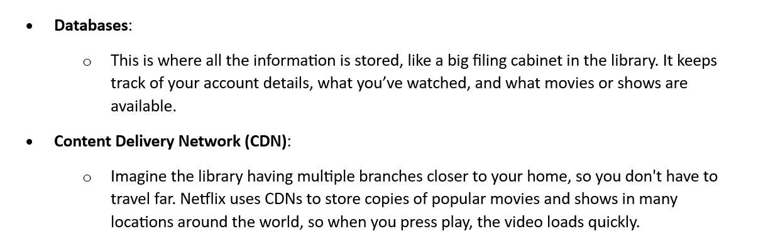
The Netflix System Design: Key Components and Architecture

Slide 5
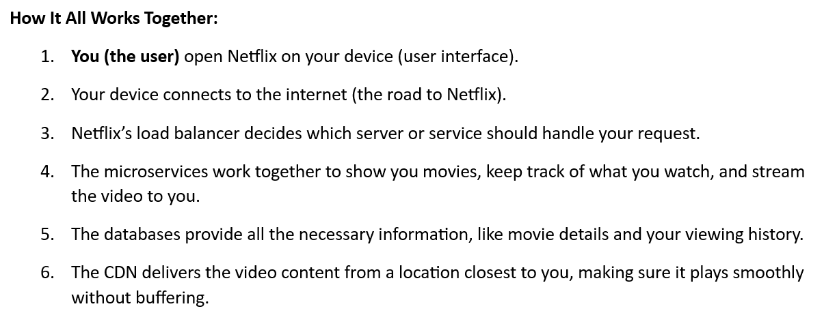
The Netflix System Design: Key Components and Architecture

Slide 6
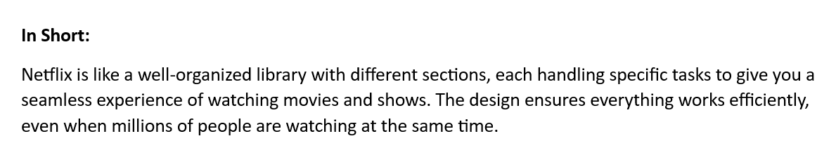
The Netflix System Design: Key Components and Architecture

