Slide 1
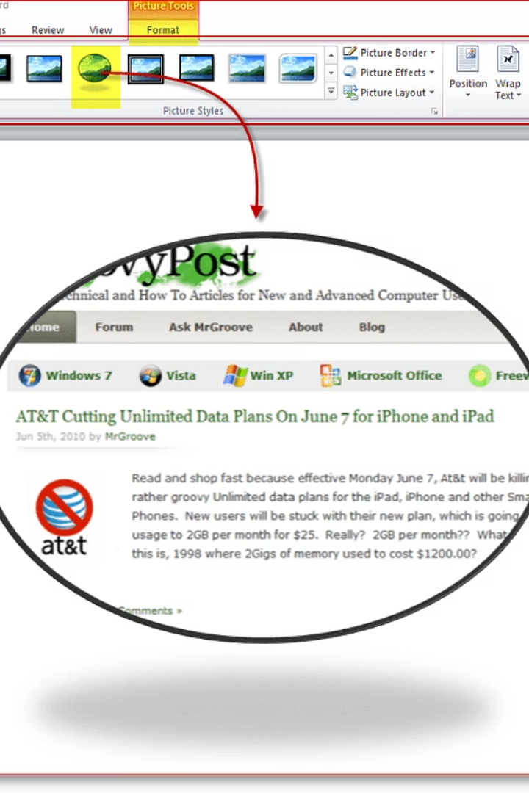

Microsoft Word Tutorial: Essential Features
What is Microsoft Word?
Microsoft Word is a computer program used to create, edit, and format documents. You can use it to write letters, resumes, reports, school work, and more.
You can use Microsoft Word on a computer, laptop, or even a mobile device.
by Ram N Java

Slide 2



Opening Microsoft Word
Start Microsoft Word
Choose Document Type
Click the Microsoft Word icon on your desktop or from the Start menu.
When it opens, you can choose to start a new blank document or use a template (like for resumes or letters).

Slide 3
Understanding the Word Window
Title Bar
Ribbon
Document Area
Shows the name of your document.
A menu with buttons grouped under tabs like Home, Insert, Layout, Review.
The white page where you type.
Cursor
Status Bar
The blinking line that shows where your text will appear.
Shows the page number, word count, and language.

Slide 4

Typing and Editing Text
Start Typing
Just click and start typing on the blank page.
Move Cursor
To edit text, use your mouse or arrow keys to move the cursor.
Delete Text
Use Backspace to delete letters before the cursor.
Use Delete to remove letters after the cursor.

Slide 5




Formatting Text
You can change how your text looks using the Home tab.
Bold
Italic
Underline
Font
Makes your text thicker. (Shortcut: Ctrl + B)
Slants your text. (Ctrl + I)
Adds a line under the text. (Ctrl + U)
Change the style of letters.
Font Size: Make text bigger or smaller.
Text Color: Change the color of the letters.
Alignment: Align text to the left, center, right, or justify.

Slide 6
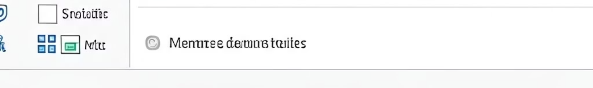




Saving Your Work
Save Command
Click File > Save or press Ctrl + S.
Choose Location
Choose a folder and type a name for your file.
Confirm Save
Click Save to keep your document safe.
Save As
You can also click File > Save As to save a new copy or to save in a different format.

Slide 7
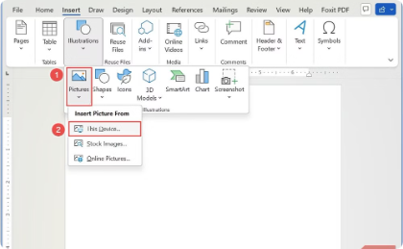
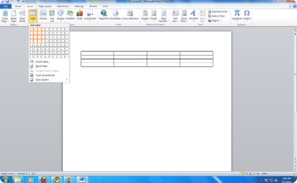
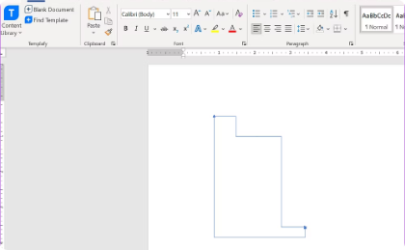
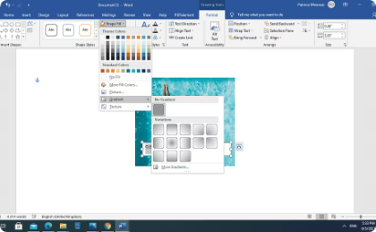
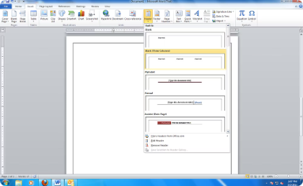
Inserting Items
Go to the Insert tab to add things to your document:
Pictures
Tables
Shapes
Text Box
Add photos from your computer.
Organize data in rows and columns.
Add arrows, circles, and other shapes.
Insert a box to type separately from main text.
Header and Footer
Add text to the top or bottom of every page.

Slide 8






Page Layout and Design
Use the Layout or Design tab to change how your page looks.
Orientation
Choose Portrait (tall) or Landscape (wide).
Margins
Page Size
Space around the edge of the page.
Choose A4, Letter, or other paper sizes.

Slide 9
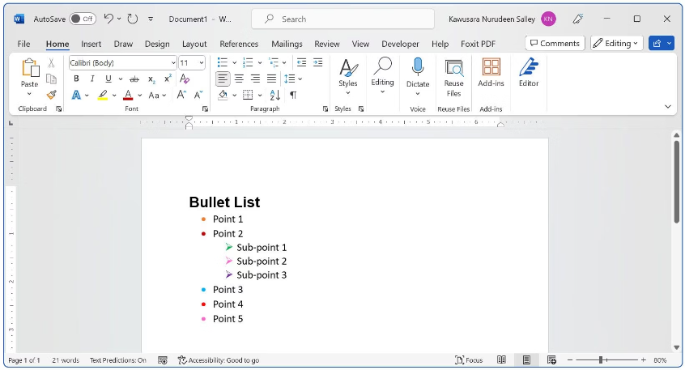
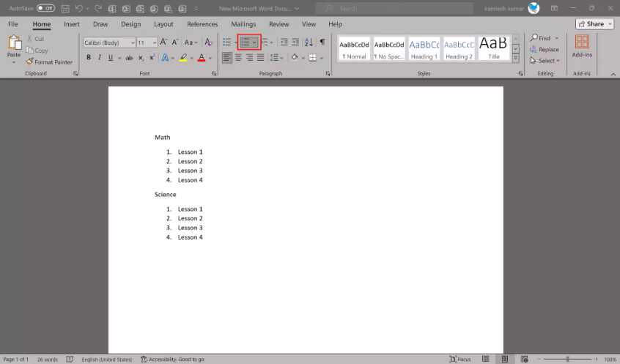
Using Bullets and Numbering
To create a list:
Bullet Lists
Numbered Lists
Click on Bullets to make a list with dots.
Click on Numbering to make a list with numbers.
First item
Second item
First step
Third item
Second step
Third step

Slide 10

Copy, Cut, and Paste
Ctrl+C
Ctrl+X
Copy
Cut
Makes a copy of selected text.
Removes selected text.
Ctrl+V
Paste
Places copied or cut text where your cursor is.

Slide 11
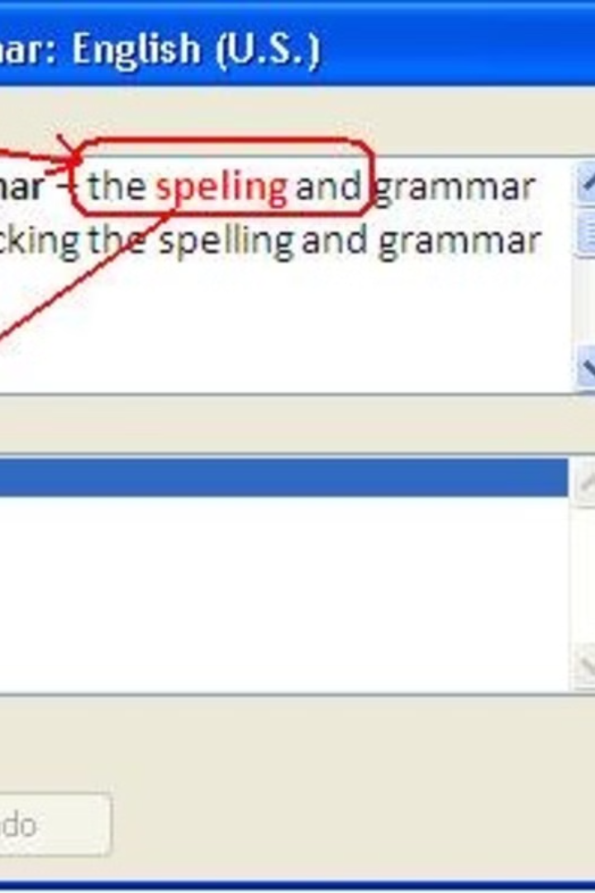



Checking Spelling and Grammar
Access Review Tab
Click on the Review tab.
Run Spell Check
Click Spelling & Grammar to check for mistakes.
Identify Errors
Word will show you red lines for spelling errors and blue lines for grammar issues.

Slide 12




Printing Your Document
Open Print Menu
Click File > Print.
Select Printer
Choose your printer.
Set Copies
Select the number of copies.
Print Document
Click Print.

Slide 13






Closing Microsoft Word
Click Close Button
Click the X in the top-right corner.
Save Prompt
If you haven't saved, it will ask if you want to Save before closing.
Confirm Action
Choose to save, don't save, or cancel.

