Slide 1
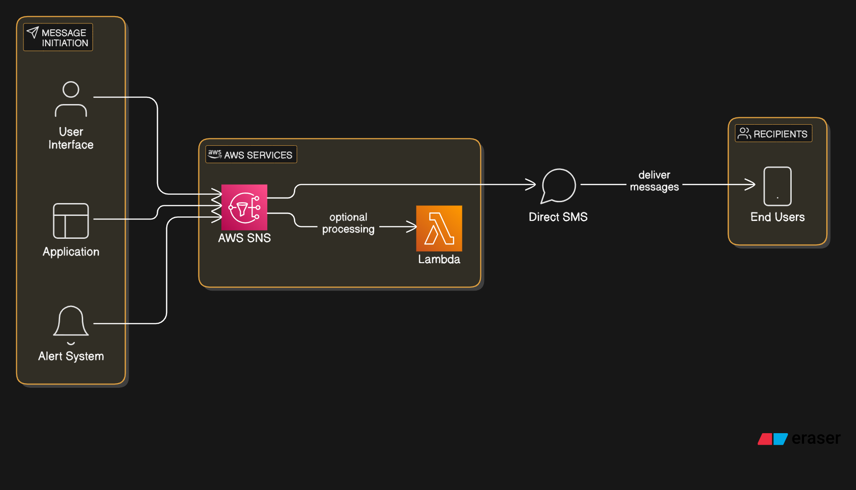


Slide 2
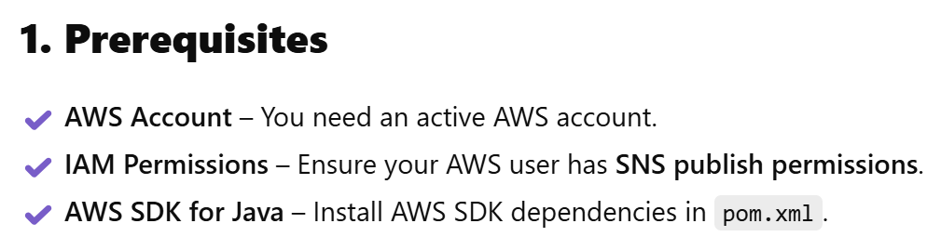
How to send SMS directly using AWS SNS in Java without using a topic

