Slide 1

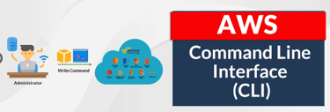
Getting Started with AWS CLI: A Beginner's Guide
The AWS Command Line Interface (CLI) is a powerful tool that allows you to interact with AWS services directly from your command line. This guide will walk you through the process of installing, configuring, and using the AWS CLI to manage various AWS services, including S3, EC2, and SQS. By mastering the AWS CLI, you'll be able to efficiently handle AWS tasks and automate your workflows.

Slide 2

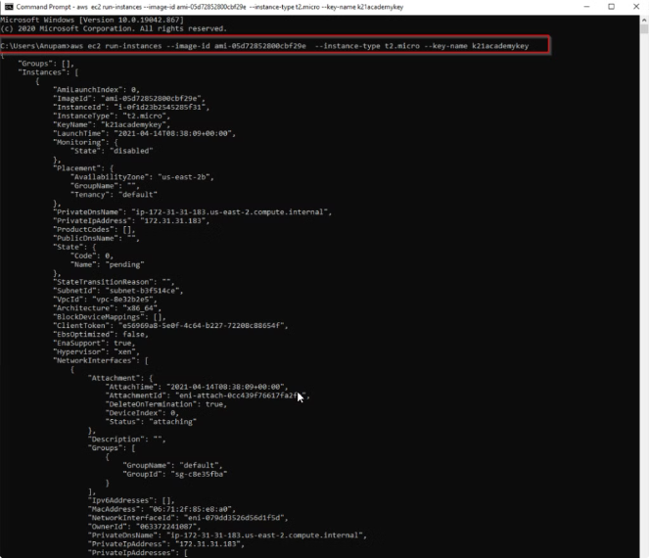
Installing AWS CLI
1
Windows Installation
1. Download the AWS CLI MSI installer from the official AWS CLI website.
2. Run the downloaded MSI installer and follow the on-screen instructions to complete the installation.
2
macOS Installation
Option 1: Install using Homebrew with the command "brew install awscli"
Option 2: Use the Bundled Installer by running the following commands:
curl "https://awscli.amazonaws.com/AWSCLIV2.pkg" -o "AWSCLIV2.pkg"
sudo installer -pkg AWSCLIV2.pkg -target /
3
Linux Installation
Use the following commands to install AWS CLI on Linux:
curl "https://awscli.amazonaws.com/awscli-exe-linux-x86_64.zip" -o "awscliv2.zip"
unzip awscliv2.zip
sudo ./aws/install

Slide 3

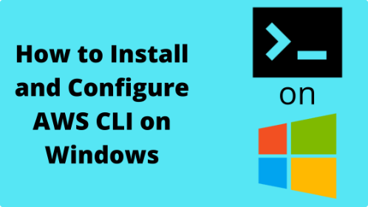
Configuring AWS CLI
1
Run Configuration Command
2
Provide Credentials
After installation, configure the CLI with your AWS credentials by running the command:
aws configure
You will be prompted to enter your
AWS Access Key ID and AWS Secret Access Key.
3
Set Default Region
4
Choose Output Format
Specify the default region name you want to use (e.g., us-west-2).
Select your preferred output format: json, yaml, text, or table.

Slide 4

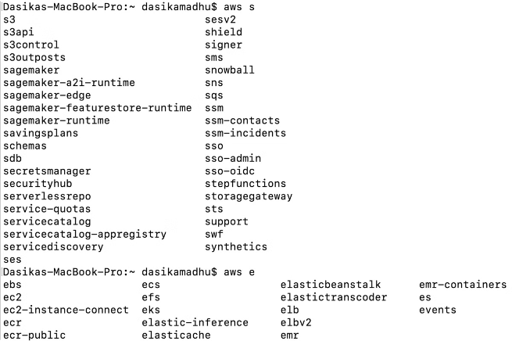
Basic AWS CLI Commands
Command
Description
aws configure list
Check your current configuration
aws s3 ls
List all your S3 buckets
aws s3 mb s3://my-new-bucket
Create a new S3 bucket
aws s3 cp myfile.txt s3://my-new-bucket/
Upload a file to an S3 bucket
aws s3 cp s3://my-new-bucket/myfile.txt .
Download a file from an S3 bucket
aws ec2 describe-instances
List all your EC2 instances

Slide 5
Working with Amazon S3
Listing S3 Buckets
Creating an S3 Bucket
File Operations
To list all your S3 buckets, use the command: aws s3 ls
To create a new S3 bucket, use: aws s3 mb s3://my-new-bucket
Upload a file: aws s3 cp myfile.txt s3://my-new-bucket/
Download a file: aws s3 cp s3://my-new-bucket/myfile.txt .

Slide 6

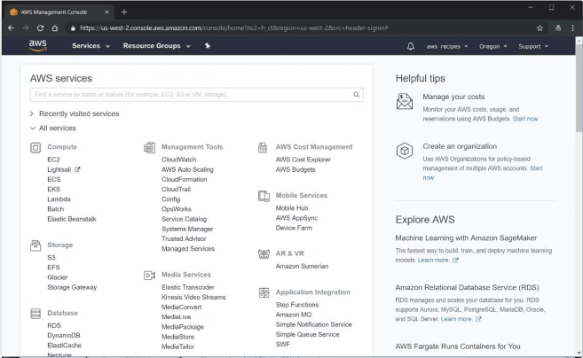
Managing EC2 Instances
Listing EC2 Instances
To list all your EC2 instances, use the command: aws ec2 describe-instances
Starting an EC2 Instance
To start an EC2 instance: aws ec2 start-instances --instance-ids i-1234567890abcdef0
Stopping an EC2 Instance
To stop an EC2 instance: aws ec2 stop-instances --instance-ids i-1234567890abcdef0
Terminating an EC2 Instance
To terminate an EC2 instance: aws ec2 terminate-instances --instance-ids i-1234567890abcdef0

Slide 7



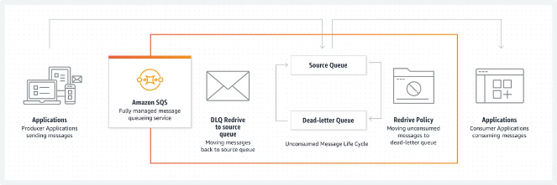


Using AWS CLI with Amazon SQS
Creating an SQS Queue
To create an SQS queue, use the command: aws sqs create-queue --queue-name MyQueue
Sending a Message
To send a message to your queue: aws sqs send-message --queue-url https://sqs..amazonaws.com//MyQueue --message-body "Hello, this is a test message"
Receiving Messages
To receive messages from your queue: aws sqs receive-message --queue-url https://sqs..amazonaws.com//MyQueue
Deleting a Message
To delete a message from your queue (after processing it): aws sqs delete-message --queue-url https://sqs..amazonaws.com//MyQueue --receipt-handle

Slide 8


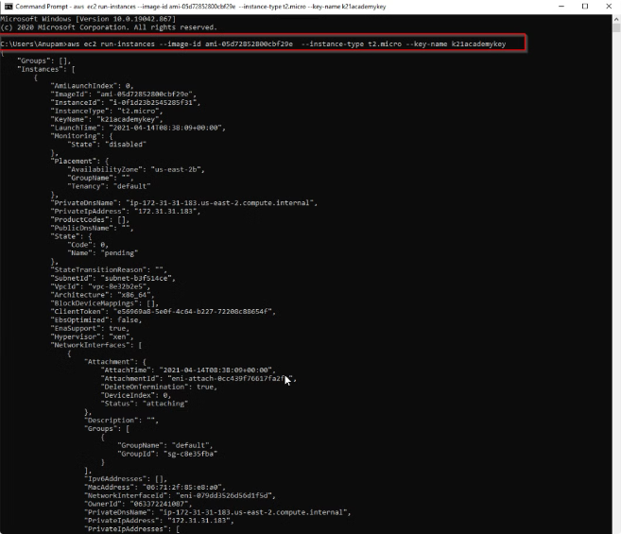


Help and Documentation
General Help
To get more information and see all available commands and options, use the command: aws help
Service-Specific Help
For specific service commands, you can also get help using: aws s3 help, aws ec2 help, aws sqs help
Official Documentation
For more detailed information, refer to the AWS CLI documentation

Slide 9
Summary and Next Steps
Key Takeaways
Practice and Exploration
Further Learning
Using AWS CLI is a powerful way to manage and automate your AWS services. By installing, configuring, and familiarizing yourself with basic commands, you can efficiently handle various AWS tasks directly from your command line.
Continue practicing with different AWS services and explore more advanced CLI features. Experiment with scripting and automation to streamline your workflows.
The AWS CLI documentation provides detailed information on all commands and their options, making it an invaluable resource for further learning. Consider exploring AWS SDK for programmatic access to AWS services in your preferred programming language.

