Slide 1
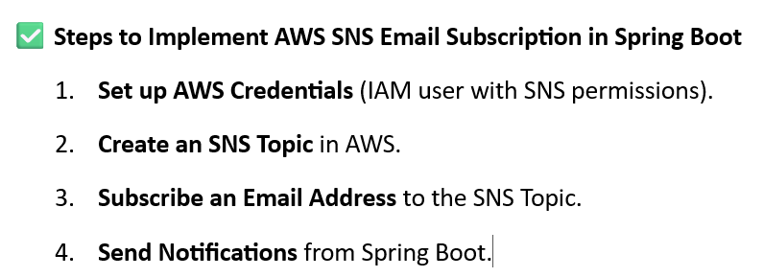
How you can integrate AWS SNS with Email Subscription in a Spring Boot application using the AWS SDK for Java.

Slide 2
