Slide 1
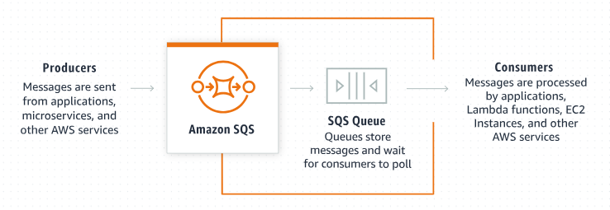
Explaining Amazon SQS Receive Message Wait Time: A Beginner's Guide
What is Amazon SQS?
Amazon Simple Queue Service (SQS) is a fully managed message queuing service by AWS. It allows you to send, store, and receive messages between software components, making it easier to build and scale distributed applications.

Slide 2
Explaining Amazon SQS Receive Message Wait Time: A Beginner's Guide
What is "Receive Message Wait Time"?
The "Receive Message Wait Time" is a setting in Amazon SQS that determines how long the ReceiveMessage API call waits for a message to arrive in the queue before returning a response.

Slide 3
Explaining Amazon SQS Receive Message Wait Time: A Beginner's Guide
Key Points:
Short Polling (Default):
When you call the ReceiveMessage API without setting a wait time, SQS uses short polling.
The API call returns immediately, whether it finds a message or not.
If there are no messages, it returns an empty response.
This method can result in higher API request rates and more cost.
Long Polling:
When you specify a "Receive Message Wait Time" (up to 20 seconds), SQS uses long polling.
The API call waits up to the specified time for a message to arrive in the queue.
If a message becomes available within the wait time, it is returned immediately.
If no message arrives within the wait time, it returns an empty response after the wait time expires.

Slide 4
Explaining Amazon SQS Receive Message Wait Time: A Beginner's Guide
Benefits of Long Polling:
Reduced Costs:
Long polling reduces the number of empty responses, leading to fewer API requests.
This can lower your costs, especially in scenarios with low message traffic.
Efficient Resource Usage:
By waiting for messages to arrive, long polling reduces unnecessary API calls and server load.
This makes your application more efficient and responsive.
Better Performance:
Long polling ensures that messages are received as soon as they are available.
This can improve the overall performance of your application, as it reduces the delay in message processing.

Slide 5
Explaining Amazon SQS Receive Message Wait Time: A Beginner's Guide
Example Scenario (User Sign-up Notifications):
Imagine you have a queue that receives user sign-up notifications. With short polling, your application keeps checking the queue frequently, even if no new users sign up. This results in many empty responses and higher costs.
With long polling, your application waits (e.g., 10 seconds) for a new message. If a user signs up during this time, the message is delivered immediately. If no new sign-ups occur, the application checks less frequently, reducing costs and improving efficiency.

Slide 6
Explaining Amazon SQS Receive Message Wait Time: A Beginner's Guide
Example Scenario (Order Processing):
Imagine you have an application that processes orders from an online store. Orders are placed into an SQS queue, and a worker application retrieves and processes these orders:
1. Without Wait Time (Short Polling):
The worker sends a request to receive messages.
If the queue is empty, it immediately gets an empty response and has to send another request soon after, leading to many requests and possible higher costs.
2. With Wait Time (Long Polling):
The worker sends a request to receive messages with a wait time of 10 seconds.
If the queue is empty, the request waits up to 10 seconds for a message to arrive.
This reduces the number of empty responses and the total number of requests, making the system more efficient and cost-effective.

Slide 7
Explaining Amazon SQS Receive Message Wait Time: A Beginner's Guide
How to Configure Receive Message Wait Time:
When creating or configuring an SQS queue, you can set the Receive Message Wait Time:
Through the AWS Management Console:
Navigate to the SQS service.
Select or create a queue.
In the queue settings, find the "Receive Message Wait Time" setting.
Set it to a value between 0 and 20 seconds (the default is 0 seconds, which means short polling).
Through the AWS SDKs or CLI:
When making a ReceiveMessage API call, you can specify the WaitTimeSeconds parameter.
Example using AWS CLI:

Slide 8
Explaining Amazon SQS Receive Message Wait Time: A Beginner's Guide
Summary:
Receive Message Wait Time allows your SQS queue to wait for messages before responding.
It helps to reduce the number of empty responses and can lower costs by making fewer requests.
Configurable through the AWS Management Console, SDKs, or CLI, it is a powerful feature for optimizing message retrieval in your applications.

