Slide 1
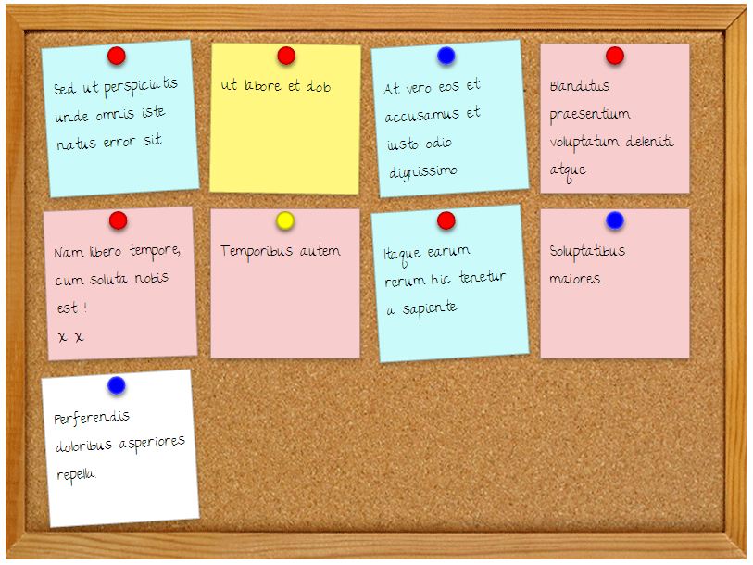
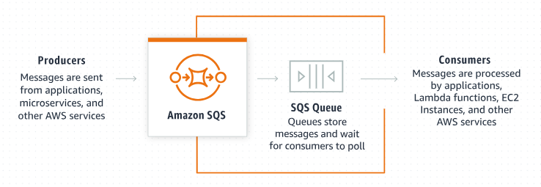
The Hidden Timer: A Beginner's Guide to SQS Visibility Timeout
What is Amazon SQS?
Amazon SQS (Simple Queue Service) is a service provided by Amazon Web Services (AWS) that allows you to send, store, and receive messages between software components, helping to decouple them.
Think of SQS as a message board where different parts of your application can leave and pick up messages without needing to communicate directly.

Slide 2
The Hidden Timer: A Beginner's Guide to SQS Visibility Timeout
What is Visibility Timeout in Amazon SQS?
Imagine you have a message board (Amazon SQS) where tasks (messages) are posted for workers (computers) to pick up and complete. Now, when a worker picks up a task, we don't want other workers to see or pick up that same task until the first worker has had enough time to finish it. This is where "Visibility Timeout" comes in.
Visibility Timeout is the period during which a message remains invisible to other workers after a worker has picked it up.

Slide 3
The Hidden Timer: A Beginner's Guide to SQS Visibility Timeout
What is Visibility Timeout in Amazon SQS?
Message Received: A worker reads a message from the queue and starts working on it.
Visibility Timeout Starts: The message becomes invisible to other workers for a specified amount of time. This period is called the "visibility timeout.“
Complete the Task: If the worker completes the task and deletes the message within the visibility timeout, the task is considered done.
Timeout Expires: If the worker does not delete the message before the visibility timeout expires (maybe because the task took too long or the worker crashed), the message becomes visible again for other workers to pick up.
Message is Invisible
If message is not deleted, the Message Visible again
Worker Reads a Message
Visibility Timeout [1 min]
9.00
9.01

Slide 4
The Hidden Timer: A Beginner's Guide to SQS Visibility Timeout
Why is Visibility Timeout Important?
Avoiding Duplicate Work: It prevents multiple workers from processing the same message simultaneously.
Handling Failures: If a worker fails or takes too long, other workers can pick up the message and complete the task, ensuring reliability.

Slide 5
The Hidden Timer: A Beginner's Guide to SQS Visibility Timeout
Example Scenario
Let’s say you have an online store where orders are processed using SQS. Each order is a message in the queue. Here’s what happens:
Worker A picks up Order 1 from the queue.
The visibility timeout is set to 2 mins.
Order 1 is now invisible to other workers for the next 2 mins.
Worker A processes the order and completes it in 1 mins, then deletes the message from the queue.
If Worker A had taken more than 2 mins and did not delete the message, Order 1 would become visible again for other workers to process.
Order 1 is Invisible
If Order 1 is not deleted, the Order 1 Visible again
Worker A
Picks up Order 1
Visibility Timeout [2 mins]
9.00
9.02

Slide 6
The Hidden Timer: A Beginner's Guide to SQS Visibility Timeout
Summary
Amazon SQS Visibility Timeout is like a timer that ensures only one worker can see and work on a message at a time. It helps in avoiding duplicate processing and makes sure that tasks are eventually completed, even if some workers fail.

