Slide 1
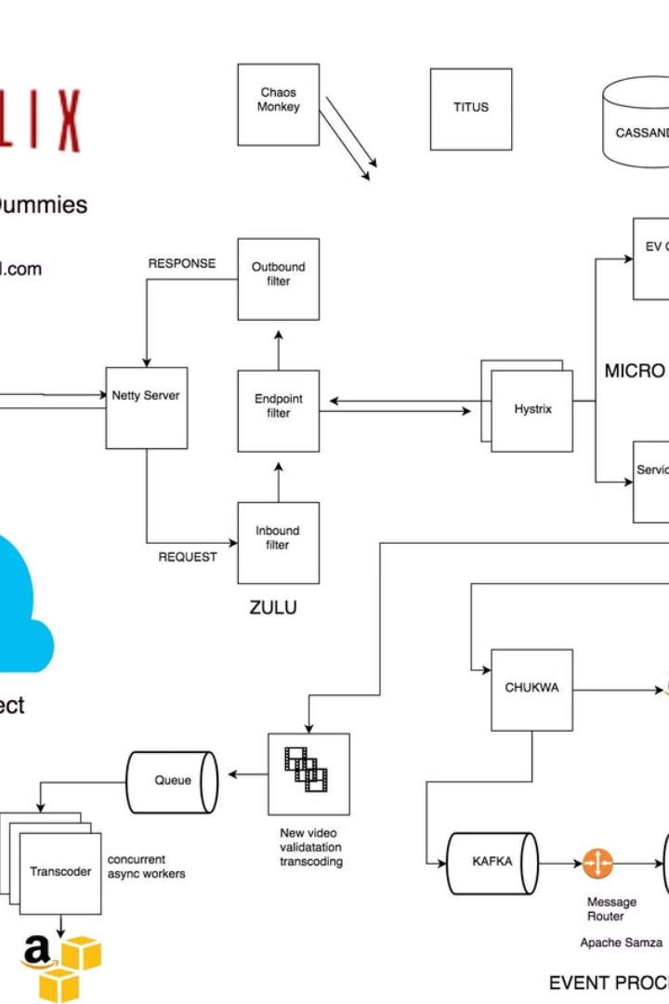

A Netflix Block Diagram:
How Netflix Works Behind the Scenes
A Netflix Block Diagram shows how Netflix works behind the scenes in a very simple way. It is a visual representation of how different parts of Netflix communicate with each other to provide you with a smooth streaming experience.
by Ram N Java

Slide 2
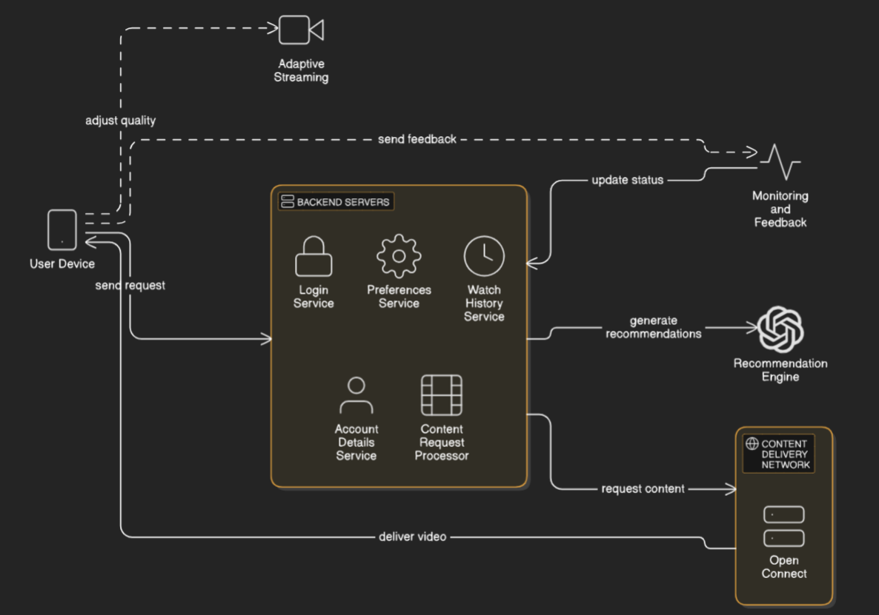

Slide 3
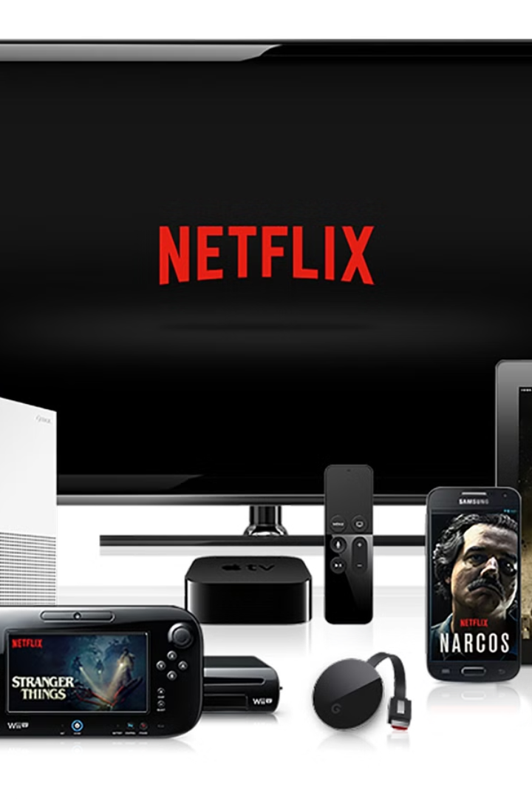
User Device
Your streaming device
Initiating the process
This is your phone, laptop, TV, or any device you use to watch Netflix.
When you open the Netflix app or website, your device sends a request to Netflix to get all the information needed to load your account.

Slide 4
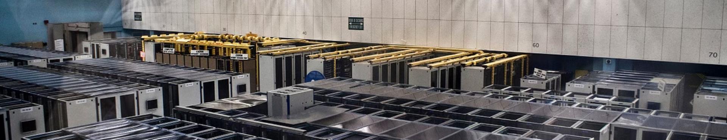



Backend Servers
Powerful computers
Data management
Request processing
These are powerful computers managed by Netflix.
They handle your login, store your watch history, preferences, and account details.
They also process requests for content (like movies or shows) and decide how to deliver it to you.

Slide 5
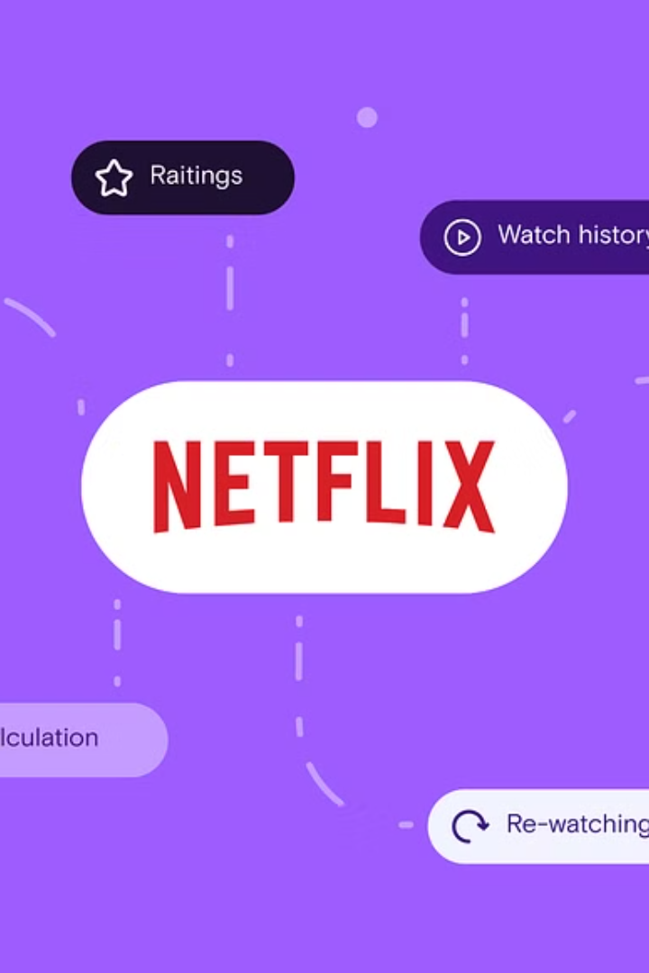



Recommendation Engine
AI-based system
This is an AI-based system that analyzes what you've watched before.
Content suggestions
It suggests new movies or shows that you might like.
Personalized experience
The backend server communicates with the recommendation engine to generate your personalized home screen.

Slide 6
Content Delivery Network (CDN)
Open Connect
Global server network
Proximity advantage
Efficient delivery
Netflix uses its own CDN called Open Connect.
CDNs are special servers located in different parts of the world to store movies and shows.
These servers are located closer to your home to ensure faster streaming.
When you select a movie, Netflix identifies the nearest CDN server to deliver the video.

Slide 7



Adaptive Streaming
Smart technology
1
This is a smart technology used by Netflix to adjust the video quality based on your internet speed.
High-speed streaming
2
If your internet is fast, Netflix streams in high quality (like 4K).
Low-speed adaptation
3
If your internet slows down, Netflix automatically reduces the quality so that the video doesn't buffer or stop.

Slide 8
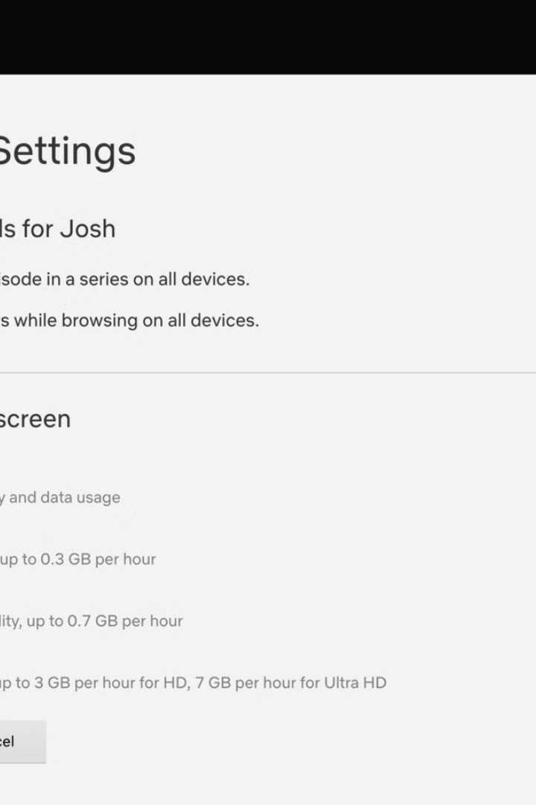
Monitoring and Feedback
Continuous monitoring
Real-time updates
While you're watching, Netflix continuously monitors your connection.
If your internet improves or slows, the system updates the video quality in real-time.

Slide 9
Summary of the Flow
1
Step 1
You open Netflix (on your device).
2
Step 2
Your device communicates with Netflix's backend servers.
3
Step 3
The backend checks your account and generates a personalized screen using
the recommendation engine.
4
Step 4
When you press "Play," the backend finds the closest CDN server to stream the video.
5
Step 5
The video streams using adaptive quality to match your internet speed.
This block diagram is like a roadmap showing how Netflix ensures you get your favorite shows with
minimal delays or interruptions.

