Slide 1
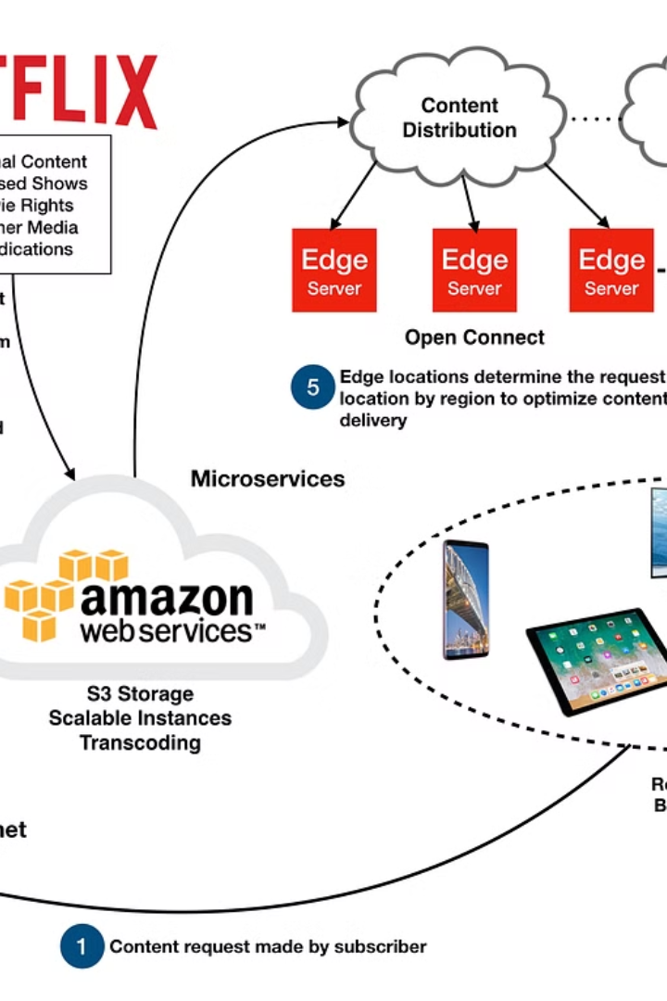

Netflix Sequence Diagram Explained for Beginners
A sequence diagram is like a step-by-step timeline that shows how different parts of a system communicate with each other. In the case of Netflix, the sequence diagram explains how you, as a user, interact with Netflix's system to stream a video.
by Ram N Java

Slide 2






Key Components in the Sequence Diagram
User (You)
Netflix App/Website
Backend Servers
Recommendation Engine
The person using
Netflix.
The interface where you interact with Netflix.
The brain of Netflix that handles user data, recommendations, and video requests.
Uses AI to suggest what you might like to watch.
Content Delivery Network (CDN - Open Connect)
Adaptive Streaming Service
Ensures smooth playback by adjusting video quality based on your internet speed.
Local Netflix servers that store and deliver videos faster.

Slide 3
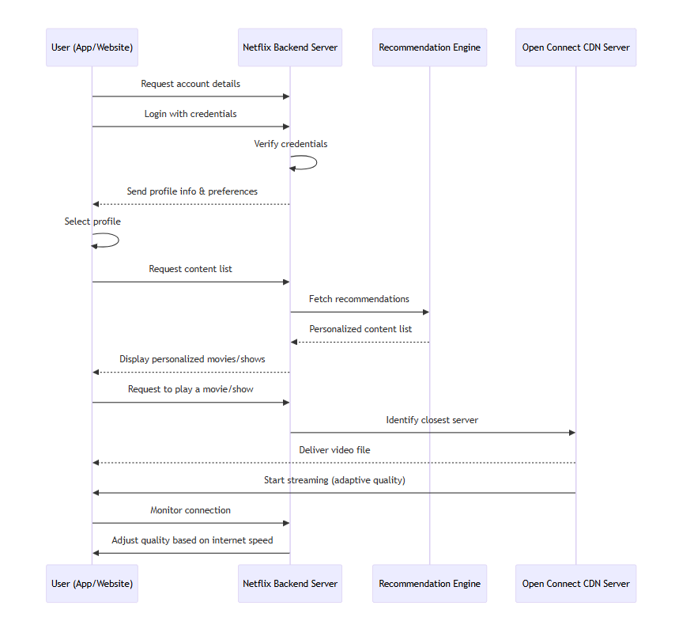

Slide 4
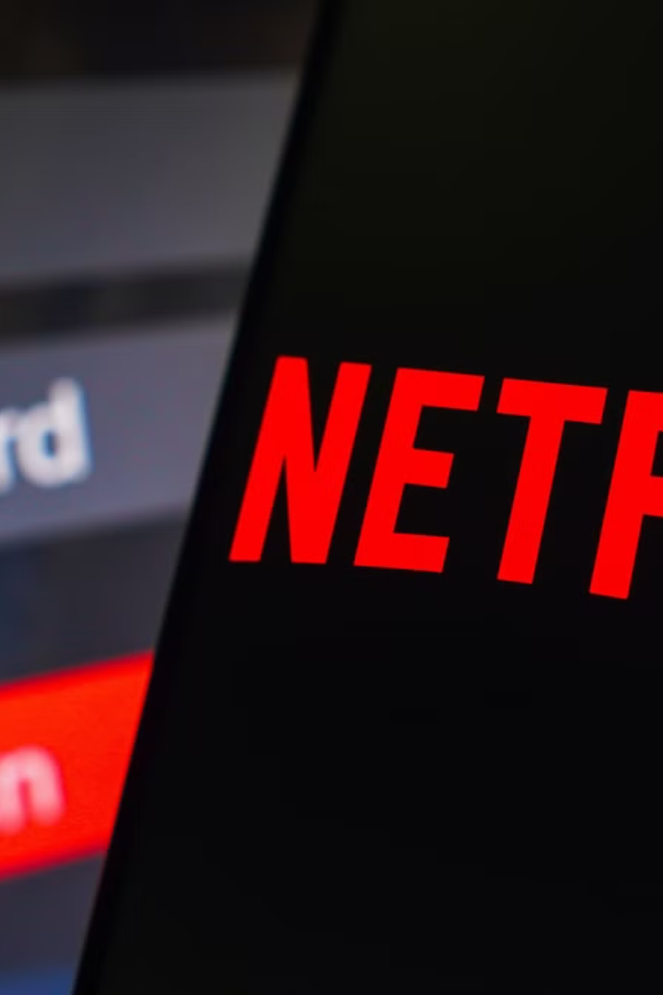
Steps in Netflix’s
Sequence Diagram
1
Step 1: User Opens Netflix App or Website
- You (the user) open the Netflix app or visit the Netflix website. - The app sends a request to Netflix's backend servers to load your account details.
2
Step 2: User Login and Profile Selection
- The backend server checks your login credentials (email and password). - Once verified, the backend sends back your profile information, including your watch history and preferences. - You select your profile to proceed.

Slide 5

Steps in Netflix's Sequence Diagram (Continued)
1
Step 3: Fetching Content List and Recommendations
- After you select your profile, the backend system sends requests to its Recommendation Engine. - The engine analyzes your viewing history and preferences using AI and provides a personalized list of movies and TV shows. - The app displays this list on your screen.
2
Step 4: User Selects a Movie or Show
When you click "Play" on a movie or show, the app sends a request to the
backend server to fetch the video file.

Slide 6
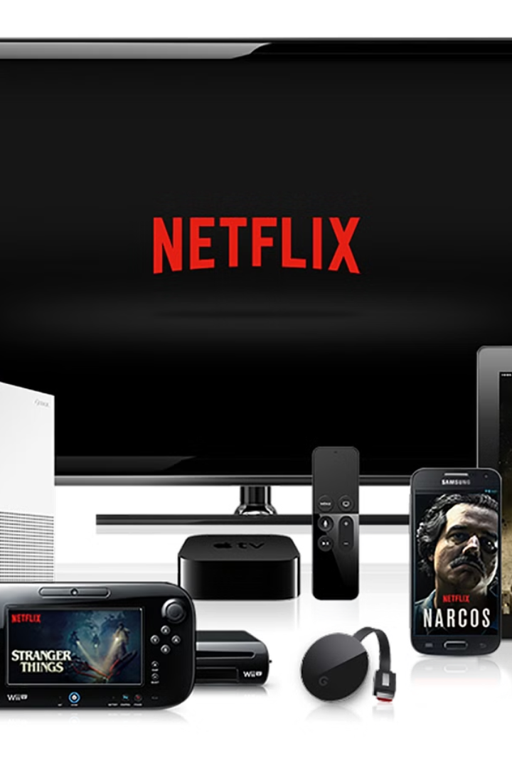
Steps in Netflix's Sequence Diagram (Continued)
1
Step 5: Backend Connects to Content Delivery Network (CDN)
- The backend server identifies the closest Open Connect CDN server (a local Netflix server near you). - The CDN server delivers the video file to your device.
2
Step 6: Adaptive Streaming Starts
- Netflix begins streaming the video using adaptive streaming. - Based on your internet speed, the system adjusts the video quality in real-time.
3
Step 7: Continuous Playback
- While you're watching, the backend server keeps monitoring your internet connection to maintain a smooth experience. - If your speed slows down, the system lowers the quality to avoid buffering.

Slide 7
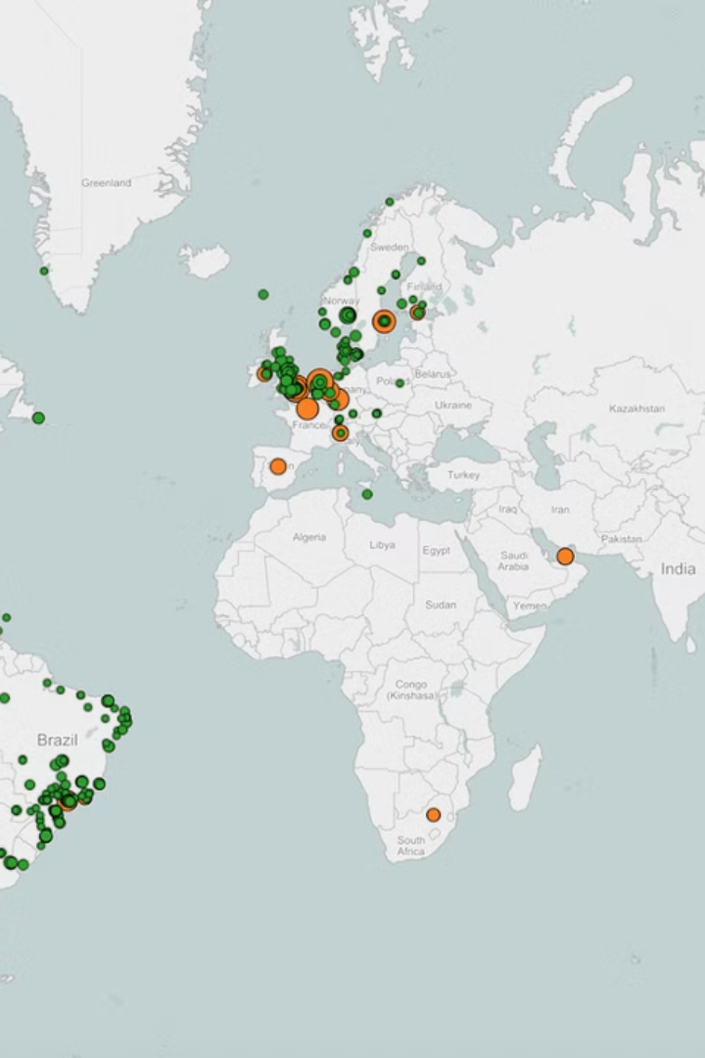
Why This Sequence Works Perfectly for Netflix
Fast Content Delivery
Personalized Experience
Using local CDN servers ensures quick access to videos.
The recommendation engine ensures the content matches your preferences.
Reliable Playback
Global Scalability
Adaptive streaming minimizes buffering.
The backend can handle millions of users at once by connecting to cloud services.

Slide 8

Conclusion
The Netflix sequence diagram is like a timeline of events that ensures you have a smooth, fast, and personalized streaming experience. It begins the moment you open the app and continues until you're watching your favorite show without interruptions. Netflix's seamless communication between its user, backend servers, CDN, and adaptive streaming system ensures you get the best possible service every time!

