Slide 1
Web Services Tutorials | Webservice Introduction
Web service is a way for two applications or two electronic devices to communicate over a network
Application 1
Application 2

Slide 2
Web Services Tutorials | Webservice Introduction
Web service uses an interoperable format to transfer the data between application
Application 1
Application 2

Slide 3
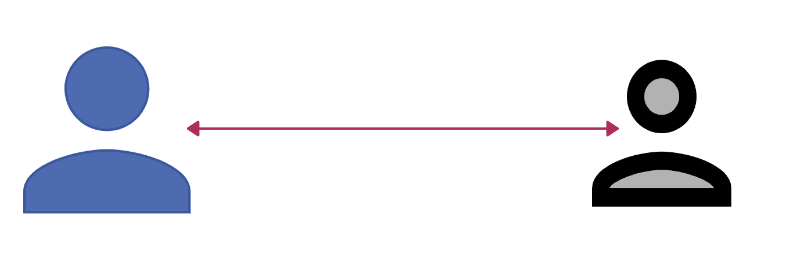
Web Services Tutorials | Webservice Introduction
Common Language
Grammer Rules
Medium
Ram - Tamil
Arun - Telugu
Application 1
Application 2
XML, JSON,CSV,txt etc.
HTTP, SMTP, FTP
LAN / Internet
Java
.NET

Slide 4
Web Services Tutorials | Webservice Introduction
In Web service there will be 2 actors [Provider and Consumer]
Consumer
Provider
Java
.NET

Slide 5



Web Services Tutorials | Webservice Introduction
HTTP Request through web browser
Web Application
Java
HTTP Request through application
Web service
Java

Slide 6
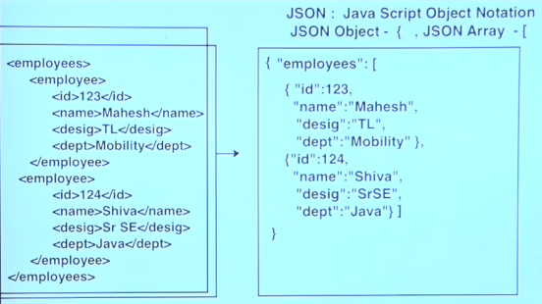
Web Services Tutorials | Webservice Introduction
Web Services Types:
SOAP - Simple Object Access Protocol
REST - Representational State Transfer

