Slide 1
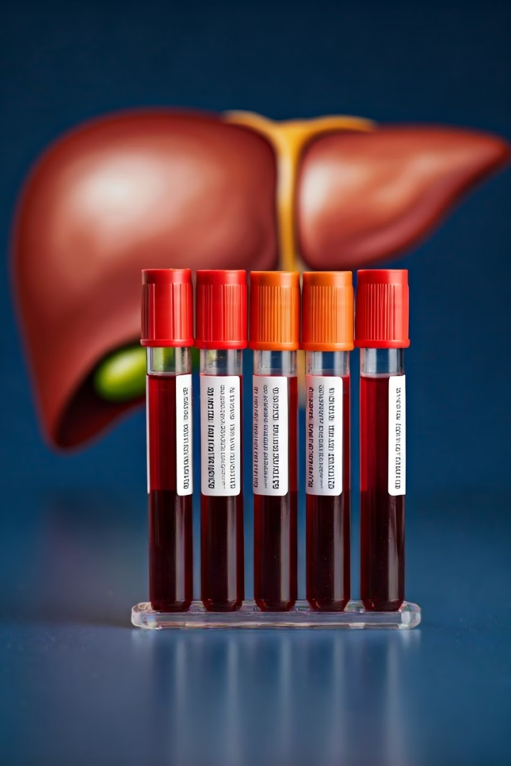

Liver Function Tests (LFTs)
Liver Function Tests (LFTs) are a group of blood tests that help to check how well your liver is working. These tests measure different enzymes, proteins, and substances that are made by the liver or released when the liver is damaged.
by Ram N Java

Slide 2





Why are Liver Function Tests Done?
Check for Liver Diseases
Detect conditions like fatty liver, hepatitis, or liver damage
Monitor Ongoing Conditions
Track the progress of ongoing liver conditions
Medication Effects
See if medicines or alcohol are harming your liver
Diagnose Symptoms
Help diagnose symptoms like jaundice (yellow skin), tiredness, or abdominal pain

Slide 3
Main Tests Included in LFTs
ALT (Alanine Aminotransferase)
AST (Aspartate Aminotransferase)
ALP (Alkaline Phosphatase)
GGT (Gamma-Glutamyl Transferase)
This is an enzyme found in liver cells
Another enzyme found in the liver and other organs
Found in the liver, bones, and bile ducts
Helps detect bile duct issues or alcohol-related liver damage
High levels mean liver damage
High levels may mean a bile duct problem or bone disease
High AST can also mean liver injury, but it's not specific to the liver

Slide 4
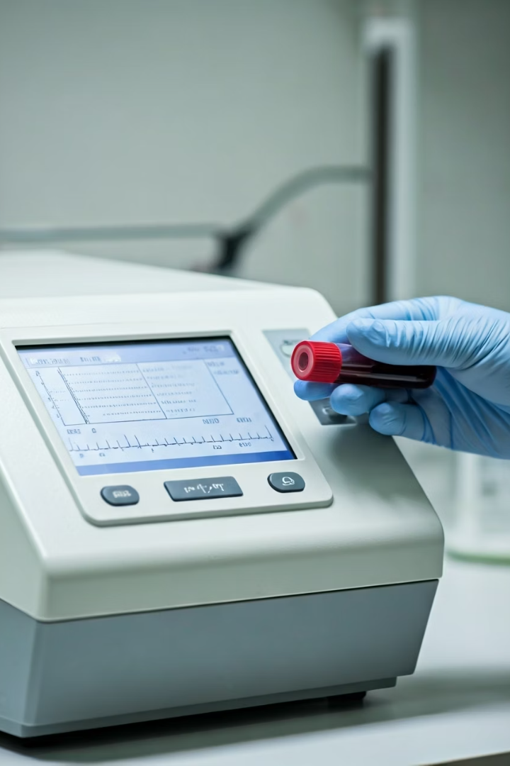
Additional Liver Function Tests
Bilirubin
A yellow substance made when the body breaks down old red blood cells
High levels can cause jaundice and suggest liver or bile duct issues
Albumin
A protein made by the liver
Low levels may mean the liver is not making enough protein
Total Protein
Measures all proteins in the blood, including albumin and others
Helps check the liver's ability to produce proteins
Prothrombin Time (PT)
Measures how long it takes for blood to clot
If it's longer than normal, it may mean the liver is not making enough clotting proteins

Slide 5






What Do the Results Mean?
Normal LFTs
Your liver is working well
Mild changes
Could be from a minor issue like fatty liver or a medicine side effect
High levels
Might mean inflammation, damage, or serious liver problems
Important: These tests do not tell exactly what disease you have, but they give a clue. Your doctor will look at the results along with your symptoms and may ask for more tests if needed.

Slide 6
Simple Liver Function Test Chart
Test
Normal Range
What It Shows
High Level Means
ALT (SGPT)
7 – 56 U/L
Liver health
Liver damage or inflammation
AST (SGOT)
10 – 40 U/L
Liver and muscle health
Liver or muscle injury
ALP
44 – 147 U/L
Bile flow and bones
Bile duct problem or bone disease
GGT
0 – 51 U/L
Bile ducts and alcohol effect
Alcohol damage or bile flow issue
Bilirubin
0.1 – 1.2 mg/dL
Yellow pigment from liver
Jaundice or liver disease
Albumin
3.4 – 5.4 g/dL
Protein made by liver
Rarely high; Low means weak liver
Total Protein
6.3 – 7.9 g/dL
All proteins in blood
Low may mean liver/kidney issue

Slide 7




Remember
Not Always Disease
1 or 2 abnormal results do not always mean disease
Pattern Recognition
Doctors check patterns in tests, not just one result
Professional Advice
Always follow up with a doctor for proper advice

Slide 8

Summary
Liver Health Check
Simple Blood Tests
They help check the health of your liver
LFTs are simple blood tests
Follow-up Care
Measure Key Indicators
Abnormal results may need further medical checks or treatment
They measure enzymes and proteins made or affected by the liver

