Slide 1
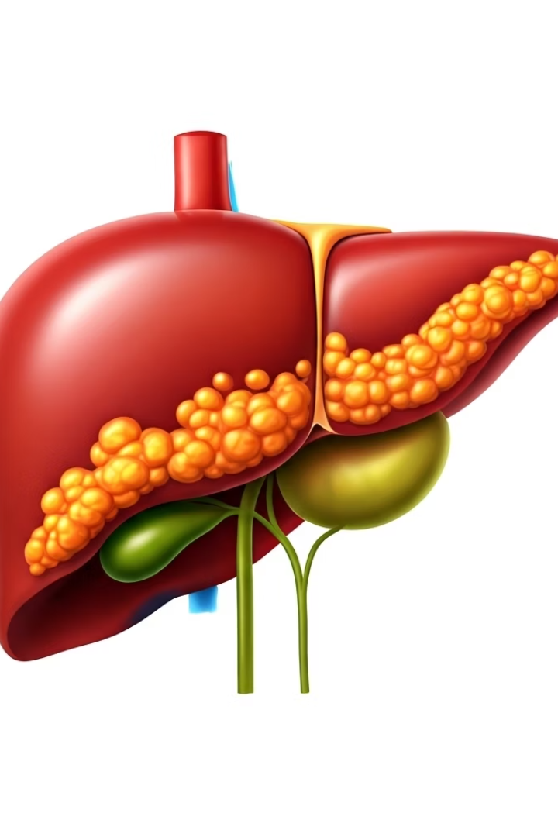

Fatty Liver Grading
Fatty Liver Grading (also called stages) means how serious the fat build-up in your liver is. Doctors divide fatty liver into different grades or stages to understand how much damage has happened.
There are four main stages of fatty liver disease, starting from mild to severe.
by Ram N Java

Slide 2
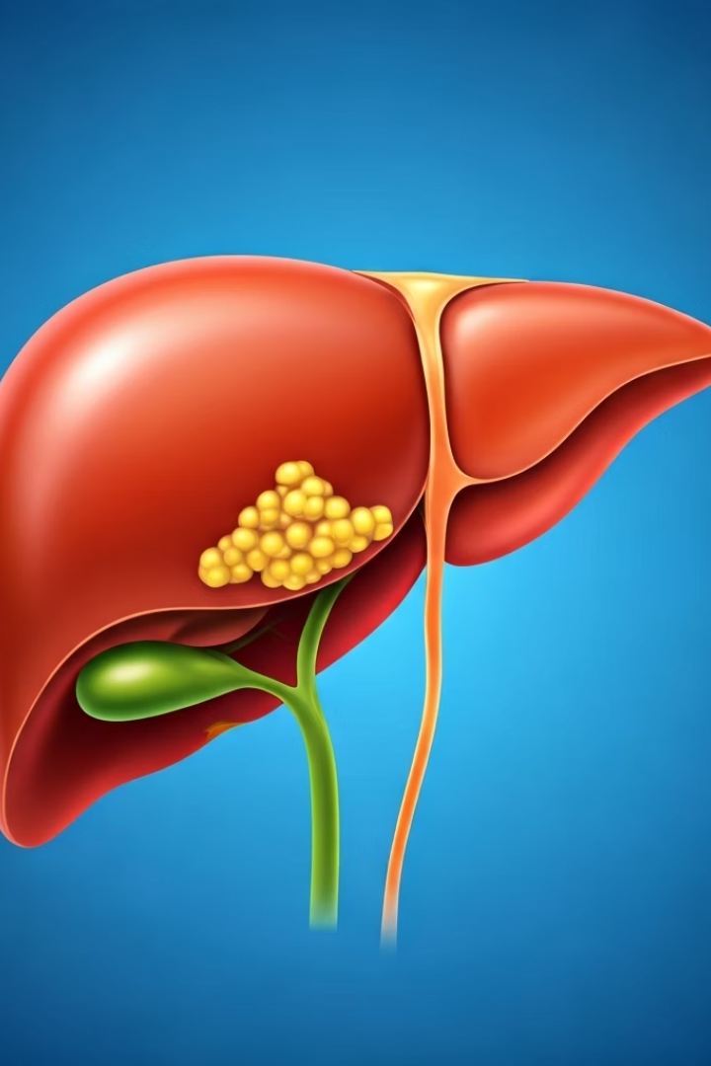
Stage 1: Simple Fatty Liver (Steatosis)
Fat starts building up in the liver
But the liver is not yet inflamed or damaged.
Symptoms
This stage often has no symptoms.
Risk Level
It is not dangerous if treated early with healthy diet
and exercise.
Classification
This stage is also called Grade 1 Fatty Liver.

Slide 3
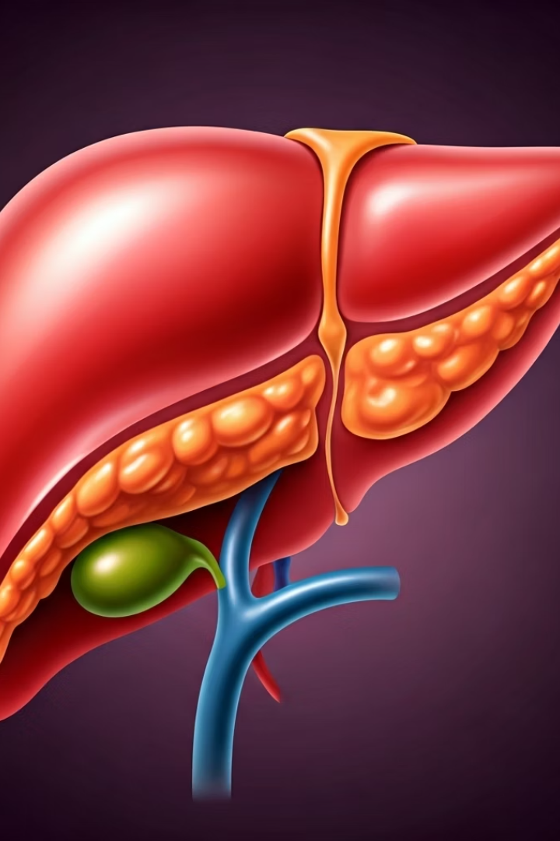




Stage 2:
Non-Alcoholic Steatohepatitis (NASH)
Inflammation
In this stage, the fat causes inflammation (swelling) in the liver.
Liver Damage
The liver becomes irritated and may get damaged.
Symptoms Begin
Some people may start to feel tired, weak, or pain on the right side of the belly.
Severity
This is more serious than simple fatty liver.

Slide 4
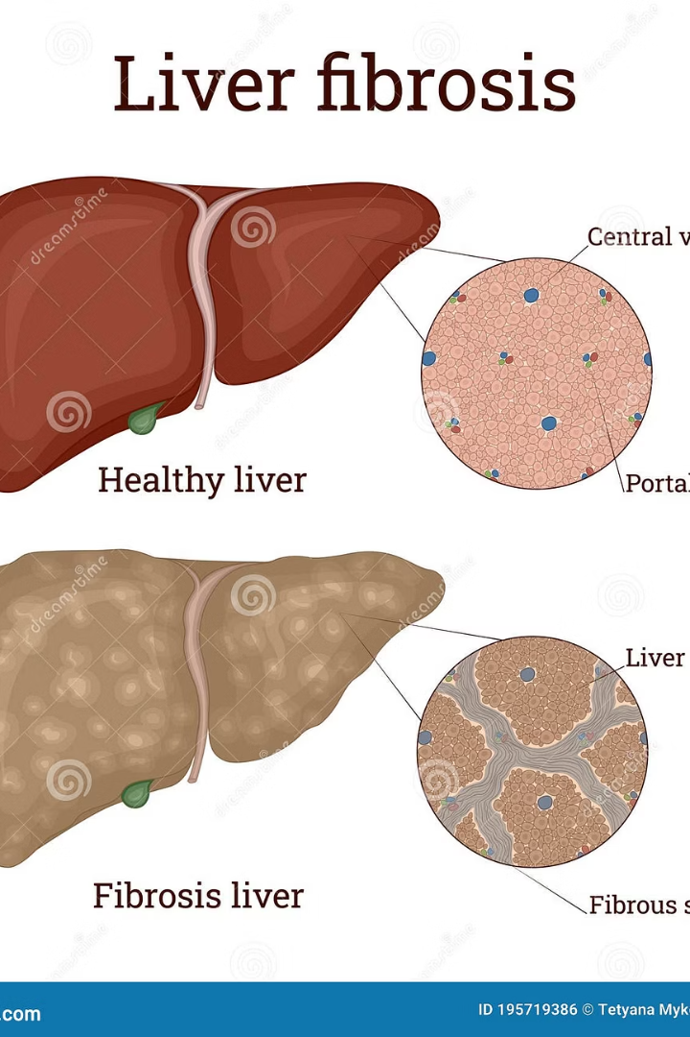




Stage 3: Fibrosis
Scarring Begins
The liver now has inflammation and scarring (called fibrosis).
Partial Function
The liver can still work, but the damage is getting worse.
Progressive Damage
If no action is taken, the liver may lose its normal function.
Treatment Needed
This stage needs medical care and lifestyle changes.

Slide 5










Stage 4: Cirrhosis
Most serious stage
End-stage liver disease
Heavily scarred and damaged
Liver cannot work properly
Severe Symptoms
Yellow skin (jaundice), swelling, very weak
Serious Complications
Can lead to liver failure or liver cancer
Advanced Treatment
Needs strong medical treatment or liver transplant

Slide 6




In Simple Words
Mild fat (Grade 1)
Can be reversed easily
Fat + inflammation (NASH)
Needs attention
Scarring (Fibrosis)
More damage
Severe damage (Cirrhosis)
Very serious
Fatty liver has 4 stages, progressing from mild fat buildup to severe liver damage.

Slide 7
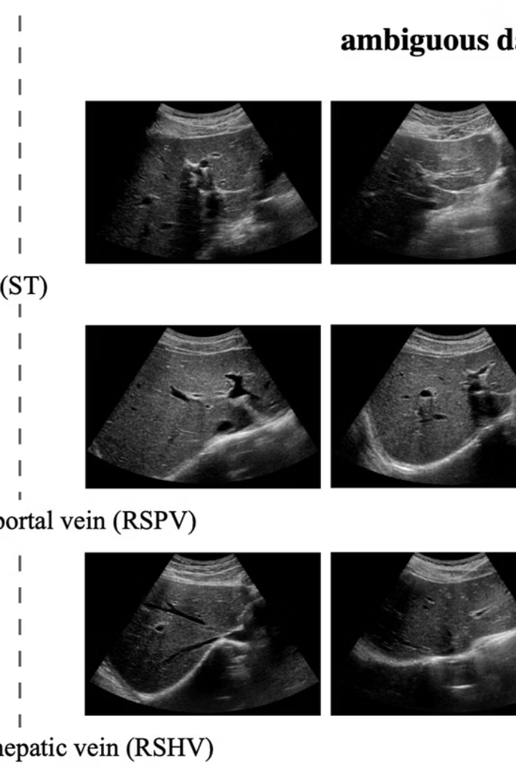



How to Know Your Stage
Imaging Tests
Blood Analysis
Tissue Examination
Ultrasound or FibroScan to visualize the liver
Blood tests to check liver enzyme levels
Liver biopsy (a small sample of liver is tested)
Doctors use these diagnostic tools to accurately determine the stage of fatty liver disease and develop an appropriate treatment plan.

Slide 8








Good News
Losing weight
Healthy eating
Even 5-10% weight loss can significantly improve liver health
Healthy diet and reduced sugar intake
Avoiding alcohol
Daily exercise
Eliminating alcohol reduces liver stress
Regular physical activity helps reduce liver fat
Early stages of fatty liver can be reversed by making these lifestyle changes.

Slide 9
Reversible Stages of Fatty Liver
Reversible Stages
❌ Usually Not Reversible
Grade 1 (Mild Fatty Liver)
Liver Fibrosis
Yes, fully reversible
Scarring begins
With healthy food, regular exercise, and weight loss.
Mild fibrosis can improve, but deep scarring is hard to fully reverse.
Grade 2 (Moderate Fatty Liver)
Cirrhosis
Yes, still reversible
But it needs more effort and early action to stop further damage.
Not reversible
Permanent liver damage. The only option in severe cases is a liver transplant.

Slide 10

Important Tip
1-2
100%
4
Best Stages for Recovery
Early Action Success Rate
Stages of Progression
Stages 1 and 2 are the best time to reverse fatty liver naturally.
The earlier you take action, the better your chances of full recovery.
Knowing the stage helps the doctor decide the right treatment.
Always talk to a doctor for proper check-up and advice.

