Slide 1


Understanding Trojans:
A Beginner's Guide
What is a Trojan?
A Trojan is a type of malware (harmful software) that looks like a normal or useful file or program, but once you open it, it can harm your computer or steal your personal information.
It is named after the Trojan Horse story from history, where something dangerous was hidden inside something that looked safe.
by Ram N Java

Slide 2

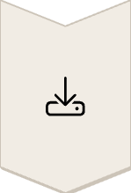


How Does a Trojan Work?
Download Deception
You might download a file that looks like a game, app, or document
Activation
When you open it, the hidden malware starts working
Hidden Operation
It can spy on you, steal your data, or let hackers control your device without you knowing

Slide 3





What Can a Trojan Do?
Data Theft
File Damage
Malware Installation
Steal your passwords, photos, and bank details
Delete or damage files on your device
Download more malware without asking you
Remote Access
Botnet Recruitment
Give hackers full access to your computer
Turn your computer into a bot (used in cyber attacks)

Slide 4

How Do Trojans Get In?
Unsafe Downloads
By downloading files from unsafe websites
Deceptive Advertising
By clicking on fake ads or pop-ups
Email Threats
Through email attachments that look real but are not
Pirated Software
By installing cracked or fake software

Slide 5
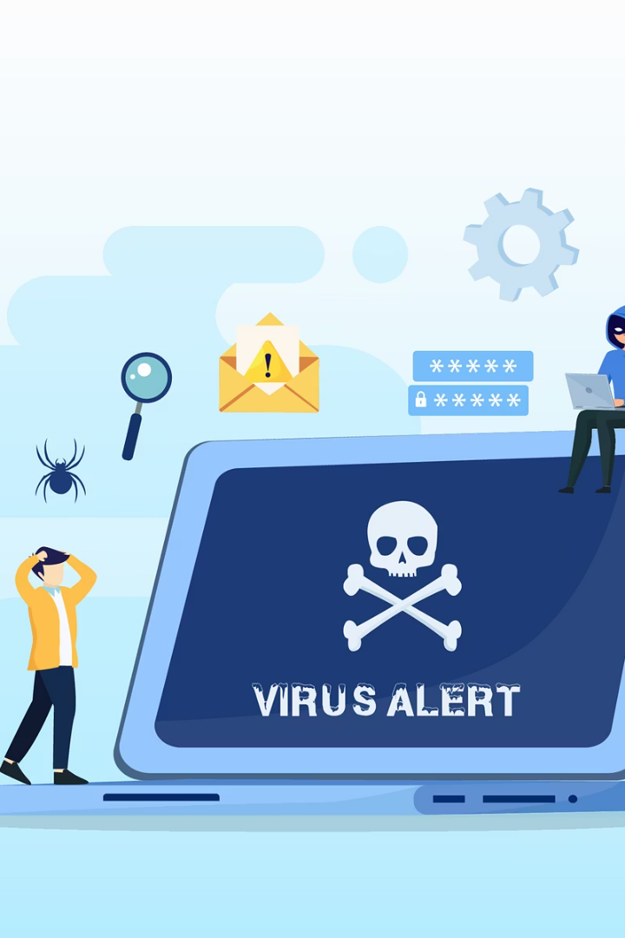




Signs Your Device May Have a Trojan
Performance Issues
Unknown Programs
Network Problems
Your device becomes slow or crashes often
Your internet is slow even when nothing is open
You see new programs or icons you didn't install
Account Anomalies
You notice strange activity in your accounts (like emails you didn't send)

Slide 6










How to Protect Yourself from Trojans
Use Protection
Use antivirus software and keep it updated
Be Cautious
Do not download files from unknown sources
Click Wisely
Avoid clicking on suspicious links or ads
Verify First
Scan all email attachments before opening
Stay Updated
Keep your system and apps updated

Slide 7
What to Do If You Have a Trojan
Disconnect
Disconnect from the internet
Scan
Run a full antivirus scan and remove the Trojan
Clean Up
Delete any suspicious programs you didn't install
Secure Accounts
Change your passwords (especially if personal data was stolen)
Get Help
Ask a computer expert for help if needed

Slide 8






Summary
Harmful Effects
It can steal your data or damage your device
Deceptive Nature
A Trojan looks like a safe file but is harmful
Protection Strategy
Stay safe by being careful with downloads and using antivirus software

