Slide 1
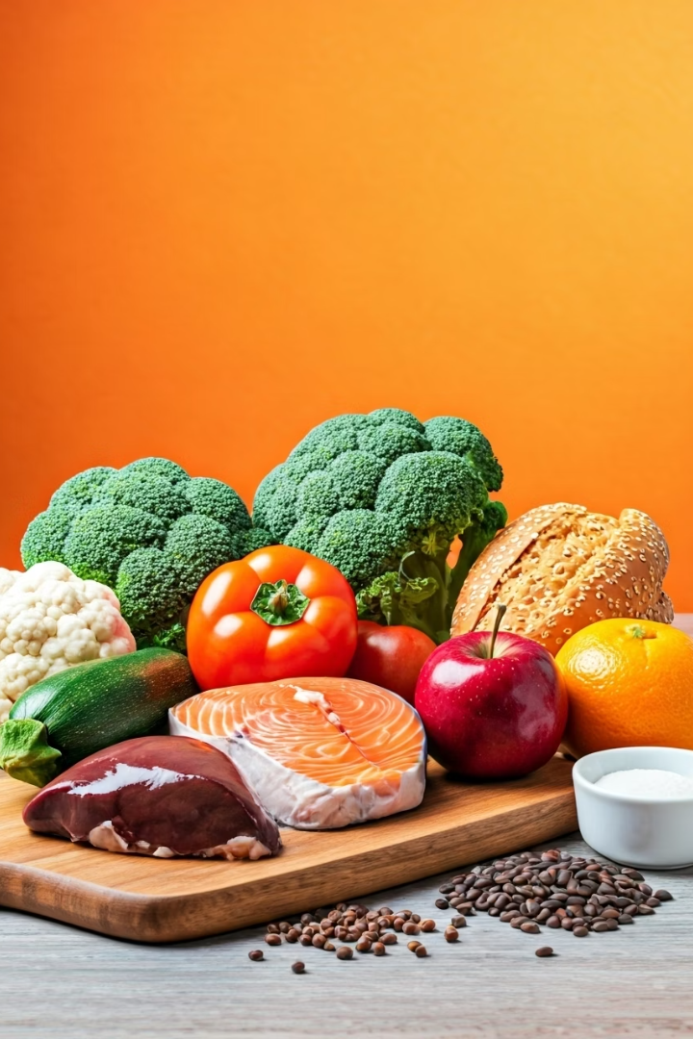

Diet for Fatty Liver
What is a Fatty Liver Diet?
A fatty liver diet is a way of eating that helps reduce fat in your liver, improve liver function, and prevent further damage. It includes healthy, natural foods and avoids unhealthy, fatty, or sugary foods.
by Ram N Java

Slide 2






Best Foods to Eat
Vegetables and Fruits
Eat more green leafy vegetables like spinach, broccoli, and cabbage.
Add fresh fruits like apples, oranges, and berries.
They are low in fat and high in fiber, which is good for your liver.
Whole Grains
Choose brown rice, oats, whole wheat bread, and millets.
They give energy and fiber without adding fat.
Lean Proteins
Eat chicken (without skin), fish (like salmon), eggs (mainly white), tofu and lentils.
These help repair liver cells and build strength.
Healthy Fats
Use olive oil or mustard oil in small amounts.
Eat nuts (like almonds, walnuts) and seeds (like flaxseeds, chia seeds) for good fat.
Water
Drink plenty of water every day. Aim for 6–8 glasses a day
Water helps to flush out toxins from the liver.

Slide 3



Foods to Avoid
Sugary Foods and Drinks
Fried and Fast Foods
White Bread and White Rice
Avoid sweets, cakes, chocolates, and soft drinks.
Stay away from chips, burgers, pizza, samosas and pakoras.
These are refined carbs that raise blood sugar and fat.
Sugary foods and drinks
increase fat in the liver quickly.
Fried and fast foods are high in
unhealthy fat and damage the liver.
Use whole grains instead of
white bread and white rice.

Slide 4
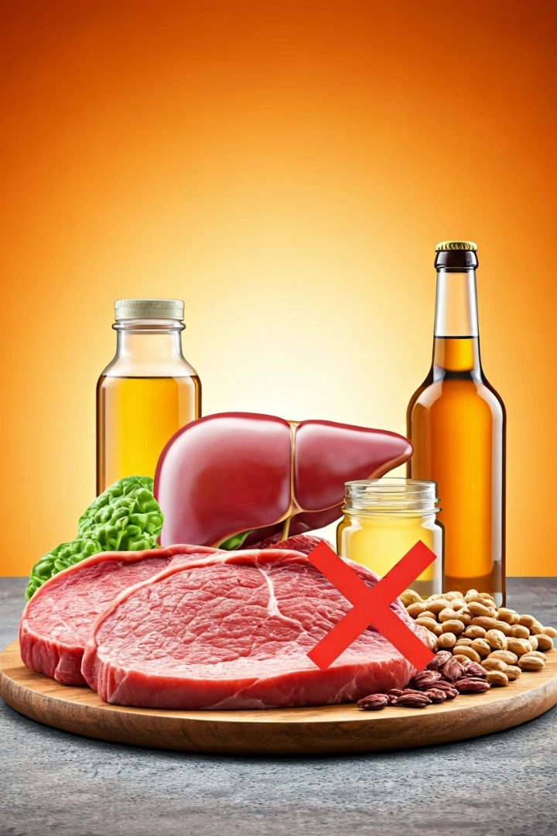
Foods to Avoid
Red Meat
Alcohol
Avoid mutton, beef, and pork.
Do not drink alcohol, even small amounts.
These have more fat and are harder for the liver to digest.
Alcohol is very harmful for fatty liver.
Processed and Packaged Foods
Avoid instant noodles, biscuits, chips, and ready-made meals.
These contain salt, sugar, and unhealthy fats.

Slide 5

Simple Tips for a Fatty Liver Diet
Eat Small and Often
Eat small meals throughout the day.
Avoid eating late at night.
Start Your Day Right
Do not skip breakfast.
Choose Wisely
Choose fresh, home-cooked food.
Read food labels and avoid high sugar or fat content.

Slide 6







In Simple Words
More Vegetables
More Fruits
4
More Lean Protein
More Whole Grains
A good diet for fatty liver means more vegetables, fruits, whole grains, and lean protein, and less sugar, fat, and no alcohol.
Healthy food = Healthy liver. Start small, and stick to it every day.

