Slide 1
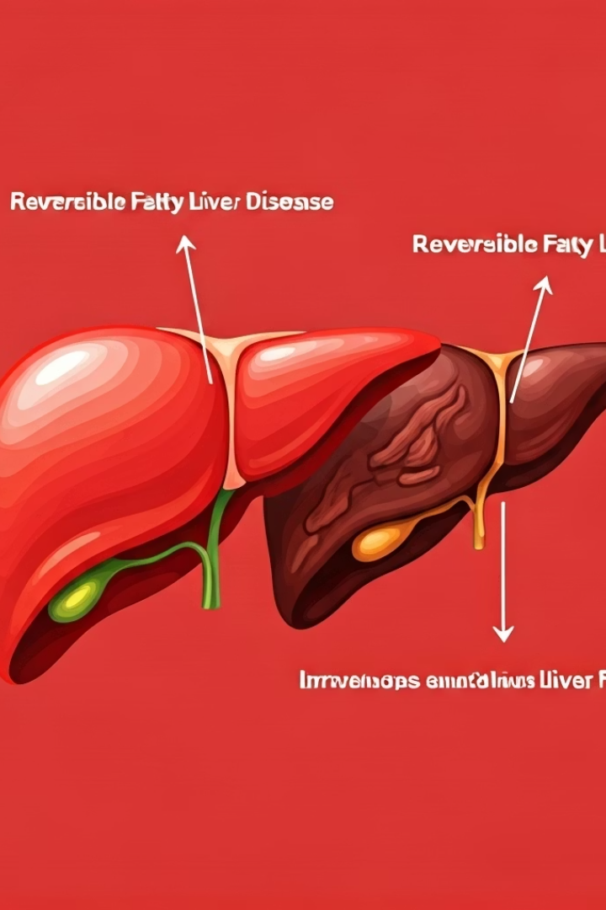

Reversible vs.
Irreversible Fatty Liver
What Does Reversible Mean?
Reversible fatty liver means the damage can be healed. With the right food, exercise, and care, the liver can go back to normal.
What Does Irreversible Mean?
Irreversible fatty liver means the liver is permanently damaged. Even with treatment, the liver cannot fully heal, but problems can be managed to avoid getting worse.
by Ram N Java

Slide 2
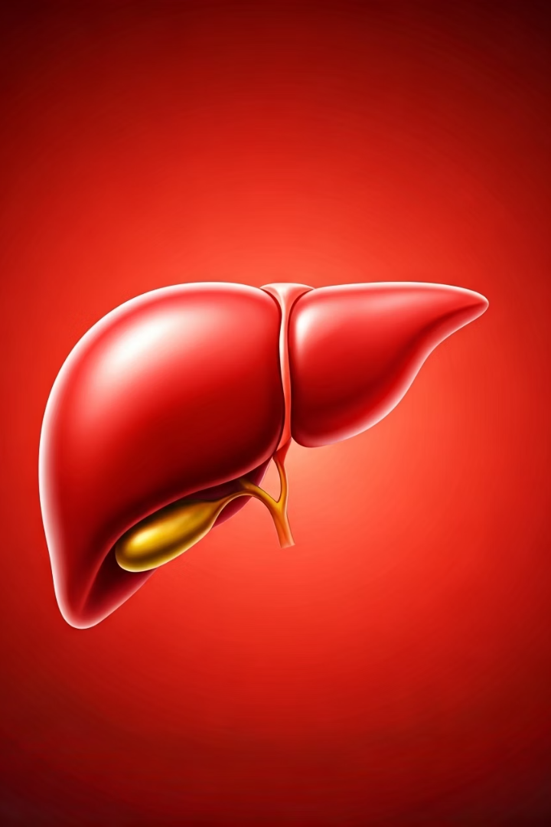
Reversible Fatty Liver:
Early Stages
Grade 1 (Simple Fatty Liver)
Only fat buildup, no damage
No symptoms usually
Fully reversible
Grade 2 (Moderate Fatty Liver)
Some inflammation, mild liver irritation
Still reversible with lifestyle changes

Slide 3
Irreversible Fatty Liver: Late Stages
Fibrosis (Scarring of Liver)
1
Liver tissue becomes stiff or scarred
Mild fibrosis may improve, but deep scars stay forever
Cirrhosis (Severe Liver Damage)
Liver is badly scarred and can't work properly
2
Can lead to liver failure or cancer
Not reversible, but symptoms can be controlled

Slide 4






How to Keep Fatty Liver Reversible
Eat healthy food
Exercise regularly
Lose extra weight
Avoid alcohol
Less sugar, fat, junk food
Manage diabetes and cholesterol
Go for regular check-ups

Slide 5


In Simple Words
Reversible Fatty Liver
Irreversible Fatty Liver
Is like a dirty room that you can clean.
Is like a broken wall that cannot be fixed easily.
Key Message
Fatty liver is easy to reverse if caught early. Do not wait for symptoms. Start a healthy lifestyle now to protect your liver.

