Slide 1
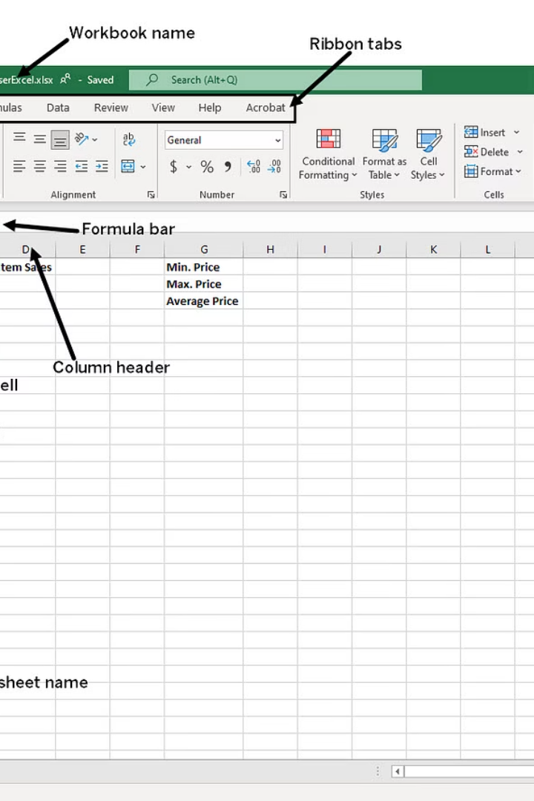

How to Use Microsoft Excel:
A Step-by-Step Beginner Guide
Step 1: Open Microsoft Excel
Click on the Excel icon from your computer or search for "Excel" in the Start menu.
Once opened, choose "Blank Workbook" to start a new Excel sheet.
by Ram N Java

Slide 2
Understand the Excel Screen
Key Components
Important Elements
Worksheet: The big grid made of rows and columns where you type data.
A cell is the box where a row and column meet (Example: A1).
Rows (horizontal lines) with numbers like 1, 2, 3...
The formula bar shows what's inside the selected cell.
Columns (vertical lines) with letters like A, B, C...
Sheets are tabs at the bottom, like "Sheet1".

Slide 3
Enter Data into Cells
Move to Next Cell
Type Your Data
Press Enter to move to the cell below, or Tab to move to the next cell on the right.
Select a Cell
Type a word or number.
Click on a cell (example: A1).
Example:
In A1 type: Name
In B1 type: Age
In A2 type: John
In B2 type: 25

Slide 4



Format Your Data
Select the cells you want to format.
Click on the Home tab at the top.
Use the formatting options
Bold
Font Size
Text Color
Makes text thicker.
Makes text bigger or smaller.
Changes text color.
Cell Color
Align Text
Fills cell with color.
Left, center, or right alignment.

Slide 5



Use AutoSum
Click on a cell below numbers.
Go to the Home tab.
Click on AutoSum – Excel adds the numbers for you.
Example:
A1: 5
A2: 10
A3: 15
A4: Click here and use AutoSum → Result: 30

Slide 6
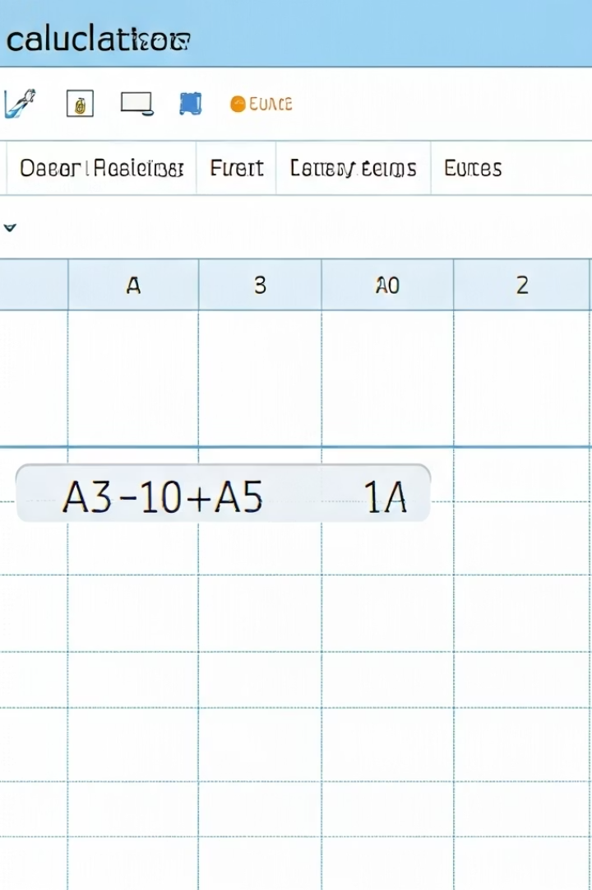



Do Simple Calculations
Excel can do math for you.
Cell
Formula
Result
A1
5
5
A2
10
10
A3
=A1+A2
15
You can also use:
=A2-A1
Subtract
=A1*A2
Multiply
=A2/A1
Divide

Slide 7






Create a Table
Click on the Insert tab
Find the table option in the ribbon
Select your data
Click and drag to highlight all your data including headers
Choose Table
Excel makes your data look neat and easier to work with

Slide 8



Sort and Filter
Select your table
Click anywhere within your data table
Go to the Data tab
Find the sorting and filtering options
Click Sort or Filter
Sort to arrange from A–Z or Z–A
Filter to show only specific values (like only people aged 25)

Slide 9








Save Your Work
Click on File
Select Save As
Choose a folder, name your file
Click Save

Slide 10

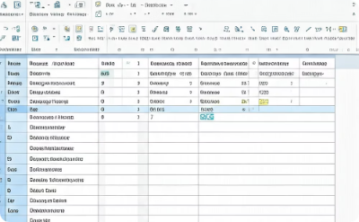
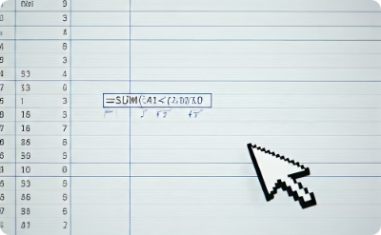
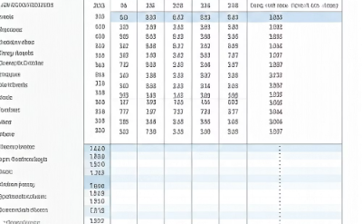
Practice
The best way to learn Excel is to practice:
Try typing data
Try formatting
Try doing math formulas
Try sorting and filtering
Enter different types of information into cells
Experiment with colors, fonts, and styles
Practice basic calculations and functions
Organize your data in different ways

