Slide 1
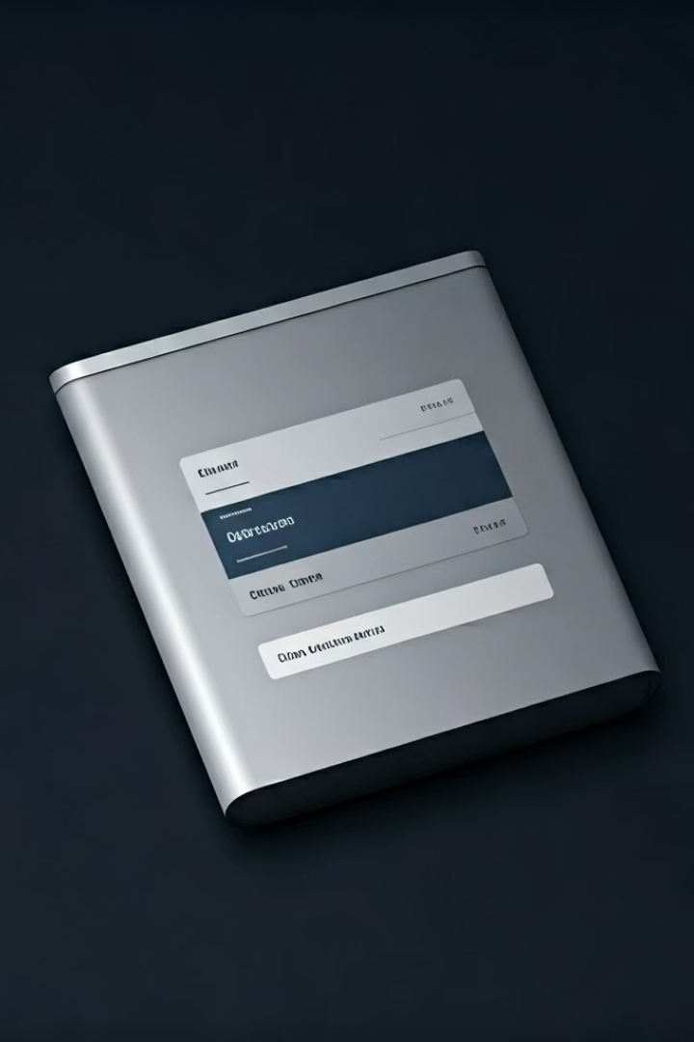

How to Turn On 2FA for Gmail
Two-Factor Authentication (2FA) adds an extra layer of security to your Gmail account. Even if someone knows your password, they cannot sign in without a second code sent to your phone.
by Ram N Java

Slide 2
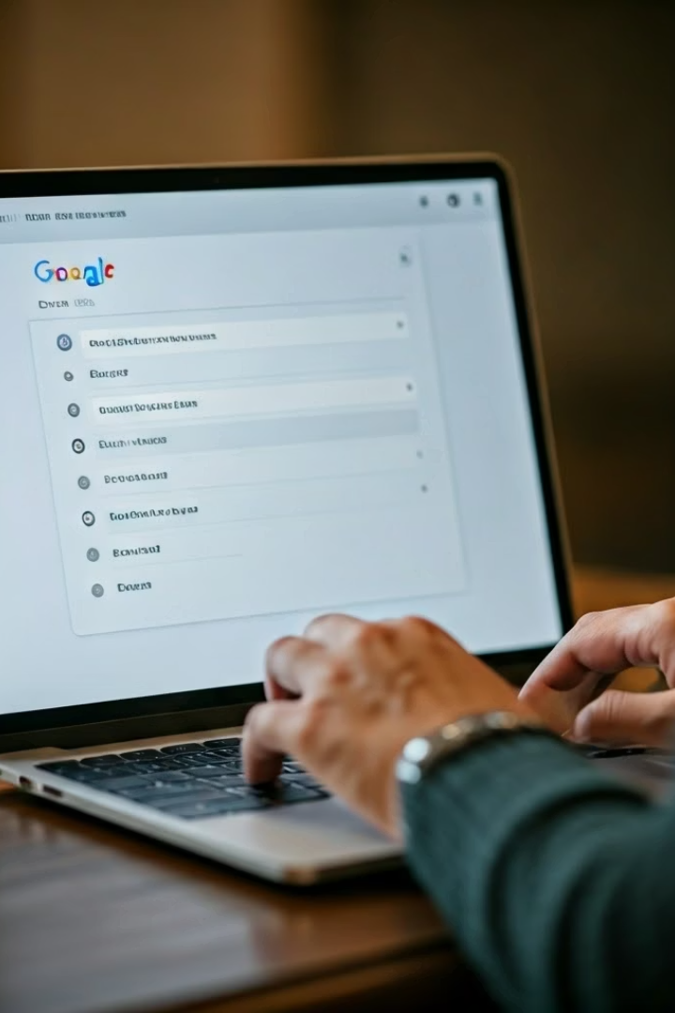
Setting Up 2FA: Getting Started
Go to Your Google Account Settings
Open your web browser and go to https://myaccount.google.com
Sign in to your Gmail/Google account if you're not already logged in
Open the Security Settings
On the left-hand side, click on Security
Scroll down to the section called "Signing in to Google"
Turn On 2-Step Verification
Find 2-Step Verification and click on "Get Started"
You may be asked to enter your password again for security

Slide 3
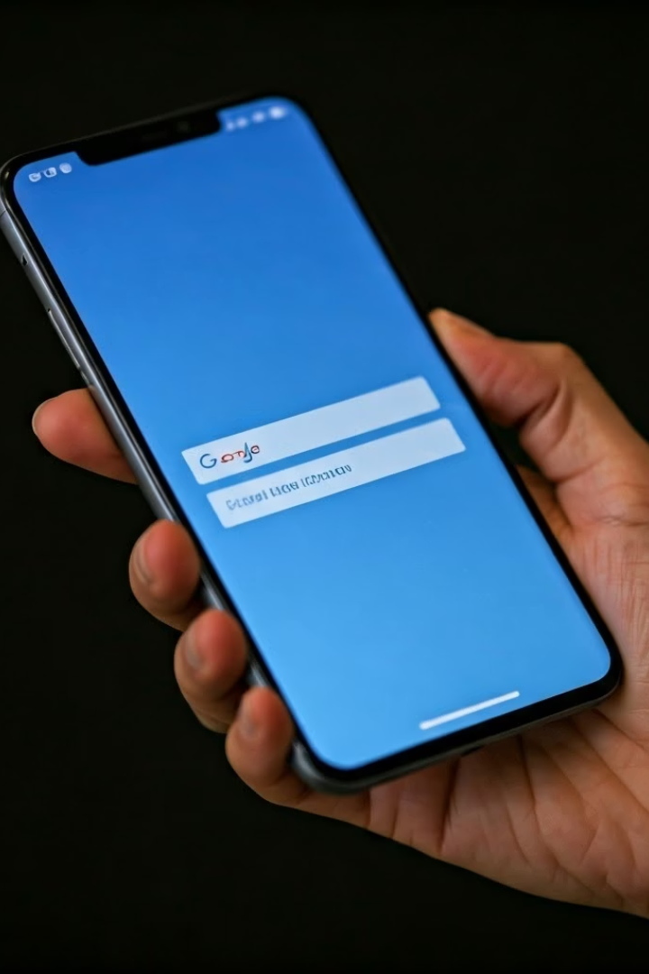



Completing Your 2FA Setup
Choose Your Verification Method
Google will suggest your phone for verification
Click Continue
You'll receive a prompt on your phone – tap Yes to approve
Set a Backup Option
If asked, you can add a backup phone number and choose to get codes via text message (SMS) or phone call
You can also set up an Authenticator App (like Google Authenticator) for added security
Turn It On
Once you finish the setup, click "Turn On" to activate 2FA for your account

Slide 4
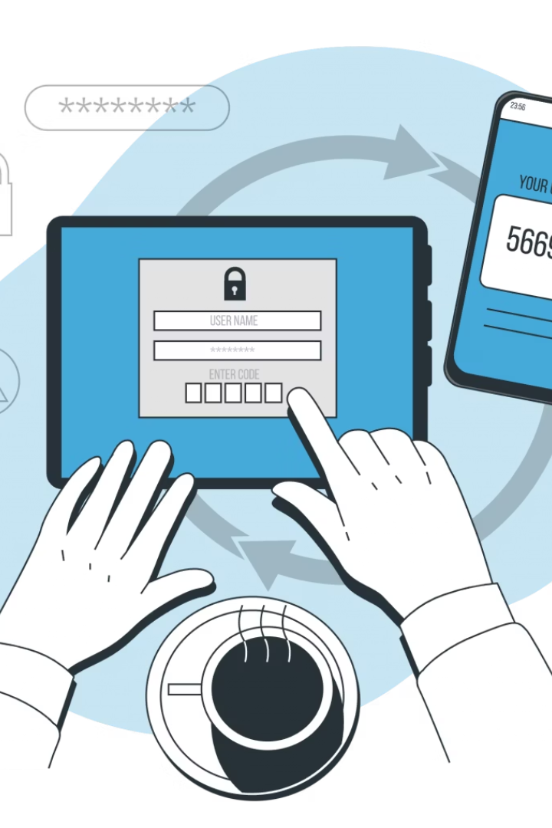



Important 2FA Security Tips
Keep Your Phone Accessible
Have a Backup Plan
Add a backup method in case you lose access to your main phone
Always keep your phone with you to complete the second step
Keep Information Current
If you change your phone number, update it in your account settings

Slide 5

Benefits of Using 2FA
Enhanced Security
Peace of Mind
By turning on 2FA, your Gmail becomes much more secure, and it helps protect your emails and personal information from hackers.
Even if someone discovers your password, they still can't access your account without the second verification step.
Simple to Use
Once set up, the verification process takes just seconds to complete when logging in.

