Slide 1
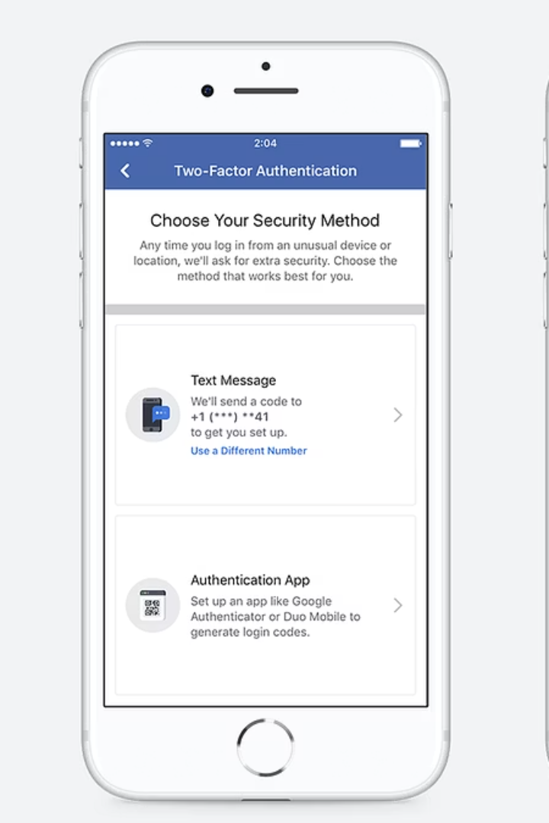

How to Turn On 2FA (Two-Factor Authentication) for Facebook
What is 2FA for Facebook?
Two-Factor Authentication (2FA) adds extra security to your Facebook account. Even if someone knows your password, they cannot log in without a special code sent to your phone or generated by an app.
by Ram N Java

Slide 2
Using 2FA When Logging In
What Happens When You Log In?
Why Use 2FA on Facebook?
First, enter your email or phone number and password.
It keeps your account safe from hackers.
Then enter the code sent to your phone or shown in your authenticator app.
It protects your photos, messages, and personal info.
It only takes a few minutes to set up but gives strong protection.

