Slide 1
DBMS COURSE PROJECT — REVIEW 1
College Club Event Management System
Phase 1: Problem Statement, ER Modeling, Relational Schema & 3NF Normalization
Presented by: Second Year CSE / IT
Database: Oracle Database 21c XE
Academic Year: 2026

Slide 2
REVIEW 1 • PROJECT CONTEXT
Introduction & Background
Campus Club Culture
• In engineering colleges, student clubs (Technical, Cultural, Sports, Literary) drive campus activities.
• Each club frequently organizes workshops, competitions, hackathons, and guest lectures throughout the year.
• Active student participation in clubs enhances practical skills and peer collaboration.
The Need for Automation
• Managing registrations across hundreds of students and multiple clubs manually is inefficient.
• Faculty coordinators struggle to verify student attendance and track club participation history.
• A well-structured relational database provides the ideal foundation to solve this campus-wide problem.

Slide 3
REVIEW 1 • WHY THIS PROJECT?
Problem Statement
Current Pain Points with Google Forms & Paper Sheets:
• Data Redundancy: Students re-enter their basic details (name, department, email) for every single event registration.
• No Duplicate Prevention: Students mistakenly register 2 or 3 times for the same event, throwing off seat count and budget.
• Past Event Registrations: Form links remain active even after an event concludes, accepting invalid registrations.
• No Centralized Member Tracking: Clubs have no automated way of knowing who their registered club members are vs outside attendees.
Proposed Relational Solution:
• Design a 3NF normalized database to store student and club data once, avoiding redundant entry.
• Enforce uniqueness and check constraints directly at the database engine level.
• Use procedural logic (triggers and procedures) to stop invalid event registrations before they enter tables.

Slide 4
REVIEW 1 • SCOPE OF WORK
Project Objectives & Scope
Key Objectives:
• Develop an Entity-Relationship (ER) model representing college clubs, students, events, and memberships.
• Translate the ER model into physical Oracle 21c DDL tables with primary, foreign, unique, and check constraints.
• Ensure the schema satisfies Third Normal Form (3NF) to eliminate insertion, deletion, and update anomalies.
• Implement business rules using Database Views, PL/SQL Stored Procedures, and Triggers.
• Build an intuitive web interface for students and club coordinators.
System Scope:
• Covers student onboarding, club member rosters, event scheduling, event registration, and analytical reporting.
• Designed to be deployable on a local university intranet or department server.

Slide 5
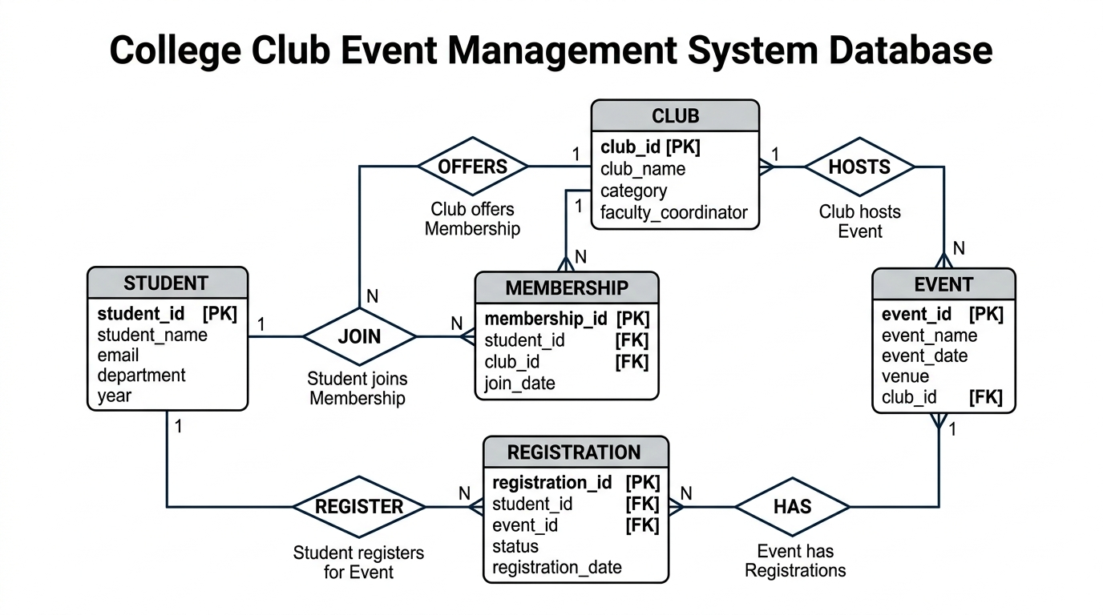
REVIEW 1 • CONCEPTUAL MODEL
Entity-Relationship (ER) Diagram
Relationship Summary:
• STUDENT joins CLUB: M:N relationship resolved by MEMBERSHIP entity.
• STUDENT registers for EVENT: M:N relationship resolved by REGISTRATION entity.
• CLUB hosts EVENT: 1:N relationship (One club hosts many events; each event belongs to one club).
• Total 5 relational entities designed in 3NF.

Slide 6
REVIEW 1 • DATA DICTIONARY
Entities & Attributes Breakdown
1. STUDENT
• Primary Key: student_id (PK, NUMBER) | Attributes: student_name, email (UNIQUE), department, year (CHECK 1-4)
• Purpose: Stores basic student profile.
2. CLUB
• Primary Key: club_id (PK, NUMBER) | Attributes: club_name (UNIQUE), category, faculty_coordinator
• Purpose: Stores official campus clubs.
3. EVENT
• Primary Key: event_id (PK, NUMBER) | Attributes: event_name, event_date, venue, club_id (FK -> CLUB)
• Purpose: Stores events organized by clubs.
4. MEMBERSHIP
• Primary Key: membership_id (PK, NUMBER) | Attributes: student_id (FK), club_id (FK), join_date
• Purpose: Associative entity linking Student & Club.
5. REGISTRATION
• Primary Key: registration_id (PK, NUMBER) | Attributes: student_id (FK), event_id (FK), status, registration_date
• Purpose: Associative entity recording event signups.

Slide 7
REVIEW 1 • RELATIONAL INTEGRITY
Database Constraints & Integrity Rules
1. Entity Integrity (Primary Keys)
• Every table possesses a surrogate Primary Key (e.g., student_id, event_id).
• Defined with GENERATED BY DEFAULT AS IDENTITY in Oracle 21c to prevent duplicate or NULL keys.
2. Referential Integrity (Foreign Keys)
• Foreign keys connect child tables to parent tables (e.g., club_id in EVENT references CLUB(club_id)).
• Configured with ON DELETE CASCADE: Deleting a club cleanly purges its associated events and memberships without orphaned records.
3. Domain Integrity (Check Constraints)
• STUDENT.year: CHECK (year BETWEEN 1 AND 4) restricts year to valid undergraduate levels.
• REGISTRATION.status: CHECK (status IN ('REGISTERED', 'CANCELLED', 'ATTENDED')) prevents invalid text.
4. Uniqueness Rules (Unique Constraints)
• STUDENT.email: Marked UNIQUE so duplicate student profiles cannot be created.
• MEMBERSHIP: UNIQUE(student_id, club_id) prevents a student from joining the same club twice.
• REGISTRATION: UNIQUE(student_id, event_id) prevents double-booking the same event.

Slide 8
REVIEW 1 • THEORY & NORMALIZATION
Normalization Justification (1NF → 2NF → 3NF)
1NF (First Normal Form) — Elimination of Repeating Groups
• Every column in every table contains single, atomic (indivisible) values.
• We do not store a student's multiple events as a comma-separated list like 'Hackathon, RoboWars'.
• Every row has a defined Primary Key.
2NF (Second Normal Form) — Elimination of Partial Dependencies
• The schema satisfies 1NF.
• No non-key attribute depends on a proper subset of a composite candidate key.
• In MEMBERSHIP and REGISTRATION, surrogate PKs are used; non-key columns depend on the entire key.
3NF (Third Normal Form) — Elimination of Transitive Dependencies
• The schema satisfies 2NF.
• No non-key attribute functionally determines another non-key attribute (X → Y where neither is superkey).
• Example: EVENT only stores club_id. Details like club_name and coordinator stay exclusively in CLUB.
• Example: REGISTRATION only stores student_id and event_id. Student names and event venues are never duplicated.

Slide 9
REVIEW 1 • MILESTONES
Review 1 Summary & Roadmap for Review 2
Accomplished in Review 1:
✔ Clear real-world problem statement and campus club domain analysis.
✔ Complete Entity-Relationship (ER) diagram with correct cardinalities and associative entities.
✔ 5 DDL tables designed with comprehensive constraints (PK, FK, UNIQUE, CHECK).
✔ Mathematically verified 3NF normalization justification.
Target Deliverables for Review 2:
➤ Deploy database on Oracle Database 21c XE with sample data (10 students, 5 clubs, 10 events).
➤ Build 2 Database Views (event_registration_count, club_member_list).
➤ Implement PL/SQL Stored Procedure (register_student_for_event) & Database Trigger.
➤ Build and demonstrate full working web application using Python 3 + Flask.

Slide 10
Thank You!
Review 1: Concept, ER Model & Schema Design
Open for Questions & Suggestions

