Slide 1

Machine Learning Consumer Loan Processing
Ram Rao
July 15, 2022
DSA 5900 Practicum

Slide 2



Project Definition
Identify Credit-Worthiness of Loan Applicants at Financial Institutions
Apply Machine Learning Models to Evaluate whether Applicants will default on a Loan
Implement a Process for Remote Machine Learning
Distributed System Training
Aggregation and Testing on Server
Stakeholders:
Agencies that Process Consumer Loans
Dr. Radhakrishnan and Dr. Trafalis are my advisors

Slide 3

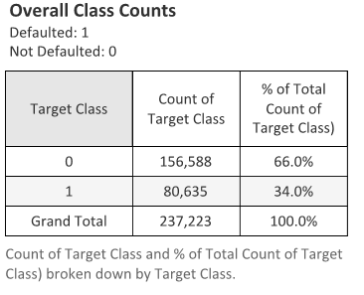




Data Ingestion
Data Source:
https://www.bondora.com/en/public-reports
Tableau, Python, Scikit Learn, Tensorflow/Keras,
PyTorch and PySft
No of Features
111 Predictor Variables
1 Target Variable
Defaulted : 1
Non-Defaulted : 0
Tableau : Data Viz
Python: Data Processing
Sckit Learn: ML Models
Tensorflow/Keras: Neural Net
PyTorch, PySft: Remote ML

Slide 4

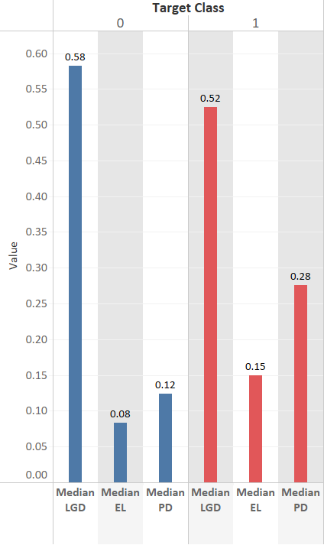
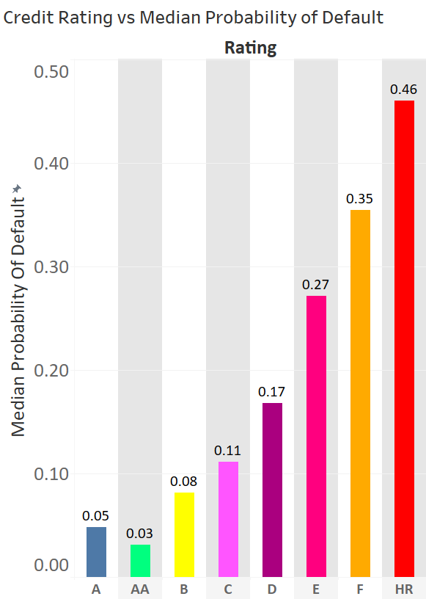
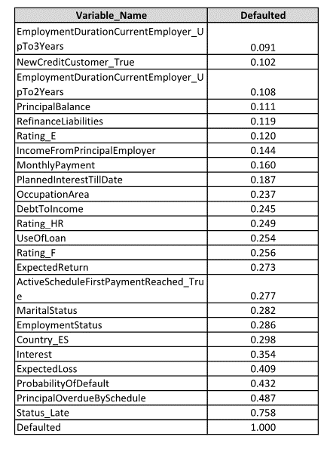
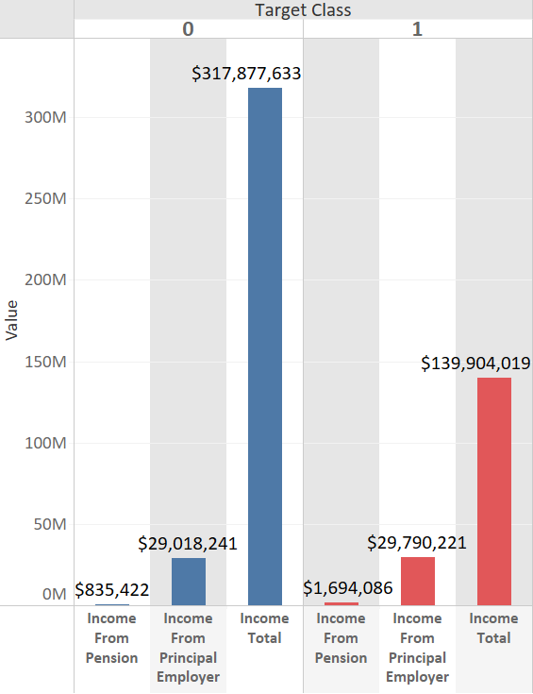
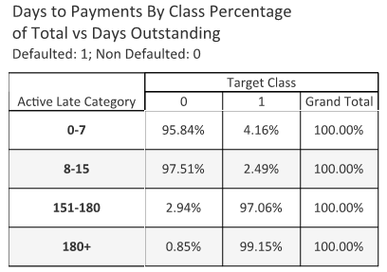
Data Exploration and
Preparation - 1
Correlation Coefficient
Exploratory Analysis:
Lower Default
Higher Income
Lower Interest Servicing
Better Credit Rating
Higher Previous Credit
Lower PrincipalOverdue
Higher Education
More Prompt Payment
No Significant Multicollinearity
Correlation Not High Between Predictor and Target

Slide 5
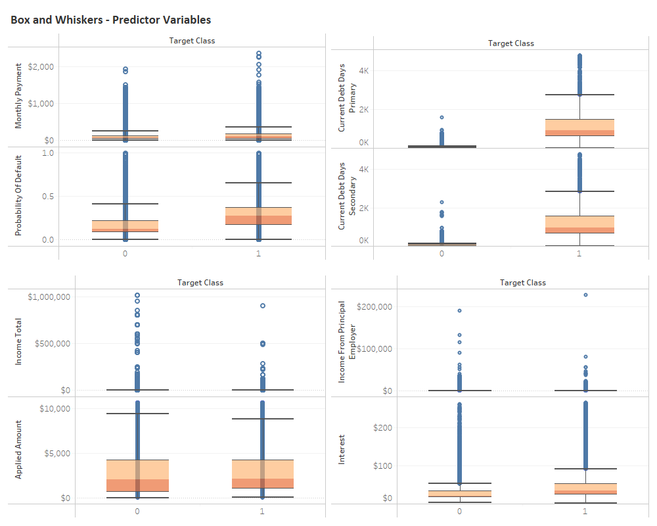
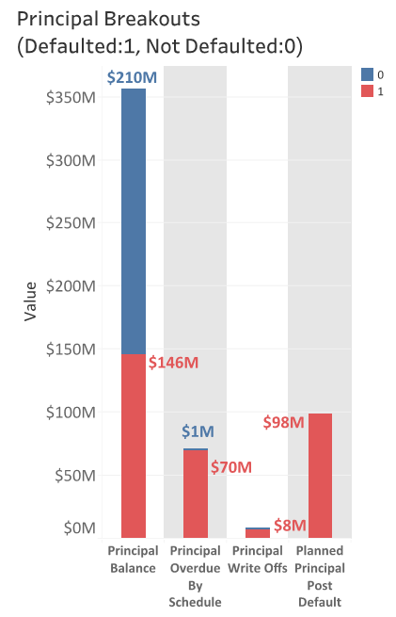
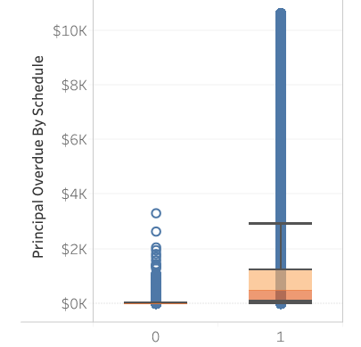
Data Exploration and Preparation - 2
Exploratory Analysis:
Higher Default
Higher Principal Overdue
Higher Spread and Max for Target Class 1
Probability of Default
Debt Types
Interest Servicing
Principal Overdue
No Significant Differences Between Classes
Applied Amount
Income Types

Slide 6
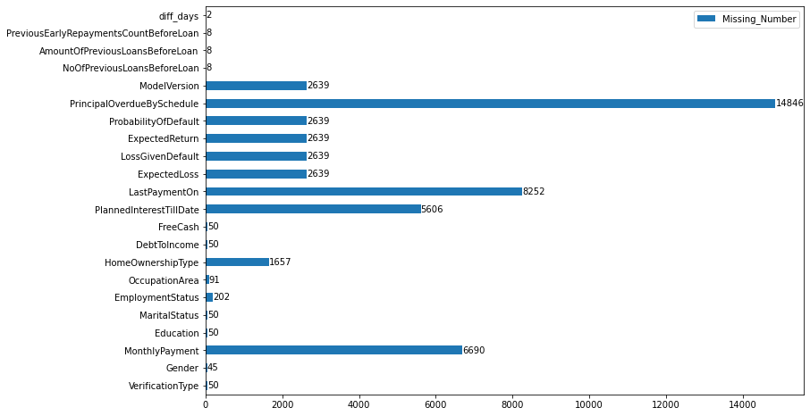
Data Exploration and
Preparation - 3
Exploratory Analysis:
Missing Value Handling
Removed Categorical Variables with No Numerical Value
Removed Variables with more than 10 pct Missing
Removed Variables Populated Following Default
Removed Rows with Missing Values for Surviving Features
Scaled Continuous Variables
One Hot Encoded Categorical Variables
PRIOR BELIEFS
No. of Missing Values, Surviving Features
Data Cleansing
Final Dataset Breakdown
Dataset ID | No of Features
Original Dataset | 112
Final Dataset | 59
Final Dataset, Following Scaling and Hot Encoding | 72
Target Class | Count of Target Class | % of Total Count of Target Class
0 | 137,895 | 65.28%
1 | 73,345 | 34.72%
Total | 211,240 | 100.00%

Slide 7
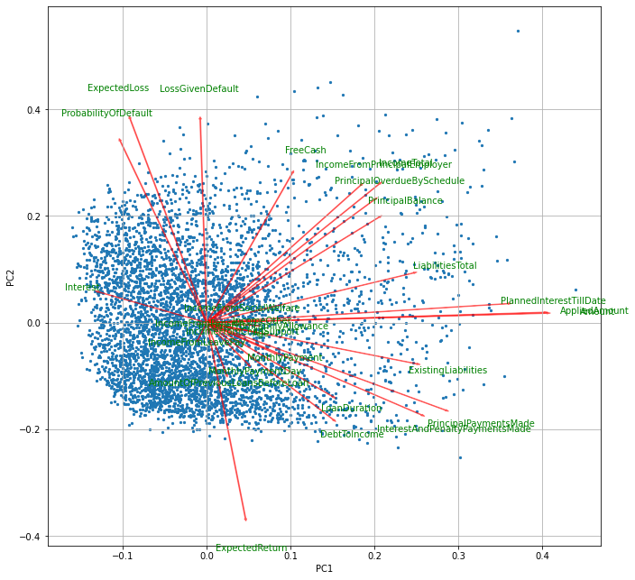
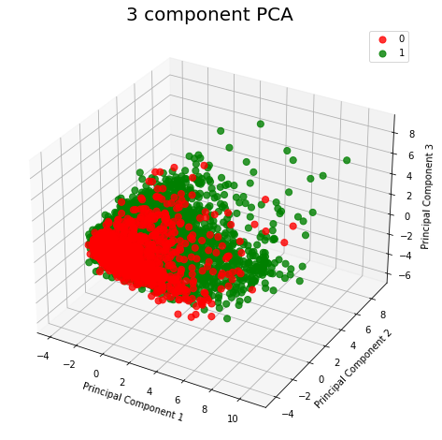
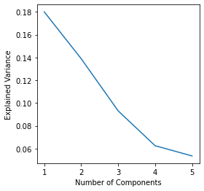
PCA Assessment
PCA Analysis:
5,000 Dataset Points Analyzed
No of Continuous Variables Scaled and Transformed: 28
Limited Variance Explained by 5 Components
No Significant Separation Between Classes Observed from PCA 1, 2, and 3
Bi Plot shows Explanation of Few Features from PCA 1 and 2
<50% Explained
PCA Not a Significant Benefit to Model Predictability, Categorical Count Outweighs Continuous Variables

Slide 8
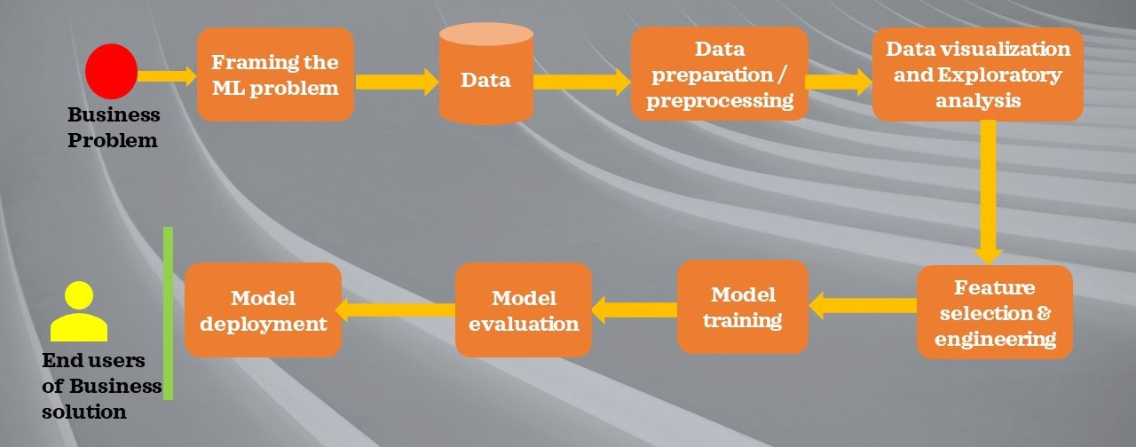
Modeling Preprocessing And Overview
Preprocessing with Sckit-Learn
Scaled Continuous Variables
One hot encoded Categorical Variables
Modeling, Training/Testing
Sckit Learn
Tensorflow Keras
Default
GridSearch CV Optimization
Remote Machine Learning – PyTorch and PySft
Sckit-Learn Metrics for Evaluation

Slide 9
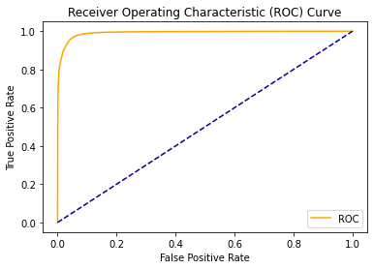
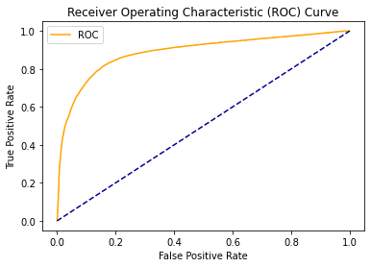
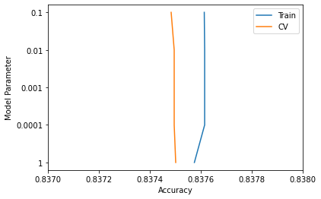
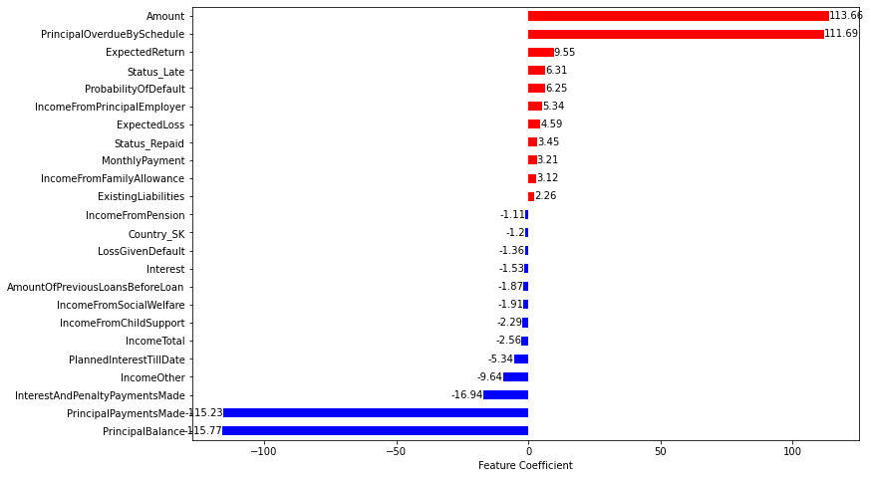
Model Results - Logistic
Regression and Naïve Bayes
Logistic Regression:
Grid Search 5-Fold CV
200 Iterations
Hyperparameters
Penalty: L1 and L2, Elasticnet
C : 1, 5, 10
Solver, lbfgs, liblinear and saga
L1_ratio: 0.2, 0.6
Naïve Bayes:
Grid Search 5-Fold CV
Hyperparameters
Alpha: 1E-4, 1E-2, 1E-1, and 1
AUC = 0.951
AUC = 0.818
Naïve Bayes
CV Results
Logistic Regression
Naïve Bayes
Logistic Regression | Class 0 Predicted | Class 1 Predicted
Class 0 Actual | 26,280 | 907
Class 1 Actual | 928 | 13,687
Naïve Bayes | Class 0 Predicted | Class 1 Predicted
Class 0 Actual | 24,283 | 2,904
Class 1 Actual | 3,762 | 10,853
Logistic Regression

Slide 10
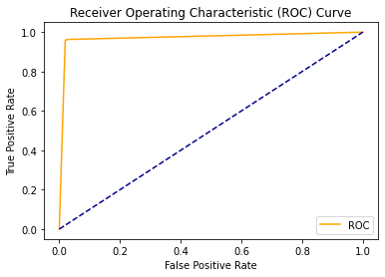

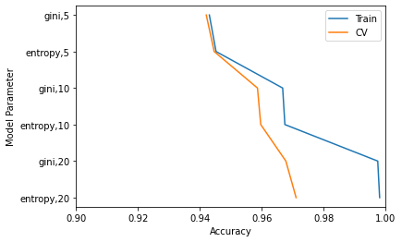
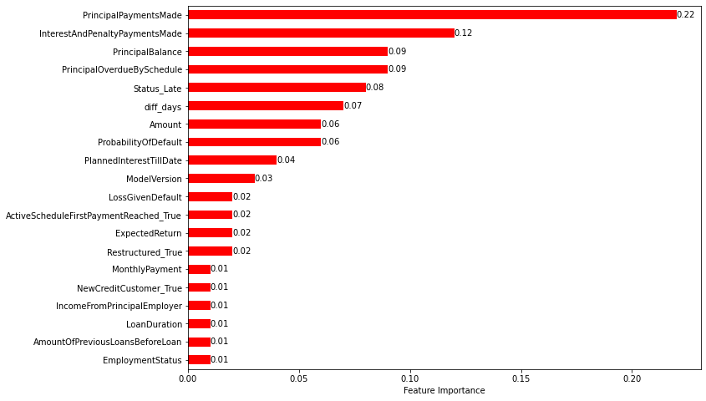
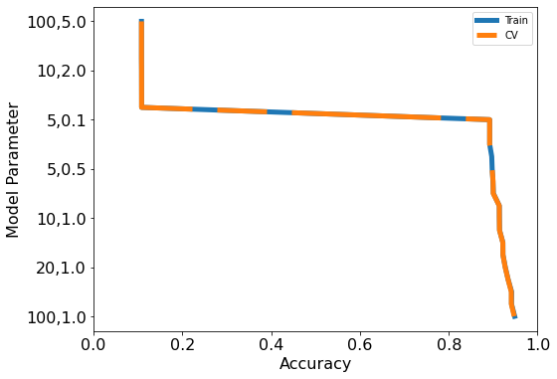
Model Results - Decision Trees and Ensemble Forest
Decision Trees:
Grid Search 5-Fold CV
Hyperparameters
Criterion : gini, entropy
Max_depth : 5, 10, 20
Ensemble Forest:
Grid Search 5-Fold CV
Hyperparameters
N_estimators: 5,10,20, 50, 100
Learning_Rate: 0.1, 0.5, 1.0, 2.0, 5.0
AUC = 0.970
AUC = 0.939
Decision Trees
Ensemble Forest
Decision Trees | Class 0 Predicted | Class 1 Predicted
Class 0 Actual | 26,663 | 554
Class 1 Actual | 591 | 14,024
Ensemble Forests
Decision Trees
CV Results
Ensemble Forest | Class 0 Predicted | Class 1 Predicted
Class 0 Actual | 26,238 | 949
Class 1 Actual | 1,276 | 13,339
Ensemble Forests
CV Results
Adaboost boosts a Weak Decision Tree Classifier of Max_Depth = 1

Slide 11
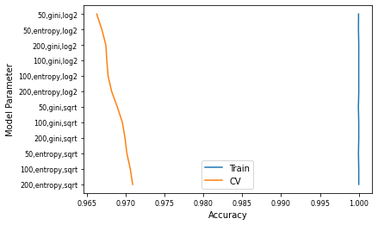
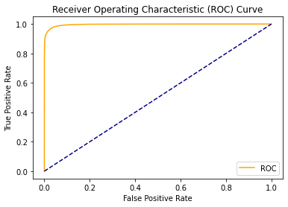

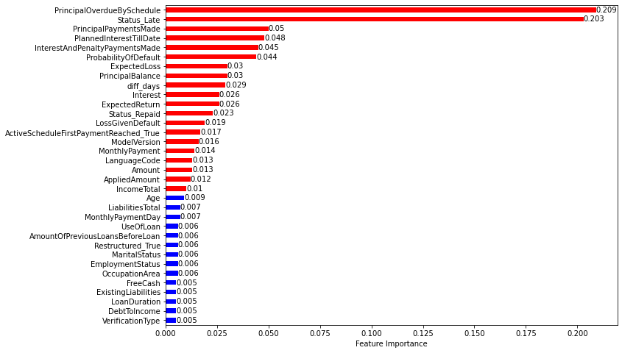
Model Results Random Forest
Random Forest:
Grid Search 5-Fold CV
Criterion: gini
Max_depth: None
Hyperparameters
N_estimators: 50, 100, 200
Criterion: gini, entropy
Max_features: sqrt, log2
Random Forests
CV Results
AUC = 0.966
AUC = 0.964
Random Forest w/Tuning
Random Forest w/o Tuning
Random Forest w/Tuning
41.2% Importance from:
1) PrincipalOverdueBySchedule
2) Status_Late
Random Forest | Class 0 Predicted | Class 1 Predicted
Class 0 Actual | 26,854 | 333
Class 1 Actual | 826 | 13,789
Random Forest w/Tuning

Slide 12
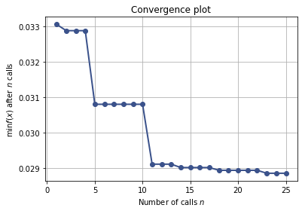
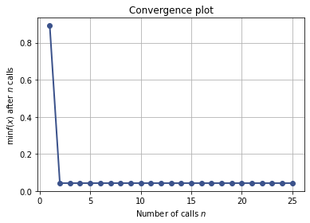
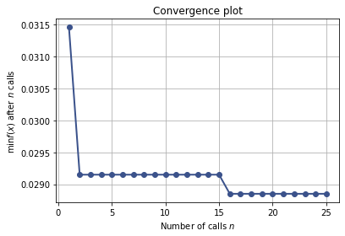
Tree, Boosted Weak Tree, Random Forest Bayesian Optimization
Bayesian Optimization:
Scikit –Optimize
Gaussian-Minimize Function
Objective Function
1-Accuracy
Surrogate Function
Multivariate Gaussian
Acquisition Function
LCB/EI/PI
25 Iterations, 5-Fold CV
Best Result from Search Space Found
Search Space
Criterion: [Gini, Entropy]
Min_samples_split: [2,5]
Max_Depth: [5,20]
Search Space
N_estimators: [5,200]
l_rate: [0.1, 5]
Search Space
Criterion: [Gini, Entropy]
Max_Features: [sqrt, log2]
N_estimators: [50,300]
Criterion: Entropy
Min_samples_split: 5
Max_Depth: 20
N_estimators 196
l_rate: 1.625
Criterion: Entropy
Max_Features: sqrt
N_estimators: 300
Decision Tree – BO Results (1-Accuracy) vs No. of Iterations
Ensemble Forest – BO Results (1-Accuracy) vs No. of Iterations
Random Forest – BO Results (1-Accuracy) vs No. of Iterations
Random Forests | Class 0 Predicted | Class 1 Predicted
Class 0 Actual | 26,842 | 345
Class 1 Actual | 816 | 13,799
Performance Similar to Gridsearch CV
Search Space Uniform to Log Uniform Sampling within Provided Bounds for Integer/Real and from Provided List for Categorical
Less Expensive And Results could be Better and Reduce Underfitting Depending on Training Set

Slide 13
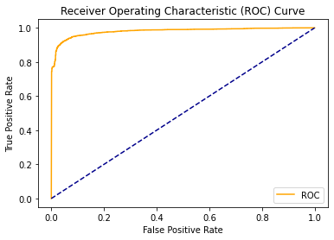
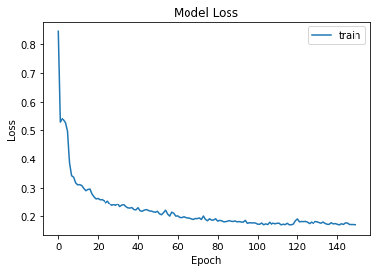
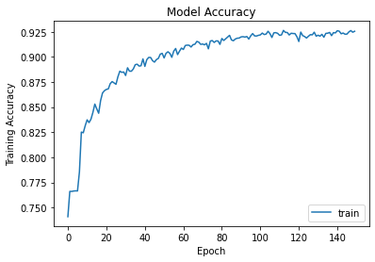
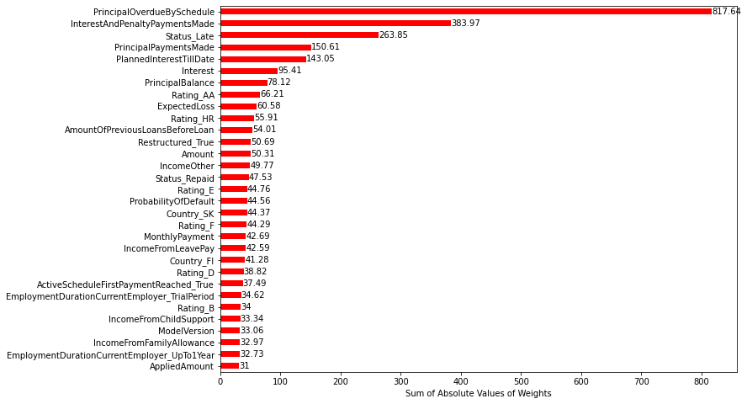
Model Results - Neural Nets, Keras/Tensorflow
Neural Net:
3 Hidden Layers: 100, 50, and 25 Neurons, Relu Activation
1 Output Layer, 1 Neuron, Sigmoid Activation
Grid Search CV = 3
Hyperparameters
Optimizer: rmsprop, adam
inits: glorot_uniform, normal, uniform
Epochs: 50, 100, 150
Batches: 5, 20
Training Errors
Training Accuracy
AUC = 0.980
Neural Network
Neural Net | Class 0 Predicted | Class 1 Predicted
Class 0 Actual | 630 | 308
Class 1 Actual | 44 | 3,018
Neural Network with Tuning

Slide 14


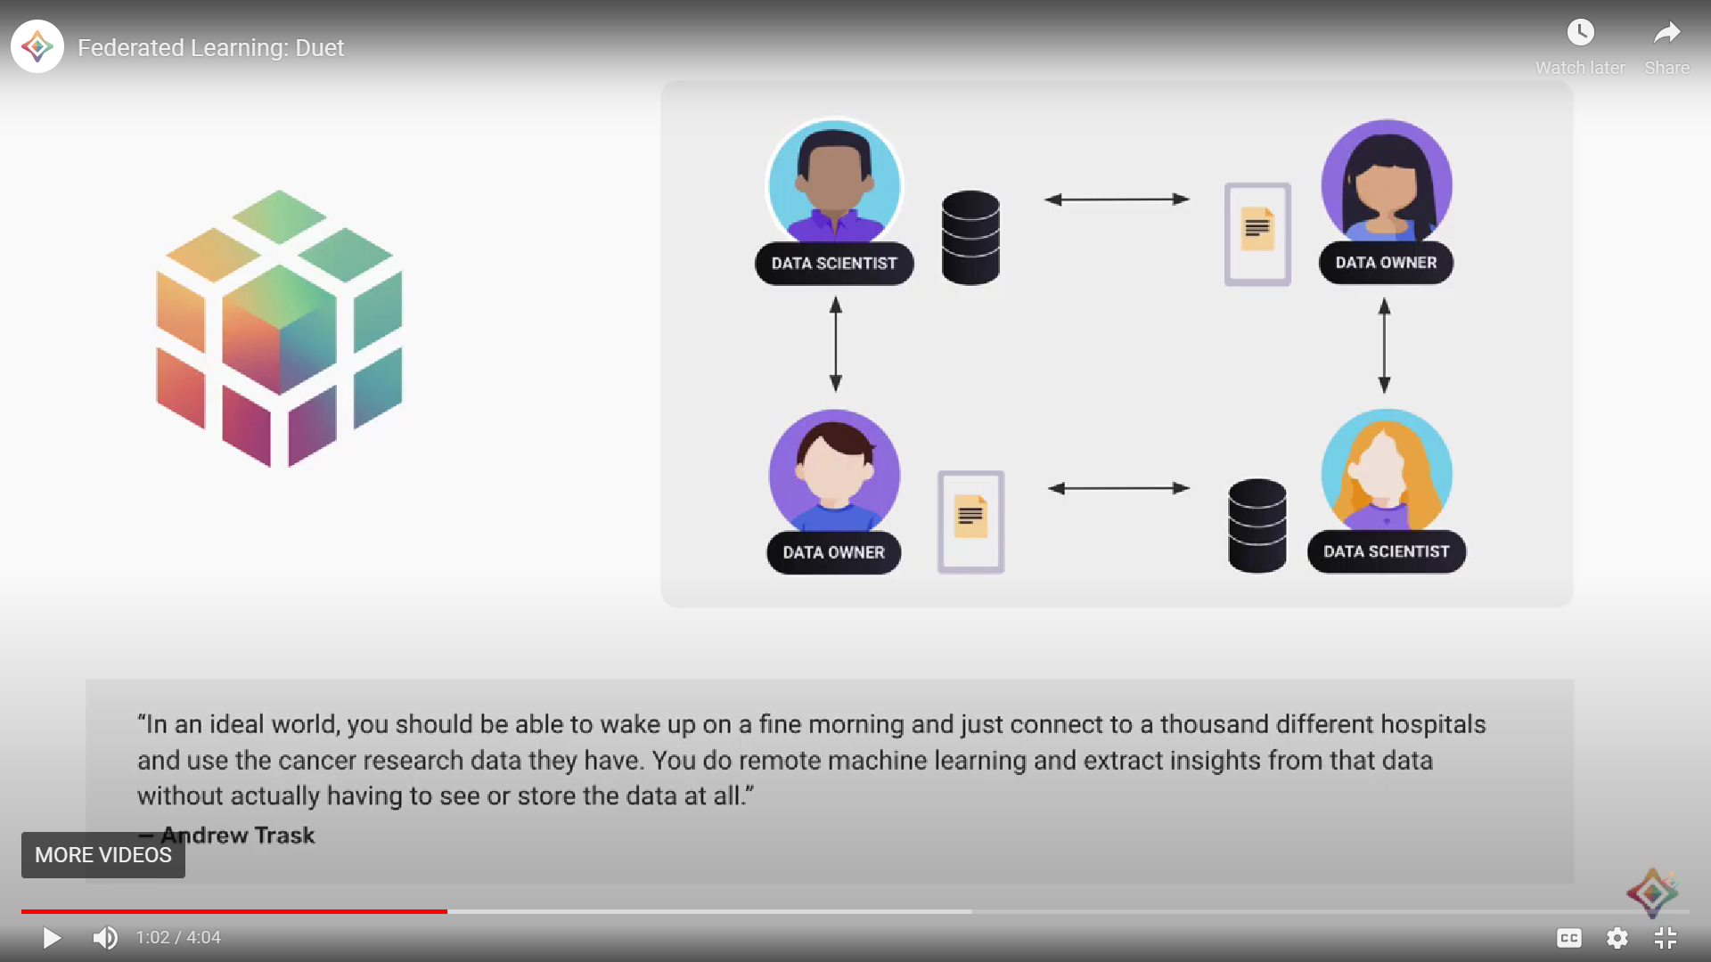
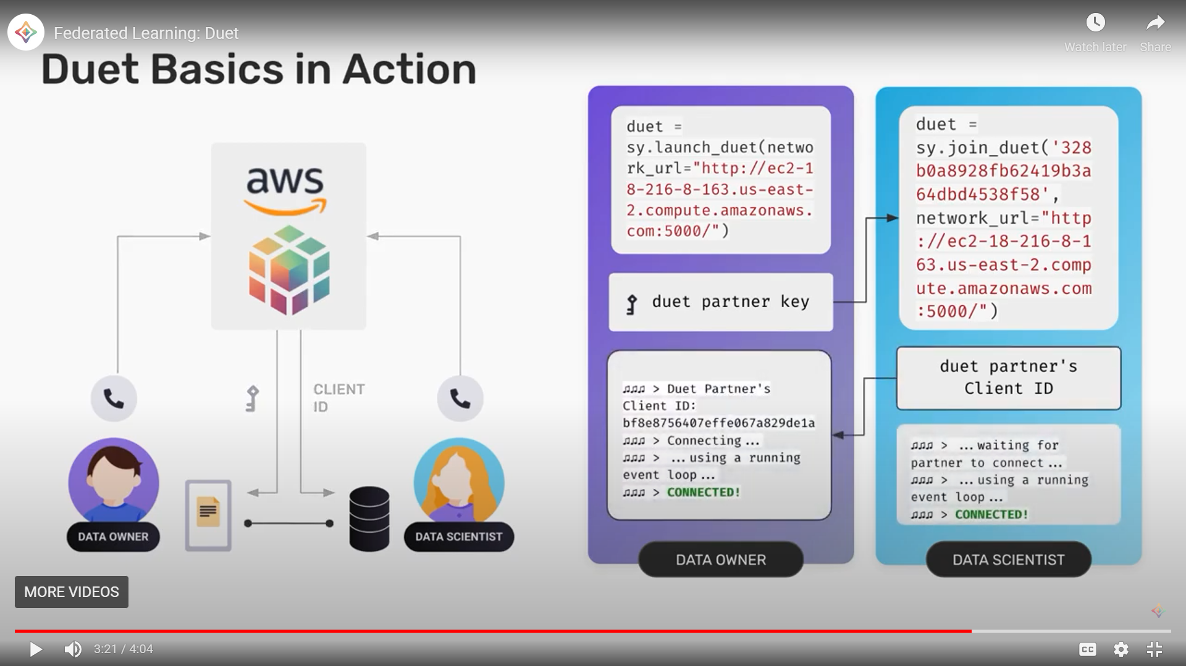
Remote Machine Learning - Overview
Why Useful?
Keeps Data Private
Data Owner has Control Over Data
Machine Learner Benefits from Access to Distributed Data
Process?
PySft Wrapper to ML Package
Encryption and Privacy Maintained
Machine Learner Can Access Multiple Data Sources Simultaneously
Models Trained Remotely and can be Aggregated for Use

Slide 15
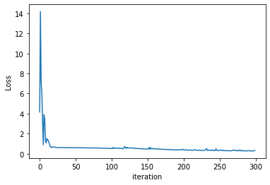
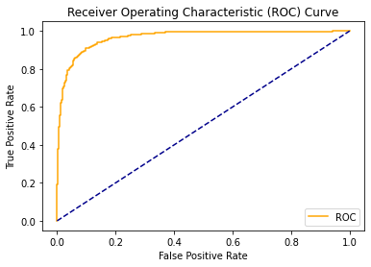
Remote Machine Learning –PyTorch/PySft Results
Remote Learning Process:
Data Owner/Data Scientist interact via PySyft and PyGrid/AWS
Data Owner sends data to Data Scientist
Data Scientist makes requests via Pysft to Data Owner
Data Scientist creates model
Data Scientist sends model to Owner
Training on Remote Server
Model Sent to Data Scientist Once Trained
Data Scientist Tests Model – Sckit Learn Packages
PyTorch and PySft:
3 Hidden Layers: 100, 50 and 25 Neurons, Relu Activation
1 Output Layer, 2 Neurons, Log_soft_max Activation
300 Epochs
Optimizer: Adam
learning_rate = .01
nn.functional.nll_loss
Training Errors
PyTorch/ PySft | Class 0 Predicted | Class 1 Predicted
Class 0 Actual | 1,262 | 99
Class 1 Actual | 97 | 632
AUC = 0.966

Slide 16
Model Evaluation – Performance Metrics
 | Best Hyperparameters | RMSE | Accuracy | Precision | Recall | F_1Score | AUC
Logistic Regression | L1 Penalty, liblinear Solver, C =5 | 0.209 | 0.956 | 0.938 | 0.936 | 0.937 | 0.951
Naïve Bayes | Alpha = 1.0 | 0.399 | 0.841 | 0.789 | 0.743 | 0.765 | 0.818
Decision Tree | Criterion – entropy, Max_depth = 20 | 0.166 | 0.973 | 0.962 | 0.960 | 0.961 | 0.970
Ensemble Forest, Boosts DT of Max_Depth: 1 | N_estimators= 196 l_rate = 1.625 | 0.199 | 0.960 | 0.950 | 0.936 | 0.943 | 0.954
Random Forest | N_estimators = 200, Criterion – entropy, Max_ features = sqrt | 0.163 | 0.972 | 0.976 | 0.943 | 0.960 | 0.966
Neural Net – Keras/Tensorflow | Batch_size = 5, epochs=150, init- glorot_uniform, optimizer= adam | 0.249 | 0.912 | 0.907 | 0.986 | 0.945 | 0.980
Neural Net - PyTorch | Not Applicable | 0.306 | 0.906 | 0.865 | 0.867 | 0.867 | 0.966

Slide 17
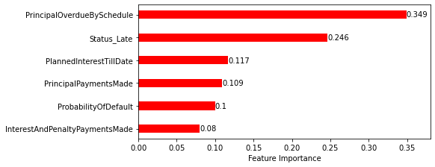
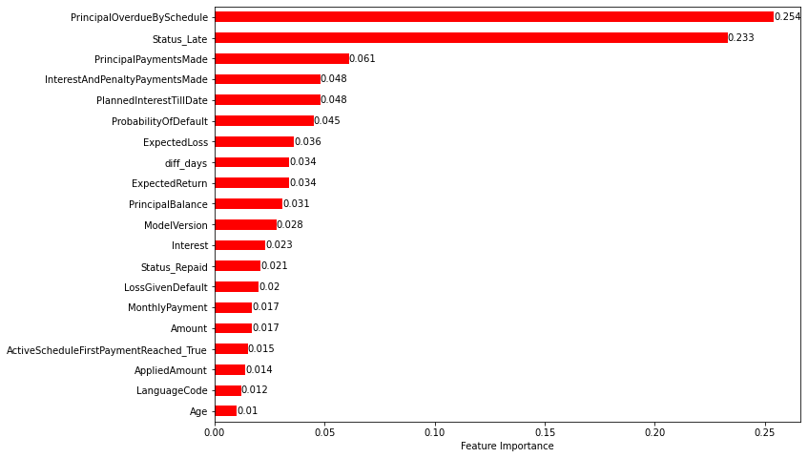
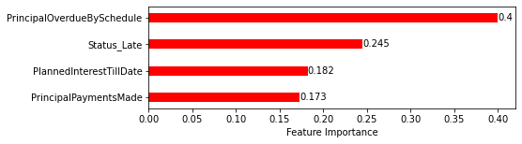
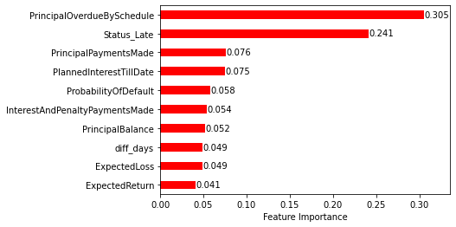
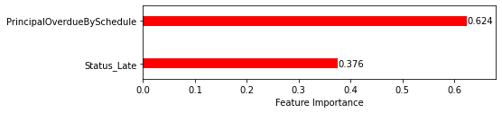
Reduced Features – Random Forest
Hyperparameters:
Criterion: Entropy
N_estimators: 300
Max_Features: sqrt
20 Feature Model
6 Feature Model
Accuracy: 0.969
Precision: 0.969
Recall: 0.941
F_1 Score: 0.955
AUC: 0.962
BASE MODEL
Accuracy: 0.972
Precision: 0.976
Recall: 0.944
F_1 Score: 0.960
AUC: 0.966
Accuracy: 0.979
Precision: 0.981
Recall: 0.960
F_1 Score: 0.970
AUC: 0.975
4 Feature Model
Results:
No Loss in Prediction Power for 10 & 20 Feature Relative to Base Model
More Interpretable than Base Model
Model Predictability Not as Good for 6, 4 & 2 Feature Models
Feature Importance
Accuracy: 0.937
Precision: 0.936
Recall: 0.879
F_1 Score: 0.906
AUC: 0.923
10 Feature Model
Accuracy: 0.979
Precision: 0.982
Recall: 0.956
F_1 Score: 0.969
AUC: 0.973
2 Feature Model
Accuracy: 0.912
Precision: 0.921
Recall: 0.819
F_1 Score: 0.867
AUC: 0.891

Slide 18

Conclusions
All Models, Except Naïve Bayes, Provided Consistent Results – 5-Fold CV
Precision, Accuracy, Recall, and F1_Scores were all above 0.90
Random Forest and Decision Tree had best RMSEs of 0.163/0.166
Neural Nets with Tensorflow/Keras had best AUC of 0.980
3-Fold Grid Search CV was Trained on 10 Pct of Dataset as it was Expensive to Train on Full Dataset
Remote (Federated) ML with PyTorch/PySft Provided Good Results
Performance Similar to Other Models
Can be Trained Remotely on Multiple Distributed Systems and Model Results can be Aggregated on Server for Testing
Smaller Feature Set Models
Random Forest; Comparison with Base Model – 71 Input Features
No Loss in Prediction Power, 20 & 10 Input Feature Models; More Interpretable
Predictive Power Less Reliable, 6, 4, & 2 Input Feature Models
This Photo by Unknown Author is licensed under CC BY

Slide 19

Questions

