Slide 1
Premiere Event Planner (POC)
Presented by-
Tasleem banu(3BR22EC174)
B Saniya(3BR22EC022)
T Vikas(3BR22EC172)
Hindu(3BR22EC113)
Under the guidance of: Sasankan sir

Slide 2
Premiere Event Planner(POC) It allows user to manage events and celebrities
This Python code defines classes for an event planner system, allowing users to manage events and celebrities. It includes functionality to add, view, update, and delete events, as well as celebrities. The Event Planner class is abstract, defining methods that must be implemented by subclasses. The Celebrity Manager class manages the list of celebrities, allowing addition, update, deletion, and viewing. The Event PlannerImpl class implements the Event Planner interface and provides methods to interact with the user, such as displaying options and handling user choices. The code includes a main loop to continuously prompt the user for actions until they choose to exit. Overall, it's a basic framework for an event planning application in Python.

Slide 3
Problem statement:
Premiere Event Planner (POC):
• CRUD: Premiere events.
• organize_movie_premieres(premiere_id):
Organize and manage movie premiere events.
•coordinate_celebrity_appearances(appearance_id):
Coordinate appearances and logistics for celebrities.

Slide 4
OUTPUT MENU:
Add Event
View Event
Update Event
Delete Event
Add Celebrity
Update Celebrity
View Celebrity
Delete Celebrity
Exit

Slide 5
ADD Event The add_event method prompts the user for event details (name, date, and number of celebrities), displays the list of available celebrities, and allows the user to select the desired celebrities for the event.
VIEW Event
The view_events method displays the list of upcoming events along with their details (date and guest celebrities).

Slide 6
UPDATE Event: The update_event method prompts the user for the name of the event to update, and if found, calls the add_event method to update the event details. It updates an existing event by deleting the old one and adding new one.
DELETE Event
The delete_event method prompts the user for the name of the event to delete, and if found, removes the event from the events dictionary.
In short it deletes an existing event

Slide 7
ADD celebrity
The add_celebrity method makes the user to add new celebrity name
In short this method adds a new celebrity to the list
UPDATE celebrity
The update_celebrity method allows the user to update the celebrity name in the list provided with new name.
It also updates an existing celebrity by deleting the old one and adding new one

Slide 8
VIEW Celebrity
The view_celebrity method allows user to check the celebrity list and read all the celebrity names
DELETE Celebrity
The delete_celebrity method allows user to delete the celebrity of their choice
Over all,the "Eventplanner" and "celebrityManager" classes provide a frame work for managing events and celebrities with "EventPlannerImp1" implementing specific functionality for managing events interactively

Slide 9
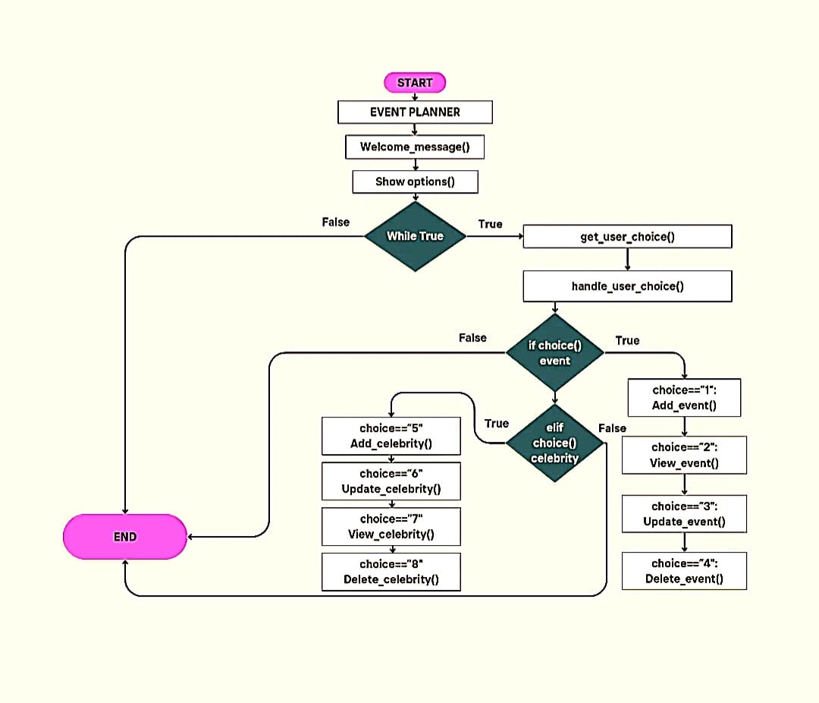
FLOW CHART

Slide 10
MAIN FUNCTION
#from abstractmethod import EventPlanner, CelebrityManager from premiere_event_planner1 import EventPlannerImpl # Example usage: planner = EventPlannerImpl() planner.welcome_message() while True: planner.show_options() choice = input(“Enter your choice: “) planner.handle_user_choice(choice)

Slide 11
Thank you

