Slide 1


SMART INDIA HACKATHON 2026
Problem Statement ID – SIH26131
Problem Statement Title - Early detection and management of crop diseases and pest infestations
Theme – Agriculture ,Food Tech & Rural Development
PS Category - Software
Team ID - 166880
Team Name (Registered on portal) - RAVEN ROOTS

Slide 2


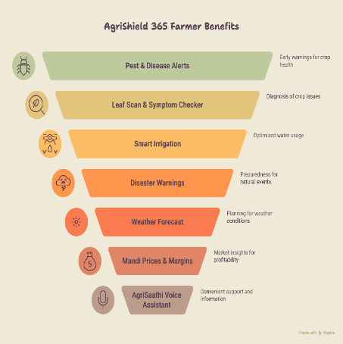
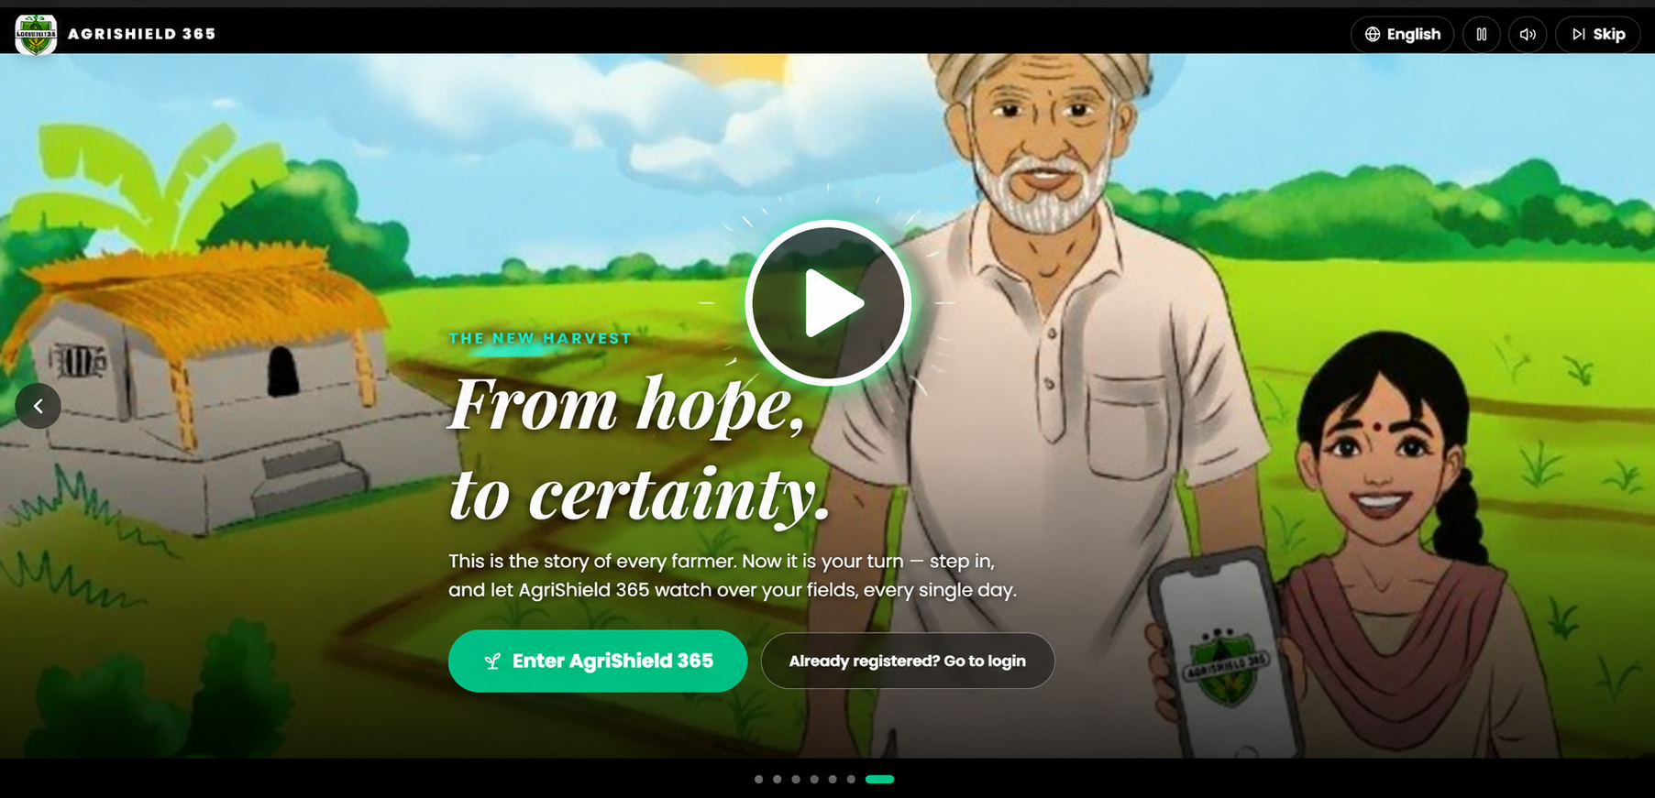


AGRISHIELD 365
Your Team Name
Every Farmer, Every Season , Protected
Solution Mechanics: How It Solves the Problem
SERVICES for our Farmer’s benefits
Brief Walkthrough of Problem and how AgriShield-365 solve it
Uniqueness of AGRISHIELD-365
1) Preventive, not Reactive (Predicts future in place of waiting for it)
2) Two-Brain Architecture(Local + cloud brain)
3) Offline-first farmer safety (PWA first priority)
4) Multi-lingual and farmer first design
5) Smart irrigation with crop science (Jal-Rakshak Module)
6) Market awareness included
7) Explainable advisories (Doesn’t just say ‘high risk’ , it explains why )
Scan 👍
Live App Link :- https://agrishield365.web.app/ YouTube Video Link :- https://youtu.be/tJPDBoMmfGI (Full Detailed Walkthrough)

Slide 3

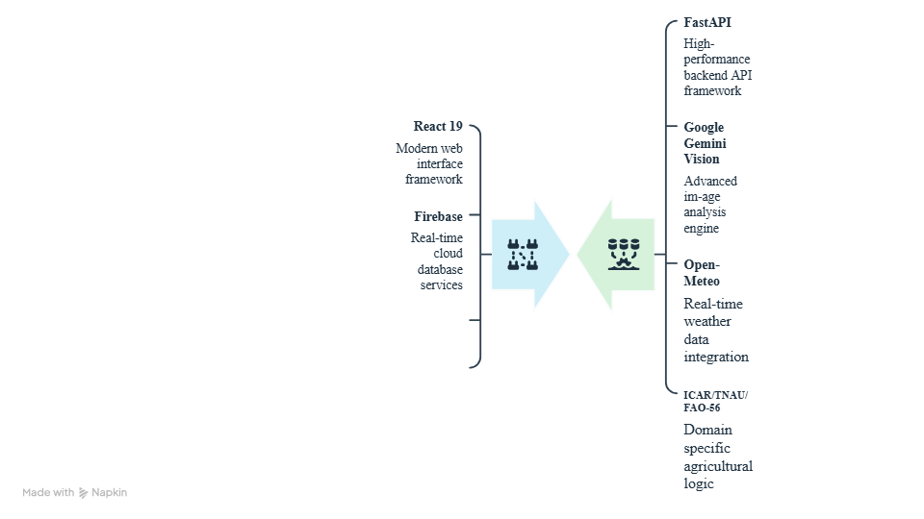
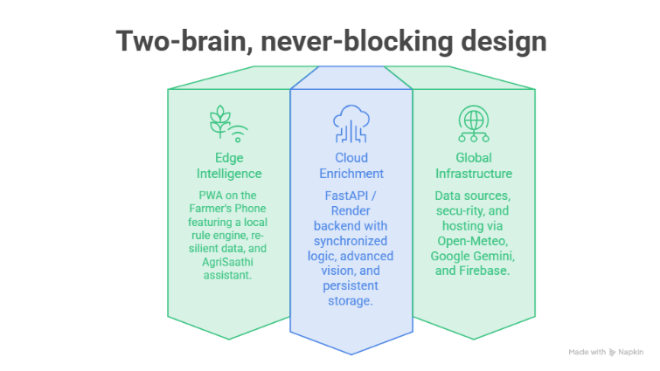
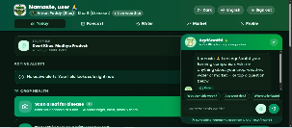

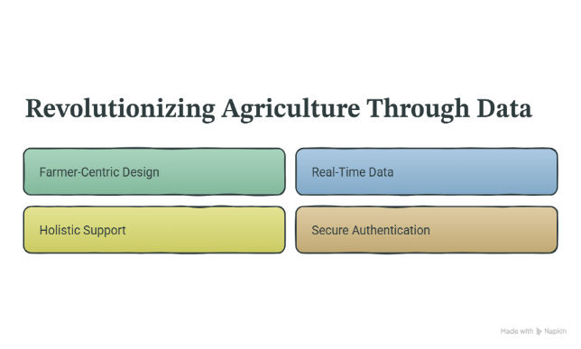
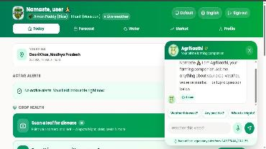
TECHNICAL APPROACH
Your Team Name
TECHNICAL APPROACH
Methodology and Implementation Process with Tech Stack
Two Brain, Never Blocking Design
Dark Themed Dashboard
Data flows through emerald and navy dashed paths, connecting real-time weather from Open- Meteo and domain logic from ICAR/TNAU/FAO-56 to provide a seamless agricultural monitoring experience.
Revolutionizing Agriculture Through Data
Light Themed Dash-board

Slide 4














Your Team Name
FEASIBILITY AND VIABILITY
Feasibility & viability of the idea, with strategies to overcome challenges
          Turning Data into Action ● Supporting Farmers ● Building a Sustainable Future
FEASIBILITY
CHALLENGES → STRATEGIES
AGRISHIELD 365 BUSINESS MODEL
Patchy village internet
Reuses Free Infrastructure
Firebase, Open-Meteo & PWA hosting
→
Offline-first PWA; cloud only enriches
4 Revenue Streams
Free core alerts for every farmer, funded by premium, B2G, B2B & fintech partners
Scalable
Same app serves one farm or a whole district
Cost-Effective
Minimal running cost per farmer
Cloud AI quota / cost
→
Local engine + offline symptom checker never depend on Gemini
Authority-Ready
Built for agriculture departments & insurers
Low digital literacy
B2C Freemium
Free core alerts; AI leaf scan & premium voice/SMS alerts at ₹99/month
B2G & Insurance
Verifies PMFBY claims & water audits — rapid validation of genuine crop-failure claims
VIABILITY
→
4 languages, voice read-aloud + voice questions
Proven Concept
Working live app with real farmer flows
Advice trust
→
ICAR/TNAU/FAO grounding + KVK disclaimer
Builds Public Trust
Advice grounded in ICAR/TNAU/FAO
B2B Agribusiness
Anonymised disease-outbreak heatmaps to pre-position organic bio-fungicides
Fintech Partners
Micro-credit scoring; low-interest crop loans for farmers with crop-loss history
Accountability
Verifiable alerts and claim records
SMS needs billing
Engagement
Story onboarding, voice & local languages
→
Premium voice/SMS alerts funded via ₹99/month plan

Slide 5
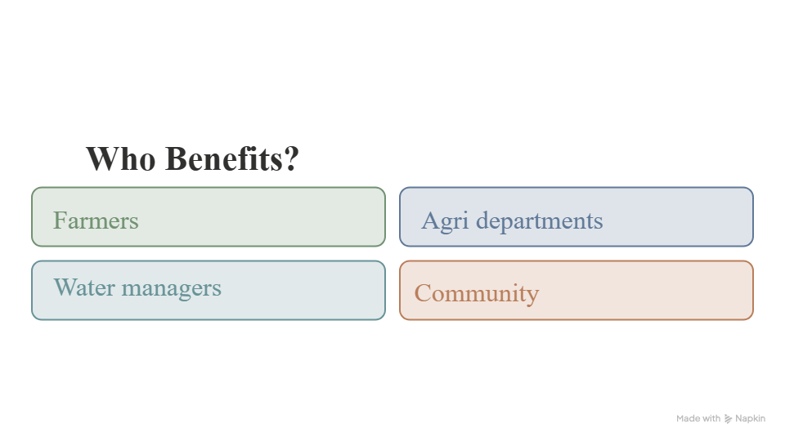





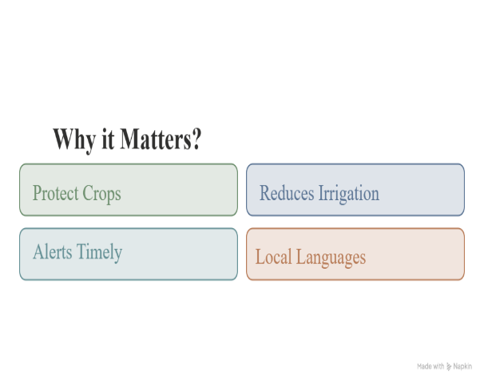


IMPACTS AND BENEFITS
AgriShield365 — the Boon of 21st-century India Estimates grounded in CICR, FAO-56, IMD/TNAU
Scan to use
POTENTIAL IMPACT ON INDIA'S AGRICULTURE
Farmers
Agri-Departments
Water Managers
Community
Protect Crops
Reduces Irrigation
Alerts Timely
Local Languages
KhetiScan — Geospatial Canopy Surveillance
Satellite NDVI/NDWI (Sentinel-2 / Landsat) spots pest-attacked & waterlogged zones across whole districts before field visits.
Smart Technology.
Safer Crops.
Sustainable Future.
BREAKTHROUGH
Major Future Plan

Slide 6










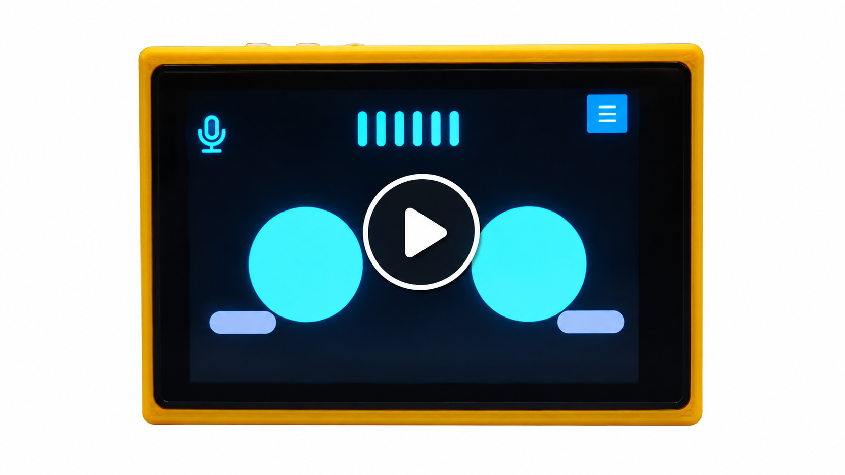
RESEARCH AND REFERENCES
Your Team Name
AGRISHIELD-365 is built upon these primary research sites and references
Pillars of
Gov. of Maharashtra (Agriculture Dept.)
mainly used for cotton-related research
Open Meteo API- Research for Weather Data
JalRakshak-Smart Irrigation
(acts as “The Water Protector”)
AgriSaathi- AI Assistant
(turns app into a conversation)
ICAR-
Research for all 3 crops in details
TNAU- Research for 8 diseases of all 3 crops
FAO- Research for Kc values
Report Link:
https://docs.google.com/document/d/12EoHv-kmXrN7Ubei2lQQ972usTdcUed9/edit?usp=sharing&ouid=105708397499206098346&rtpof=true&sd=true
Introducing LILLY : Our AGRISHIELD-365 deployed as Smart Farming Assistant
YouTube video link: https://youtu.be/a5vdY3kb6ZQ
Why hardware as a “Future plan” in a Software project ?
a) 24×7 –It works all day all night relentlessly.
b) his plot's data — sensors measure your field's leaf wetness, soil, canopy — not district-level downloaded weather
c) Acts, not just advises — can hold the pump itself and verify every liter of water saved.

