Slide 1
DSCS 6030 Intro to Data Mining and Machine Learning
Nik Bear Brown
nik@ccs.neu.edu
Research Progress

Slide 2
Topics
Literature review
Datasets
Algorithms
Evaluation
-- precision and recall

Slide 3
What is research? Original Research
Identify a problem
Find out what others have done
Develop a solution/twist/variant
Test your solution:
Works Better?
Interesting somehow?

Slide 4
What is a Literature Review?
A Literature Review is a way to:
Compare studies and know “the state of the art” on a topic of interest
Find what algorithms are used on a topic of interest
Find data related to a topic of interest
Find how algorithms are evaluated algorithms are used on a topic of interest
Find what still needs to be solved on a topic of interest

Slide 5
Steps in a Literature Review
Establish a research topic
Identify where to search
Select appropriate search terms
Determine relevant literature
Analyze, Synthesize and Summarize evidence into a report

Slide 6
Step 1: Research Topic
What interests you?
Has to involve machine learning in DSCS 6030
Have FUN!!!!

Slide 7
Step 2: Where to Search
Google (and other search engines)
Academic Literature
Books, scholarly journal articles
Dissertations
Government documents
Papers published by professional conferences

Slide 8
Where to Search
ACM Digital Library http://dl.acm.org/
IEEE Xplore http://ieeexplore.ieee.org/Xplore/home.jsp
Google Scholar http://scholar.google.com/
SpringerLink http://link.springer.com/
Google, Yahoo, etc,

Slide 9
Machine Learning Journals
Journal of Machine Learning Research www.jmlr.org
Machine Learning
Neural Computation
Neural Networks
IEEE Transactions on Neural Networks
IEEE Transactions on Pattern Analysis and Machine Intelligence
Annals of Statistics
Journal of the American Statistical Association
...

Slide 10
Machine Learning Conferences
KDD - ACM SIGKDD Conference on Knowledge Discovery and Data Mining http://www.kdd.org/kdd2015/
NIPS - Neural Information Processing Systems https://nips.cc/
ICML - International Conference on Machine Learning http://icml.cc/2015/
ECML - The European Conference on Machine Learning and Principles and Practice of Knowledge Discovery in Databases http://www.ecmlpkdd2015.org/
ACML - Asian Conference on Machine Learning http://acml-conf.org/2015/acml.php
wikicfp - Machine Learning http://www.wikicfp.com/cfp/call?conference=machine%20learning
...

Slide 11
Step 3: Appropriate Search Terms
Try to be specific:
Algorithm names
Key words
Author names

Slide 12
Step 4: Determine relevant literature
To determine what is relevant literature ask whether it will help:
Background research of related work.
Data sources?
What algorithms are being used and code sources.
How are you going to evaluate the success of your project?

Slide 13
Step 5: Analyze, Synthesize and Summarize
Document your search process:
Keep record of all materials examined
Keep a record of key words used for searches
Bookmark URL in a separate folder for the topic
Keep a record of data sources
Keep a record of code sources
Keep a record of algorithms

Slide 14
Step 5: Analyze, Synthesize and Summarize
Briefly summarize findings
Synthesize literature by identifying common themes
Differentiate b/w what is “known” and “not known”
Identify topics of debate
Evaluate and analyze findings
Identify relevance of data to your research project
Remember: Reference all citations & create a bibliography

Slide 15
Step 5: Analyze, Synthesize and Summarize
Making links between studies
Agreements
Similarly, where do studies agree?
Disagreements
Dis-similarly, where do studies dis-agree?

Slide 16
Step 5: Analyze, Synthesize and Summarize
Making links between algorithms that are intended to do similar things
Pros
List the pros of the algorithm (i.e. what are its strengths especially in relation to similar algorithms)
Cons
List the cons of the algorithm (i.e. what are its weaknesses especially in relation to similar algorithms)

Slide 17
Machine Learning Datasets
UCI Repository: http://www.ics.uci.edu/~mlearn/MLRepository.html
UCI KDD Archive: http://kdd.ics.uci.edu/summary.data.application.html
Statlib: http://lib.stat.cmu.edu/
Delve: http://www.cs.utoronto.ca/~delve/
ChemDB http://cdb.ics.uci.edu/cgibin/LearningDatasetsWeb.py
Golem dataset http://www.cs.ox.ac.uk/activities/machinelearning/applications.html

Slide 18
https://www.data.gov/
U.S. Government’s open data https://www.data.gov/
API https://www.data.gov/developers/apis
Agriculture
Business
Climate
Consumer
Ecosystems
Education
Energy
Finance
Health
Local Government
Manufacturing
Ocean
Public Safety
Science & Research

Slide 19
Datasets API
Twitter API https://dev.twitter.com/
Instagram api https://instagram.com/developer/
Facebook API https://developers.facebook.com/
Flickr API https://developer.yahoo.com/flickr/
Yahoo! Finance APIs https://developer.yahoo.com/finance/
And Google gdata, Yelp, etc. , etc. etc.

Slide 20
Datasets Dumps
Wikipedia. https://en.wikipedia.org/wiki/Wikipedia:Database_download
Common Crawl http://commoncrawl.org/
Miller, George A. 1995. WordNet: A Lexical Database for English. Communications of the ACM Vol. 38, No. 11: 39-41. https://wordnet.princeton.edu/
BioLexicon http://www.ebi.ac.uk/Rebholz-srv/BioLexicon/biolexicon.html
UniProt http://www.uniprot.org/downloads
Gene Ontology http://www.geneontology.org/

Slide 21
Datasets Dumps
PubMed/Medline (2013) PubMed XML Data Retrieved from http://www.nlm.nih.gov/databases/journal.html
arXiv (2013) arXiv Bulk Data Access Retrieved from http://arxiv.org/help/bulk_data
AG's news corpus (2013). AG's corpus of news articles. Retrieved from http://www.di.unipi.it/~gulli/AG_corpus_of_news_articles.html
Last.fm (2013). Last.fm music tags. Retrieved from http://www.last.fm/charts/toptags
UC Irvine Machine Learning Repository (2013). Spambase. Retrieved from http://archive.ics.uci.edu/ml/datasets/Spambase

Slide 22

Datasets Scraping/Crawling
rvest: package for web scraping with R
Web-Scraping in R http://www.r-bloggers.com/web-scraping-in-r/
Create “bots” to scrap the web.

Slide 23
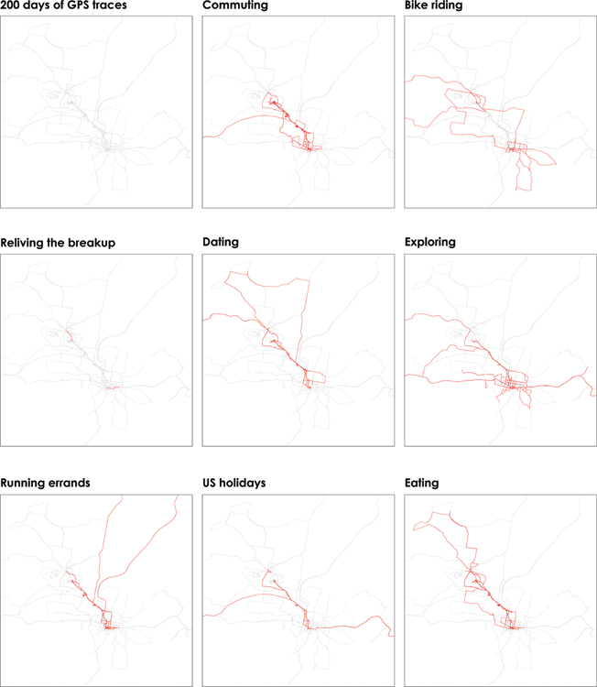
Datasets Sensors
Your phone? You can track your own phone by installing NMEA or GPS data logger apps.
Microphones
Cameras
Cameras on drones
Etc.

Slide 24
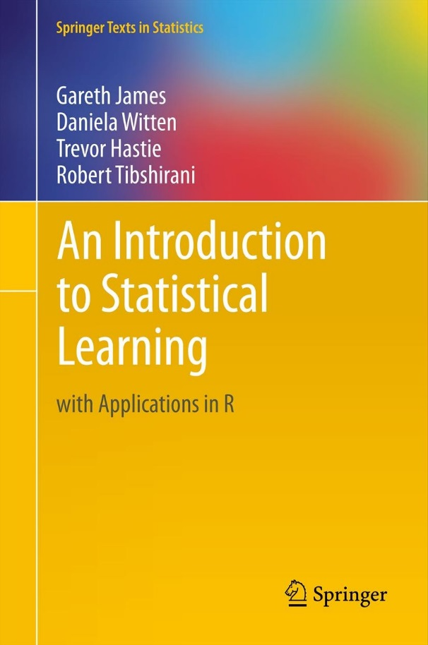
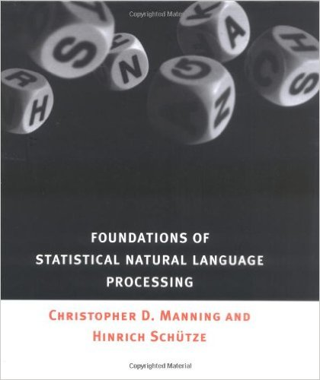
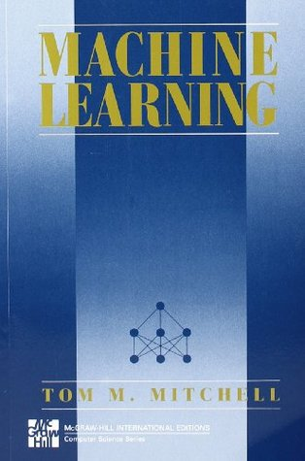
Algorithms
Books, websites and YouTube to dig deeper into algorithms

Slide 25
Algorithms
Install the R package and play with it.
R packages come with detailed descriptions of their theory and usage.
Tutorials on the web.

Slide 26
Evaluation
How fast does it work?
How does is scale?
How much memory does it use?
Precision
Recall

Slide 27
How fast does it work?
Time it for n=1, 10, 100, 1000, … data points
Plot the results.
Note that the memory usage effects its actual running speed.

Slide 28
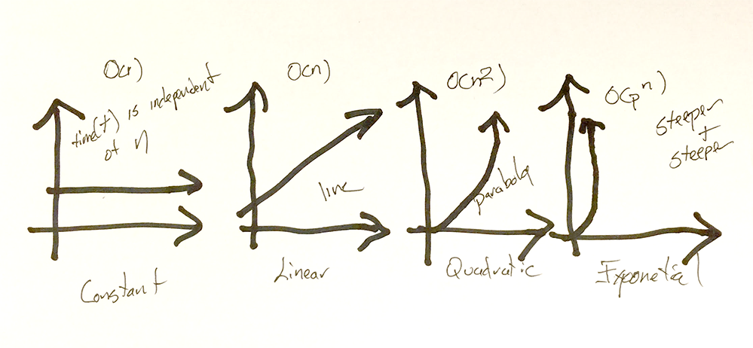
How fast does it work?

Slide 29
How does is scale?
Worst case running time. Obtain bound on largest possible running time of algorithm on input of a given size N.
Average case running time. Obtain bound on running time of algorithm on random input as a function of input size N.

Slide 30
How does is scale? Big-O, Ω, Θ
Upper bounds. T(n) is O(f(n)) if there exist constants c > 0 and n₀ ≥ 0 such that for all n ≥ n₀ we have T(n) ≤ c · f(n).
Lower bounds. T(n) is Ω(f(n)) if there exist constants c > 0 and n₀ ≥ 0 such that for all n ≥ n₀ we have T(n) ≥ c · f(n).
Tight bounds. T(n) is Θ(f(n)) if T(n) is both O(f(n)) and Ω(f(n)).

Slide 31
How much memory does it use?
Use a memory profiler
Rprofmem {utils}
Description - Enable or disable reporting of memory allocation in R.
Usage
-- Rprofmem(filename = "Rprofmem.out", append = FALSE, threshold = 0)

Slide 32
Precision and Recall
Sec. 8.3
Precision: fraction of retrieved docs that are relevant = relevant/retrieved
Recall: fraction of relevant docs that are retrieved
= retrieved/relevant
Precision P = tp/(tp + fp)
Recall R = tp/(tp + fn)
 | Relevant | Nonrelevant
Retrieved | True positive | False positive
Not Retrieved | False negative | True negative

Slide 33
Difficulties in using precision/recall
Sec. 8.3
Need large numbers to average
Often need human relevance assessments
--- People can vary quite a bit as to whether they are reliable assessors
Assessments have to be binary (yes or no)
--- Partial assessments?
Heavily skewed by assessment of what is “true”

Slide 34
ROC Analysis History
“ROC curves also proved useful for the evaluation of machine learning techniques. The first application of ROC in machine learning was by Spackman who demonstrated the value of ROC curves in comparing and evaluating different classification algorithms.”
– from http://en.wikipedia.org/wiki/Receiver_operating_characteristic

Slide 35
ROC (Receiver Operating Characteristic) curve analysis
We are given a number of test cases for which we know the “truth.”
For a single t (decision threshold) setting, we can calculate (test our method for) TP, TN, FP, and FN.
TP = true positive = present and detected
TN = true negative = not present and not detected
FP = false positive = not present but detected
FN = false negative = present but not detected
TP+TN+FP+FN = # of normals and abnormals in our study population.

Slide 36
ROC analysis
Positive predictive value
PPV = TP / (TP+FP) (TPF = TP / (TP+FN))
Probability that a result is true when the algorithm says that the result is true
Negative predictive value
NPV = TN / (TN+FN) (Specificity = TN / (TN+FP))
Probability that the result is false when the algorithm says that the that the result is false

Slide 37
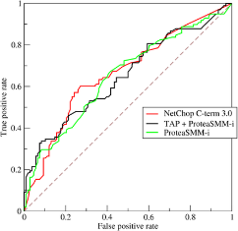
ROC analysis
From https://en.wikipedia.org/wiki/Receiver_operating_characteristic

Slide 38
Evaluation – Finding a Gold Standard
Human annotated curated data is often a “gold standard.”
--- For example, may use Gallup poll data to assess a sentiment algorithm
Looking at how papers in the field evaluate similar algorithms is a good way to asses how to evaluate an algorithm
Breakthroughs in algorithms sometimes come from finding clever ways of evaluating results

