Slide 1
Machine Learning Spring ’16 Final Project
Romil Shah
NUID: 001673595

Slide 2
Parkinson’s Disease and Machine Learning Algorithms
Detection and separation of Healthy and PD patients
Based on 2 patterns:
Speech Pattern Data
Gait, Speed, EMG Data

Slide 3
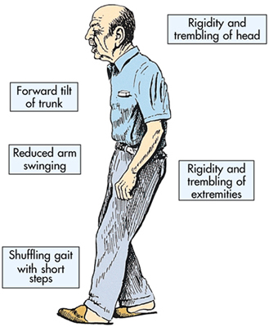
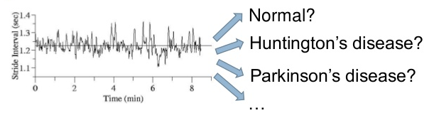
Motivation
Annually over 200,000 are affected, speech and muscles are affected
Diagnosis involves medical history only
Incurable but early diagnosis leads to reduction of effects
Using walk and speech data of healthy and PD patients help in diagnosis and labelling
Using ML algorithms to predict
Images:
http://www.aquatictherapist.com/index/2009/05/working-with-the-parkinsons-patient-in-water-download-the-2008-manual.html

Slide 4
Speech Pattern
Features: (a) Jitter, (b) Shimmer, (c) Pitch, (d) Vocal fundamental frequencies
Labeled dataset with 20 samples for healthy and 20 for PD patients
Trained using supervised learning
Clustering using unsupervised learning
Time series of Feature 4: Jitter (rap)
RED: Parkinson’s Patient
BLUE: Healthy

Slide 5
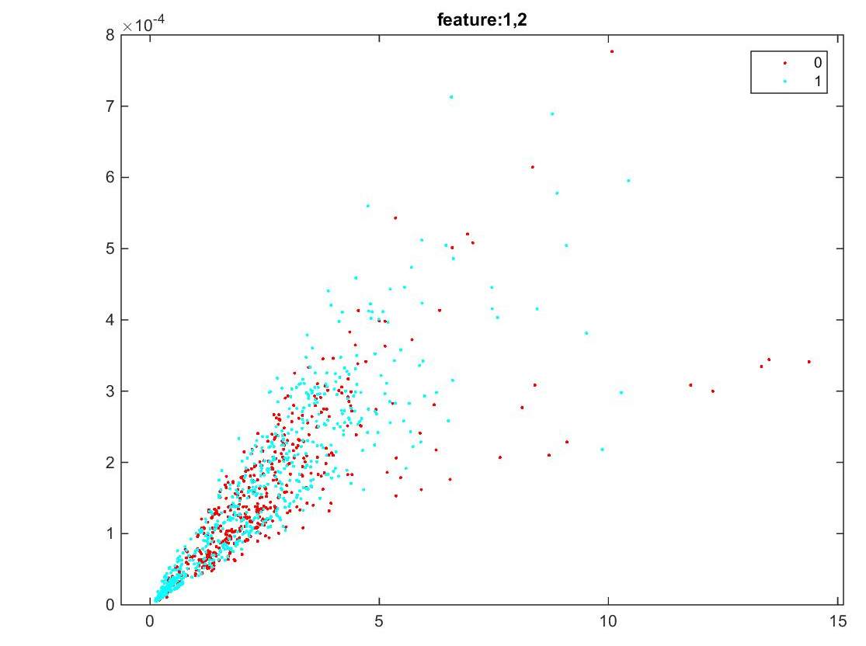
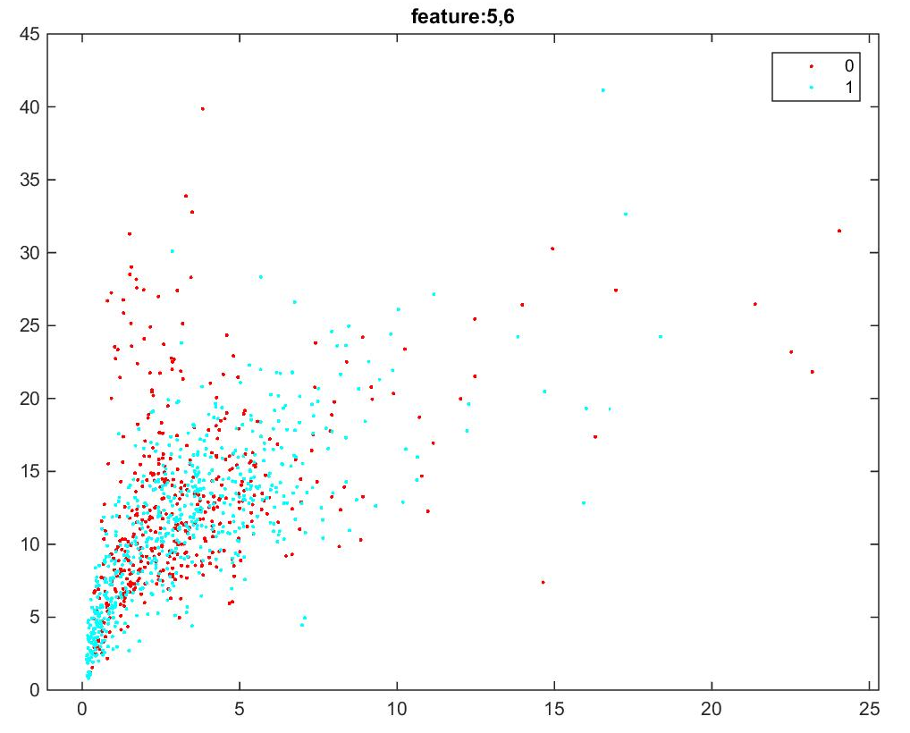
Scatter plot of Jitter and Shimmer

Slide 6



Algorithms
Supervised Learning:
1. SVM – 1040 points of form (xi,yi) with yi as labels
Hyperplane: w.x – b = 0
2. Naïve Bayes – Probabilistic model
3. k-NN – Non parametric vote based neighbors
Unsupervised:
1. K-means – Clustering based on the data rather than labels
NP-hard problem
Smaller dataset thus runs fast

Slide 7
Results
SVM
Naïve Bayes
K-NN
K-Means

Slide 8
Gait Pattern
Features: (a) Ankle acceleration [x,y,z], (b) Thigh acceleration [x,y,z], (c) Trunk acceleration [x,y,z], (d) Annotation for freezing
Unlabeled dataset with missing data too
Trained using supervised learning
Clustering using unsupervised learning
Frozen gaits are peaks in the graph:

Slide 9
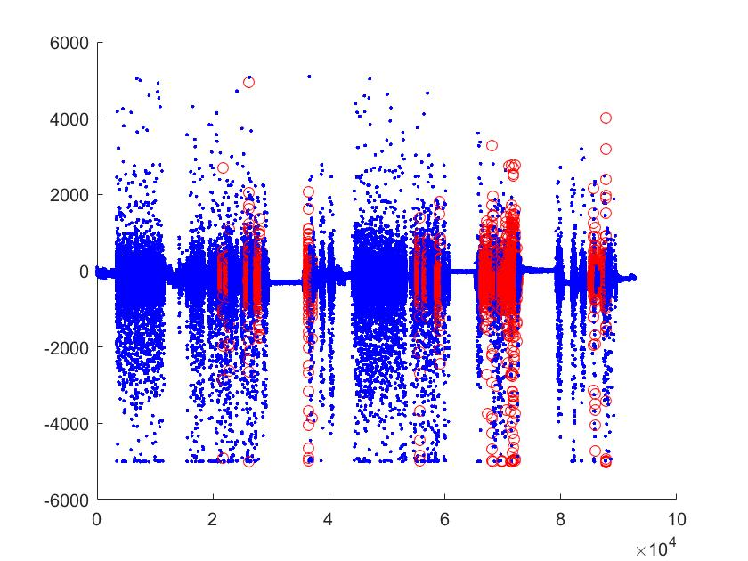
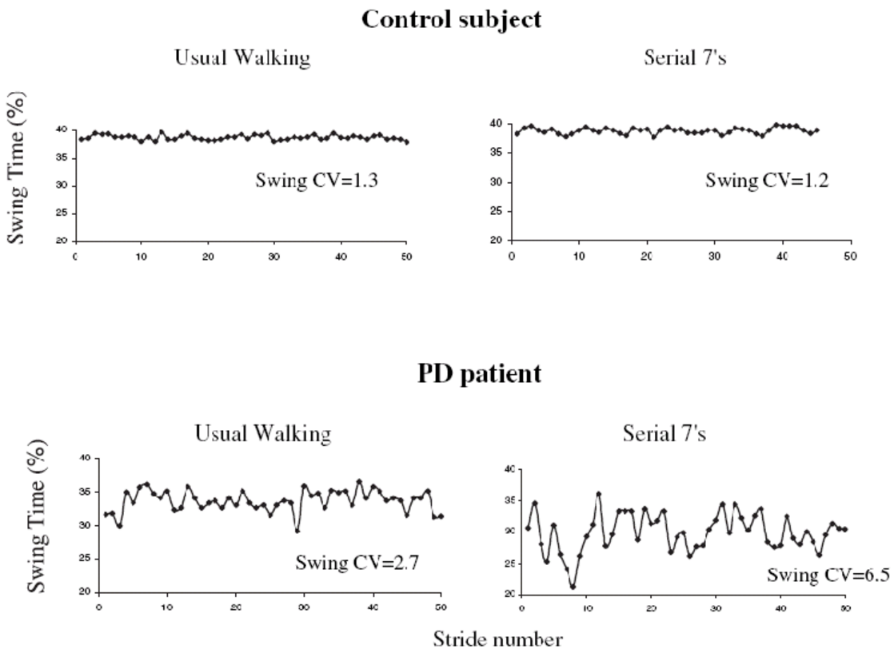
Healthy vs PD
Time series of Feature 1: Ankles (horizontal acceleration)
RED: Freezing points
BLUE: Normal walk

Slide 10
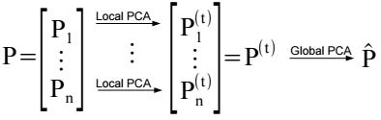
Algorithms
Supervised Learning:
1. k-NN – Used without the missing data
2. k-NN – Used with the missing data and recovering the data using PCA
Unsupervised:
1. K-means – Clustering based on the data without any missing points
2. K-means – Clustering after recovering the missing data using PCA
Approach for missing data:
First do PCA analysis.
Determine the number of unique groups (clusters) based on PCA results
After determining the number of clusters, apply k-means clustering to do the classification

Slide 11
Results
K-NN
Missing Data
K-Means
Missing Data
K-NN
Predicted Data
K-Means
Predicted Data

Slide 12
Computation Time & Accuracy
Algorithm | Labeled Small Dataset |  | Unlabeled Large Dataset
 | Time | Accuracy | Time | Accuracy
SVM | 45.0857 | 54.76 | - | -
Naïve | 1.4973 | 78.57 | - | -
k-NN | 0.6692 | 60.19 | 1.3866 | 85.97
k-Means | 0.4790 | 50.57 | 0.8486 | 91.39
PCA + Naïve | - | - | 1.5694 | 89.22
PCA + k-Means | - | - | 1.4219 | 92.82

Slide 13
Conclusion
PCA can be used for missing data and then K-Means or such algorithm can be applied
Supervised learning is more suitable for labeled and smaller data and Unsupervised is more suitable for unlabeled and large dataset
Tradeoff between computation time and accuracy for large dataset with missing data
But using PCA the missing data problem is mitigated

Slide 14
References
Datasets:
1. Speech data: http://archive.ics.uci.edu/ml/datasets/Parkinson+Speech+Dataset+with++Multiple+Types+of+Sound+Recordings
2. Gait, Speed, Walk data: https://archive.ics.uci.edu/ml/datasets/Daphnet+Freezing+of+Gait
Other:
1. “Parkinson's disease: clinical features and diagnosis”, http://www.ncbi.nlm.nih.gov/pubmed/18344392
2. “A Machine Learning Approach to Diagnosis of Parkinson’s Disease”,
http://scholarship.claremont.edu/cgi/viewcontent.cgi?article=1784&context=cmc_theses
3. http://www.mathworks.com/help/stats/supervised-learning-machine-learning-workflow-andalgorithms.html
4. https://physionet.org/pn3/gaitpdb/

