Slide 1
GyMyo
GYM ACTIVITY AND FALL TRACKER

Slide 2
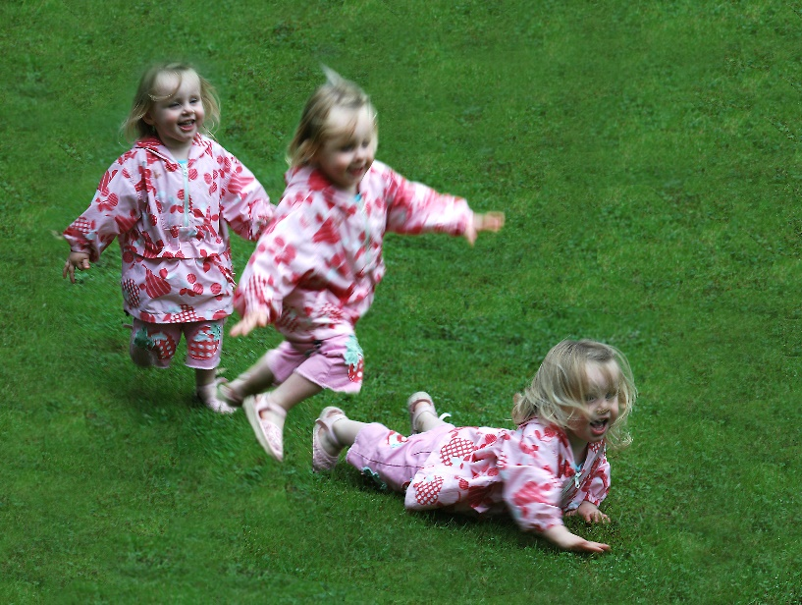

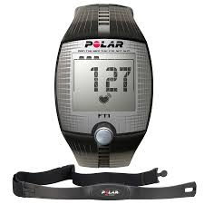
Problem?
Costly devices
Limited application
APPS? Less accuracy
Fall detection

Slide 3

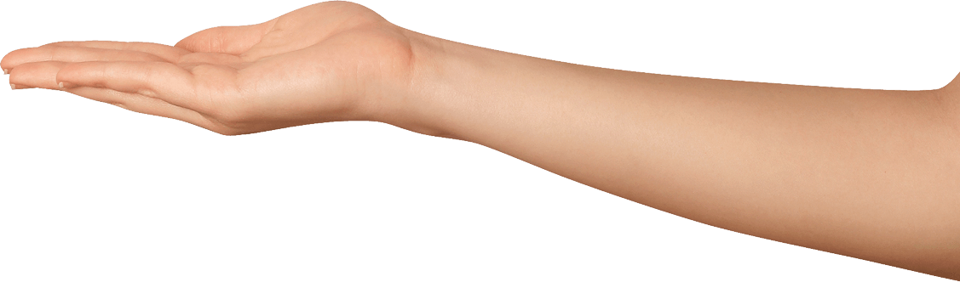
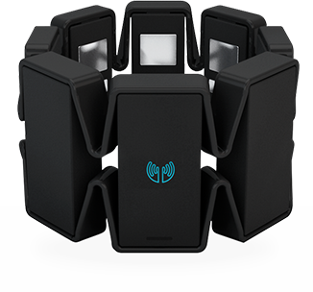

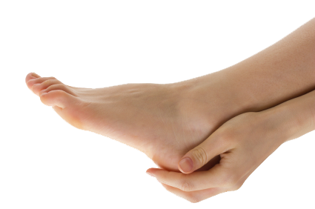
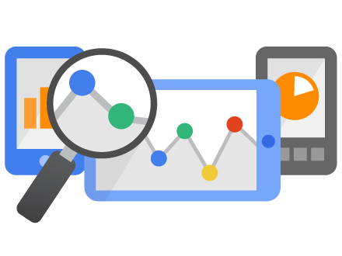
NEURAL NETWORK ANALYSIS
CONCEPT

Slide 4
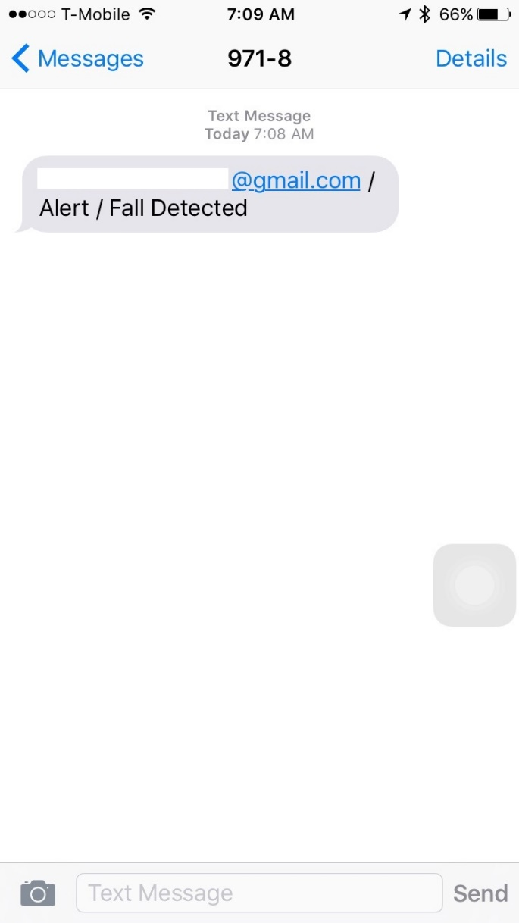
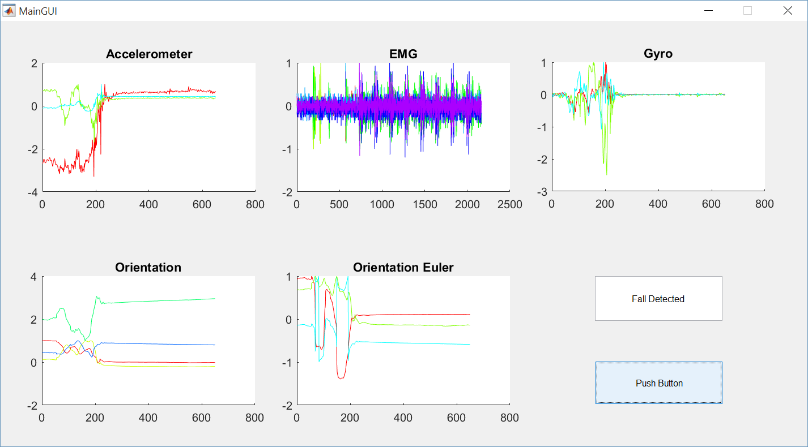
The Fall System

Slide 5
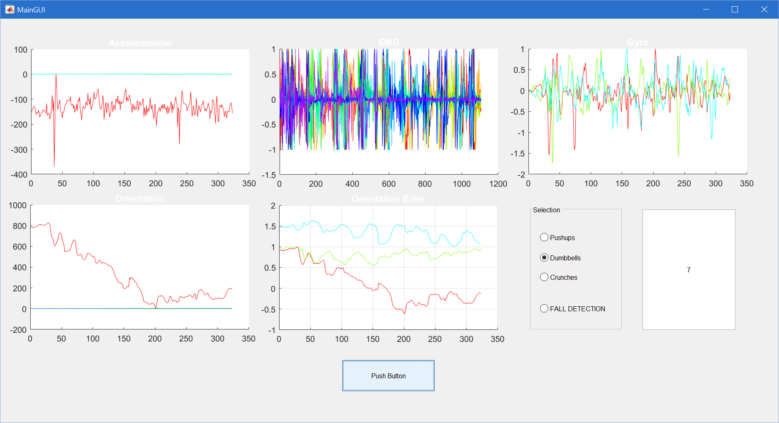
GYM System
Dumbbells Done

Slide 6
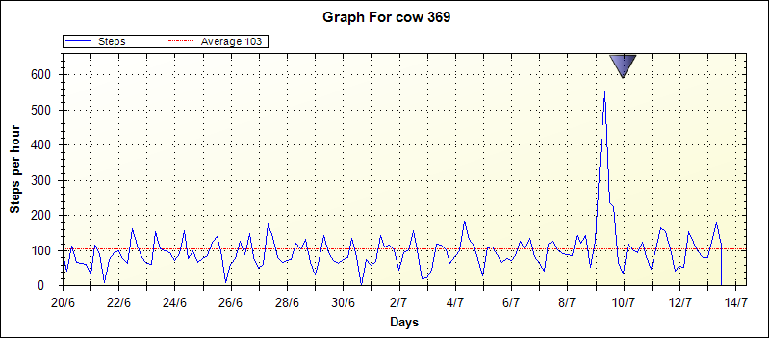
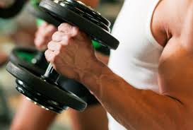
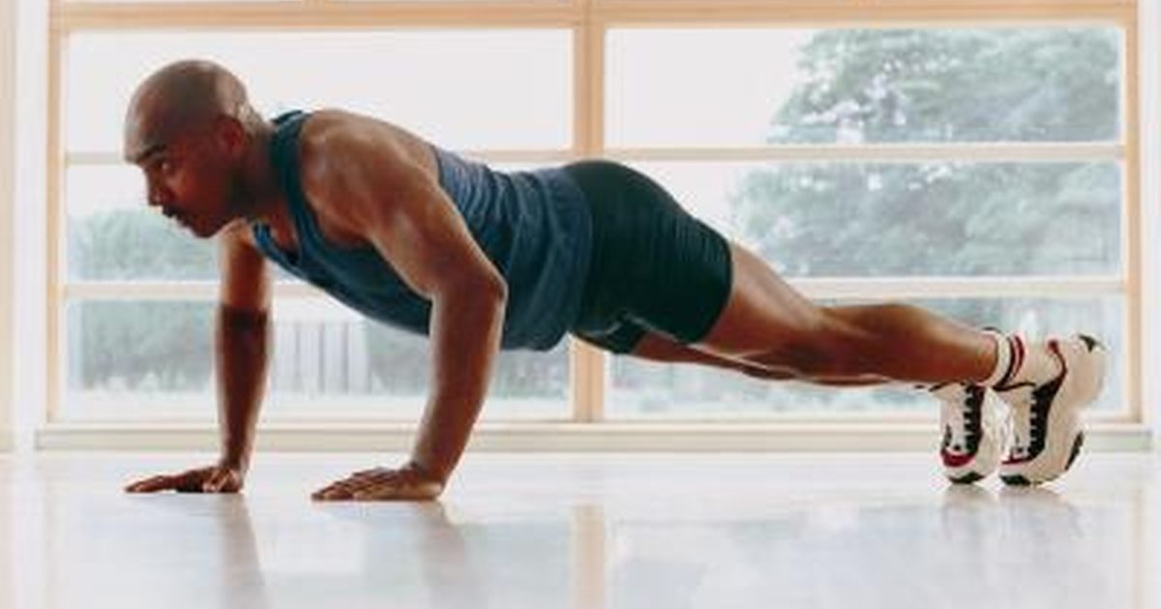
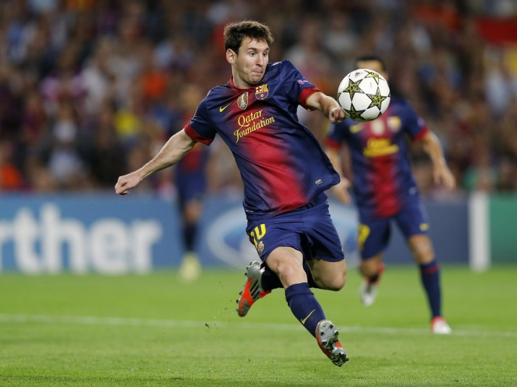
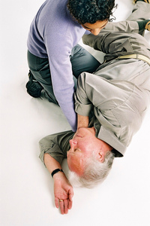
Why do we need this?

Slide 7
Value Propositions
Customer Segments
Real Time tracking using EMGs, Gyros and Acceleros
Real Time Report/Alert system
Data collection and Analytics
Low Cost, Low Maintenance
Gym activity tracking
Human Safety
Health Tracking
Sports
Further Enhancements
Connecting App with Leaderboard

Slide 8
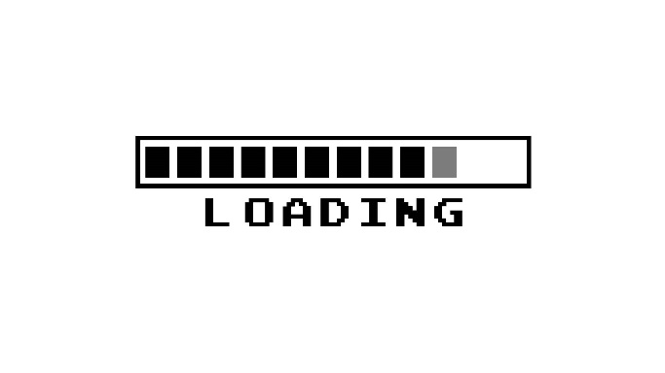
Thank U. D. U.
Romil Shah
Electrical engineer under Process

