Slide 1
MyoWalk
Walk Pattern and Fall Detection

Slide 2
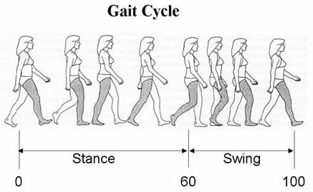
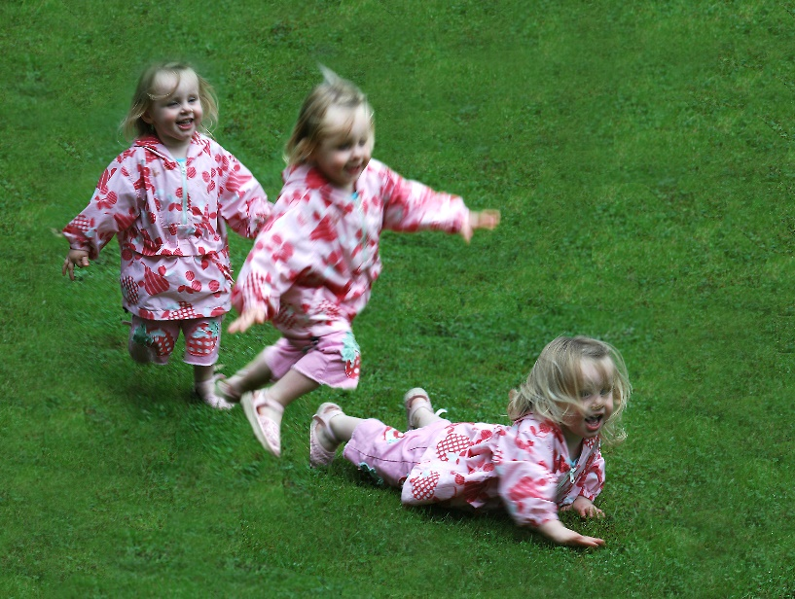

Problem?
Detect walking pattern
Determine Fall/Accident
Report

Slide 3

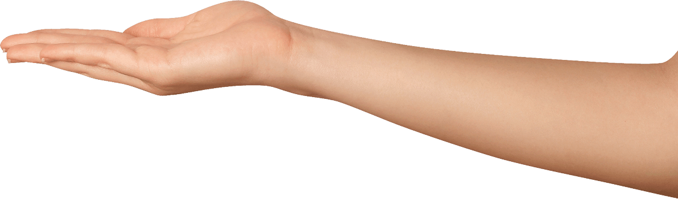
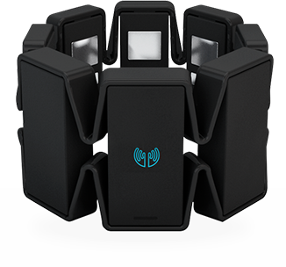
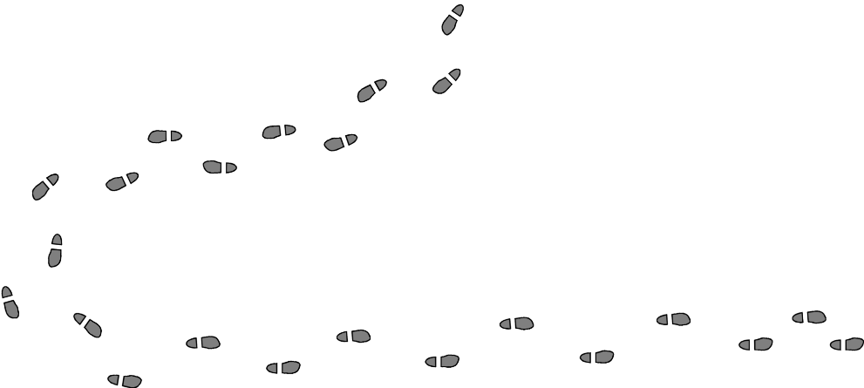

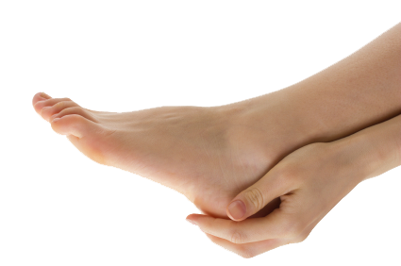

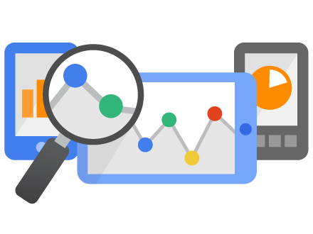
CONCEPT

Slide 4
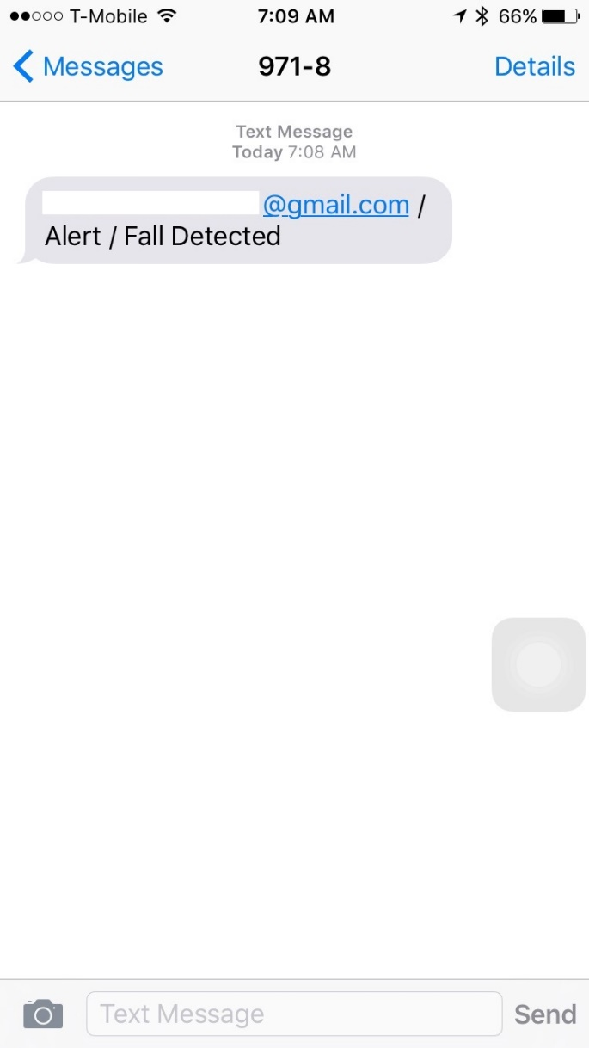
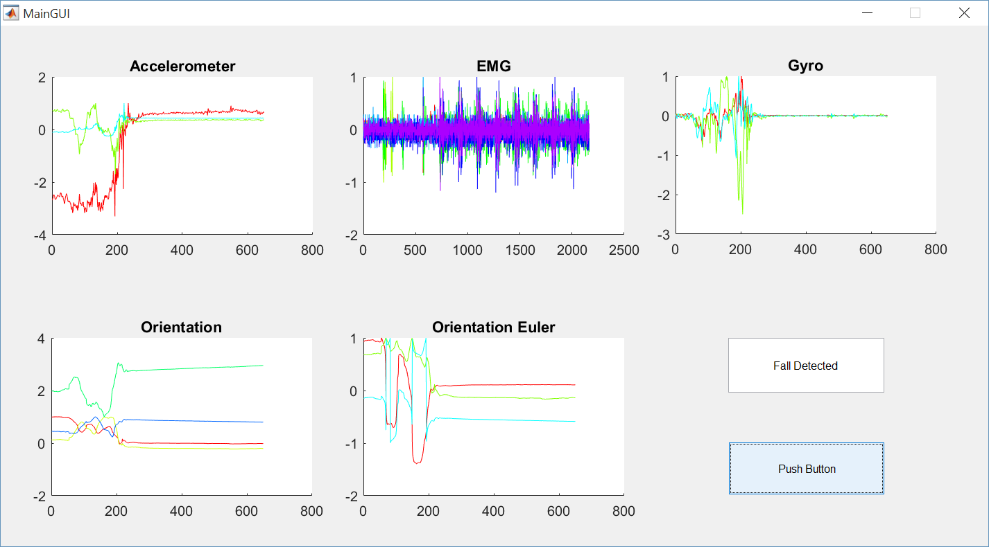
The Alert System

Slide 5
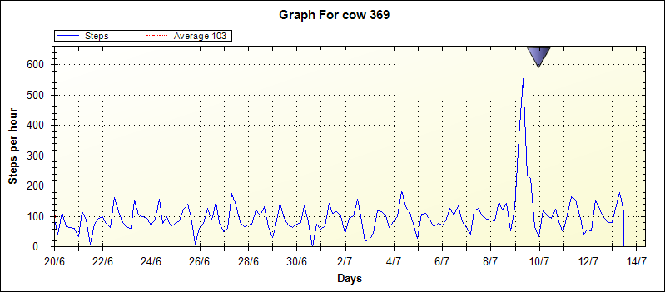
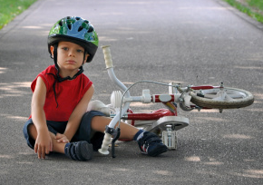
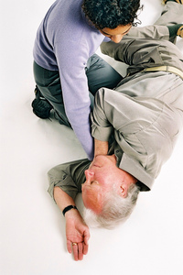
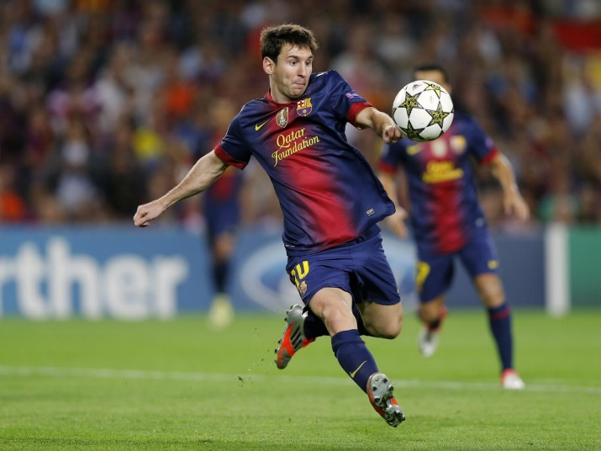
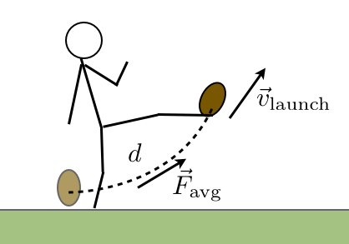
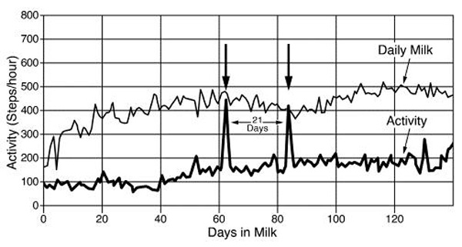
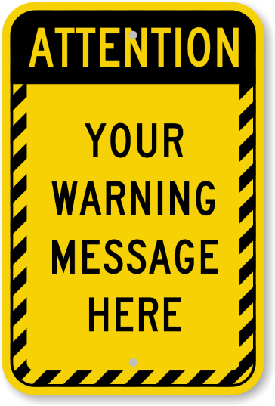
Why do we need this?

Slide 6
Value Propositions
Customer Segments
Real Time tracking using EMGs, Gyros and Acceleros
Real Time Report/Alert system
Data collection and Analytics
Low Cost, Low Maintenance
Animal Husbandry
Human Safety
Wildlife tracking
Sports
(And help Patriots analyze their leg powers)

Slide 7
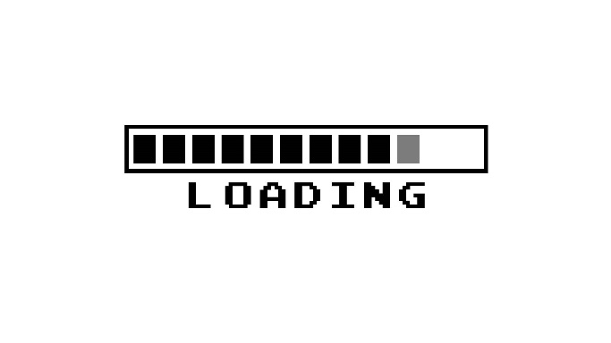
Thank U. B U.
Romil Shah
Electrical engineer under Process

