Slide 1
Mobile App for Direct Market Access for Farmers
CSE7101- Capstone Project
Review-1
Batch Number:CSE_198
Roll Number | Student Name
20221CSE0099 | Soma Venkata Harshitha
20221CSE0084 | Boyapati Chowdary Ram Saketh
20221CSE0258 | Saginadam Puspalatha
Under the Supervision of,
Ms.Rama Bai V
School of Computer Science and Engineering
Presidency University
Name of the Program: School of Computer Science and Engineering
Name of the HoD: Dr. Asif Mohammed , Dr. Blessed Prince
Name of the Program Project Coordinator: Dr. Jayavadivel Ravi, Mr.Muthuraju V
Name of the School Project Coordinators: Dr. Sampath A K , Dr. Geetha A

Slide 2
Problem Statement Number: 281
Organization: Ministry of Agriculture and Farmers Welfare
Category (Hardware / Software / Both) :Software
Problem Description: Create a mobile application that connects farmers directly with consumers and retailers. The app should include features for listing produce, negotiating prices, and managing transactions, thereby reducing dependence on intermediaries. Expected Solution: A user-friendly mobile platform that enables farmers to showcase their products and connect with buyers directly, enhancing their income potential.

Slide 3
Content
Problem Statement
Objectives
Background and Related work for title Selection
Analysis of Problem Statement
Innovation or Novel Contributions
Git-hub Link
Timeline of the Project
References

Slide 4
Analysis of Problem Statement
Technology Stack Components:
Frontend: Flutter (Dart) for cross-platform mobile app development
Backend & Database: Node.js and Firebase
Authentication: Firebase Authentication
Payment Gateway Integration: Razorpay or PayPal API
Push Notifications: Firebase Cloud Messaging (FCM)
Maps & Location Services: Google Maps API
IDE & Development Tools: Android Studio

Slide 5
Github Link
The Github link provided should have public access permission.
Github Link
https://github.com/ramsakethboyapati/Capstone-project-Mobile-App-for-Direct-Market-Access-for-Farmers

Slide 6
Analysis of Problem Statement (contd...)
Software Requirements:
Operating System: Windows 10 / macOS / Linux
IDE: Android Studio (with Flutter & Dart plugins)
Backend Services: Firebase (Cloud Firestore / Realtime Database, Authentication, FCM)
Payment Gateway APIs: Razorpay / PayPal API
Maps & Location API: Google Maps API

Slide 7
Analysis of Problem Statement (contd...)
The goal is to develop a mobile application that bridges the gap between farmers and end consumers or retailers by eliminating middlemen. This platform should allow farmers to list
their produce, facilitate direct price negotiation, and manage transactions efficiently. By doing
so, the app aims to empower farmers with better market access, increase their profitability, and provide consumers with fresher produce at competitive prices. The solution needs to be
user-friendly and accessible to farmers with varying levels of digital literacy.

Slide 8
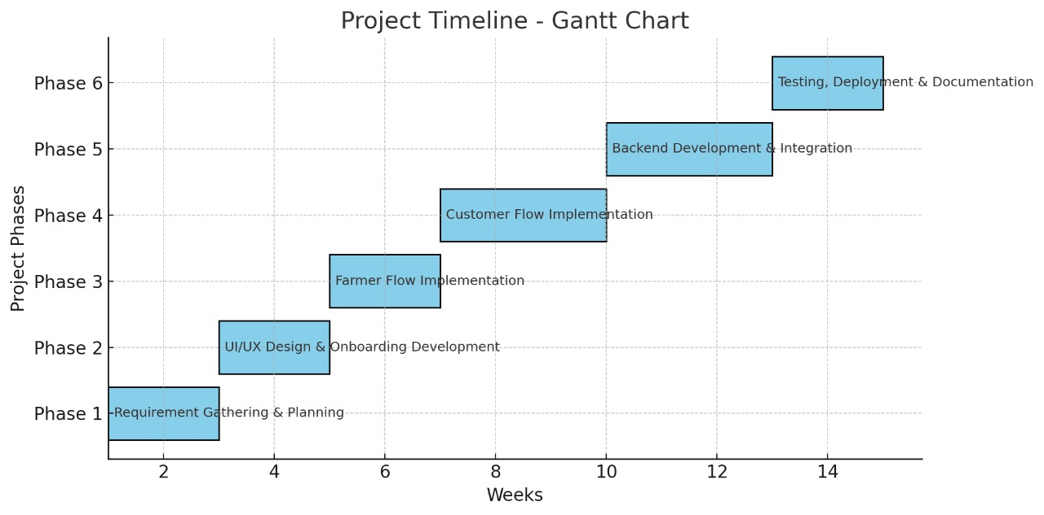
Timeline of the Project (Gantt Chart)

Slide 9
References (IEEE Paper format)
An Android Based E-Commerce Application for Farmers” Ayush Kumar, Anchal Thakre, Sudhir Kadam,(Department of Electronics and Telecommunication, College of Engineering, Bharati Vidyapeeth (Deemedto Be University) Pune, Maharashtra, India)
AGRICULTURAL LAND E-COMMERCE SHOPPING APPLICATION” Pravir Mandal*1, SonamSalam*2 *1,2Department Of Computer Engineering, SRPCE College Of Engineering, Nagpur, Maharashtra,India.

Slide 10


