Slide 1

Predicting Customer Churn
Tony Ramsett
06/24/2020
MSDS692 – Data Practicum 1

Slide 2
Agenda
1
Introduction
2
Data Set-up
3
Predictive Models
4
Business Impacts

Slide 3

Introduction

Slide 4




Business Description
New telecom company called Telco with 7,043 customers that offers internet/television services
Lack churn deflection and retention strategies
Provided one month of customer data
Desire predictive model and insights to anticipate churn
Business description/strategies/assumptions are made up for purposes of this project

Slide 5
Project Purpose
Purpose: Build a predictive model that effectively predicts customer churn and provide Telco with actionable recommendations and insights to begin reducing churn through improved business strategies.
Current Telco Strategy:
Retain Everyone – Telco spends $50 on ALL customers in effort to reduce churn
Predictive Model Strategy:
Predictive Model – Effectively predict which customers will churn to focus retention efforts
“…acquiring a new customer is anywhere from five to 25 times more expensive than retaining an existing one.” - Harvard Business Review, 2017
Business Cost Per Strategy
n = 7032
Project Goals:
Sustain long-term growth by reducing customer churn
Reduce costs compared to current business strategies
Provide actionable recommendations and insights to Telco
Model Choices: Logistic Regression, Decision Trees, and Random Forest
Assumptions:
Acquiring a new customer costs $250
Retaining a customer costs $50
$???,???
Sources: (Fendarkar, P., 2018), (Gallo, A., 2014), (Heintz, B., 2018)
Business description/strategies/assumptions are made up for purposes of this project

Slide 6
Data Set Summary
Size/Variables
Dimensions
Demographics
Service/Plan
7,043 rows x 21 columns
Customer ID, Gender, Senior Citizen, Partner, Dependents
Tenure, Phone Service, Multiple Lines, Internet Service, Online Security, Online Backup, Device Protection, Tech Support, Streaming TV, Streaming Movies, Contract, Paperless Billing, Payment Method, Monthly Charges, Total Charges
Churn
Churn Rate
27%
Sources: (Fendarkar, P., 2018)

Slide 7
Project Timeline
8 week project spanning from 05/06/20 – 06/24/20 followed the Data Science Lifecycle
Week 1
Week 2
Week 3
Week 4
Week 5
Week 6
Week 7
Week 8
Business Understanding
Data Mining
Data Cleaning
Data Exploration
Feature Engineering
Predictive Modeling
Data Visualization

Slide 8

Data Set-up

Slide 9
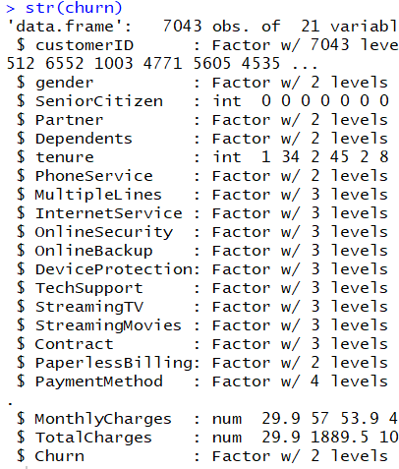
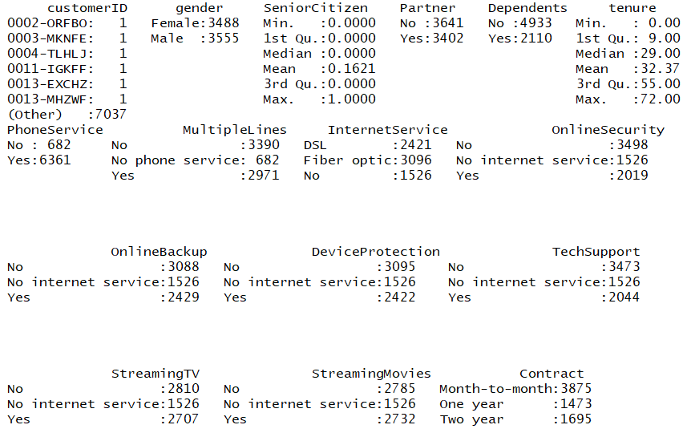
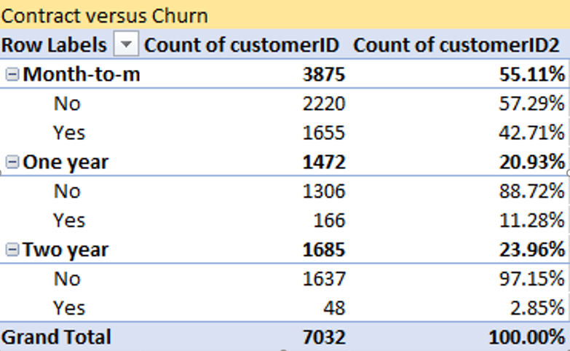
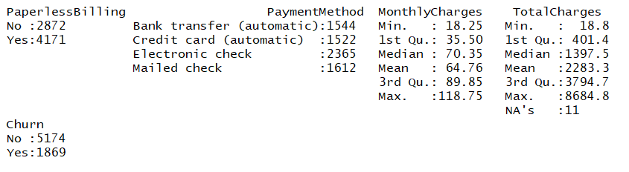
Data Exploration
Data Structure
Data Summary
Pivot Tables
Several pivot tables to view how churn relates to variables
Data structured with various data types
Quickly view variable distributions, NA’s, and descriptive statistics of numeric variables

Slide 10
Data Cleaning
Pre Data Cleaning
Post Data Cleaning
Remove Demographic variables:
Customer ID, Gender, Senior Citizen, Partner, Dependents
Removed Total Charges → Already have Monthly Charges
Focus solely on Service and Plan Information
11 NA’s in data set:
All within Total Charges feature
Remove 11 rows (customers) containing NA values
Data Wrangling:
MultipleLines, OnlineSecurity, OnlineBackup, DeviceProtection, TechSupport, StreamingTV , StreamingMovies contain values of ‘Yes’, ‘No’, and ‘No Internet Service’
Map ‘No Internet Service’ values to ‘No’
Data Dimensions: 7043x21
Data Dimensions: 7032x15

Slide 11
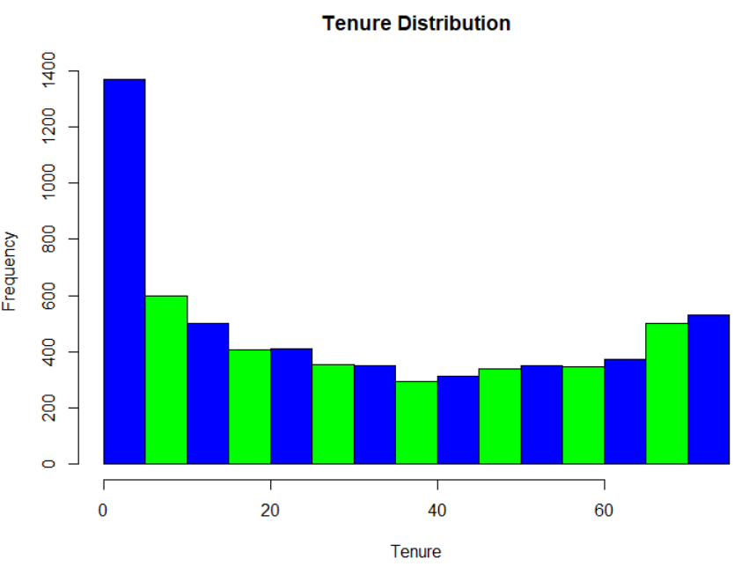
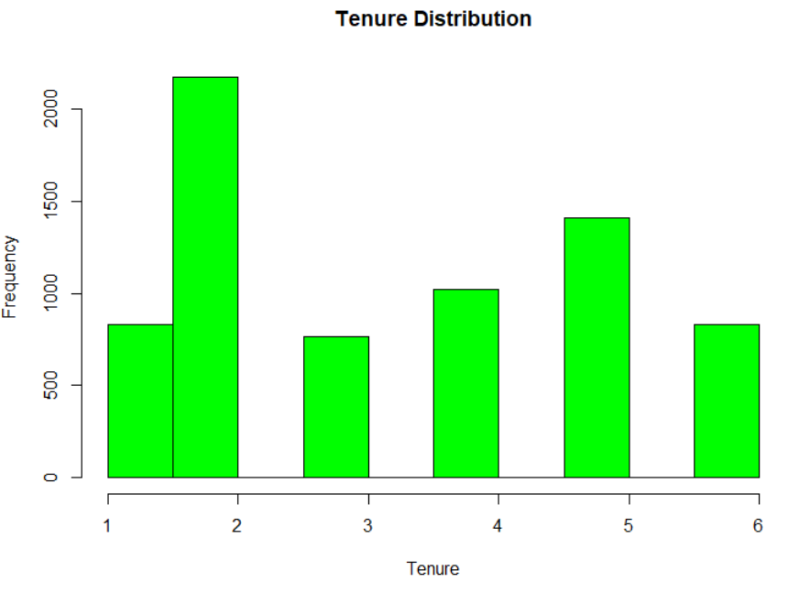
Feature Engineering
Pre Feature Engineering
Post Feature Engineering
Customer tenure set-up numerically by individual months ranging from 0 – 72
Engineered to number of years to distinguish tenure group
Code output – sorted alphabetically, not by year

Slide 12
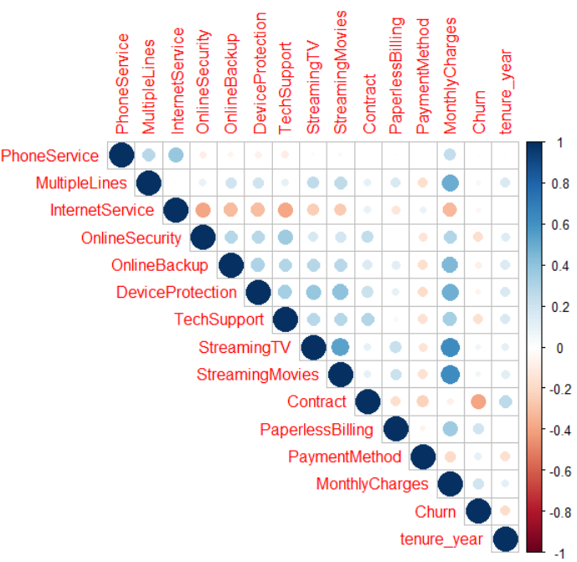
Data Exploration
Correlation Plot
Usage
Correlation plots used to quickly interpret correlations between variables in a data set
Conclusions
Several categorical variables converted to numerical variable for correlation plot usage
‘Monthly Charges’ shows moderate to good correlations with several variables but not with ‘Churn’ classifier
No other concerns with correlations
Sources: (An Introduction to corrplot Package, n.d.), (Braglia, L., 2014), & (Ramsett, 2019))

Slide 13

Predictive Models

Slide 14

Training/Test Sets
Usage
Splits
Result
Training data set used for model set-up
Test data set used for predictive modeling and model output
Data split into 75/25 split with 75% churn rate in each set
75% of data in Training set
25% of data in Test set
Training set: 5,274 columns by 15 rows
Test set: 1,758 columns by 15 rows

Slide 15
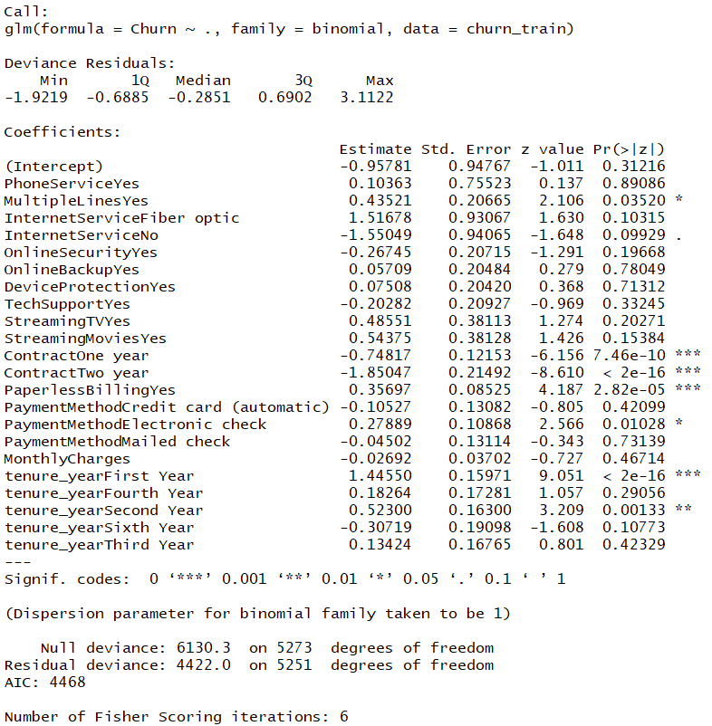
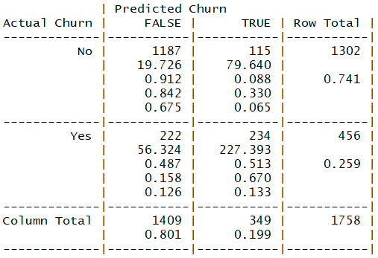

Logistic Regression
Variable Importance
1. Tenure Year – First Year
2. Contract – Two Year
3. Contract – One year
4. Paperless Billing – Yes
5. Tenure Year – Second year
Usage
Supervised learning classification algorithm to learn about relationships between variables
Model Output
Confusion Matrix
Accuracy: 0.8083
Recall: 0.6705, Precision: 0.5132, F1 Score: 0.5814
Sources: (Saraswat, M., n.d.), (Shulga, D., 2018)

Slide 16
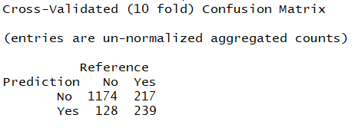
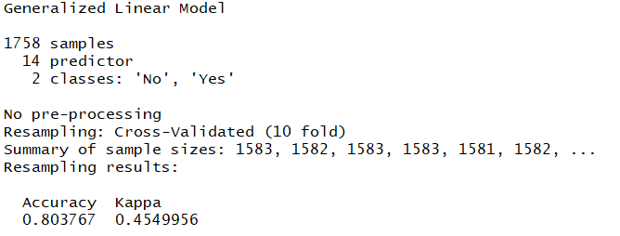
Logistic Regression with 10-Fold Cross-Validation
Usage
Fine tuning technique to reduce model bias and variance as well as risk of over-fitting model.
Confusion Matrix
Model Output
Accuracy: 0.8038
Recall: 0.5241, Precision: 0.6512, F1 Score: 0.5808
Sources: (Saraswat, M., n.d.)

Slide 17
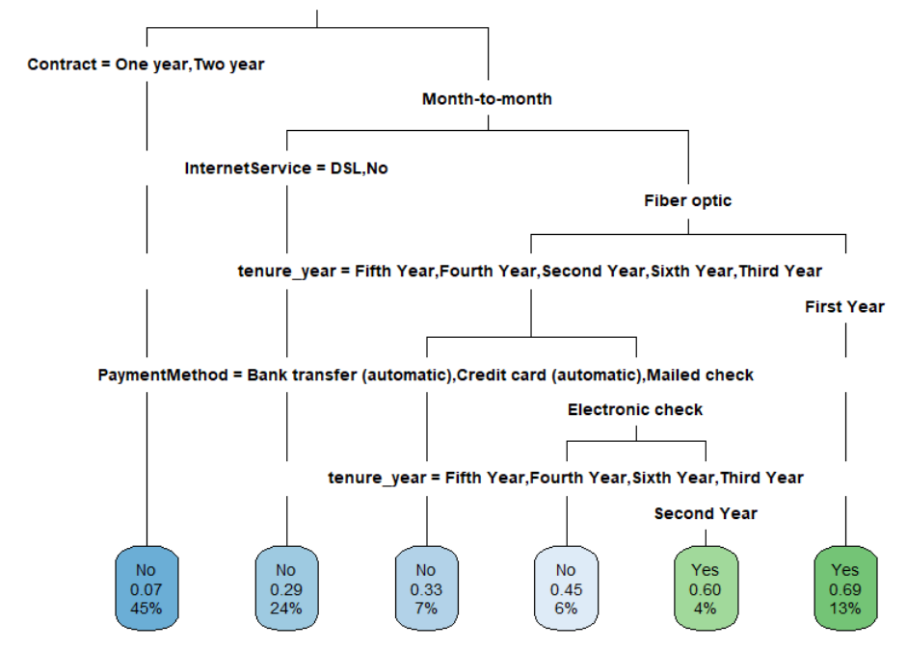
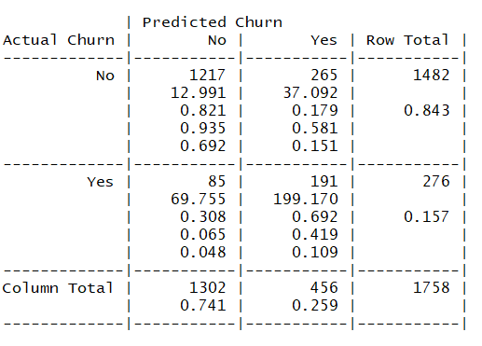
Decision Tree
Variable Importance
Usage
1. Contract
2. Tenure
3. Payment Method
4. Monthly Charges
5. Internet Service
Classifier algorithm that models a tree structure to model relationships between variables
Decision Tree Plot
Confusion Matrix
Accuracy: 0.8009
Recall: 0.4189, Precision: 0.6920, F1 Score: 0.5219
Sources: (Lantz, B., 2019)

Slide 18
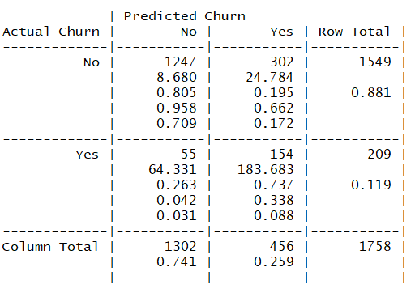
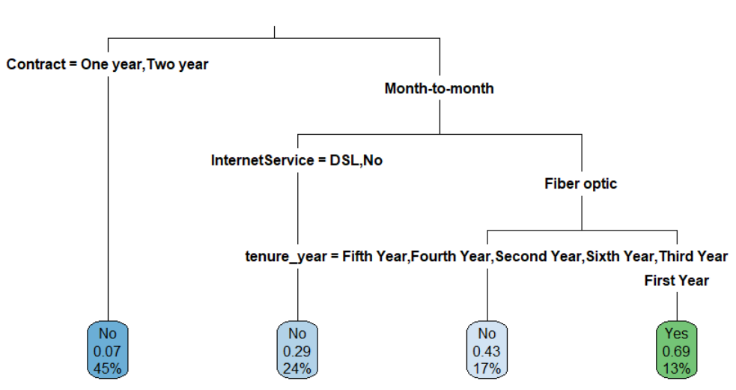
Decision Tree – Pruned
Usage
Confusion Matrix
Fine tuning method to reduce the size of the tree and prevent overfitting of the model
Decision Tree Plot
Accuracy: 0.7969
Recall: 0.3377, Precision: 0.7368, F1 Score: 0.4632
Sources: (Das, S., 2017), (Lantz, B., 2019)

Slide 19
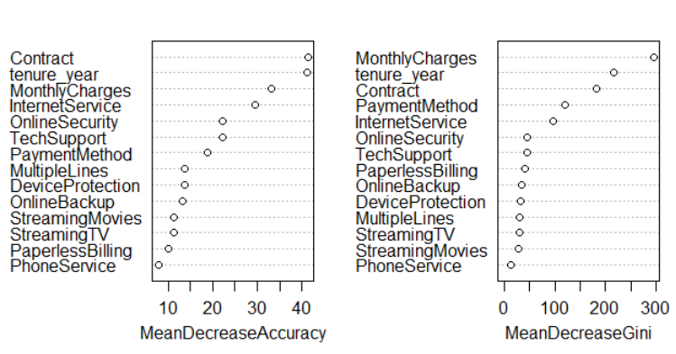
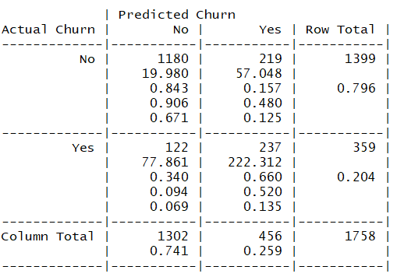
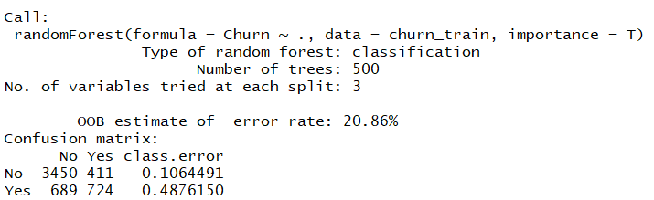
Random Forest
Variable Importance
Top 5
Variables
Usage
Ensemble method that utilizes multiple decision trees and uses vote system for model output
Confusion Matrix
Random Forest Output
Accuracy: 0.8060
Recall: 0.5197, Precision: 0.6602, F1 Score: 0.5816
Sources: (Lantz, B., 2019)

Slide 20

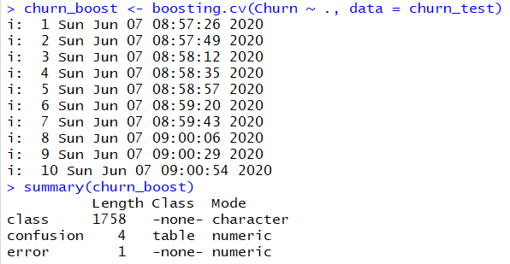
Random Forest with 10-Fold Cross-Validation
Usage
Fine tuning technique to reduce model bias and variance as well as risk of over-fitting model.
Confusion Matrix
Model Output
Accuracy: 0.7907
Recall: 0.5044, Precision: 0.6183, F1 Score: 0.5556
Sources: (Das, S., 2017), (Lantz, B., 2019)

Slide 21
Model Comparison
Model | Accuracy | Recall | Precision | F1 Score
Logistic Regression | 0.8083 | 0.6705 | 0.5132 | 0.5814
Random Forest | 0.8060 | 0.5197 | 0.6602 | 0.5816
Logistic Regression – 10CV | 0.8038 | 0.5241 | 0.6512 | 0.5808
Decision Tree | 0.8009 | 0.4189 | 0.6920 | 0.5219
Decision Tree – Pruned | 0.7969 | 0.3377 | 0.7368 | 0.4632
Random Forest – 10CV | 0.7907 | 0.5044 | 0.6183 | 0.5556
Logistic Regression is the MOST ACCURATE model with the HIGHEST RECALL rate
This model is the selection for the Cost Savings Model

Slide 22

Business Impacts

Slide 23
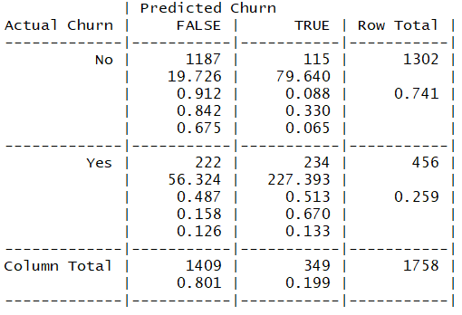
Cost Savings Model
Model Output | Costs per Customer
True Negatives | $0 * (1,187/1,758) = $0.00
True Positives | $50 * (234/1,758 ) = $6.66
False Positives | $50 * (222/1,758)= $6.31
False Negatives | $250 * (115/1,758 ) = $16.35
Total | $29.32
Model Choice = Logistic Regression
Assumptions:
Acquiring new customer costs $250
Retaining a customer costs $50
Reminders:
Test Set = 1,758 Customers
Current ‘Retain Everyone’ strategy = Spend $50 an ALL customers
Apply Cost Per Customer to All Customers
$29.32 * 7,043 = $206,501
Logistic Regression Confusion Matrix
Business Cost Per Strategy
n = 7,043
True Negatives = 1,187
True Positives = 234
False Positives = 222
False Negatives = 115
Over $140,000 dollars SAVED compared to nearest model
Sources: (DataOptimal, 2020), (Heintz, 2018)

Slide 24
Recommendations
Churn Rate by Tenure
n = 7,032
Churn Rate by Contract
n = 7,032
High churn rate for customers in first two years
No Churn | Churn
Highest churn rate for customers in Month-to-Month contracts
n = 3,875
n = 1,472
Lowest churn rate for customers in Two Year contracts
n = 1,685
1
Review current business and communication strategies with newer customers to enhance their experience with methods such as service improvements and feedback
2
Sign new customers to two year contracts with an ongoing strategy to transition customers with month-to-month contracts to two year contracts

Slide 25
Recommendations
Churn Rate by Payment Method
n = 7,032
Churn Rate by Internet Service
n = 7,032
No Churn | Churn
No Churn | Churn
Highest churn rate for customers paying with Electronic Check
Highest churn rate for customers with Fiber Optic internet
n = 2,365
n = 3.096
n = 1,604
n = 2,416
n = 1,542
n = 1,521
n = 1,520
3
Review the payment system with an electronic check payments focus for customer pain points
4
Analyze customer feedback regarding fiber optic internet to understand where negative experiences occur

Slide 26
References
An Introduction to corrplot Package. (n. d.) https://cran.r-project.org/web/packages/corrplot/vignettes/corrplot-intro.html
Braglia, L. (2014, April 2). Converting multiple columns from character to numeric format in r.
https://stackoverflow.com/questions/22772279/converting-multiple-columns-from-character-to-numeric-format-in-r
Das, S. (2017). Decision Trees and Pruning in R. DZone. https://dzone.com/articles/decision-trees-and-pruning-in-r
DataOptimal. (2020). Create Better Data Science Projects With Business Impact: Churn Prediction with R. DataOptimal.
https://www.dataoptimal.com/churn-prediction-with-r/
Fendarkar, P. (2018). Telco Customer Churn. https://www.kaggle.com/palashfendarkar/wa-fnusec-telcocustomerchurn
Gallo, A. (2014). The Value of Keeping the Right Customers. Harvard Business Review. https://hbr.org/2014/10/the-value-of-keeping-the-right-customers

Slide 27
References
Heintz, B. (2018). Cutting the Cord: Predicting Customer Churn for a Telecom Company. Towards Data Science.
https://towardsdatascience.com/cutting-the-cord-predicting-customer-churn-for-a-telecom-company-268e65f177a5
Lantz, B. (2019). Machine learning with R: expert techniques for predictive modeling. Packt Publishing.
Parimi, S. (2018). Predict Customer Churn with R. http://rstudio-pubs-static.s3.amazonaws.com/425842_7f6b2293079f4a5d8fc7d62aeac2a545.html
Ramsett, A. (2019). Week4_DecisionTreesAndRF.docx. Regis University.
Ramsett, A. (2019). Week5_SVMandANN.docx. Regis University.
Saraswat, M. (n.d.). Practical Guide to Logistic Regression Analysis in R. Hackerearth. https://www.hackerearth.com/practice/machine-
learning/machine-learning-algorithms/logistic-regression-analysis-r/tutorial/
Shulga, D. (2018). 5 Reasons “Logistic Regression should be the first thing you learn when becoming a Data Scientist. Towards Data Science.
https://towardsdatascience.com/5-reasons-logistic-regression-should-be-the-first-thing-you-learn-when-become-a-data-scientist-
fcaae46605c4
TutorialsPoint. (2020). R-Functions. https://www.tutorialspoint.com/r/r_functions.htm

Slide 28
Github Link
https://github.com/ramsetta/ChurnModel

