Slide 1


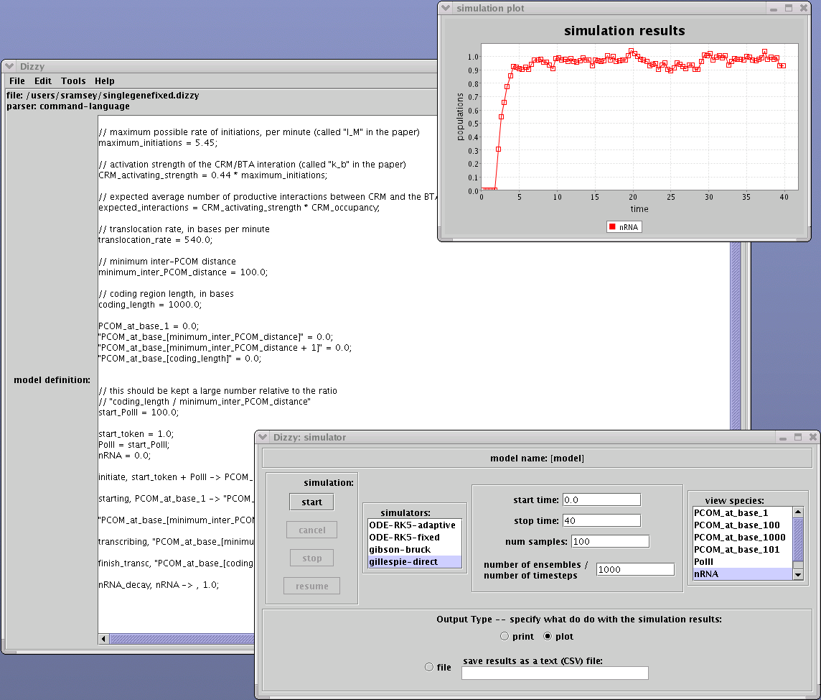
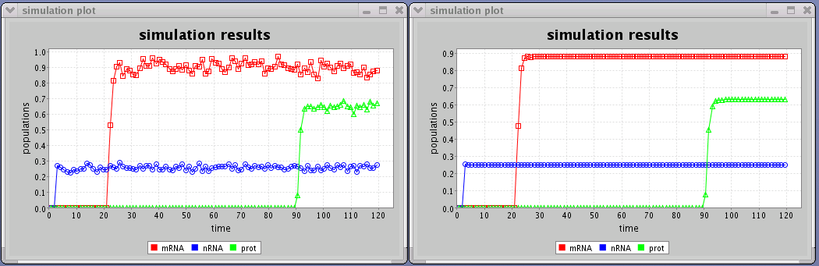
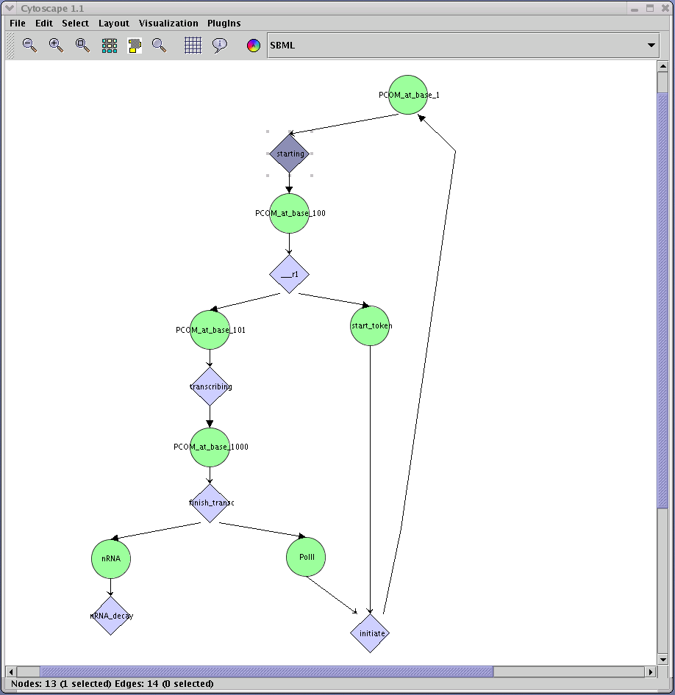
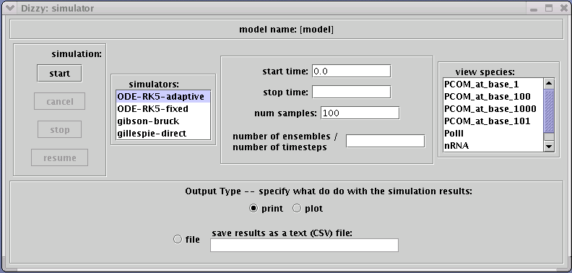
Dizzy: a software system for simulating the chemical kinetics of complex systems
Stephen Ramsey and Hamid Bolouri
Institute for Systems Biology, Seattle, Washington, USA
Abstract
Dizzy is a software system and model definition language that is designed to perform stochastic simulations of the chemical kinetics of complex systems, such as regulatory networks. A user describes the system as a "model" containing a set of chemical species and reactions involving the species. A model may be defined using the "Dizzy" language (specifically adapted for use with the Dizzy program) or in the Systems Biology Markup Language (SBML). The kinetics of the system is modeled using one of the built-in simulators; both deterministic and stochastic simulators are available. The deterministic simulators model the kinetics of the system using ordinary differential equations (ODEs). The stochastic simulators model the kinetics of the system as a stochastic process consisting of individual reaction events. The result of the simulation is time-series data for the expectation value of the
population (or concentration) of the species in the model.
Gene activation in S. Purpuratus model,
stochastic simulation (time in minutes)
Gene activation in S. Purpuratus model,
deterministic simulation (time in minutes)
Systems biology workbench (SBW)
Motivation
Many steps in gene expression involve small numbers of molecules, such as two copies of the gene or small numbers of RNA molecules being transcribed. As a result gene expression patterns between cells can be highly variable, as demonstrated experimentally by Elowitz et al. and others. To date, it has been difficult to study the degree to which such stochastic effects influence the behavior of regulatory networks in individual cells. This difficulty is because it has been computationally expensive to conduct stochastic simulations except in the simplest systems such as the lysis/lysogeny bifurcation in the life cycle of phage lambda. Dizzy is a modeling and simulation environment optimized for the study of possible stochastic effects in genetic and protein interaction networks.
Dizzy language
parser
SBML parser
Dizzy simulation
engine
Dizzy application
screen shot of the Dizzy program
Java network launching protocol (JNLP)
Dizzy language features
support for arbitrary arithmetic expressions, and built-in mathematical functions (including some transcendental functions of biological relevance)
reaction rates may be defined in terms of a simple "reaction parameter”, or in terms of a custom reaction rate expression (e.g., the Hill Equation)
support for designating multiple compartments (physical reaction volumes)
support for designating a time-dependent boundary condition (e.g., for modeling embryonic development)
loop construct for defining arrays of species or reactions
a preprocessor, which permits macro definitions and file inclusion
model element re-use and hierarchical definitions of model elements
Cytoscape
Dizzy interoperates with Cytoscape,
using Paul Shannon’s SBML plugin
Block diagram of the Dizzy system
Dizzy web site
http://labs.systemsbiology.net/bolouri/Dizzy
Dizzy features
an intuitively simple kinetic model definition language called "Dizzy"
import / export of models in the Systems Biology Markup Language (SBML) format; compliant with SBML level 1 specification
interoperates with Cytoscape for graphical simulation of model network
interoperates with Systems Biology Workbench (SBW) as “simulation service”
the ability to efficiently simulate complex multi-step biological processes such as transcription or translation, as a sequence of connected individual reactions
Java application programming interface (API) for developing a Java application that uses the Dizzy simulation engine and/or modeling language
(PLANNED: embed Dizzy simulation engine within BioTapestry)
References
G.K. Ackers, A.D. Johnson, and M.A. Shea, "Quantitative model for gene regulation by lambda phage repressor", PNAS v79 (1982)
M.A. Gibson and J. Bruck, "A probabilistic model of a prokaryotic gene and its regulation", Caltech preprint (1999)
M.A. Gibson and J. Bruck, "Efficient exact stochastic simulation of chemical systems with many species and many channels", Caltech
preprint "CaltechPARADISE:1998.ETR026" (1998)
D.T. Gillespie, "A general method for numerically simulating the
stochastic time evolution of coupled chemical reactions", J. Comp. Phys. v22, 403-434 (1976)
H. Bolouri and E.H. Davidson, "Transcriptional regulatory cascades in development: initial rates, not steady state, determine expression
kinetics", available FRPNAS early edition (2003)
D. Orrell, "Stochasticity and stability in biochemical systems",
in preparation (2003)
Dizzy simulators
ODE-based simulator (4th-order Runge-Kutta with fixed & adaptive step size)
Gillespie stochastic algorithm, "direct method" implementation
Gibson-Bruck stochastic algorithm, "next reaction method" implementation
Gibson-Bruck “multi-step” fast stochastic method for long reaction chains
Screen shot of Dizzy simulation driver

