Slide 1
Graph Engineering
Part 1: Do you need a graph at all
Loop or graph · Signals that justify a node · What fan-out costs
Part 2: Building the first graph
Nodes and edges · State and reducers · Pausing for a human
Which nodes exist, which transitions are permitted, what state they carry
Part 3: Running it in production
Topologies · Who adds information · Failures · Who pays
Part 4: The other kind of graph
Knowledge graphs · Building one with LLMs · Retrieval and text-to-Cypher
One review loop that outgrows itself: when to add a node, how to run the graph, and how it fails.
Then the other kind of graph, and the point where the two meet.
Part 5: Where the graphs meet
Shared memory · The write path · Learning on graphs
Notes: ai-engineering/05-graph-engineering
Notes:
Pillar five. The loop from last time is good at one job. Today we take a review loop, ask when it has truly outgrown itself, build the graph it needs, and then watch that graph fail in production. The second half turns to knowledge graphs, a different thing with the same name, and ends where the two join.

Slide 2
PART 1
Our review loop keeps failing. Is it time for a graph?
Workflows are graphs, and agents are loops inside them
Five signals that justify a node
Split the verifier before you split the system
Adding agents averaged out to nothing
Fan-out costs tokens whether it helps or not
If you do need one, grow it in this order
Do you need a graph at all
Loop or graph · Signals that justify a node · What fan-out costs
2
Notes:
We begin with the decision, because the most expensive mistake in this pillar is building a graph you did not need. By the end of this part you should be able to say no to one, with numbers.

Slide 3
Our review loop keeps failing. Is it time for a graph?
The problem
Part 1 · Do you need a graph at all
Graph engineering is designing which nodes exist, which transitions are permitted, and what state they carry.
"A loop is just a directed, cyclic graph." (LangChain, 3 years of LangGraph)
A loop is already a directed cyclic graph, so moving to a graph means adding nodes and edges, each with a price.
Source: notes/01-graph-vs-loop.md
3
Notes:
Picture a review loop. It drafts a change summary, checks it, and tries again. It keeps passing bad work, and someone on the team says we need a multi-agent graph. Before agreeing, notice what they are proposing. The loop is already a graph with one cycle. The real question is which extra nodes earn their cost.
Source: notes/01-graph-vs-loop.md

Slide 4
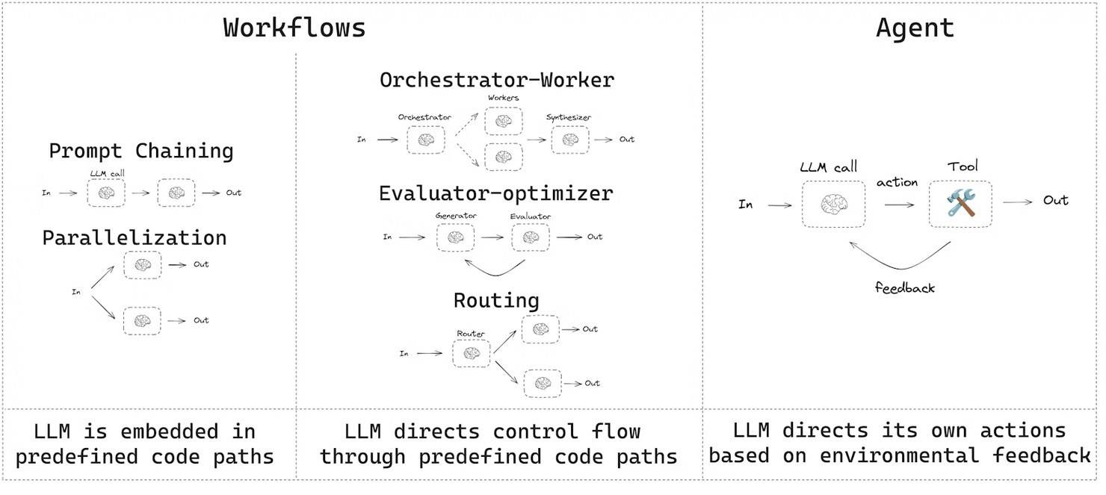
Workflows are graphs, and agents are loops inside them
Two shapes
Part 1 · Do you need a graph at all
Workflow: predefined code paths
Agent: the model directs its own process
Production graphs are mostly fixed shapes with one or two agent nodes
Production agents retry and revise, so they need cycles, which a DAG forbids
LangGraph docs, "Workflows and agents", after Anthropic (2024)
Graph engineering for agents means cyclic graphs, because retrying and revising need a way back.
Source: notes/01-graph-vs-loop.md
4
Notes:
On the left are the workflow shapes you have seen, on the right the agent loop. Most real systems put a couple of those loops inside a fixed shape. One lesson from LangChain matters here: an agent must go from A to B, find B failed, and come back. A DAG cannot say that. Anything that forbids cycles is a workflow engine, not an agent framework.
Source: notes/01-graph-vs-loop.md

Slide 5
Five signals that justify a node
The test
Part 1 · Do you need a graph at all
Start with a loop. Add a node only when one of these forces it.
Signal | Why the loop fails
Distinct specialties | One agent carries each role's baggage into the next
Parallel fan-out and join | A loop is sequential, so wall-clock cost is unnecessary
Per-step model or tool | One agent enforces one model and one tool policy
Auditable control flow | Emergent loop paths are hard to reconstruct
Overloaded verifier | A dedicated reviewer removes criteria confusion
Escalating to a graph is a cost you justify with a specific signal, and not a maturity level you graduate to.
Source: notes/01-graph-vs-loop.md
5
Notes:
Run our review loop against this list. Does it need parallel work? Different models? If nothing applies, stop. And beware the name. Raieli and Iuculano's travel planner has four agents, but a controller calls them in a fixed order and no edge is conditional. That is a pipeline, and it is better for being one.
Source: notes/01-graph-vs-loop.md

Slide 6
Split the verifier before you split the system
Worked example
Part 1 · Do you need a graph at all
PYTHON
One check judging four things does all four badly
# sketch: before, one call judges everything
ok = llm_judge(draft, "correct, safe, complete?")
# after: one check per criterion, in the same loop
checks = {
"tests": run_tests(), # code
"schema": valid_schema(draft), # code
"safety": llm_judge(draft, RULE), # model
}
failing = [k for k, ok in checks.items()
if not ok]
Turn what you can into code
Measure again; if the pass rate recovers, ship the loop
If one criterion still fails, it has earned its own node
The most common "we need a graph" is really an overloaded verifier, which you can split inside the existing loop.
Source: notes/06-when-not-to-build-a-graph.md
6
Notes:
This is what I would do with our review loop first. One judge is being asked about correctness, style, safety and completeness at once. Split it, make the mechanical parts code, and measure. The sketch is a shape and not a library. Either the loop recovers, or you now know exactly which node to add.
Source: notes/06-when-not-to-build-a-graph.md

Slide 7
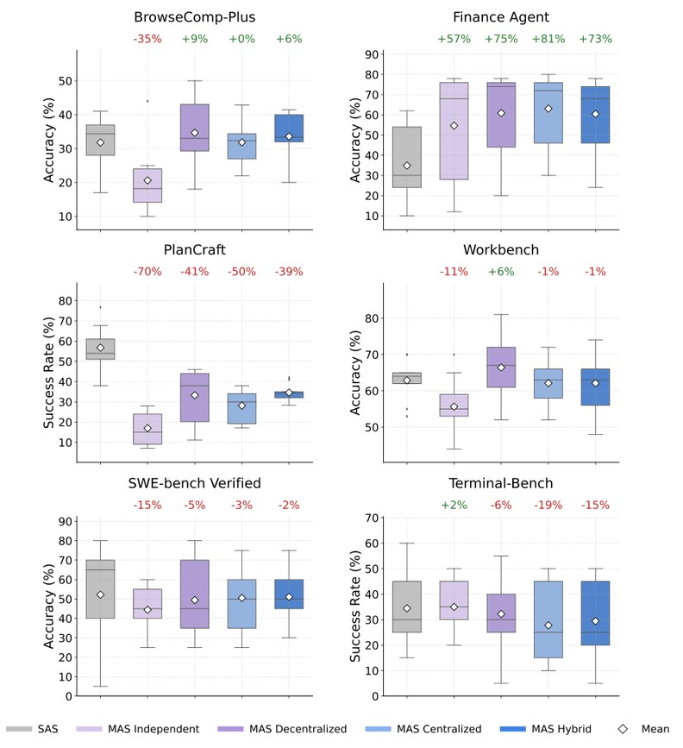
Adding agents averaged out to nothing
The evidence
Part 1 · Do you need a graph at all
260 configurations, six benchmarks, compute matched
Finance Agent: centralized team +80.8%; PlanCraft: every variant lost 39–70%
Mean change −0.3%, 95% CI −58.7% to +77.2%
Above about 45% single-agent score, more agents had negative returns
Kim et al., Towards a Science of Scaling Agent Systems (2025), Fig. 2
Across 260 controlled configurations the mean multi-agent gain was −0.3%, so the task shape decides.
Source: notes/06-when-not-to-build-a-graph.md
7
Notes:
Kim and colleagues matched compute and ran 260 configurations. Finance Agent splits into parallel subtasks, and a centralized team scored 80.8 percent higher. In PlanCraft each step constrains the next, and every variant lost. The mean is close to zero with an enormous interval. So check how your task decomposes, and whether a single agent already does well.
Source: notes/06-when-not-to-build-a-graph.md

Slide 8
Fan-out costs tokens whether it helps or not
The bill
Part 1 · Do you need a graph at all
Anthropic's research system
Controlled runs
Vendor estimate
Poor fit
Kim et al. saw 1.6–6.2× a single agent's tokens at matched performance
About 3× tokens per cycle, break-even near a 50% pass rate (flowtivity); test it
Every agent needs the same context, or the agents depend on each other
Agents use about 4× a chat's tokens; multi-agent systems about 15×
Fan-out pays only for high-value work whose branches are truly independent, so measure your own break-even.
Source: notes/06-when-not-to-build-a-graph.md
8
Notes:
Three sources and one shape. The first figure is first party, the second controlled, the third a vendor estimate, so treat that one as something to test. The logic is sound: when most cycles fail and get redone, you pay fan-out for work you throw away. Run the same tasks both ways and record tokens, wall-clock time and pass rate.
Source: notes/06-when-not-to-build-a-graph.md

Slide 9
If you do need one, grow it in this order
Monday morning
Part 1 · Do you need a graph at all
adopt incrementally
1
Bottleneck — Write down the workflow and where it stalls
2
Real edges — Mark each step: reads the previous output, or incidental
3
3–5 nodes — Sketch a few. Not twelve
4
Baseline — Loop against graph: tokens, wall-clock, pass rate
5
One at a time — Each node justified by a signal
Adopt a graph by finding real edges, sketching 3 to 5 nodes, and adding nodes one at a time against a baseline.
Source: notes/06-when-not-to-build-a-graph.md
9
Notes:
Say our review loop did earn a graph, because it needs one reviewer per changed file. This order keeps you honest. Every node brings a prompt to maintain, state to synchronise and another place a wrong answer could come from. Next we build the smallest version, and see what each primitive buys.
Source: notes/06-when-not-to-build-a-graph.md

Slide 10
PART 2
A loop can't do what our reviewer now needs
Spend agency per node, as if it costs money
The whole program fits on a slide
The highest-yield first graph is generate, then verify
Every key has one writer or a reducer
Parallel writes without a reducer fail
One reviewer per changed file, decided at runtime
Checkpoints give you pause, resume and time travel
Publishing waits for a person
Gate the edges where consequence concentrates
Building the first graph
Nodes and edges · State and reducers · Pausing for a human
10
Notes:
Now we build it. Three problems drive this part. The checker must stay independent. Many reviewers must write at once without losing work. And the run must be able to stop, wait for a person and come back.

Slide 11
A loop can't do what our reviewer now needs
The problem
Part 2 · Building the first graph
We need an independent checker, one reviewer per changed file, and a human before publish. A single loop expresses none of them cleanly.
A graph earns its place when work needs independent checking, parallel workers or a pause, which one loop can't express.
Source: notes/02-graph-primitives.md
11
Notes:
These three needs set the agenda. The checker gives us nodes and edges. The per-file reviewers give us state and reducers. The human before publish gives us checkpoints. We will add them one at a time, to the same review graph.
Source: notes/02-graph-primitives.md

Slide 12
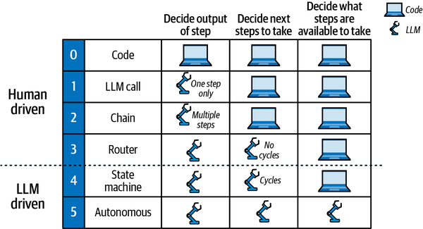
Spend agency per node, as if it costs money
Nodes
Part 2 · Building the first graph
Code: parsing, validation, API calls
Router or one LLM call: classify, summarise, draft
Agent: open-ended reasoning, many variable calls
Human checkpoint: approval, paid for in latency
Oshin & Campos, Learning LangChain (O'Reilly, 2025), Fig. 5-1
Use code where you can, one LLM call where you must, and an agent only where the path is unknown.
Source: notes/02-graph-primitives.md
12
Notes:
The figure orders architectures by who decides: the output, the next step, the available steps. Moving down gives the model more freedom and costs you predictability. In our review graph, parsing the diff is code, summarising a file is one call, and almost nothing needs to be a full agent.
Source: notes/02-graph-primitives.md

Slide 13
The whole program fits on a slide
Edges
Part 2 · Building the first graph
PYTHON
Nodes read state and return only changed keys
builder = StateGraph(MessagesState)
builder.add_node("node_a", node_a)
builder.add_node("node_b", node_b)
builder.add_edge(START, "node_a")
builder.add_conditional_edges("node_a", router)
builder.add_edge("node_b", "node_a") # cycle
graph = builder.compile()
def router(state) -> str:
# ordinary code over state
if needs_more(state):
return "node_b"
return END
The router is plain code naming the next node
Conditional edges give branches, gates, cycles and early exit
A graph program is nodes that return changed keys, plus routers that are ordinary code choosing the next node.
Source: notes/02-graph-primitives.md
13
Notes:
Nothing here is an LLM until you put one in a node. The router is a plain function. That matters, since routing you can read is routing you can test. The last edge makes the cycle, and the rest of this part fills in what state carries.
Source: notes/02-graph-primitives.md

Slide 14
The highest-yield first graph is generate, then verify
The first shape
Part 2 · Building the first graph
Generate
produces a draft
Verify
tests, schema, rubric
Done
passes or attempts exhausted
back-edge with the critique, bounded by an attempt counter
The verifier sees the task and the output, never the generator's reasoning
The back-edge carries the critique into the next attempt
A verifier that sees only the task and the output stays independent, and an attempt counter bounds the back-edge.
Source: notes/02-graph-primitives.md
14
Notes:
This is where our review graph starts: two nodes and a bounded back-edge. Keep two things straight. The critique travels back to the generator, but the reasoning never travels forward to the verifier. If it did, the verifier would inherit the framing and find the argument convincing.
Source: notes/02-graph-primitives.md

Slide 15
Every key has one writer or a reducer
State
Part 2 · Building the first graph
PYTHON
operator.add concatenates parallel writes
class ReviewState(TypedDict):
task: str # set once, read by all
draft: str # one writer: generator
findings: Annotated[list[str],
operator.add]
# many writers: reducer
attempts: int # the bound on the cycle
Custom reducers can dedupe
attempts lives in state so the router can bound the cycle
Decide up front who writes each state key, and give any key with several writers a reducer.
Source: notes/03-state-and-reducers.md
15
Notes:
State is what the nodes coordinate through, so the type is the design. Read this class as a writing policy. The task is set once. The draft belongs to the generator. Findings have many writers, so they need a reducer. And the counter is here because a router can only read what is in state.
Source: notes/03-state-and-reducers.md

Slide 16
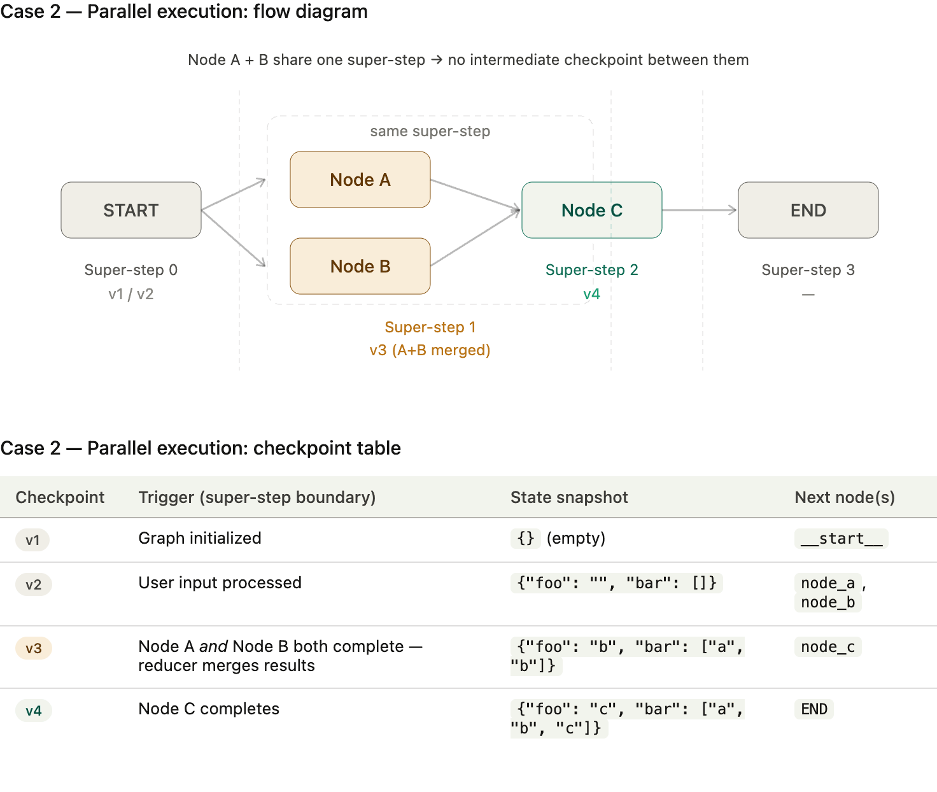
Parallel writes without a reducer fail
What breaks
Part 2 · Building the first graph
Branches A and B run in one super-step
No checkpoint falls between them
Same key, no reducer gives InvalidUpdateError
Outside LangGraph the same race silently loses work
LangGraph docs (LangChain), via sources/langgraph_extended.pptx
Branches in one super-step that write one key with no reducer raise an error in LangGraph and lose work elsewhere.
Source: notes/03-state-and-reducers.md
16
Notes:
With a reducer, the checkpoint in the figure holds both writes merged before C runs. Without one, LangGraph raises an error and you are lucky, because you find out. A hand-rolled system has the same race and no error. You just lose a reviewer's findings on the occasional run, and nobody notices.
Source: notes/03-state-and-reducers.md

Slide 17
One reviewer per changed file, decided at runtime
Fan-out
Part 2 · Building the first graph
PYTHON
Each Send carries its own private input
def fan_out(state) -> list[Send]:
return [Send("review_file",
{"path": p,
"task": state["task"]})
for p in state["changed_files"]]
builder.add_conditional_edges(
"plan", fan_out, ["review_file"])
builder.add_edge("review_file", "synthesize")
Results merge through the reducer
Cap N: unbounded fan-out is a cost bug
To tell a real edge from an incidental one, ask whether the next step reads the previous output. If not, fan out.
Source: notes/03-state-and-reducers.md
17
Notes:
We do not know how many files changed until the run begins, so static edges cannot express this. Send decides at runtime. Files do not read each other's reviews, so those edges were incidental and can fan out. The synthesis does read them, so that edge is real.
Source: notes/03-state-and-reducers.md

Slide 18
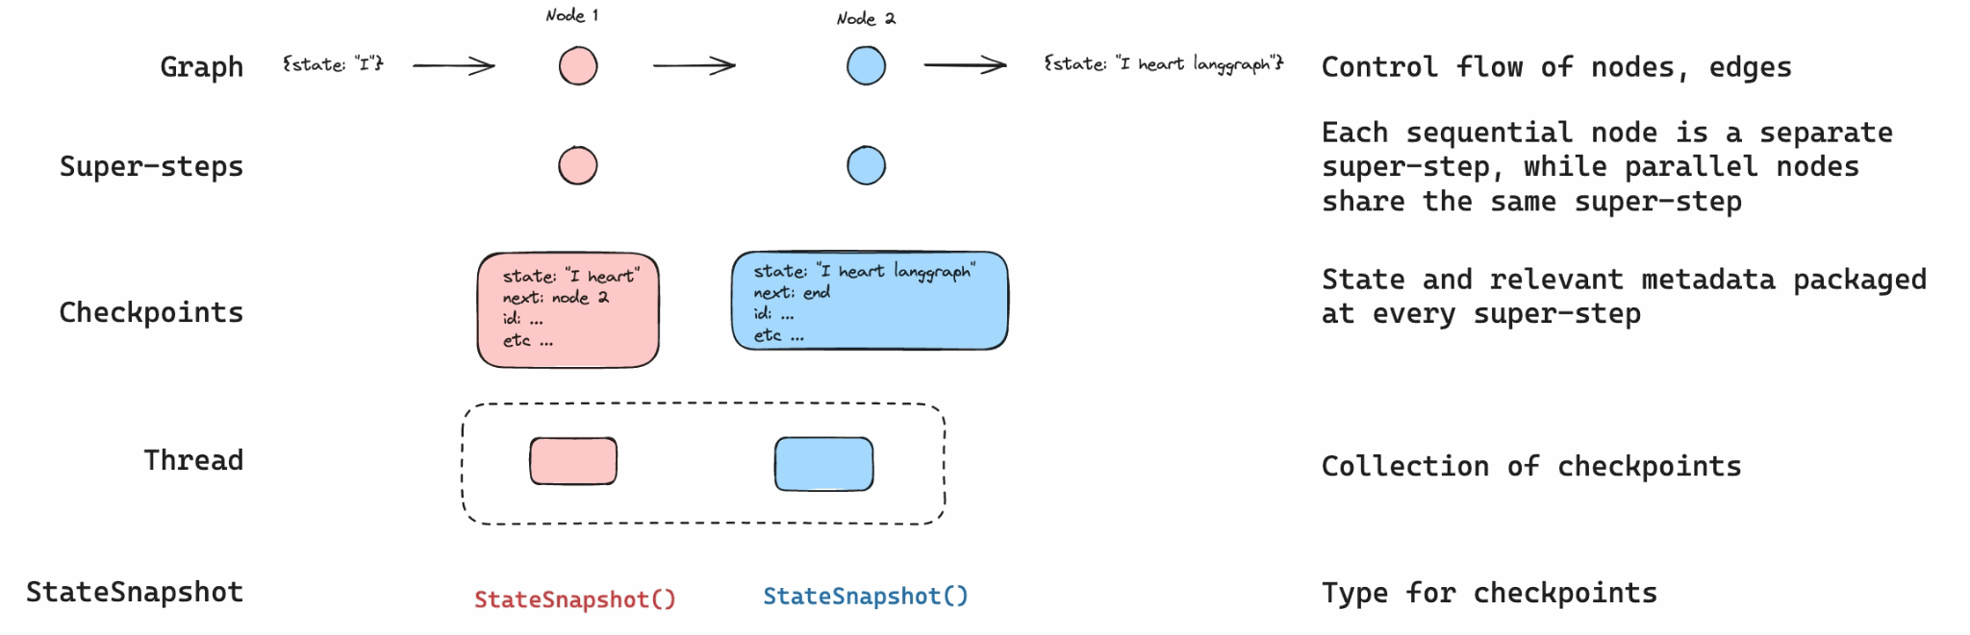
Checkpoints give you pause, resume and time travel
Pausing
Part 2 · Building the first graph
A checkpoint after every super-step
A thread collects them under one thread_id
Human-in-the-loop, crash resume and time travel share one mechanism
LangGraph docs, persistence (LangChain), via sources/langgraph_extended.pptx
Saving state after every super-step gives one mechanism for human approval, crash recovery and time travel.
Source: notes/04-durable-execution-and-interrupts.md
18
Notes:
A loop lives in a call stack, so when the process dies, the state dies with it. Writing state out after each super-step solves three problems at once. Choose the thread ID deliberately, because it decides what counts as the same conversation. Ours is review-42.
Source: notes/04-durable-execution-and-interrupts.md

Slide 19
Publishing waits for a person
Worked example
Part 2 · Building the first graph
PYTHON
interrupt() passes the human what they need
graph = builder.compile(checkpointer=saver)
config = {"configurable":
{"thread_id": "review-42"}}
def publish(state):
decision = interrupt(
{"draft": state["draft"]})
if decision != "approve":
return {"status": "rejected"}
send_to_cms(state["draft"]) # after
return {"status": "published"}
graph.invoke({"task": "..."}, config) # pauses
graph.invoke(Command(resume="approve"), config)
Gotcha: the node reruns from line 1 on resume
So keep side effects after the interrupt
interrupt_before/after are for debugging
On resume a node reruns from its first line, so any side effect belongs after the interrupt.
Source: notes/04-durable-execution-and-interrupts.md
19
Notes:
This is the last piece of our review graph. The first invoke pauses inside publish. The second one, perhaps a day later, resumes it. The trap is that resume does not continue from the interrupt line. It runs the node again, so a send placed above the interrupt would send twice. Put the interrupt inside a tool and the gate travels with the tool.
Source: notes/04-durable-execution-and-interrupts.md

Slide 20
Gate the edges where consequence concentrates
Monday morning
Part 2 · Building the first graph
"Human approval checkpoints ... at exactly the edges where consequence concentrates." (TrueFoundry)
Gate before | Why
Irreversible actions: send, pay, delete, deploy | Can't be undone, so check first
Crossing a trust boundary: external API, other tenant | Someone else bears the cost
Low-confidence router decisions | Cheap for a human, expensive to mis-route
After the plan, before the build (n8n) | The plan is the cheapest thing to correct
A gate on every node trains people to approve without reading, so gate only where consequence concentrates.
Source: notes/04-durable-execution-and-interrupts.md
20
Notes:
The first graph is now complete: generate, verify, one reviewer per file, a gate before publish. It has one gate, because of what too many gates do to the humans behind them. Look through your own graph on Monday, and find the single edge you could not take back.
Source: notes/04-durable-execution-and-interrupts.md

Slide 21
PART 3
Fifty nodes ran and one broke production. Which?
Five topologies recur
Should the agents share a context?
A second agent helps only if it adds information
Mechanical failures come from the wiring
Bounds belong in the wiring
Swarms fail in ways single agents don't
Coupled loops drift together, so keep an anchor
Operate the graph, don't just demo it
n8n's workflow builder: every loop has a bound
Running it in production
Topologies · Who adds information · Failures · Who pays
21
Notes:
Our graph now works in a demo. This part is about what happens next: more shapes to choose from, a harder test for adding agents, the failures only graphs have, and how to find out what a run actually did.

Slide 22
Fifty nodes ran and one broke production. Which?
The problem
Part 3 · Running it in production
A graph run can spawn fifty nodes, each calling models and tools. Without attribution you can't say which one spent the money or made the decision.
Graphs spread cost and decisions across many nodes, so every model and tool call has to carry its node's identity.
Source: notes/08-governance-and-production.md
22
Notes:
A single loop has one identity and one bill. A graph has neither. With Send and conditional edges, the graph that ran is not even the graph you drew. We will come back to attribution at the end of this part, once we have seen the failures that make it matter.
Source: notes/08-governance-and-production.md

Slide 23
Five topologies recur
The catalogue
Part 3 · Running it in production
Pattern | Shape | Use when | Fails by
Generate-then-verify | produce, check, back-edge | Produce and check split cleanly | Checker sees producer's reasoning
Supervisor | router, specialists, router | Work arrives in several kinds | Mis-routing, bottleneck
Fan-out and fan-in | split, N workers, merge | Many independent items | Missing reducer, correlated errors
Hierarchical | subgraph as one node | Reused or team-owned sub-topology | Failures hidden inside
Handoff | status key read by an edge | Agents shouldn't know each other | Status values drift
Five shapes cover most graphs, and each has a named failure, so choosing a shape also chooses what to watch.
Source: notes/05-topology-patterns.md
23
Notes:
Our review graph already combines two of these, generate-then-verify and fan-out. Read the last column most carefully. You can also search for a topology: Meta Agent Search in ADAS writes agents as code and scores them, but its evaluator runs model-written code in your process, so sandbox it.
Source: notes/05-topology-patterns.md

Slide 24
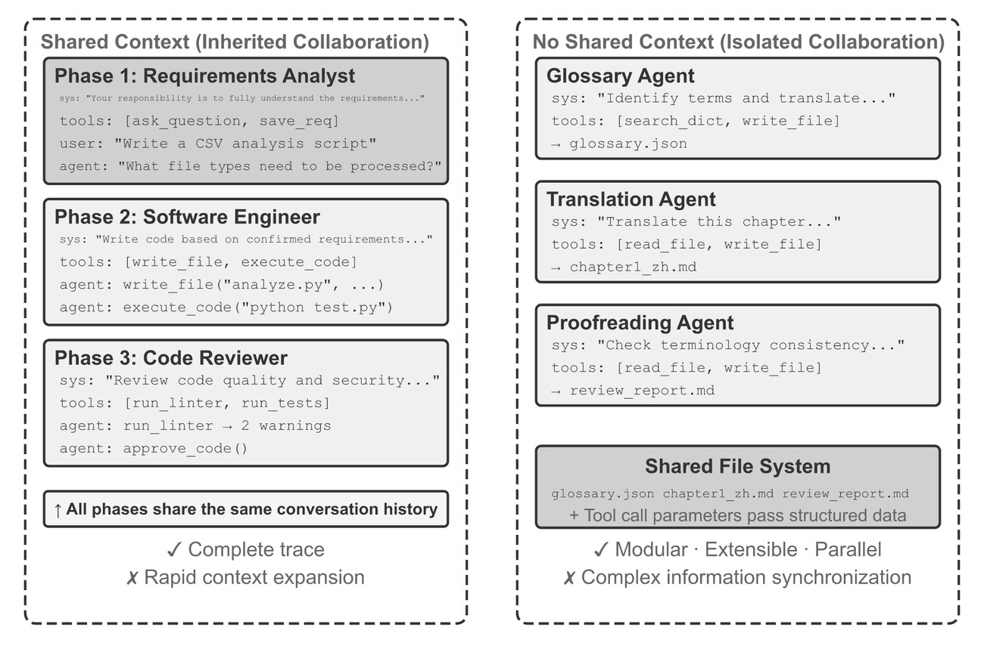
Should the agents share a context?
A design dimension
Part 3 · Running it in production
Shared: one trajectory, like threads; nothing lost, everything accumulates
Isolated: own window, like processes; only what is passed
Isolation keeps a verifier independent
Pass file paths, not file contents
Li, AI Agents in Depth, ch. 10, Fig. 10-1 (Apache-2.0)
Isolate contexts if the cumulative trajectory would pass about half the window; share if no information can be lost.
Source: notes/05-topology-patterns.md
24
Notes:
Li's analogy is threads against processes. Our verifier must be isolated by design. Our per-file reviewers can be too, since each needs only a brief. Agents pass meaning and not bytes, and a message can be misread, so every interface needs a contract the receiver can check.
Source: notes/05-topology-patterns.md

Slide 25
A second agent helps only if it adds information
A harder test
Part 3 · Running it in production
Same information
New information
Self-review with no tools is often neutral or harmful
Execution, tool or visual feedback
WebGen-Agent screenshots took Claude 3.5 Sonnet from 26.4% to 51.9%
Debate among copies: a single agent was best or tied above 100 thinking tokens (Tran & Kiela)
A reviewer earns its node when it can run something
Recombining adds nothing
Tests, browser, search
A reviewer that only rereads text is the same model a second time; it earns a node when it can run something.
Source: notes/05-topology-patterns.md
25
Notes:
This is the data-processing argument: recombining the same information cannot add any. It has a boundary. With 70 percent of the context masked, a sequential pipeline beat the single agent, which is a context problem and not new information. So give our reviewer the test runner.
Source: notes/05-topology-patterns.md

Slide 26
Mechanical failures come from the wiring
What breaks first
Part 3 · Running it in production
Failure | Detect | Fix
Infinite cycle | GraphRecursionError (recursion_limit, default 25) | Attempt counter in state, bound per node
Deadlock | Run idle at a join | Explicit join inputs; error nodes still write the key
Race on shared state | InvalidUpdateError, or silent loss | A reducer or one writer per key
Unbounded fan-out | Token spend spikes, rate limits | Cap N; budget per run and per node
Mis-routing | Route distribution in traces | Test the router as a classifier
File-space collision | Diffs match no single worker | One worktree per worker
Wiring failures such as cycles, deadlocks and races have mechanical detectors and fixes, if you let the framework report them.
Source: notes/07-failure-modes-at-scale.md
26
Notes:
These are the friendly failures, since something visibly goes wrong. Our review graph could hit several. A reviewer that errors without writing its key leaves the join waiting forever, so route errors to a node that still writes. The harder ones are coming.
Source: notes/07-failure-modes-at-scale.md

Slide 27
Bounds belong in the wiring
Worked example
Part 3 · Running it in production
PYTHON
Every back-edge has a counter
# sketch: three bounds on the review graph
MAX_ATTEMPTS, MAX_FILES = 3, 20
def route_after_verify(state) -> str:
if state["passed"]:
return "publish"
if state["attempts"] >= MAX_ATTEMPTS:
return "escalate"
return "generate"
def fan_out(state) -> list[Send]:
files = state["changed_files"][:MAX_FILES]
return [Send("review_file", {"path": p})
for p in files]
graph.invoke(inputs, {"recursion_limit": 40})
Every Send has a cap on N
recursion_limit is set deliberately
The limits here are illustrative
Before running unattended, give every back-edge a counter, every Send a cap, and recursion_limit a chosen value.
Source: notes/07-failure-modes-at-scale.md
27
Notes:
This is the pre-flight check as code. The numbers are mine, chosen for illustration, so pick yours from your traces. Notice the escalate route. When attempts run out, the honest outcome is to say so and not to publish the last draft.
Source: notes/07-failure-modes-at-scale.md

Slide 28
Swarms fail in ways single agents don't
What breaks at scale
Part 3 · Running it in production
Correlated errors
Byzantine faults
Semantic conflicts
Shared model, prompt and index, so N agreeing workers are not N independent ones
Agents fail by being confidently wrong; timeouts can't catch that
Both writes succeed and the result is still wrong; reducers don't help
Cascading amplification
MAST
Structure beats wording
Merged unchecked, errors grew 17.2×; an orchestrator held them to 4.4× (Kim et al.)
14 failure modes in three groups, κ = 0.88
Better prompts and roles improved ChatDev by only +15.6%
Most multi-agent failures are structural, so fix topology and verification before you reword prompts.
Source: notes/07-failure-modes-at-scale.md
28
Notes:
In the book's translation lab the glossary agent mistranslated reasoning. The translator applied it faithfully, and the proofreader, checking against the glossary, saw perfect consistency. Every stage did its job and the error survived all of them. Hence the fix: a reviewer who reads the output against the source. The 17.2 and 4.4 are error counts relative to a single agent, and Kim et al. read them as descriptive, since amplification did not predict success in their regression.
Source: notes/07-failure-modes-at-scale.md

Slide 29
Coupled loops drift together, so keep an anchor
What breaks last
Part 3 · Running it in production
Control failures
The answer to each
Goodhart: the metric detaches from its meaning
Paired metrics, with a counter-metric
Owned references, held by slower loops
Upward blindness: a loop can't question its target
Separated cadences, where fast loops escalate
Inter-loop conflict: loops fight each other
Frozen nodes: anchors the graph can't edit
Measurement decay: the gauge gets tuned
Held-out tests, banked revenue
Without an anchor the graph can't edit, it stays perfectly self-consistent while drifting far from reality.
Source: notes/07-failure-modes-at-scale.md
29
Notes:
This reading comes from Eigent, a vendor blog, though each failure has an older name in control theory. The danger is that nothing looks wrong: every loop agrees with every other loop, and they are all wrong. An anchor made tunable is an anchor that will eventually be tuned.
Source: notes/07-failure-modes-at-scale.md

Slide 30
Operate the graph, don't just demo it
Back to attribution
Part 3 · Running it in production
Identity
Budgets
Records
graph_id: topology and version
Per node: one node looping
The actual runtime graph, not the declared one
run_id / thread_id: one execution
Per run: a whole run going wrong
Model calls through a named alias, so rollback is a config change
node_id: cost and errors per node
Per tenant: one customer draining the pool
Carry graph, run and node IDs on every call, and budget per node, per run and per tenant.
Source: notes/08-governance-and-production.md
30
Notes:
This answers the opening question. With node_id on every call you learn why a run was expensive, and not just that it was. The tenant level is the one a run-scoped framework can't enforce alone, since the limit has to hold across concurrent runs, so it usually lives in a gateway.
Source: notes/08-governance-and-production.md

Slide 31
n8n's workflow builder: every loop has a bound
Case study
Part 3 · Running it in production
From a third-party teardown (Rathod), not n8n itself. Check the repository before relying on the constants.
Node | Role | Bound
Supervisor | Routes each message to a subgraph | -
Discovery | Explores the node registry | 50 iterations
Planner | Builds a plan, then pauses for approval | -
Builder | Executes tool calls | 100 per session
Responder | Renders the user-facing reply | -
Parameter Updater | Surgical edits to node parameters | -
n8n's reported design: per-node bounds, one gate after planning, and a 30K cap on the artifact under construction.
Source: notes/08-governance-and-production.md
31
Notes:
Everything we covered appears here. Specialisation is prompt-only, on the same model. Compaction triggers at 150K in a 200K window, and the workflow itself is capped at 30K tokens, so the agent can't fill its context with the thing it is editing. That closes the execution graph. Now, the other graph.
Source: notes/08-governance-and-production.md

Slide 32
PART 4
The top vector hits didn't mention the entity
Two things are called "graph"
Entities, and relationships that carry facts
Cypher lets you draw the pattern you want
From text to a graph you can trust
Keep mentions, and never merge at extraction time
Extract, enhance, expand
What GraphRAG actually showed
Five ways to retrieve, tried in order
The QA agent is generate-then-verify again
The other kind of graph
Knowledge graphs · Building one with LLMs · Retrieval and text-to-Cypher
32
Notes:
New problem, new example. We leave the review graph and turn to SEC filings from the Neo4j course. Here a graph is data and not execution. We will see why vector search needs it, how to build one you can trust, and how to query it.

Slide 33
The top vector hits didn't mention the entity
The problem
Part 4 · The other kind of graph
"How is Lauritsen related to cyclotron research?" The top three chunks scored 0.906, 0.903 and 0.902. Only the first mentioned Lauritsen.
KG & LLMs in Action, ch. 13
Embeddings encode overall meaning and don't guarantee a named entity is present, so high scores can miss the entity.
Source: notes/11-kg-rag-and-text-to-cypher.md
33
Notes:
Three near-identical scores, and two of those chunks never name the person we asked about. Vector retrieval is doing its job. It finds text with similar overall meaning. Facts split across chunks, aggregate questions and exact entities all need something else.
Source: notes/11-kg-rag-and-text-to-cypher.md

Slide 34
Two things are called "graph"
A warning about the word
Part 4 · The other kind of graph
 | Agent graph | Knowledge graph
Nodes are | Units of computation | Entities
Edges are | Permitted transitions | Typed relationships
The graph is | Execution topology | Data structure for retrieval
Runtime concern | Routing, state, cost | Traversal, entity resolution
An agent graph is execution topology and a knowledge graph is a data structure; they share only a name until agents share memory.
Source: notes/01-graph-vs-loop.md
34
Notes:
Everything so far was the left column. From here on we are in the right column, so a node is an entity like a company or a fund manager. The two meet in the final part of the talk, where a knowledge graph becomes the state that agents coordinate through.
Source: notes/01-graph-vs-loop.md

Slide 35
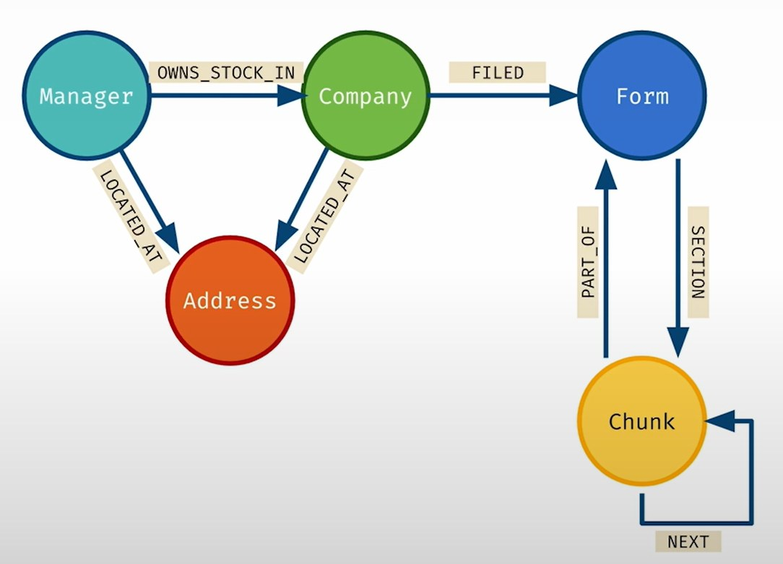
Entities, and relationships that carry facts
The data model
Part 4 · The other kind of graph
Nodes carry labels and properties
Relationships are typed and directed, and carry properties: value sits on OWNS_STOCK_IN
LPG (Neo4j): properties on edges, Cypher
RDF: triples, SPARQL, ontologies
Knowledge Graphs for RAG, DeepLearning.AI and Neo4j (Kollegger, 2024)
A graph whose edges are all RELATED_TO says that things connect but not how, so the edge type holds the knowledge.
Source: notes/09-kg-fundamentals-and-cypher.md
35
Notes:
This is the SEC graph we will build. Evidence often belongs on the edge. In the book's rare-disease graph, each disease and phenotype link carries its reference and frequency as properties, and that single fact is why the chapter picks a property graph over RDF. Type 1 diabetes keeps two IDs, disease and phenotype, because its role depends on context.
Source: notes/09-kg-fundamentals-and-cypher.md

Slide 36
Cypher lets you draw the pattern you want
The query language
Part 4 · The other kind of graph
CYPHER
() nodes, -[]-> relationships
// co-actors of a person
MATCH (p:Person {name: $name})
-[:ACTED_IN]->(m:Movie)
<-[:ACTED_IN]-(co:Person)
RETURN co.name, collect(m.title) AS movies
// idempotent load: constraint + MERGE
CREATE CONSTRAINT unique_chunk IF NOT EXISTS
FOR (c:Chunk) REQUIRE c.chunkId IS UNIQUE;
MERGE (c:Chunk {chunkId: $id})
ON CREATE SET c.text = $text
MERGE matches or creates
A uniqueness constraint makes reloads safe
Cypher draws graph patterns in ASCII, and MERGE with a uniqueness constraint makes data loads idempotent.
Source: notes/09-kg-fundamentals-and-cypher.md
36
Notes:
Read the first query aloud and you have read the picture: a person, acted in, a movie, acted in by someone else. The second half matters more for us, because the pipeline we build next will reload data many times, and it must not create duplicates when it does.
Source: notes/09-kg-fundamentals-and-cypher.md

Slide 37
From text to a graph you can trust
Building one
Part 4 · The other kind of graph
Chunk
keep doc, page, offset
Extract
small model gives mentions
Resolve
stronger model and graph signals
Assemble
MERGE with provenance
Evaluate
false-merge rate blocks the load
An n-hop answer is right with probability pⁿ: 85% per hop is 44% over five hops
That is arithmetic and not a measurement, but errors compound with depth
Use the model only where judgement is needed
Errors compound per hop, so 85% per hop gives 44% over five, which makes entity resolution the load-bearing step.
Source: notes/10-building-kgs-with-llms.md
37
Notes:
Do the arithmetic first, and the pipeline explains itself. If each hop can be wrong, deep traversal multiplies the risk. Most per-hop errors are resolution errors: two entities merged, or one split. Hence the separate stage, the stronger model, and an evaluation that can block the load.
Source: notes/10-building-kgs-with-llms.md

Slide 38
Keep mentions, and never merge at extraction time
Worked example
Part 4 · The other kind of graph
CYPHER
The metagraph keeps resolution reversible
// raw mentions
(:Document)-[:HAS_PAGE]->(:Page)
-[:MENTIONS]->(:Entity)
// resolution evidence
(:Entity)-[:META_SIMILAR]->(:Entity)
// the KG proper
(:Entity)-[:RESOLVES_TO]->(:Canonical)
// graph-based resolution: weakly connected
// components over META_SIMILAR, one canonical
Weight false merges above missed merges
A high compression ratio rewards over-merging
Storing mentions and resolution evidence separately keeps merges reversible, and a false merge corrupts every path through it.
Source: notes/10-building-kgs-with-llms.md
38
Notes:
This schema has three layers. Mentions record what the text said, evidence records why two mentions might be the same, and canonicals are the current belief. If a merge turns out wrong, you undo the last layer and lose nothing. A merge in place has no such exit.
Source: notes/10-building-kgs-with-llms.md

Slide 39
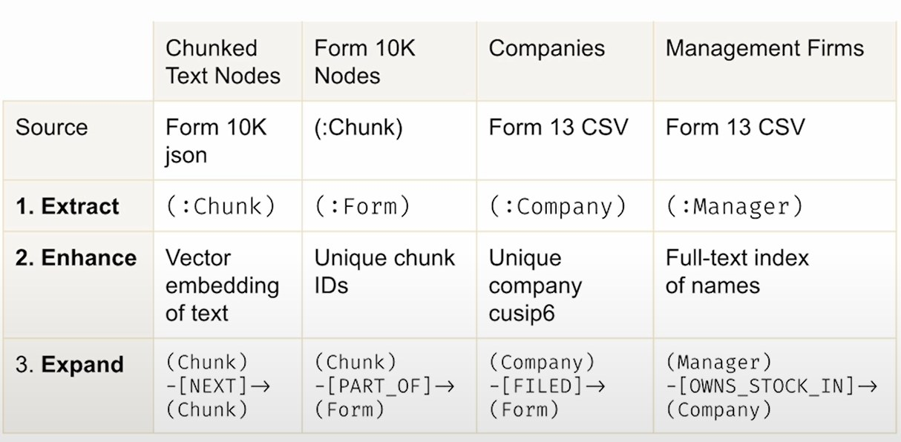
Extract, enhance, expand
The course's graph
Part 4 · The other kind of graph
Extract: 10-K text into Chunk nodes with embeddings
Enhance: NEXT and PART_OF add document structure
Expand: fuse Form 13 managers and holdings
One OWNS_STOCK_IN edge per quarter
Knowledge Graphs for RAG, DeepLearning.AI and Neo4j (Kollegger, 2024)
Start with a minimum viable graph, add document structure, then fuse structured data onto the same entities.
Source: notes/10-building-kgs-with-llms.md
39
Notes:
This is our SEC graph. Notice the order. Text first, because it is what you can search. Then structure, so chunks know their neighbours. Then a second source joined by key, where a manager owns stock in a company. The quarter sits on the relationship key, so each quarter gets its own edge.
Source: notes/10-building-kgs-with-llms.md

Slide 40
What GraphRAG actually showed
The evidence
Part 4 · The other kind of graph
Comprehensiveness
Diversity
Directness
The caveat
Win rates 72–83% (podcasts), 72–80% (news)
Win rates 75–82% and 62–71%
Vector RAG wins, with more concise answers
LLM judge, global sensemaking questions, corpora of about 1M tokens
GraphRAG's community summaries help whole-corpus questions, which falls short of showing that graphs beat vectors.
Source: notes/11-kg-rag-and-text-to-cypher.md
40
Notes:
Edge and colleagues at Microsoft Research pre-summarise communities in an entity graph. The judge was an LLM, with no ground truth accuracy. You may also meet a 53.4 versus 42.9 figure for multi-hop accuracy. That is a vendor post with no dataset or method, so do not quote it. Write your own test set.
Source: notes/11-kg-rag-and-text-to-cypher.md

Slide 41
Five ways to retrieve, tried in order
Choosing
Part 4 · The other kind of graph
Mode | Use when | Fails when
Vector | Local lookups: the passage about X | Multi-hop, aggregates, exact entities
Canned traversal | Known question shapes in production | A shape you didn't template
Text-to-Cypher | Open-ended questions over a well-named schema | Large or badly named schema, no validator
Hybrid | Vector entry points and graph expansion | Wrong entry points make expansion worse
Global | Themes across a whole corpus | Specific lookups, high indexing cost
Default to vector, then canned traversals, then text-to-Cypher with a validator for the long tail.
Source: notes/11-kg-rag-and-text-to-cypher.md
41
Notes:
The order is about risk. A canned traversal can't invent a relationship. Text-to-Cypher can, so it comes last and with a validator. In the course, widening each vector hit with its NEXT neighbours also surfaced NetApp's ONTAP software, which the plain retriever's answer left out. That is hybrid at its smallest.
Source: notes/11-kg-rag-and-text-to-cypher.md

Slide 42
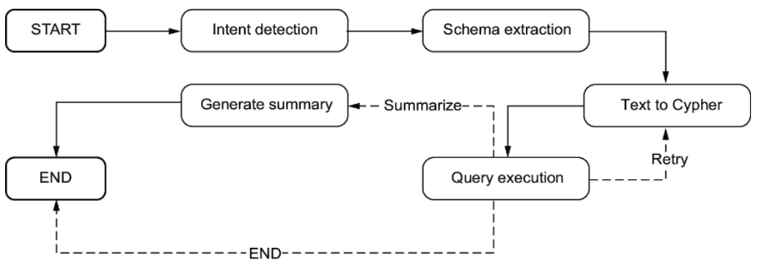
The QA agent is generate-then-verify again
Monday morning
Part 4 · The other kind of graph
Ask for relationships, then reasoning, then query
Annotate the schema; one few-shot fixes value on OWNS_STOCK_IN
The database is the verifier; retry on error is bounded
Negro et al., Knowledge Graphs and LLMs in Action, Fig. 15.3 (2025)
Missing: an EXPLAIN validator before execution
Text-to-Cypher is a bounded generate-then-verify loop, and listing relationships first reduces invented relationship types.
Source: notes/11-kg-rag-and-text-to-cypher.md
42
Notes:
And here the two graphs touch for the first time: a knowledge graph queried by an execution graph. The back-edge carries the database error to the next attempt. The typed state doubles as an audit trail, and a free dataset of failures. If you try one thing Monday, put EXPLAIN in front of execution.
Source: notes/11-kg-rag-and-text-to-cypher.md

Slide 43
PART 5
Where the graphs meet
A swarm keeps rediscovering what it already found
Each step moves something out of the agent
All the safety lives in the write path
Whoever owns the schema owns the errors
Know the pattern? Hand-written features can win
Build a shared-memory swarm in four gates
Shared memory · The write path · Learning on graphs
43
Notes:
Last part. Parallel agents repeat each other's work because each run starts fresh. What if the knowledge graph were their shared state? It works, and it makes mistakes permanent, so most of this part is about the write path.

Slide 44
A swarm keeps rediscovering what it already found
The problem
Part 5 · Where the graphs meet
A swarm alone re-derives findings. A swarm writing to a shared graph accumulates them. The agent forgets; the graph does not, and that cuts both ways.
Execution-state mistakes die with the run, while knowledge-graph mistakes persist and spread to every later reader.
Source: notes/12-kg-as-shared-agent-memory.md
44
Notes:
Execution state lives for one thread, and only the graph's own nodes read it. A knowledge graph lives across runs, for any agent and for people too. That lifetime is the appeal. It is also the risk, since nothing throws the mistakes away for you.
Source: notes/12-kg-as-shared-agent-memory.md

Slide 45
Each step moves something out of the agent
The progression
Part 5 · Where the graphs meet
Loop
iteration and evaluation
Swarm
parallel search, with redundancy
Graph
shared facts, provenance, memory
Loop: Karpathy's autoresearch keeps a change only if the metric improves
The swarm costs real money: Anthropic reports about 15× chat tokens
Topology makes spend tractable, not cheap
Loops externalise evaluation, swarms externalise search, and a shared graph externalises facts and provenance.
Source: notes/12-kg-as-shared-agent-memory.md
45
Notes:
The same move, three times. Autoresearch moves judgement into a fixed metric. A swarm moves search into parallel workers, and it creates redundancy. A graph moves shared facts into something that outlives them. Shared-graph workers can also spread a correlated error further, which is why the write path comes next.
Source: notes/12-kg-as-shared-agent-memory.md

Slide 46
All the safety lives in the write path
Worked example
Part 5 · Where the graphs meet
PYTHON
Workers submit, never write directly
@dataclass
class GraphUpdate:
nodes: list[dict] # id, type, props, spans
edges: list[dict] # src, type, dst, conf
run_id: str
agent_id: str
def publish(update, graph, validator):
validator.check_schema(update.nodes,
update.edges)
validator.check_provenance(update.nodes,
update.edges)
with graph.transaction() as tx:
tx.upsert_versioned_nodes(update.nodes)
tx.add_edges(update.edges)
tx.commit()
The reducer idea, at database scale
Validation runs before the transaction
Workers submit updates to a validator instead of writing directly, which is the reducer idea at database scale.
Source: notes/12-kg-as-shared-agent-memory.md
46
Notes:
Remember the reducer from our review graph: many writers, one rule for merging. This is the same idea with a longer lifetime. No worker gets a database connection. Each hands over a typed update, and the publisher checks schema and provenance before anything is stored.
Source: notes/12-kg-as-shared-agent-memory.md

Slide 47
Whoever owns the schema owns the errors
The non-negotiables
Part 5 · Where the graphs meet
Complete provenance
Reversible resolution
Claims are not truths
Every node and edge records run_id, agent_id and a source span
ALIAS_OF or RESOLVES_TO with evidence; never merge destructively
Agent A claims X, citing S. Contradictions live side by side
A shared graph stores claims with provenance and keeps contradictions, because no agent's write counts as truth.
Source: notes/12-kg-as-shared-agent-memory.md
47
Notes:
The anti-pattern is the chat transcript becoming the database. If a run's only durable record is its conversation log, you can't query it, can't roll it back, and the next agent can't read it without reading everything. These three properties are what make a graph more than a bigger transcript.
Source: notes/12-kg-as-shared-agent-memory.md

Slide 48
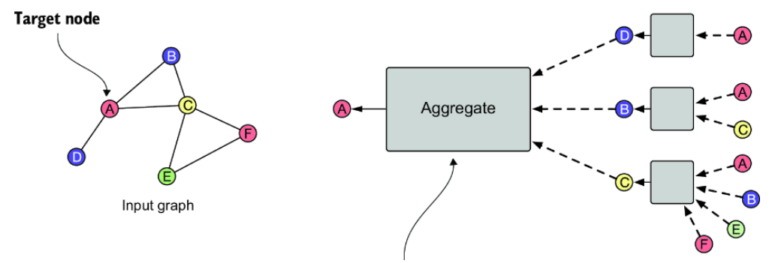
Know the pattern? Hand-written features can win
Learning on the graph
Part 5 · Where the graphs meet
Degree only: F1 0.43; Node2Vec: 0.64
Degree and neighbours per faction: 0.93, stable
Elliptic: SAGE caught 82.7% of illicit nodes; GCN missed 32%
Predicted links are claims, out of default traversals
Negro et al., Knowledge Graphs and LLMs in Action, Fig. 11.5 (2025)
Features are the graph ML bottleneck, and a false predicted link does what a false merge does to every later traversal.
Source: notes/13-graph-ml-and-gnns.md
48
Notes:
Connected nodes tend to be alike, so encoding that by hand beat an untuned embedding on the book's small example, where the test set is 14 members, so read the numbers small. Compute it from training labels only, or the test nodes leak answers. The figure shows message passing, where a GNN learns the same kind of thing. If such a model writes to the shared graph, it goes through the write path like any other agent.
Source: notes/13-graph-ml-and-gnns.md

Slide 49
Build a shared-memory swarm in four gates
Monday morning
Part 5 · Where the graphs meet
each step earns the next
One measured loop — A fixed metric and reversible actions
1
A role split — Generator and verifier with isolated contexts
2
A persistent graph — Gate: do queries across sessions work?
3
A swarm writing to it — Gate: wall-clock gain with no loss of quality
4
Build one measured loop first and add the swarm last, evaluating each layer by its own metric.
Source: notes/12-kg-as-shared-agent-memory.md
49
Notes:
This is the whole pillar in four steps. Evaluate by layer: extraction F1, false-merge rate, path validity and redundant findings. Each has a misreading, and a right answer through a wrong path is luck. We began by asking if you need a graph. This is the same question, asked four more times.
Source: notes/12-kg-as-shared-agent-memory.md

Slide 50
Rules of thumb
Keep these
Wrap-up
First graph
Agency
State
Generate-then-verify is the highest-yield first graph
Code where you can, one LLM call where you must, an agent only where the path is unknown
Every shared key has one writer or a reducer
Gates
Verifiers
Anchors
Gate the edges where consequence concentrates, not every node
See the task and the output, never the generator's reasoning
Keep at least one anchor the graph can't edit
Start with a loop, and add a node only when a specific signal forces it.
Source: notes/01-graph-vs-loop.md
50
Notes:
If you remember six things, make them these. Each came from a failure we walked through today, from the verifier that ratified a draft to the graph that agreed with itself while drifting away from reality.
Source: notes/01-graph-vs-loop.md

Slide 51
Where to go next
Keep going
Wrap-up
The lab: practice/langgraph-graph, in Python or TypeScript
Try this first
Your own domain: build a small graph, then a shared-memory swarm
Take a loop you already run, and split its verifier by criterion. Measure before you draw a single node.
The notes: every slide here has its code and figures in notes 01–13
Knowledge Graphs for RAG: the hosted DeepLearning.AI and Neo4j course
06-eval: measure whether the whole system is correct
The cheapest graph experiment is splitting one verifier by criterion and measuring before drawing any node.
Source: notes/06-when-not-to-build-a-graph.md
51
Notes:
The lab walks you through a graph with real code. Next pillar is evaluation, which asks the question we kept postponing today: how do you know the whole system is right? Thank you.
Source: notes/06-when-not-to-build-a-graph.md

