Slide 1
Python for Data Analysis
Part 1: Getting a table you can trust
Why a DataFrame · Alignment · Dtypes · Copy-on-Write · Cleaning in one function
Part 2: Asking for the right rows and tables
loc and iloc · Boolean masks · Merge with checks · Long and wide
From a messy export to a chart you can trust
Part 3: Summarising without fooling yourself
Split-apply-combine · agg and transform · The mean-of-rates trap · Lost keys
Load it · Select and join it · Summarise it · Respect time · See it
Part 4: Respecting time
Parsing · Frequencies · Resampling · Shift and rolling · Leakage
Part 5: Seeing the data
Figure and Axes · pandas plot · seaborn · Choosing a chart
Notes: data-analytics/01-python-for-data-analysis
Notes:
Today we meet pandas from the start. We follow one small online shop that sells kettles, grinders, filters and scales. Its data arrives as a messy export, and by the end we can load it, clean it, join it, summarise it and plot it. The theme is that the dangerous errors here do not raise exceptions. They produce a clean number that is wrong.

Slide 2
PART 1
Getting a table you can trust
Why not just use a list of dictionaries?
Pandas matches on labels, not on positions
Four checks on every new frame
Pandas 3: a selection behaves like a copy
The export becomes a clean frame in one rerunnable function
A gap is a question, not a value to fill
Why a DataFrame · Alignment · Dtypes · Copy-on-Write · Cleaning in one function
2
Notes:
We start with the data structure, and then with the file we actually receive. By the end of this part we have 11 clean orders, and we can account for every row we removed.

Slide 3
Why not just use a list of dictionaries?
The problem
Part 1 · Getting a table you can trust
A DataFrame is a table whose rows and columns carry labels, and whose operations match on those labels.
McKinney built pandas for labelled statistical data (SciPy 2010)
A DataFrame replaces loops over row dictionaries with named column operations that align on labels.
Source: notes/01-series-and-dataframe.md
3
Notes:
The shop's first orders fit in a list of dictionaries, and computing revenue means writing a loop for every question. With a frame, the same question is one line that says what it means. That saving is why pandas exists. But the deeper idea is the one on this slide: labels are not decoration. Let's see what they do.
Source: notes/01-series-and-dataframe.md

Slide 4
Pandas matches on labels, not on positions
Part 1 · Getting a table you can trust
PYTHON
Same label, same row, whatever the order.
week1 = pd.Series(
{"kettle": 4, "filter": 30, "grinder": 2})
week2 = pd.Series(
{"filter": 25, "scale": 6, "kettle": 5})
print(week1 + week2)
# filter 55.0
# grinder NaN
# kettle 9.0
# scale NaN
Result: the union of labels.
One side missing: NaN, not a guess.
Bare NumPy would add by position and give [29 36 7].
Arithmetic between Series aligns on labels and gives NaN where a label exists on only one side.
Source: notes/01-series-and-dataframe.md
4
Notes:
Two weeks of units sold, with products in different orders and not quite the same products. Filter meets filter, kettle meets kettle. Grinder has no partner, so the result is NaN, because pandas will not pretend it knows what two plus nothing is. The same numbers as bare arrays give 29, 36 and 7, which is meaningless, and nothing warns you.
Source: notes/01-series-and-dataframe.md

Slide 5
Four checks on every new frame
Part 1 · Getting a table you can trust
shape
dtypes
head
isna().sum()
Rows and columns. Did you get what the source says it holds?
A number stored as str will concatenate rather than add.
See real values: stray capitals, symbols, odd formats.
Gaps per column. A whole-number column printing .0 is hiding one.
Run shape, dtypes, head and isna().sum() on every new frame, since most problems show up there first.
Source: notes/01-series-and-dataframe.md
5
Notes:
This is the habit that pays for the whole chapter. Dtypes deserve special care because they decide what an operation means. And a column of whole numbers printing as floats is the classic sign of a missing value, because NaN is a float.
Source: notes/01-series-and-dataframe.md

Slide 6
Pandas 3: a selection behaves like a copy
Part 1 · Getting a table you can trust
PYTHON
Copy-on-Write is the only mode in pandas 3.
fixed = orders.copy()
fixed["qty"][fixed["customer"] == "ana"] = 0
# ChainedAssignmentError warning; nothing changes
fixed.loc[fixed["customer"] == "ana", "qty"] = 0
# one .loc call: this works
Old books warn about views and SettingWithCopyWarning, which is gone.
One rule: to change part of a frame, use a single .loc.
Under Copy-on-Write any selection acts as a copy, so change part of a frame with a single .loc call.
Source: notes/01-series-and-dataframe.md
6
Notes:
This is where older material will actively mislead you. The first form selects, then assigns onto a temporary that is thrown away, and pandas warns about it. The second makes the selection and the assignment in one call, so it reaches the frame.
Source: notes/01-series-and-dataframe.md

Slide 7
The export becomes a clean frame in one rerunnable function
Part 1 · Getting a table you can trust
13 raw rows go in, 11 orders come out, and every removal is accounted for.
Read the raw text
Find the comment line, the $, the n/a.
Parse with options
comment, na_values, dates
Fix text and types
Strip and lower text, then to_numeric.
Drop with reasons
One duplicate, one return.
Assert
Unique ids, no missing prices.
Keep the raw file unchanged. Next month's export runs through the same steps.
Do every cleaning step in one function over an unchanged raw file, so the work can be rerun and audited.
Source: notes/02-loading-and-cleaning.md
7
Notes:
The export has a comment line, Ana and ana, a filter with a trailing space, a dollar sign in the price, a duplicated order and a negative quantity. None of this is exotic. Each fix goes into one function that prints how many rows it loaded and kept. If you edit the file by hand, nobody can rerun your work, including you next month.
Source: notes/02-loading-and-cleaning.md

Slide 8
A gap is a question, not a value to fill
Part 1 · Getting a table you can trust
In the shop's export | What it means | What we did
region blank or - | Not recorded | Label it unknown, and keep the row
qty is n/a on order 1006 | A value that exists but got lost | Confirm with the owner, set it to 1
qty is -1 on order 1008 | A return, not a sale | Remove it, and say so
Order 1006 appears twice | Duplicate export row | Drop on order_id
Decide what to do with a missing value by asking why it is missing, because filling with the mean by reflex can invent data.
Source: notes/02-loading-and-cleaning.md
8
Notes:
Filling with the mean shrinks the variance and can invent values that are impossible. So ask why each gap exists. And when you coerce, count: errors equal to coerce turns every failure into NaN without a word.
Source: notes/02-loading-and-cleaning.md

Slide 9
PART 2
Asking for the right rows and tables
Which row is "row 1" after you filter?
The same frame, two meanings of a number
loc and iloc differ in more than labels
A careless join took revenue from 523.5 to 756.0
Four checks make any join safe
Long for analysis, wide for reading
loc and iloc · Boolean masks · Merge with checks · Long and wide
9
Notes:
Now we have a clean frame. This part is about asking for exactly the rows you mean, and bringing in other tables without changing the answer by accident.

Slide 10
Which row is "row 1" after you filter?
The problem
Part 2 · Asking for the right rows and tables
Filtering keeps the original labels, so label 3 can sit at position 1. loc and iloc then give different answers, and neither complains.
Say which you mean, every time
After a filter, labels and positions differ, so use loc for labels and iloc for positions.
Source: notes/03-indexing-and-selection.md
10
Notes:
With a fresh default index, labels and positions happen to match, which teaches a bad habit. The first filter breaks it. Everything in this chapter follows from keeping those two ideas apart.
Source: notes/03-indexing-and-selection.md

Slide 11
The same frame, two meanings of a number
Part 2 · Asking for the right rows and tables
PYTHON
iloc counts positions from zero.
filters = orders[orders["product"] == "filter"]
# order_id customer
# 1 1002 ben
# 3 1004 cara
# 6 1007 eli
# 9 1011 dev
filters.iloc[1]["order_id"] # 1004: second row
filters.loc[3]["order_id"] # 1004: label 3
filters.loc[0] # KeyError: 0
loc looks up labels, and label 0 was a kettle.
reset_index(drop=True) renumbers after a filter.
A filtered frame keeps its labels with gaps, so position 1 can be label 3 and label 0 may no longer exist.
Source: notes/03-indexing-and-selection.md
11
Notes:
Position 1 is the second row, whose label happens to be 3. Label 0 no longer exists, since order 1001 was a kettle. One more trap: a slice with loc includes its end, so loc zero to two has three rows, while iloc zero to two has two.
Source: notes/03-indexing-and-selection.md

Slide 12
loc and iloc differ in more than labels
Part 2 · Asking for the right rows and tables
loc
iloc
df.loc[0:2] includes the end: three rows
df.iloc[0:2] excludes the end: two rows
Takes masks and column names
Integers only, like a Python list
df.loc[mask, "qty"] = 0 is the way to set values
The way to say "the first row"
labels
positions
loc slices include the end and accept masks and names, while iloc slices exclude the end and accept only integers.
Source: notes/03-indexing-and-selection.md
12
Notes:
Masks combine with an ampersand and a pipe, with parentheses around each condition, because the words and and or do not work element by element. The sum of a mask counts the matching rows, and its mean is the share.
Source: notes/03-indexing-and-selection.md

Slide 13
A careless join took revenue from 523.5 to 756.0
Part 2 · Asking for the right rows and tables
PYTHON
Repeats on both sides multiply rows.
blown = orders.merge(promos, on="customer",
how="left")
# rows: 11 -> 16
# revenue: 523.5 -> 756.0, and no error
orders.merge(promos, on="customer", how="left",
validate="many_to_one")
# MergeError: Merge keys are not unique in right
validate turns a silent error into a loud one.
A merge on a key that repeats on both sides multiplies rows and inflates totals without error, so state validate.
Source: notes/04-reshaping-and-joins.md
13
Notes:
This is the most expensive mistake in the chapter. Ana has two orders and two promotions, so four rows. Ben has three orders and two promotions, so six. Revenue goes up because rows were duplicated, and nothing raised an error.
Source: notes/04-reshaping-and-joins.md

Slide 14
Four checks make any join safe
Part 2 · Asking for the right rows and tables
State how
The default inner join drops unmatched rows.
State validate
many_to_one checks the key really is unique on the right.
Compare row counts
Before and after: 11 and 11.
Compare one total
Revenue stays 523.5.
Audit unmatched keys with indicator=True, and clean keys first, since "Ana" and "ana " will not join.
On every merge state how and validate, then compare the row count and one total before and after.
Source: notes/04-reshaping-and-joins.md
14
Notes:
The same checks apply to any SQL you write later. With them in place, joining orders to customers and products answers a question no single table could. Brew gear brings the most margin at 142.0, but consumables keep about 62 of every 100 in revenue.
Source: notes/04-reshaping-and-joins.md

Slide 15
Long for analysis, wide for reading
Part 2 · Asking for the right rows and tables
Long (tidy)
Wide
Each variable is a column
Easy for people to scan
What groupby and seaborn expect
Good for reports
Get there with melt
Get there with pivot_table, and state aggfunc
one row per observation
one column per category
Tidy long data has one variable per column and one observation per row, which is what groupby and seaborn expect.
Source: notes/04-reshaping-and-joins.md
15
Notes:
Wickham's tidy data gives us the vocabulary. Before any aggregation, ask what one row means. Use plain pivot only when keys are unique, since it raises an error on repeats, and pivot_table otherwise.
Source: notes/04-reshaping-and-joins.md

Slide 16
PART 3
Summarising without fooling yourself
What is the margin rate in each region?
Every groupby is split, apply, combine
The method depends on what each group should return
Averaging rates overstates every region
Name your aggregates, and always keep a count
Split-apply-combine · agg and transform · The mean-of-rates trap · Lost keys
16
Notes:
Groupby answers most analyst questions. It is also where a confident wrong number most often enters a report.

Slide 17
What is the margin rate in each region?
The problem
Part 3 · Summarising without fooling yourself
The obvious answer, averaging a rate per order, gives the wrong number for every region in the shop.
The fix is one line, once you see it
Averaging per-order rates weights small and large orders alike, so it gives the wrong group rate.
Source: notes/05-groupby-and-aggregation.md
17
Notes:
It looks like a simple question, and it has a tempting wrong answer. We get to it after the model that makes groupby simple.
Source: notes/05-groupby-and-aggregation.md

Slide 18
Every groupby is split, apply, combine
Part 3 · Summarising without fooling yourself
Split
Divide rows by key.
Apply
Compute on each piece, on its own.
Combine
Put results into one object.
Wickham's name for the pattern (JSS 2011). Overlapping windows fall outside it and need rolling.
A groupby splits rows by key, applies a function to each piece independently, and combines the results.
Source: notes/05-groupby-and-aggregation.md
18
Notes:
Wickham gave this pattern its name. Think about what comes out of each piece, because that picks the method.
Source: notes/05-groupby-and-aggregation.md

Slide 19
The method depends on what each group should return
Part 3 · Summarising without fooling yourself
Method | Returns | Example
agg | One row per group | Revenue and count by region
transform | One value per original row | Each order's share of its region's revenue
filter | Some rows, kept or dropped by group | Customers with at least two orders
apply | Anything, rebuilt from each piece | Top order per region; slowest, so try the others first
agg returns one row per group, transform one value per original row, filter a subset of rows, and apply anything.
Source: notes/05-groupby-and-aggregation.md
19
Notes:
Agg shrinks. Transform keeps the shape, which is why it's the tool for adding a group statistic as a new column. Reach for apply last. It is the most flexible and the slowest.
Source: notes/05-groupby-and-aggregation.md

Slide 20
Averaging rates overstates every region
Part 3 · Summarising without fooling yourself
Margin rate by region, on the shop's 11 orders.
Region | Revenue | Margin | Mean of rates | True rate
east | 108.0 | 43.0 | 0.492 | 0.398
north | 169.0 | 69.0 | 0.453 | 0.408
south | 128.5 | 64.0 | 0.515 | 0.498
unknown | 118.0 | 46.0 | 0.415 | 0.390
To get a group's rate, sum the numerator and the denominator and then divide, because a mean of rates ignores size.
Source: notes/05-groupby-and-aggregation.md
20
Notes:
East has a small filter order at about 62 percent and a large grinder order at about 37. Averaging gives 0.492, while the shop kept 43 of 108, or 0.398. The ranking changes too: east beats north on the mean of rates and loses on the true rate. The same trap applies to conversion rate and to cost per click.
Source: notes/05-groupby-and-aggregation.md

Slide 21
Name your aggregates, and always keep a count
Part 3 · Summarising without fooling yourself
PYTHON
A mean of one order prints as confidently as a mean of ten thousand.
by_region = orders.groupby("region").agg(
revenue=("revenue", "sum"),
margin=("margin", "sum"),
orders=("order_id", "count"),
)
by_region["rate"] = (
by_region["margin"] / by_region["revenue"])
Missing keys vanish unless you pass dropna=False.
Check that the groups add up to the total.
Report a count beside every group statistic, and check that groups add up, because missing keys vanish by default.
Source: notes/05-groupby-and-aggregation.md
21
Notes:
Named aggregation gives you readable columns. Missing keys are the other silent loss here: a row with no region drops out of a groupby, so the groups no longer add up to the total. Size and count also differ when a column has gaps.
Source: notes/05-groupby-and-aggregation.md

Slide 22
PART 4
Respecting time
The whole year in one line
Old frequency names now raise an error
resample is a groupby on time bins
A window that peeks ahead is cheating
Three smaller rules that save real errors
Parsing · Frequencies · Resampling · Shift and rolling · Leakage
22
Notes:
The shop now has a full synthetic year of daily revenue. Time looks like one more grouping key, but it has its own rules.

Slide 23
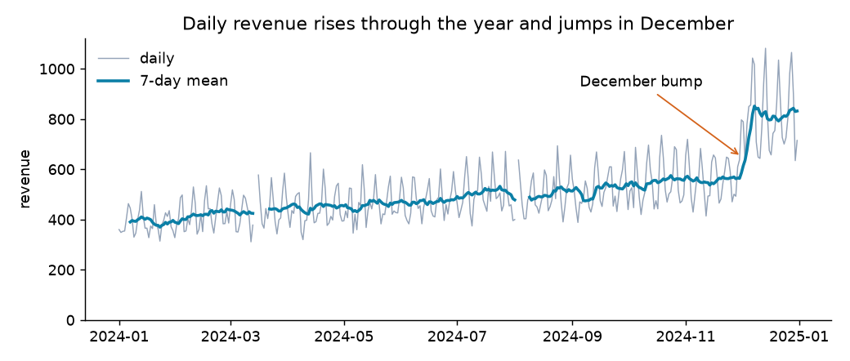
The whole year in one line
The problem
Part 4 · Respecting time
Rows have an order, so a previous value exists.
Months differ in length, so monthly totals are not directly comparable.
A missing day is often an absent row, invisible in a table.
Synthetic daily revenue for 2024, with trend, weekly pattern, outages and a December jump. Generated in the chapter's code.
Time series have ordered rows, unequal months and silently absent days, so they need more care than an ordinary grouping key.
Source: notes/06-time-series.md
23
Notes:
How did we do last month sounds like a groupby, and it nearly is. But rows have order, months differ, a label can sit at either end of a period, and an outage leaves no row at all. Here the line breaks in March for two lost days, because we made gaps visible.
Source: notes/06-time-series.md

Slide 24
Old frequency names now raise an error
Part 4 · Respecting time
Meaning | Current | Removed
Month end / month start | ME / MS | M
Quarter end | QE | Q
Year end | YE | A, Y
Hour | h | H
Minute | min | T
Second | s | S
Pandas 3 removed the frequency aliases M, Q, Y, H and T, so write ME, QE, YE, h and min instead.
Source: notes/06-time-series.md
24
Notes:
This is where code from older books breaks most often. The reason is a real ambiguity: ME says month end, as distinct from MS for month start. Datetimes also now default to microsecond resolution, so an integer conversion gives numbers a thousand times smaller than old code expected.
Source: notes/06-time-series.md

Slide 25
resample is a groupby on time bins
Part 4 · Respecting time
PYTHON
count shows March lost two days.
# asfreq shows absent days as NaN
regular = daily.asfreq("D")
regular.resample("ME").agg(
["sum", "mean", "count"])
# sum mean count
# 2024-01-31 11992.8 386.9 31
# 2024-02-29 12266.4 423.0 29
# 2024-03-31 12775.1 440.5 29
mean is fair across month lengths.
closed, label set which edge belongs and which names the bin.
Resample into bins with sum, mean and count together, since months differ in length and absent days hide in the sum.
Source: notes/06-time-series.md
25
Notes:
Asfreq makes the outage visible. Then resample gives a table per month, and count exposes that March has only 29 observations. A bin is an interval. For month-end bins, pandas defaults to closing and labelling on the right. For five-minute bins, on the left. Choose on purpose where it matters.
Source: notes/06-time-series.md

Slide 26
A window that peeks ahead is cheating
Part 4 · Respecting time
Backward-looking
Forward-looking
shift(1): yesterday's value
shift(-1): tomorrow's value
rolling(7).mean() is trailing by default
center=True reads future days
Reacts after the December jump
Rises on November 29, before the jump
safe in a model
leakage
A negative shift and center=True both read the future, which is acceptable on a chart and cheating in a model.
Source: notes/06-time-series.md
26
Notes:
The centred average starts rising on November 29, days before anything happened, because it reads from the future. That is fine for a chart. For a forecast it looks brilliant in testing and can't exist in production.
Source: notes/06-time-series.md

Slide 27
Three smaller rules that save real errors
Part 4 · Respecting time
Compare like with like: shift(7) compares the same weekday. The typical change drops from 13% to about 9%.
Which day?
22:00 UTC on March 31 is already April 1 in Oslo.
Rows or calendar: rolling(7) counts rows, and rolling("7D") counts days. They differ when rows are absent.
Store in UTC: convert for display, and pick the reporting zone before daily totals. A local day can last 23 hours.
Compare seasonal data with a seasonal shift, use time-based windows on irregular data, and store timestamps in UTC.
Source: notes/06-time-series.md
27
Notes:
Daily change on this data mostly measures the weekly pattern, since Saturday beats Tuesday every week. Shift by seven and what remains is mostly noise. And the zone changes the answer to which day a sale happened on, even which month.
Source: notes/06-time-series.md

Slide 28
PART 5
Seeing the data
The same column, three stories
Ask for the Figure and the Axes by name
Small multiples show the shape and the level at once
Pick the chart from the question
Figure and Axes · pandas plot · seaborn · Choosing a chart
28
Notes:
Plots are how you find out what's wrong with your data and what's interesting. Here the reader is you. Persuading others is pillar 05.

Slide 29
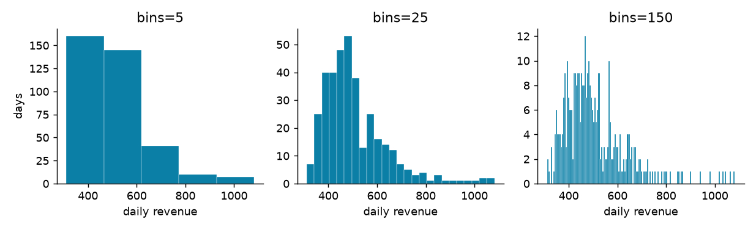
The same column, three stories
The problem
Part 5 · Seeing the data
At 5 bins a staircase, at 150 static, and at 25 a main body with a long right tail.
Daily revenue with 5, 25 and 150 bins. Generated in the chapter's code from synthetic data.
A histogram's shape depends on its bin count, so try several before you trust what you see.
Source: notes/07-plotting.md
29
Notes:
The mean sits above the median at 507 against 477, the same fact in numbers. Charts have choices in them, and the first skill is noticing that you made one.
Source: notes/07-plotting.md

Slide 30
Ask for the Figure and the Axes by name
Part 5 · Seeing the data
PYTHON
Figure: the canvas you save.
fig, axes = plt.subplots(1, 2, figsize=(9, 3))
by_month.plot.bar(ax=axes[0])
axes[0].set(title="Mean daily revenue by month")
by_product.sort_values().plot.barh(ax=axes[1])
fig.tight_layout()
fig.savefig("bars.png")
Axes: one plot on it.
plt.plot draws on whichever is current.
A Figure is the canvas and an Axes is one plot on it, so name them with plt.subplots rather than rely on a current Axes.
Source: notes/07-plotting.md
30
Notes:
Nearly every Python plot is matplotlib underneath, so these two objects explain most plotting confusion. Pandas plot methods take ax, so you can place them. Implicit plotting stops being obvious as soon as you have two plots.
Source: notes/07-plotting.md

Slide 31
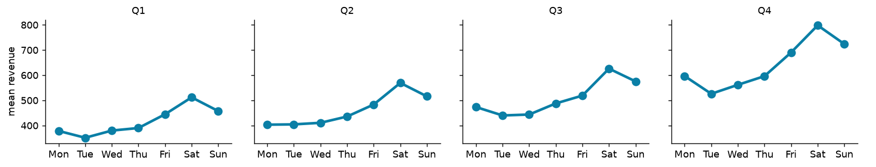
Small multiples show the shape and the level at once
Part 5 · Seeing the data
On one scale, the weekly shape holds while the level rises. Figure-level catplot draws this with col=.
Mean revenue by weekday per quarter, on a shared y axis. Generated in the chapter's code from synthetic data.
Small multiples on a shared scale compare a pattern across groups, and seaborn's figure-level functions draw them from tidy data.
Source: notes/07-plotting.md
31
Notes:
Rather than four lines on one plot, draw one plot four times. Axes-level functions such as boxplot draw on an Axes you give them. Figure-level functions such as catplot build their own figure so they can lay out facets. This is the chart for when a single plot has turned into spaghetti.
Source: notes/07-plotting.md

Slide 32
Pick the chart from the question
Part 5 · Seeing the data
Question | Chart | Call
How does it change over time? | Line | ax.plot
How do categories compare? | Sorted bars from zero | plot.barh
What shape does one column have? | Histogram | ax.hist
How do groups' distributions differ? | Box | sns.boxplot
How do two numbers relate? | Scatter | sns.scatterplot
Same pattern across groups? | Small multiples | sns.catplot(col=...)
Choose a line for time, sorted bars for comparison, a histogram for shape, a box for groups and a scatter for relationships.
Source: notes/07-plotting.md
32
Notes:
Two omissions are on purpose. Pie charts use angle, and Cleveland and McGill found people judge position and length more accurately. And two y axes imply a relationship set by whichever scales you chose, so draw two panels instead. Pillar 05 returns to both.
Source: notes/07-plotting.md

Slide 33
Rules of thumb
What to remember
Load
Select
Join
Keep the raw file. Put every fix in one rerunnable function.
loc for labels, iloc for positions, a single .loc to set.
State how and validate. Compare rows and one total.
Group
Time
Plot
Print counts. Sum then divide for ratios. Check groups add up.
Show gaps with asfreq. Keep model features looking backward.
Question first. Bars from zero. One y axis.
The dangerous errors in pandas raise no exception, so build the checks into every load, join, group and chart.
Source: notes/07-plotting.md
33
Notes:
If you remember one thing, it's that none of today's worst errors raise an exception. The row counts and totals are how you catch them.
Source: notes/07-plotting.md

Slide 34
Where next
What to remember
Practice: the notebooks in practice/, after bash fetch_data.sh.
Pillar 02: is a difference real, or luck? Probability and statistics.
Pillar 03: did the change cause it? Experiments and causality.
Pillar 05: make charts that convince other people.
Pillar 06: forecasting, cohorts, funnels and SQL on real analyses.
With data in a frame, the next question is whether a difference is real, which takes probability and statistics.
Source: notes/07-plotting.md
34
Notes:
You can now get data into a frame, clean it, reshape it, summarise it and see it. What it can't yet tell you is whether a difference is real or luck. That's next.
Source: notes/07-plotting.md

