Slide 1
Visualisation and Storytelling
Part 1: Choosing the form
Why plot · The grammar · Encoding accuracy · Two honest lies
Part 2: Static charts in Python
Object model · Declutter · Small multiples · Seaborn
From a chart that is correct to a decision that gets made
Part 3: Interactive charts
When it earns its cost · Plotly · Export · Linked views
Choose it · Draw it · Explore it · Build it · Argue from it
Part 4: JavaScript underneath
Three levels · The data join · One chart three ways
Part 5: Dashboards and the decision
Monitoring · Streamlit and BI tools · The Big Idea · Sizing · Story
Notes: data-analytics/05-visualisation-and-storytelling
Notes:
Fernhill Home is a fictional online homewares retailer. In January 2025 it cut its email budget. Revenue kept growing and the dashboard stayed green, while repeat buying fell by nearly a third. We follow that one dataset: choose the right form, draw it in Python, make it explorable, rebuild it in JavaScript, and then get a decision made.

Slide 2
PART 1
Choosing the form
Summary statistics agree. The data does not.
A chart is a set of independent decisions
Change one word and it is a different chart
Choose the chart by the question
Two ways an honest dataset gets misrepresented
Why plot · The grammar · Encoding accuracy · Two honest lies
2
Notes:
Before any library, we need a way to think about what a chart is and which one fits the question.

Slide 3
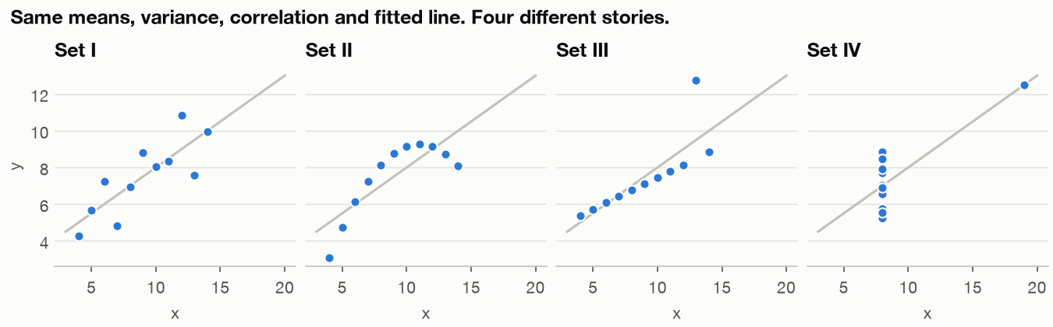
Summary statistics agree. The data does not.
The problem
Part 1 · Choosing the form
Four datasets with the same summaries and four different stories.
A table of statistics could not have told you.
Anscombe's quartet, 1973: same means, variances, correlation and fit.
Plot before you summarise, because identical statistics can hide completely different data.
Source: notes/01-grammar-and-chart-choice.md
3
Notes:
This is the oldest argument for plotting. So if we must plot, how do we decide what to draw?
Source: notes/01-grammar-and-chart-choice.md

Slide 4
A chart is a set of independent decisions
The grammar of graphics
Part 1 · Choosing the form
Data
tidy rows
Encoding
field to channel
Scale
value to position or colour
Mark
line, bar, point
Facet
repeat per group
Wilkinson's grammar replaced a menu of chart types with composable parts.
Wickham's layers made it practical; Vega-Lite and Altair carry it into JSON and Python.
The grammar treats a chart as data, encodings, scales and marks, so you can change one part at a time.
Source: notes/01-grammar-and-chart-choice.md
4
Notes:
Swap the mark and keep everything else, and you have a different chart with the same mapping.
Source: notes/01-grammar-and-chart-choice.md

Slide 5
Change one word and it is a different chart
Part 1 · Choosing the form
PYTHON
Same data and encodings, three marks.
base = alt.Chart(total).encode(
x="month:T", y="repeat_rate:Q")
line = base.mark_line()
bars = base.mark_bar()
dots = base.mark_circle()
Altair compiles this to Vega-Lite JSON.
In a grammar-based library the mark is one independent choice, so comparing forms costs a single word.
Source: notes/01-grammar-and-chart-choice.md
5
Notes:
This is a compressed form of the code in practice/ch01_grammar_and_choice.py, which adds styling and titles.
Source: notes/01-grammar-and-chart-choice.md

Slide 6
Choose the chart by the question
Then check the encoding
Part 1 · Choosing the form
The question | Reach for | Why
How does it change over time? | Line | Position on a common scale
Which category is biggest? | Sorted bars | Length from a zero baseline
What share is this? | Sorted bars, stacked bar | Length beats angle
How is it distributed? | Histogram, box plot | Shape and outliers
Do two measures move together? | Scatter | Two positions
Name the question first, then choose the form whose encoding answers it most accurately.
Source: notes/01-grammar-and-chart-choice.md
6
Notes:
Cleveland and McGill's experiments order the encodings: position on a common scale first, then length, angle and slope, then area, then shading. That ranking is why bars usually beat pies.
Source: notes/01-grammar-and-chart-choice.md

Slide 7
Two ways an honest dataset gets misrepresented
Honest data, misleading chart
Part 1 · Choosing the form
Two y-axes
Truncated bars
Crossing points come from two arbitrary scales
A bar's length is its message
Knaflic's tax-rate example: about 13% looks like about 460%
Change one range and the story changes
Use two panels or index to a common base
Bars start at zero; lines may zoom if the axis says so
Dual axes and truncated bars both let a scale choice manufacture the message, so use panels and zero baselines.
Source: notes/01-grammar-and-chart-choice.md
7
Notes:
Neither chart contains a false number. The distortion comes entirely from the scale.
Source: notes/01-grammar-and-chart-choice.md

Slide 8
PART 2
Static charts in Python
The default chart is correct and tells you nothing
Remove first, then direct attention
Small multiples show what four tangled lines hid
Put the choices in one place so they cannot drift
Matplotlib draws. Seaborn does the statistics.
Object model · Declutter · Small multiples · Seaborn
8
Notes:
Now we draw it. A static chart is still what most decisions see, in a memo or a slide.

Slide 9
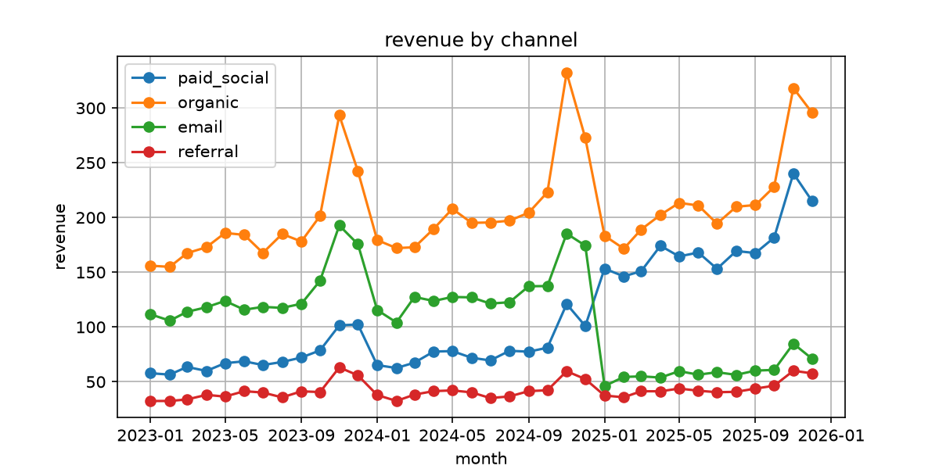
The default chart is correct and tells you nothing
The problem
Part 2 · Static charts in Python
Box, ticks and legend compete with the data.
The event that matters is not marked.
Fernhill's revenue by channel with matplotlib's defaults.
Default styling draws the data correctly but leaves every decision about emphasis to the reader.
Source: notes/02-matplotlib-and-seaborn.md
9
Notes:
Nothing here is false. It simply does not help you see anything.
Source: notes/02-matplotlib-and-seaborn.md

Slide 10
Remove first, then direct attention
Declutter in order
Part 2 · Static charts in Python
1
Use the object API — A Figure holds Axes; call methods on ax.
2
Remove — Top and right spines, heavy gridlines, tick marks.
3
Label directly — Name each line at its end, keep a legend for two or more series.
4
Mark the event — A thin rule and a short label.
5
Set it once — rcParams and a fixed colour per entity.
Every element must earn its place, and one shared style module keeps those choices from drifting.
Source: notes/02-matplotlib-and-seaborn.md
10
Notes:
Make the choices once in practice/chartstyle.py, not chart by chart.
Source: notes/02-matplotlib-and-seaborn.md

Slide 11
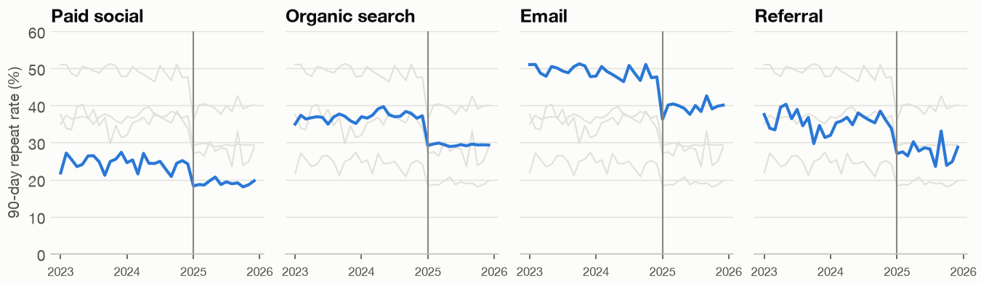
Small multiples show what four tangled lines hid
Same data, one panel per channel
Part 2 · Static charts in Python
Every channel drops at the same moment.
So it is not only mix. Hold that thought.
Each channel against the others in grey.
Small multiples separate tangled series while keeping one shared scale, so you can compare across panels.
Source: notes/02-matplotlib-and-seaborn.md
11
Notes:
The whole of chapter five depends on this view: the fall is within every channel as well as in the mix.
Source: notes/02-matplotlib-and-seaborn.md

Slide 12
Put the choices in one place so they cannot drift
Part 2 · Static charts in Python
PYTHON
Most of chartstyle.py is one rcParams call.
plt.rcParams.update({
"axes.spines.top": False,
"axes.spines.right": False,
"axes.grid": True,
"axes.grid.axis": "y",
})
fig, ax = plt.subplots(figsize=(8, 4))
ax.axvline(CUT, color=MUTED, linewidth=1)
Call methods on ax, not on plt.
Set matplotlib's rcParams once in a shared module and draw through ax, so styling stays consistent across charts.
Source: notes/02-matplotlib-and-seaborn.md
12
Notes:
A compressed form of practice/chartstyle.py, which has more settings.
Source: notes/02-matplotlib-and-seaborn.md

Slide 13
Matplotlib draws. Seaborn does the statistics.
Part 2 · Static charts in Python
Matplotlib
Seaborn
You place every element
Takes tidy data and column names
Full control for final figures
Adds grouping, intervals and facets
Rich styling through rcParams
Returns matplotlib objects to adjust
Use seaborn for statistical views from tidy data, then adjust the matplotlib objects it returns.
Source: notes/02-matplotlib-and-seaborn.md
13
Notes:
Seaborn is built on matplotlib, so the two are not rivals. Heatmaps need care with colour too: use a diverging scale only where a midpoint means something.
Source: notes/02-matplotlib-and-seaborn.md

Slide 14
PART 3
Interactive charts
Who will actually drag that slider?
Match the medium to the reader
A plotly figure is a dictionary until the browser reads it
Export a static copy every time
One rich chart, or several linked views?
When it earns its cost · Plotly · Export · Linked views
14
Notes:
Hover and zoom feel powerful. They also hand work to the reader, so the first question is whether they will do it.

Slide 15
Who will actually drag that slider?
The problem
Part 3 · Interactive charts
Overview first, zoom and filter, then details on demand.
Shneiderman, The Eyes Have It, 1996
Interaction should follow the reader's sequence of overview, filter, then detail, and only when they will use it.
Source: notes/03-plotly-and-interactive.md
15
Notes:
The people who asked for the analysis will not brush a time range to find the January fall. A manager exploring her own channel next week might.
Source: notes/03-plotly-and-interactive.md

Slide 16
Match the medium to the reader
Part 3 · Interactive charts
Your reader | Their question | Medium
Executive reading a memo | What should we do? | Static, answer in title
Analyst checking your work | Does it hold in my segment? | Interactive chart
Manager every week | Is my number okay? | Dashboard
Curious public | Where am I in this? | Interactive piece
If you can state the finding, state it. Use interaction for readers with their own questions.
Source: notes/03-plotly-and-interactive.md
16
Notes:
Notice what is missing: using interaction simply because it is available.
Source: notes/03-plotly-and-interactive.md

Slide 17
A plotly figure is a dictionary until the browser reads it
Part 3 · Interactive charts
PYTHON
Python writes JSON; plotly.js renders it.
fig = px.line(monthly, x="month", y="revenue",
color="channel",
custom_data=["sessions", "orders"])
fig.update_traces(hovertemplate=
"%{x|%b %Y}<br><b>£%{y:,.0f}</b><br>"
"%{customdata[0]:,} sessions"
"<extra>%{fullData.name}</extra>")
Default hover leaks column names, so write a template.
Plotly figures are JSON rendered by plotly.js, so any tooltip field must ship in the page and be templated.
Source: notes/03-plotly-and-interactive.md
17
Notes:
The default hover text is what every unconfigured plotly chart shows. Fixing it is most of the work.
Source: notes/03-plotly-and-interactive.md

Slide 18
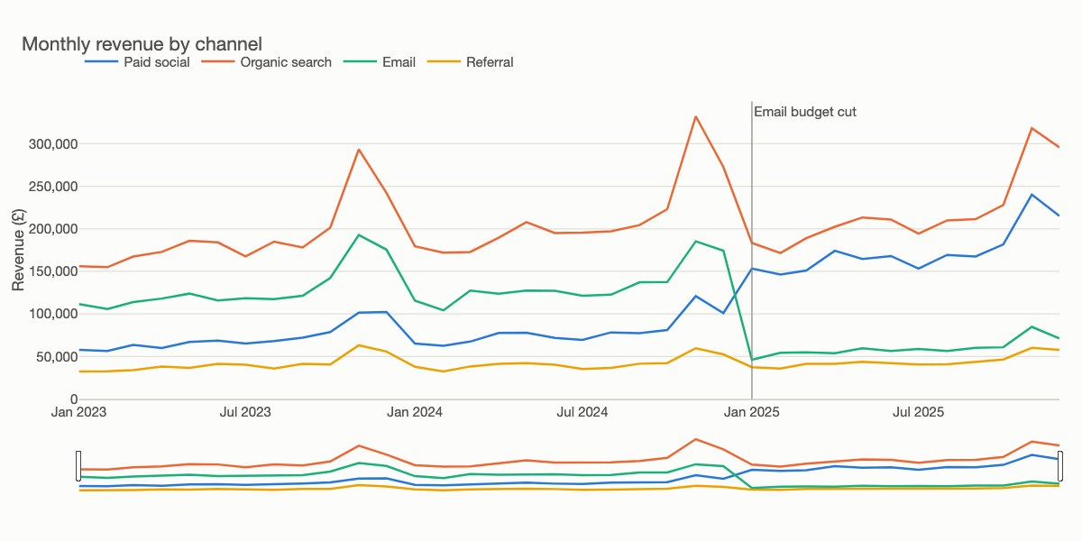
Export a static copy every time
Hover cannot be printed
Part 3 · Interactive charts
Inline for email, CDN for hosted pages.
Hover fails on phones and in print, so keep a table.
The same figure as a PNG. Inline HTML 4.7 MB, CDN 10 KB in this run.
Ship inline HTML for email, CDN HTML for hosted pages, and always a static copy because hover cannot print.
Source: notes/03-plotly-and-interactive.md
18
Notes:
The data ships in the page either way, which is why a static plotly file cannot filter ten million rows.
Source: notes/03-plotly-and-interactive.md

Slide 19
One rich chart, or several linked views?
Part 3 · Interactive charts
Plotly
Altair
Rich single charts with hover
A selection is a declared parameter
Dropdowns flip trace visibility
scale=alt.Scale(domain=brush) links views
All data ships in the HTML
Raises MaxRowsError above 5,000 rows
Use plotly for one rich chart and Altair for linked views, since its selections are part of the grammar.
Source: notes/03-plotly-and-interactive.md
19
Notes:
When the user's choice must trigger a new query, you have outgrown a static file and need a server.
Source: notes/03-plotly-and-interactive.md

Slide 20
PART 4
JavaScript underneath
What happens when no library has your chart?
Three levels, and each one decides more for you
The data join is the idea that makes D3 D3
The same chart, written by hand in D3
Climb down the ladder only when you must
Three levels · The data join · One chart three ways
20
Notes:
Everything interactive so far ran as JavaScript. Now we meet that layer and see what writing it directly buys.

Slide 21
What happens when no library has your chart?
The problem
Part 4 · JavaScript underneath
D3 has no barChart(). It binds data to document elements and gives you the geometry.
Bostock, Ogievetsky and Heer, IEEE TVCG 2011
D3 is a toolkit for binding data to the document, so the chart is yours to assemble rather than a function to call.
Source: notes/04-javascript-d3-vega-lite-observable-plot.md
21
Notes:
Sooner or later someone asks for a chart no library offers, or one that has to live inside a web product.
Source: notes/04-javascript-d3-vega-lite-observable-plot.md

Slide 22
Three levels, and each one decides more for you
Part 4 · JavaScript underneath
D3
scales, joins, shapes
Vega-Lite
a JSON grammar
Observable Plot
marks and options
All three render to SVG or Canvas in the browser. Altair generates Vega-Lite.
D3, Vega-Lite and Plot sit at different levels of abstraction, and Altair is a Python route to Vega-Lite.
Source: notes/04-javascript-d3-vega-lite-observable-plot.md
22
Notes:
We draw the same Fernhill chart at each level to feel the difference.
Source: notes/04-javascript-d3-vega-lite-observable-plot.md

Slide 23
The data join is the idea that makes D3 D3
Part 4 · JavaScript underneath
JAVASCRIPT
Make the elements match the list.
svg.selectAll("path")
.data(series)
.join("path")
.attr("stroke", (d) => colour(d.key))
.attr("d", (d) => line(d.values));
Needed ones are created, extras removed.
The D3 data join makes page elements match a list of data, creating and removing them as the data changes.
Source: notes/04-javascript-d3-vega-lite-observable-plot.md
23
Notes:
A simplified form of step 3 in practice/js/repeat_chart.mjs. Once you see charts as a list of data and a matching list of elements, the rest of D3 stops looking like a pile of method chains.
Source: notes/04-javascript-d3-vega-lite-observable-plot.md

Slide 24
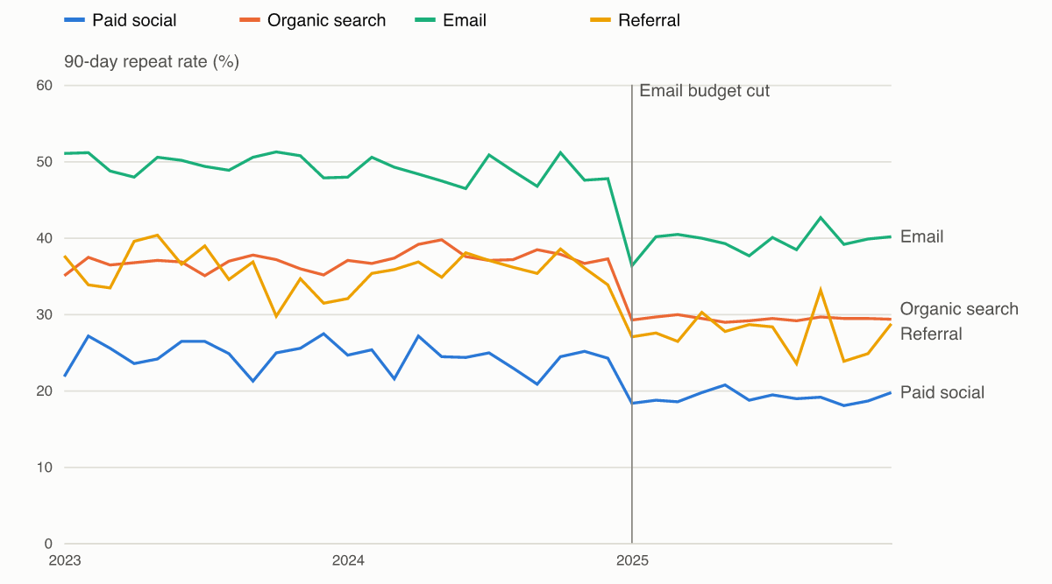
The same chart, written by hand in D3
67 lines of chart code
Part 4 · JavaScript underneath
Scales, axes, labels and legend are all your code.
Hover uses large invisible targets.
Rendered in Node with jsdom and resvg. The same module runs in a browser.
With D3 every element is your code, including large invisible hover targets that thin lines cannot provide.
Source: notes/04-javascript-d3-vega-lite-observable-plot.md
24
Notes:
You can test the hover without a browser by firing events under jsdom, but jsdom has no layout, so text measuring needs a real browser.
Source: notes/04-javascript-d3-vega-lite-observable-plot.md

Slide 25
Climb down the ladder only when you must
Part 4 · JavaScript underneath
 | D3 | Vega-Lite | Plot
This chart | 67 lines | 33 lines | 24 lines
You describe | Elements | A JSON spec | Marks
Good at | New forms | Portable specs | Fast exploration
Fights you on | Time | Pixel placement | Bespoke interaction
Use Altair or plotly while you can, Vega-Lite for embedded specs, Plot for speed, and D3 when design justifies it.
Source: notes/04-javascript-d3-vega-lite-observable-plot.md
25
Notes:
The line counts are this one chart as written, including styling, and are an illustration rather than a benchmark.
Source: notes/04-javascript-d3-vega-lite-observable-plot.md

Slide 26
PART 5
Fernhill's revenue tile was green the whole time
A Streamlit dashboard is a script that reruns
Ask who will change it in six months
Write the sentence before you open a slide tool
One line, one event, and the answer as the title
Say the size, the assumptions, and what you do not know
Dashboards and the decision
Monitoring · Streamlit and BI tools · The Big Idea · Sizing · Story
26
Notes:
Two different jobs: something people monitor, and telling someone what you found so that they act.

Slide 27
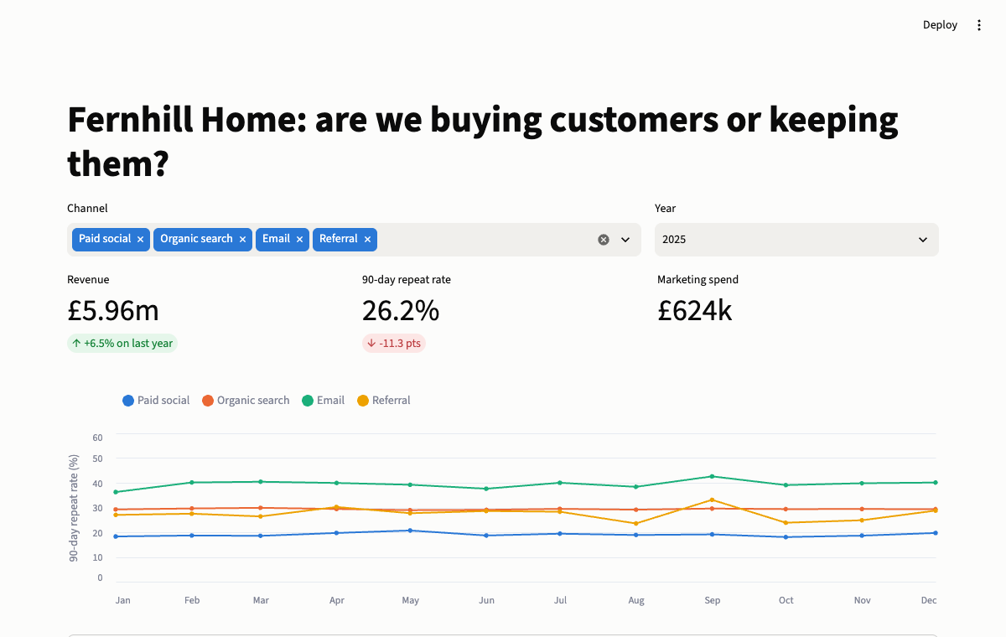
Fernhill's revenue tile was green the whole time
The problem
Part 5 · Dashboards and the decision
Revenue +6.5%; repeat rate -11.3 pts.
Anything you can push by spending needs a partner metric.
The rebuilt dashboard, with revenue beside repeat rate.
Pair a growth metric with a health metric, because anything you can raise by spending looks fine alone.
Source: notes/05-dashboards-and-storytelling.md
27
Notes:
The dashboard did not lie. It answered the question it was built to answer.
Source: notes/05-dashboards-and-storytelling.md

Slide 28
A Streamlit dashboard is a script that reruns
Part 5 · Dashboards and the decision
PYTHON
Each click reruns the script top to bottom.
@st.cache_data
def load(): ...
data = load()
chosen = st.multiselect("Channel", names, default=names)
view = data[data.channel.isin(chosen)]
st.metric("Revenue", f"£{view.revenue.sum() / 1e6:.2f}m")
Cache the expensive work.
AppTest tests it with no browser.
Streamlit reruns the whole script on every widget change, so widgets are plain values and caching is essential.
Source: notes/05-dashboards-and-storytelling.md
28
Notes:
A compressed form of practice/dashboard_app.py. No callbacks to wire up.
Source: notes/05-dashboards-and-storytelling.md

Slide 29
Ask who will change it in six months
Part 5 · Dashboards and the decision
Streamlit
Metabase
Looker Studio
Python in git, with code review and tests. For bespoke tools maintained by people who write Python.
Open source or cloud. SQL with parameters and point-and-click questions, for standard reporting.
Free and hosted by Google. A browser canvas for quick reports on Google data; not the same as Looker.
Pick the dashboard tool by who maintains it, because a Streamlit app owned by non-coders becomes a ticket queue.
Source: notes/05-dashboards-and-storytelling.md
29
Notes:
Six months from now, if the marketing team wants to edit it, you want them able to.
Source: notes/05-dashboards-and-storytelling.md

Slide 30
Write the sentence before you open a slide tool
Who, what, how, then the Big Idea
Part 5 · Dashboards and the decision
Cutting the email budget saved £120k a year and has cost us several times that in margin, so we should restore it and test the effect with a holdout.
A Big Idea: point of view, what is at stake, one complete sentence (Duarte, via Knaflic)
The Big Idea is one complete sentence with your point of view and the stakes, and writing it exposes what you do not know.
Source: notes/05-dashboards-and-storytelling.md
30
Notes:
Before any chart: who is the audience, what must they know or do, and only then how data supports it. Priya, the CMO, is the audience.
Source: notes/05-dashboards-and-storytelling.md

Slide 31
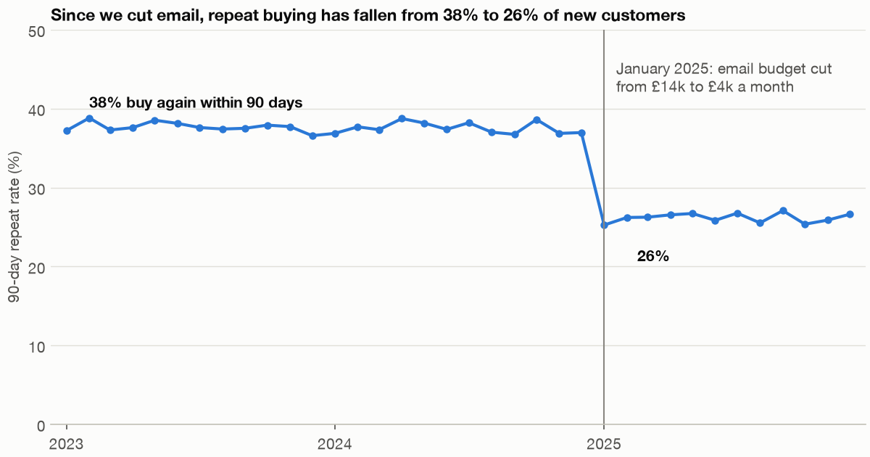
One line, one event, and the answer as the title
The explanatory version
Part 5 · Dashboards and the decision
Mix explains 4.3 pts; within channels 7.1 pts.
The title states the finding as a sentence.
From four channels to the single message.
An explanatory chart keeps one series, marks the event, and states the finding in the title.
Source: notes/05-dashboards-and-storytelling.md
31
Notes:
Hold channel rates at 2024 levels and apply the 2025 mix, which gives the mix effect. The remainder is within-channel.
Source: notes/05-dashboards-and-storytelling.md

Slide 32
Say the size, the assumptions, and what you do not know
Worked sizing
Part 5 · Dashboards and the decision
£120k saved
budget, per year
about £547k lost
margin at 40%, assumed
8.8%
break-even margin
Holdout
before and after is not cause
Conclusion survives any plausible margin, so the assumption is safe to state.
Paid social is a separate question and this data does not settle it.
Report the break-even as well as the estimate, so the reader can see the decision survives its assumptions.
Source: notes/05-dashboards-and-storytelling.md
32
Notes:
The margin and revenue-per-repeat figures are assumptions in the code, and Fernhill is synthetic with this effect built in.
Source: notes/05-dashboards-and-storytelling.md

Slide 33
Rules of thumb for visualisation and story
Wrap-up
Form
Honesty
Style
Name the question, then pick the encoding. Position beats length, which beats angle and area.
Bars start at zero. Never use two y-axes. Show the window you have.
Remove, then emphasise. Label directly. Colour by job, and validate the palette.
Interaction
Dashboards
Story
Essential things stay visible without hover. Export a static copy.
Name the decision. Give numbers a comparison and growth a partner metric.
Write the sentence first. Titles state findings. Propose the test.
Name the question, show it honestly, remove the clutter, and state the decision you want in one sentence.
Source: notes/05-dashboards-and-storytelling.md
33
Notes:
Source: notes/05-dashboards-and-storytelling.md

Slide 34
Where next
Wrap-up
Applied analyses: six worked business questions using these charts.
Practice: rebuild the Fernhill charts in practice/, then change the question.
Read next: Knaflic for explanatory work, Wilke for chart choice, Munzner for the theory.
Next, use these charts on six worked analyses in the applied-analyses pillar.
Source: notes/05-dashboards-and-storytelling.md
34
Notes:
Source: notes/05-dashboards-and-storytelling.md

