Slide 1
Agentic Applications
Part 1: Open the loop
Fixed graph · Router node · Open loop · Compaction · Judging a report
Part 2: Add a clock
The latency budget · Queueing · Fast and slow · Computer use · GUI agents
Models, tools and a loop, doing a real task
Part 3: Add a judge
The loop · Interface design · Sandbox layers · Held-out tests · Supervision
Part 4: Check the numbers
Open the loop · Add a clock · Add a judge · Check the numbers · Meet the user
Wrong question · Read-only access · Agree the metric · The validator · Charts
Part 5: Meet the user
Chatbot, editor, ambient · The router's history · Trust · One engine, new domain
Notes: generative-ai/07-agentic-applications
Notes:
This is the payoff of the generative AI layer. We take the loop and the tools and we build things that finish real work. Along the way one question keeps coming back: what would prove this answer wrong, and who checks? We start with an agent whose cost is bounded and end with where the agent sits beside a person.

Slide 2
PART 1
Open the loop
How much of the path should the model choose?
A fixed graph decides first, then works section by section
The open loop is one while statement
Read each new research agent by asking which part it changed
A research report has no test suite, so you need a judge
Fixed graph · Router node · Open loop · Compaction · Judging a report
2
Notes:
We start with the choice every application makes first: how much of the path do you fix in advance? A fixed graph has bounded cost. An open loop can handle work you could not outline, and you pay for that in context, in wandering and in having to judge the output.

Slide 3
How much of the path should the model choose?
The problem
Part 1 · Open the loop
Every step the model chooses is a step you cannot budget, test or replay in advance.
Autonomy is a cost, so buy only as much as the task needs.
Autonomy is paid for in calls, latency and failure modes, so grant only as much as the task needs.
Source: notes/01-internet-search-agent.md
3
Notes:
An agent that may do anything is hard to reason about. So the first design decision is not which model but who owns the path. We will see a fixed graph first, and then what we get and what we pay by opening it.
Source: notes/01-internet-search-agent.md

Slide 4
A fixed graph decides first, then works section by section
Part 1 · Open the loop
Router
one-field decision: search or not
Outline
plan the sections
Search and draft
per section, at most 2 retries
Compile
assemble the report
A router node answers a one-field question, so it can be tested alone.
A dedicated call writes the query, with its own system prompt.
The cost is bounded: one extra classifier call, and failures stay local to a node.
A router node and a fixed plan keep search bounded and debuggable, for one extra classifier call.
Source: notes/01-internet-search-agent.md
4
Notes:
The usual design binds a search tool and lets the model call it mid-turn. This project splits that into nodes on purpose. You give up flexibility and get one trace per step, plus state you can inspect per node.
Source: notes/01-internet-search-agent.md

Slide 5
The open loop is one while statement
Part 1 · Open the loop
PYTHON
It stops when the model answers in plain text.
for step in range(MAX_STEPS):
reply = model(messages, tools)
messages.append(reply)
if not reply.tool_calls:
return reply.text
for call in reply.tool_calls:
result = run_tool(call)
messages.append(result)
compact_if_needed(messages)
return force_answer(messages)
A step cap bounds the run.
Compaction starts at 80% of the context.
An open research agent is a capped loop with compaction, so the code is small and the risks are in the run.
Source: notes/02-deep-research-bot.md
5
Notes:
The W&B workshop agent is built with no framework at all. Model, tools, append the results, stop on plain text. Then add the two things long runs need: a cap so it ends, and compaction so it fits. The notes run a stubbed version of this with real output.
Source: notes/02-deep-research-bot.md

Slide 6
Read each new research agent by asking which part it changed
Part 1 · Open the loop
Part changed | Paper | Reported, in the authors' own setup
Plan shape | TTD-DR (2025) | Draft first and revise; 69.1% and 74.5% win rates against OpenAI Deep Research
Retrieval | Open Deep Search (2025) | DeepSeek-R1 on FRAMES: 30.1% alone, 75.3% with the tool
Interleaving | WebThinker (NeurIPS 2025) | Think, search and draft mixed, not in fixed phases
Training | SFR-DeepResearch (2025) | RL on synthetic data; up to 28.7% on Humanity's Last Exam
Whole span | CodeScientist (Findings of ACL 2025) | 19 candidate discoveries; 6 judged sound and incrementally novel
New research agents mostly change one part of the same loop, and CodeScientist shows how far raw output is from verified results.
Source: notes/02-deep-research-bot.md
6
Notes:
Huang et al.'s survey gives the map: workflow, planning, retrieval and tuning. CodeScientist is the one to remember because its figures survived code review and replication, and they are small.
Source: notes/02-deep-research-bot.md

Slide 7
A research report has no test suite, so you need a judge
Part 1 · Open the loop
One judge, one read
RACE, relative to a reference
Scores vary from run to run
Task-specific weighted criteria
No reference to compare against
Scored against a reference report
Easy to prefer length
Sample the judge several times
Noise that looks like a score
Still fallible, so hold the training target apart
Judge a report relative to a reference on weighted criteria, and remember that a judge you train against becomes a target.
Source: notes/02-deep-research-bot.md
7
Notes:
DeepResearch Bench has 100 PhD-level tasks with reference reports. DR Tulu's highest-reward run did worse downstream, which is the warning: a rubric you optimize against stops measuring what it measured. That closes the open loop, and the next constraint is time.
Source: notes/02-deep-research-bot.md

Slide 8
PART 2
Add a clock
A voice turn is a serial sum, and people can feel it
Load multiplies everything except the silence wait
The fast model reads a status and never claims it is done
GUI agents moved from finding the button to whole desktops
The latency budget · Queueing · Fast and slow · Computer use · GUI agents
8
Notes:
Research agents can take minutes. A voice agent has about two seconds. Time changes the architecture, and screens add a perception problem. This part is about what a hard budget does to the loop.

Slide 9
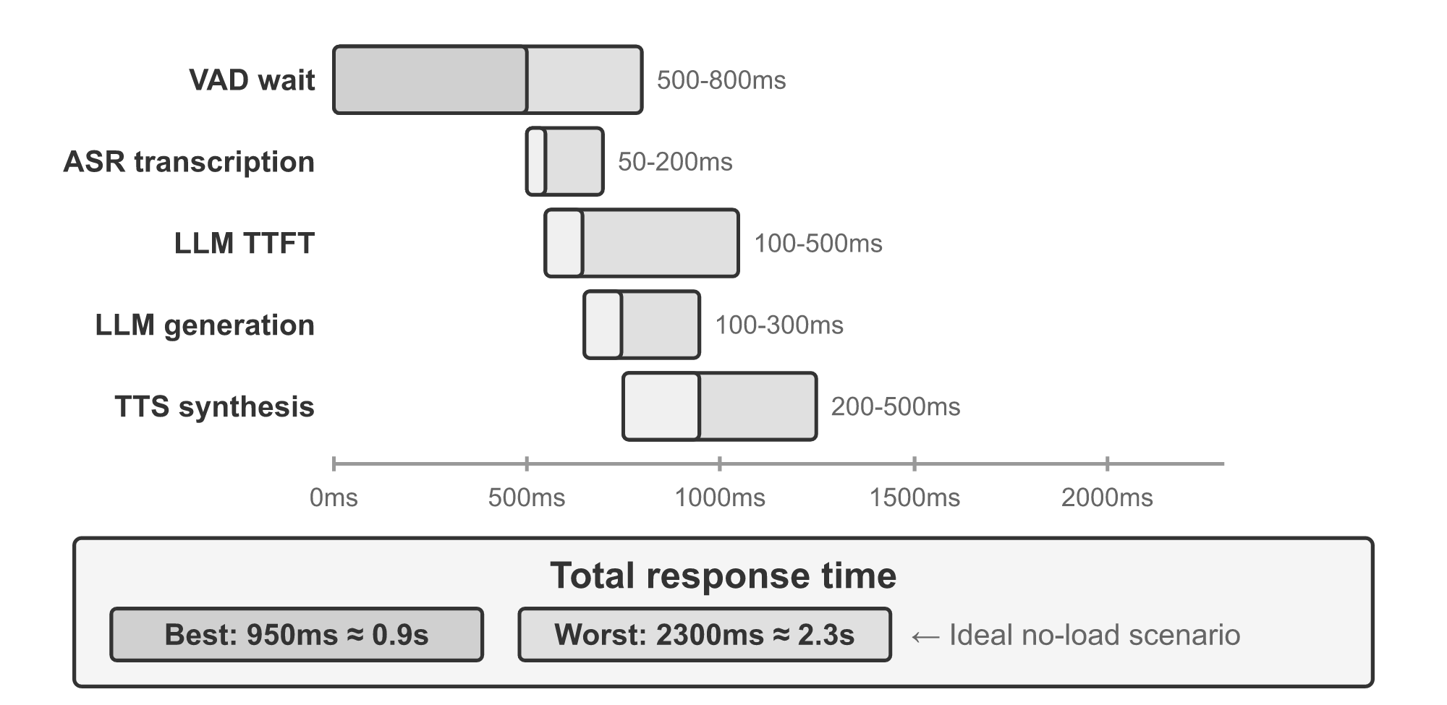
A voice turn is a serial sum, and people can feel it
The problem
Part 2 · Add a clock
VAD waits 500 to 800 ms on silence.
Then ASR, first token, first segment and TTS.
Together: about 1 to 2 s when idle.
Latency waterfall for a serial response (Li, AI Agents in Depth, 2026, ch. 6)
Voice latency is a serial sum led by the silence wait, so a faster LLM alone will not fix it.
Source: notes/03-real-time-multimodal-agents.md
9
Notes:
Each stage looks reasonable by itself. The sum is what the caller feels. So what happens when the server gets busy?
Source: notes/03-real-time-multimodal-agents.md

Slide 10
Load multiplies everything except the silence wait
Part 2 · Add a clock
Latency budget from the note's runnable block. Model stages scale by 1/(1 − utilization); VAD does not.
Load | Factor | Fast end | Slow end
0% | x1.0 | 950 ms | 2,300 ms
50% | x2.0 | 1,400 ms | 3,800 ms
70% | x3.3 | 2,000 ms | 5,800 ms
80% | x5.0 | 2,750 ms | 8,300 ms
With queueing a fast voice stack hits two seconds at 70% load, so capacity planning is a latency decision.
Source: notes/03-real-time-multimodal-agents.md
10
Notes:
These figures are arithmetic on typical stage ranges, not a measurement of any system. Note the slow end is over budget even when idle, which means it needs a design change and not a utilization limit.
Source: notes/03-real-time-multimodal-agents.md

Slide 11
The fast model reads a status and never claims it is done
Part 2 · Add a clock
PYTHON
The slow agent updates a status line.
def fast_reply(user_said, state, status):
if "done" in user_said and state != "done":
return f"Not yet: {status}."
if state == "needs_user":
return f"One question: {status}."
if state == "done":
return f"All set: {status}."
return f"Still on it, {status}."
The rule lives in code, not in a prompt.
Test the output with an assertion over a transcript.
Keep a voice responsive with a fast foreground and a slow worker, and enforce the no-false-done rule in code.
Source: notes/03-real-time-multimodal-agents.md
11
Notes:
A confident done while the slow agent is still working is the worst failure of this design. The same split appears in computer use: responses got about 15 times faster when a fast model handled the talking.
Source: notes/03-real-time-multimodal-agents.md

Slide 12
GUI agents moved from finding the button to whole desktops
Part 2 · Add a clock
Paper | Move | Evidence
AppAgent (2023) | Taps and swipes, knowledge from exploration | 50 tasks in 10 apps
SeeAct (2024) | Separate the action from grounding it | GPT-4V 51.1% on live sites with oracle grounding
OpenCUA (NeurIPS 2025) | Open dataset with reasoning traces | 3 operating systems, 200+ apps
Agent S3 (2025) | Several rollouts, then select a winner | 72.6% on OSWorld at 100 steps, human 72.36%
Grounding was the early bottleneck for GUI agents, and later scores come from spending more tries and more time.
Source: notes/03-real-time-multimodal-agents.md
12
Notes:
Agent S3 spends compute and time to buy reliability, the reverse of voice. An agent with no one waiting can take more tries and a voice agent cannot. Report time per task alongside the score. Now let us give an agent a stricter judge.
Source: notes/03-real-time-multimodal-agents.md

Slide 13
PART 3
Add a judge
Tests can say no. Can you trust a yes?
The loop is reproduce, localize, patch, verify
Say what each sandbox layer stops, and what it does not
The lab runs every attack with a stub model and no key
Green visible tests are necessary, and not sufficient
The loop · Interface design · Sandbox layers · Held-out tests · Supervision
13
Notes:
A coding agent's work can be run. That gives us a machine that can say no. This part builds one, and then attacks it with a lab you can run with no key.

Slide 14
Tests can say no. Can you trust a yes?
The problem
Part 3 · Add a judge
A coding agent acts on a real machine and its tests are its judge, so both the machine and the judge need protecting from it.
The lab's overfit run ends with every visible test green and a wrong fix.
A coding agent needs limits on what it can do and a verdict it cannot influence.
Source: notes/04-coding-agent.md
14
Notes:
A research report is judged later and with effort. A patch is judged in seconds. That is a real gift, as long as the agent cannot rewrite the tests or do damage while running them.
Source: notes/04-coding-agent.md

Slide 15
The loop is reproduce, localize, patch, verify
Part 3 · Add a judge
Reproduce
turn prose into a failing test
Localize
search and read
Patch
a targeted edit
Verify
run the tests
edit and execute until the tests pass or a limit stops it
SWE-agent's default solved 18.0% of SWE-bench Lite with GPT-4 Turbo.
With no edit tool, 10.3%. With the full file shown, 12.7%.
The interface changed results by more than most prompt changes do.
Reproducing first gives the agent a verdict, and interface choices move results a lot on the same model.
Source: notes/04-coding-agent.md
15
Notes:
The SWE-agent ablations are one model and one benchmark, changing one thing at a time. Showing more of a file made it worse. A good interface is a limit on what the model has to deal with.
Source: notes/04-coding-agent.md

Slide 16
Say what each sandbox layer stops, and what it does not
Part 3 · Add a judge
Layer | Stops | Does not stop
Tool schema | Arbitrary commands from the model | Code the tests execute
Path confinement | ../, absolute paths, symlink escapes | The same, through a subprocess
Write scope | Editing tests to pass them | Reading anything in the repo
Edit guards | Blind, ambiguous, clobbering, broken edits | Wrong logic
Process limits | Hangs, key leakage, disk filling | Network, writes elsewhere
A file-tool check is a promise about the tool and a process limit a promise about the code, so state what each misses.
Source: notes/04-coding-agent.md
16
Notes:
The lab's escape scenario writes a file outside the repo through code it runs. That is an honest limit of the lab. Real containment takes an operating system sandbox.
Source: notes/04-coding-agent.md

Slide 17
The lab runs every attack with a stub model and no key
Part 3 · Add a judge
BASH
Offline: a scripted model, so results repeat.
cd practice/coding-agent
uv run python run.py fix overfit guards escape
fix 5 steps, finished, held-out tests pass
overfit finished, held-out tests FAIL
guards 15 steps, 9 calls refused
timeout killed after 2 s, then recovered
loop refused 3rd repeat, halted on the 4th
escape wrote escaped.txt outside the repo
overfit passes the visible suite and fails held-out.
escape is a limit we show on purpose.
You can test a harness with no model at all, by scripting the bad behaviour and checking that limits hold.
Source: notes/04-coding-agent.md
17
Notes:
This is the part to copy. Harness behaviour does not depend on the model being clever. Script the attack, then assert what happened. Swapping in Claude is one file, which is marked illustrative because it needs a key.
Source: notes/04-coding-agent.md

Slide 18
Green visible tests are necessary, and not sufficient
Part 3 · Add a judge
Tests the agent can see
Tests held out, and a person who can read it
Can be special-cased by accident
Finish accepts them
SWE-bench scores on tests the agent never saw
SWE-agent failures include overly specific fixes
Shen & Tamkin: assisted learners scored 4.15 of 27 points lower
The gap was largest on debugging, in an exploratory cut
A necessary gate
A small preprint with a chat assistant, so hold it loosely
Hold tests back from the agent, and keep the debugging skill that human review depends on.
Source: notes/04-coding-agent.md
18
Notes:
Every limit so far assumes a person can review the result. Debugging is the skill that review draws on. So what happens when there is no test at all, only a number?
Source: notes/04-coding-agent.md

Slide 19
PART 4
Check the numbers
The query ran. Is the answer right?
The run profiles, agrees a metric, queries, and then is checked
A lead needs a sense of noise, and four lines give you one
The chart shows the answer and its weakness at once
What this design does not do
Wrong question · Read-only access · Agree the metric · The validator · Charts
19
Notes:
A wrong patch usually breaks a test. A wrong analysis returns a number that looks like a right one. We run this part on real data from the analytics pillar: restaurant tips and the Titanic.

Slide 20
The query ran. Is the answer right?
The problem
Part 4 · Check the numbers
Which day do customers tip the most? On the same 244 rows, Sunday wins in dollars and Friday wins as a share of the bill.
The SQL executes either way, and execution catches none of this.
A data agent can run a correct query and still answer the wrong question, so execution is not validation.
Source: notes/05-data-analysis-agent.md
20
Notes:
Wrong question, wrong population, weak evidence, and a sentence the numbers do not support. None of those throw an error. Text-to-SQL research measures mostly the first one, and Biswal et al. show many real questions need reasoning past the query: baselines never passed 20% exact match in their set, and hand-written TAG pipelines reached 55%.
Source: notes/05-data-analysis-agent.md

Slide 21
The run profiles, agrees a metric, queries, and then is checked
Part 4 · Check the numbers
Profile
rows, nulls, distinct values
Agree metric
from a named list
Read-only SQL
enforced at the connection
Recompute
pandas, without its SQL
Answer
with n and an interval
Read-only below the text: an SQLite authorizer refuses writes, whatever the SQL looks like.
The validator takes a structured claim and recomputes it separately.
Put the metric before the query and the recomputation after it, so that a check never shares the agent's reasoning.
Source: notes/05-data-analysis-agent.md
21
Notes:
Asking the model if it is right shares its errors. So the validator sees metric, grouping, group and value, and recomputes from source data. Then it applies the rules a statistician would apply by reflex.
Source: notes/05-data-analysis-agent.md

Slide 22
A lead needs a sense of noise, and four lines give you one
Part 4 · Check the numbers
PYTHON
No distribution assumption: resample each group.
def bootstrap(a, b, n=2000, seed=7):
rng = np.random.default_rng(seed)
diffs = [
rng.choice(a, len(a)).mean()
- rng.choice(b, len(b)).mean()
for _ in range(n)
]
return np.percentile(diffs, [2.5, 97.5])
Interval includes zero: the agent may not claim a lead.
Titanic: women 74.2%, men 18.9%, interval [.49, .61].
Bootstrap the difference between groups, and refuse the claim of a lead when the interval includes zero.
Source: notes/05-data-analysis-agent.md
22
Notes:
The Titanic gap is a real lead, and the interval says so clearly. For tips by day it is not. The next slide shows what the agent ends up allowed to say.
Source: notes/05-data-analysis-agent.md

Slide 23
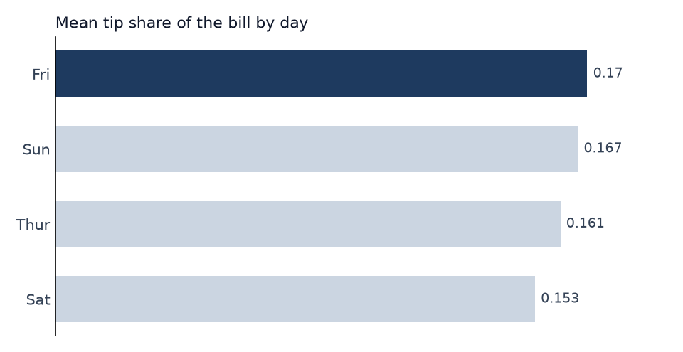
The chart shows the answer and its weakness at once
Part 4 · Check the numbers
The tool enforces a zero baseline and one accent.
No free plotting code, so no second sandbox.
Friday has 19 bills and Saturday 87, so the sentence must carry n.
Mean tip share by day, generated by the lab from tips.csv
Give the agent one narrow chart tool with enforced defaults, and still state the sample size in words.
Source: notes/05-data-analysis-agent.md
23
Notes:
Near-equal bars tell the truth about the lead. The chart cannot show that Friday rests on 19 bills. In the lab, the agent's first two submissions on this question were refused before it was allowed to answer.
Source: notes/05-data-analysis-agent.md

Slide 24
What this design does not do
Part 4 · Check the numbers
Open questions
Multiple comparisons
Same blind spots
It checks one metric, one grouping and one group. A question like why sales dropped has no such shape.
An agent that explores twenty cuts and reports the best has a false-positive problem. Log the queries.
The validator is code someone wrote. It only checks what it was written to check.
A validator checks only the claims it has a shape for, so log the search and keep a person on open questions.
Source: notes/05-data-analysis-agent.md
24
Notes:
Say these limits out loud when you present such a system. Now one question is left, and it applies to all of them. Where does the agent sit next to the person who has to trust it?
Source: notes/05-data-analysis-agent.md

Slide 25
PART 5
Meet the user
Where should the agent sit?
Three positions, by who works when
The router is older than the LLM, and still earns its place
A confirmation helps only if the person can disagree with it
Reflection needs anchors it cannot edit
One engine, a new domain, and a pitch that outran its sources
Chatbot, editor, ambient · The router's history · Trust · One engine, new domain
25
Notes:
An agent can pass every test and still fail, if the person cannot see or undo what it did. The final part is about position: who is working when, and what that makes hard.

Slide 26
Where should the agent sit?
The problem
Part 5 · Meet the user
An agent that is right every time still fails if it fires while nobody is looking, or edits what someone else is editing.
The interface usually gets picked by accident, because chat boxes are easy.
Where the agent sits decides your hardest engineering problem, so choose the position on purpose.
Source: notes/06-application-patterns.md
26
Notes:
Oshin and Campos give three answers, and they differ in concurrency: who is working when.
Source: notes/06-application-patterns.md

Slide 27
Three positions, by who works when
Part 5 · Meet the user
Pattern | Who works when | Hardest part
Chatbot | Turn-taking: the user asks and the agent answers | Safe write access to the canvas
Collaborative | Both at once, on the same artifact | Merging the agent's edits with the user's
Ambient | The agent works while the user does something else | Defining interesting, and keeping reflection from drifting
The patterns differ in concurrency and get harder in that order, and each has one problem to solve first.
Source: notes/06-application-patterns.md
27
Notes:
These run from easiest to add to hardest. A coding agent on a branch is the version-control level of collaboration. A voice agent's fast and slow pair is a kind of concurrency too.
Source: notes/06-application-patterns.md

Slide 28
The router is older than the LLM, and still earns its place
Part 5 · Meet the user
1
2016: Joint models — Liu and Lane learn intent and slots together.
2
2018: Slot gate — Goo et al.: 4.2% and 1.9% relative frame gains on ATIS and Snips.
3
2019: BERT — Chen et al. apply BERT to the joint task.
4
2020: DIET — No clear benefit from large pretrained models; beats fine-tuned BERT, about six times faster to train.
5
2025: Workflow graphs — Park et al.: state machine for the plan, LLMs inside each state; 52% better task accuracy than their baseline.
With few known intents, a small router or workflow graph can beat an LLM on cost and testability.
Source: notes/06-application-patterns.md
28
Notes:
Louvan and Magnini warn that the datasets are solved, not language understanding. Separately, Blending showed three small models beating ChatGPT on retention on one platform, so measure the outcome your product is for.
Source: notes/06-application-patterns.md

Slide 29
A confirmation helps only if the person can disagree with it
Part 5 · Meet the user
Bansal et al., CHI 2021, more than 1,500 participants, with AI and people about equally accurate.
Showing an explanation
Showing the evidence
Raised team accuracy when the AI was right
The diff and the test run
The query, n and the recomputed number
Lowered it when the AI was wrong
The agent's edit before it lands
None beat simply showing confidence
Can work as persuasion
Something the person can check
Explanations also persuade when the AI is wrong, so show checkable evidence at the point of approval.
Source: notes/06-application-patterns.md
29
Notes:
The right column is our inference from the study, applied to the labs. Amershi et al.'s guidelines point the same way: support efficient correction and dismissal, and update cautiously.
Source: notes/06-application-patterns.md

Slide 30
Reflection needs anchors it cannot edit
Part 5 · Meet the user
PYTHON
Nobody sees the alerts that were not sent.
ANCHORS = {"outage"} # reflection cannot edit
rules = {"outage", "price_drop"}
def should_alert(kind):
return kind in ANCHORS or kind in rules
# the user ignores one of each, reflection removes both
# price_drop sent, then never again
# outage sent, and sent again
# log: stopped treating price_drop as interesting
# log: stopped treating outage as interesting
Anchors keep what must always surface.
The log is the only trace of a rule change.
An ambient agent can silence itself unnoticed, so keep events it must surface and log each rule change.
Source: notes/06-application-patterns.md
30
Notes:
Removing the anchor is one of the exercises. No error is raised and only the log shows it.
Source: notes/06-application-patterns.md

Slide 31
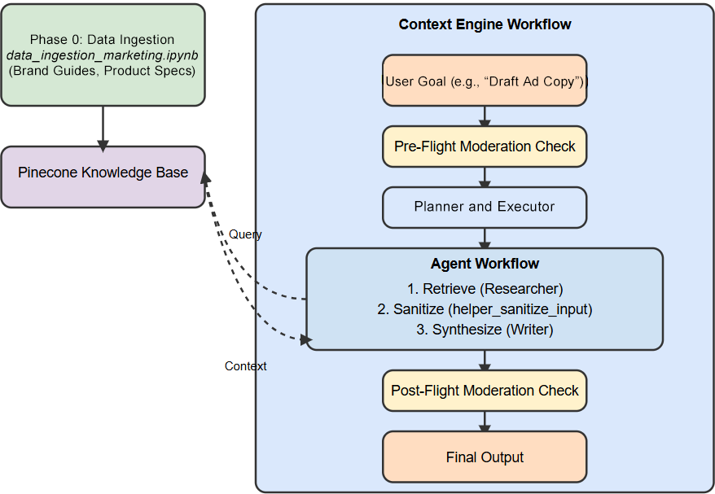
One engine, a new domain, and a pitch that outran its sources
Part 5 · Meet the user
New corpus and goals: engine.py did not change.
A 69.63 s run pushes the interface toward batch.
The pitch made claims that no source stated.
Context Engine end to end (Rothman, Context Engineering for Multi-Agent Systems, 2025, Fig. 9.1)
A good engine moves to a new domain with a new corpus, but check grounding claim by claim, since a fluent pitch is no proof.
Source: notes/06-application-patterns.md
31
Notes:
Rothman's approach to re-tasking is useful. His evidence is single runs, and the persuasive pitch is a grounding failure, which is the question we started with again: what would prove this answer wrong?
Source: notes/06-application-patterns.md

Slide 32
Rules of thumb for agentic applications
Closing
Autonomy
Time
Code
Known shape: fixed graph. Open-ended work: a capped loop with compaction.
Budget by stage. Load multiplies model stages. Enforce no false done in code.
Enforce limits in tools. Say what each layer misses. Hold tests back.
Data
People
Always
Agree the metric first. Recompute. Read-only at the connection.
Pick the position on purpose. Show evidence, since explanations also persuade.
Ask what would prove this answer wrong, and who checks.
For every agent, decide who owns the path and what limits are enforced, and name the check that could prove it wrong.
Source: notes/06-application-patterns.md
32
Notes:
If you keep one thing, keep the last card. Tests, recomputation, a reference report and a person are all answers to the same question.
Source: notes/06-application-patterns.md

Slide 33
Where to go next
Closing
Run the labs: practice/coding-agent and practice/data-analysis-agent, offline.
The one idea to keep
Then with keys: practice/deep-research-bot notebooks.
An agent is only as trustworthy as the check that could prove it wrong.
ai-engineering: the harness, loop and graph engineering under these applications.
Read: SWE-agent; Biswal et al.; Bansal et al.
You have seen what an agent can do, so next learn the engineering layer that makes it reliable.
Source: notes/06-application-patterns.md
33
Notes:
The engineering layer takes each decision we made by hand here and turns it into something you can build on: context, harness, loop and graph engineering.
Source: notes/06-application-patterns.md

