Slide 1
RL & Alignment
Part 1: Learning from a score
Agent and reward · Exploration · Value and policy · The families · Why a model is an agent
Part 2: Humans as the score
The three stages · Fine-tuning in practice · Bradley-Terry · Overoptimization
Part 3: Cheaper optimizers
What PPO costs · DPO · GRPO · GSPO · Offline or online
The reward signal is the product
Part 4: A constitution as the score
Principles · SL-CAI · RLAIF · Noise and bias · Self-improvement
Part 5: Agents as the student
The stages · Memorize or generalize · Priors · Data and environments · Reward design · RLVP · Tools
A score · Humans · Optimizers · A constitution · Agents · Reasoning · Production
Part 6: Reasoning and search
DeepSeek-R1 · What RL really adds · pass@k · Search before training
Part 7: Running it for real
Comparing runs · Production · Multi-agent RL · RL in RAG
Generative AI · Pillar 05
Notes: generative-ai/05-RL
Notes:
Today we follow one agent. It starts in a treasure hunt, knowing nothing, told only a score. By the end it is a language model calling tools. The algorithm changes several times along the way, but the deciding question does not: what is the score, who wrote it, and what happens when the model finds its loophole?

Slide 2
Nobody gives the agent the answer
One loop underlies every method in this deck
With no exploration, the agent never finds the best machine
Regret says how much not knowing costs
Linear structure keeps regret flat as the arms multiply
The goal decides the bandit algorithm
A Bayesian policy wins on average and loses on some instances
Three ways to estimate how good a state is
The behaviour you learn about changes the path you get
The PPO clip removes the incentive to move too far
A language model is already an RL agent
PART 1
Learning from a score
Agent and reward · Exploration · Value and policy · The families · Why a model is an agent
2
Notes:
We begin with no notation at all, because reward, policy and value are simple ideas. Then we give them their proper names, since every paper later in the deck assumes them.

Slide 3
Nobody gives the agent the answer
The problem
Part 1 · Learning from a score
An RL agent gets no answer key. It acts, receives a score, and has to work out for itself which actions earned it.
The reward is the whole instruction, so it is also the only thing you get to say
RL differs from supervised learning because the agent has only a delayed score, never the right answer.
Source: notes/00-rl-in-plain-language.md
3
Notes:
Winder's comparison is learning to ride a bike. You could not learn it from a labelled dataset of riders. You get on, you wobble, and falling is the feedback. Everything in this pillar follows from that, including what goes wrong when the score measures the wrong thing.
Source: notes/00-rl-in-plain-language.md

Slide 4
One loop underlies every method in this deck
Part 1 · Learning from a score
State
what the agent sees
Action
chosen by the policy
Environment
applies the action
Reward
a score
new state, next action
An agent sees a state, acts, and receives a reward and a new state, and training adjusts its policy to raise total reward.
Source: notes/00-rl-in-plain-language.md
4
Notes:
Keep these four boxes in mind. For the treasure hunt the state is the room and inventory. For a language model the state is the conversation so far and the action is the next token. Only the reward source changes across the rest of the deck.
Source: notes/00-rl-in-plain-language.md

Slide 5
With no exploration, the agent never finds the best machine
Part 1 · Learning from a score
TEXT
Zero exploration locks onto whichever machine came first.
# 1000 pulls of three slot machines, many runs
# epsilon avg reward on best machine
0.0 199.6 0%
0.1 654.8 85%
0.5 580.8 66%
A little finds the best one and mostly stays.
Too much keeps paying to try losers.
Some exploration is necessary but too much is wasteful, as 0.1 beat both 0 and 0.5 in this bandit.
Source: notes/00-rl-in-plain-language.md
5
Notes:
This is a program from the on-ramp chapter and these are its real results. A low-scoring agent with epsilon zero looks like a failed algorithm, when it may only be a machine that never tried the good option.
Source: notes/00-rl-in-plain-language.md

Slide 6
Regret says how much not knowing costs
Part 1 · Learning from a score
Policy | Regret bound | Needs
Explore-then-commit | Δ + (4/Δ)(1 + log(nΔ²/4)) with the commit tuned to the gap | The gap Δ
UCB | 3ΣΔ + Σ 16 log n/Δ; gap-free 8√(nk log n) | The horizon n
MOSS | 39√(kn) + ΣΔ, no log factor | The horizon n
Exp3 | √(2nk log k) in expectation, heavy-tailed | Rewards in [0,1], any adversary
Floor, any policy | (1/27)√((k−1)n) on some Gaussian instance | Nothing beats it in the worst case
With fixed gaps regret grows like log n, in the worst case like √n, and no policy beats √n on every instance.
Source: notes/01c-bandit-algorithms.md
6
Notes:
Regret is the reward lost against always pulling the best arm. The bounds assume k arms, horizon n and 1-subgaussian rewards. Lattimore and Szepesvari, chapters 6 to 15.
Source: notes/01c-bandit-algorithms.md

Slide 7
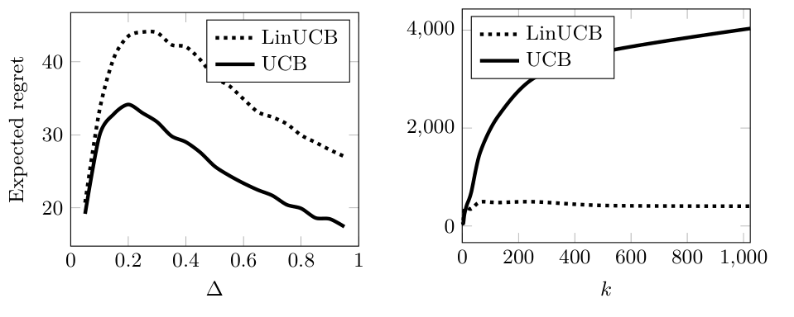
Linear structure keeps regret flat as the arms multiply
Part 1 · Learning from a score
UCB treats each arm alone, so regret climbs to about 4,000 at 1,000 arms.
LinUCB shares a ridge estimate across arms and stays under 500.
The price: the model must be right, and UCB wins on the two-armed problem.
UCB and LinUCB regret against the number of arms, d = 5, n = 5,000 (Lattimore and Szepesvari, 2020, Fig. 19.1)
LinUCB's regret depends on the feature dimension rather than the number of arms, provided the linear model holds.
Source: notes/01c-bandit-algorithms.md
7
Notes:
The regret bound is O(d sqrt(n) log(nL)). Use it for recommendation and routing, where arms outnumber the rounds you can afford.
Source: notes/01c-bandit-algorithms.md

Slide 8
The goal decides the bandit algorithm
Part 1 · Learning from a score
Goal | Method | Guarantee
Rewards drift | Mirror descent on a clipped simplex | Tracking regret O(√(nmk log(kn/m)))
Rank a slate from clicks | TopRank under a click model | O(√(m³ln log n)) worst case
Recommend one arm | Sequential halving or track-and-stop | Error shrinks exponentially in n or log(1/δ)
Large action set | Linear Thompson sampling | Bayesian regret O(d√(n log n log(n/d)))
Match the algorithm to the goal first; a regret rate for one goal says little about another.
Source: notes/01c-bandit-algorithms.md
8
Notes:
Lattimore and Szepesvari, chapters 31, 32, 33 and 36. The rates are theory, with no experiments in chapters 31 to 33.
Source: notes/01c-bandit-algorithms.md

Slide 9
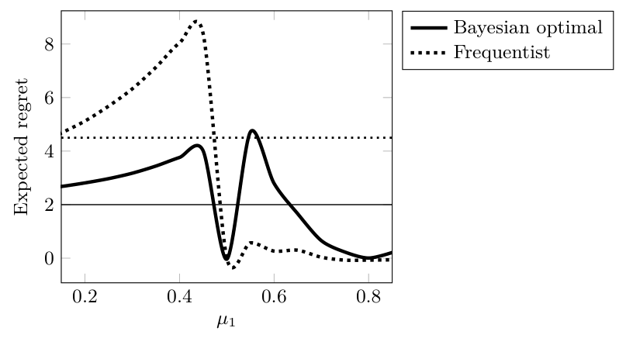
A Bayesian policy wins on average and loses on some instances
Part 1 · Learning from a score
Bayesian optimal averages about 2 under a uniform prior.
Frequentist rule averages about 4.5, and peaks near 9 for arms just below 1/2.
The catch: the average is over the prior, so a wrong prior voids the win.
Expected regret on a one-armed Bernoulli bandit with the other arm at 1/2 (Lattimore and Szepesvari, 2020, Fig. 35.2)
Bayesian regret is an average over a prior and does not bound any single instance.
Source: notes/01c-bandit-algorithms.md
9
Notes:
n is 500 and the arm is Beta(1,1). The frequentist rule is better only for arms above 1/2.
Source: notes/01c-bandit-algorithms.md

Slide 10
Three ways to estimate how good a state is
Part 1 · Learning from a score
Method | Needs a model? | Updates from | Trade-off
Dynamic programming | Yes | Bellman equation over all next states | Exact but only with a known model
Monte Carlo | No | The full return at episode end | Unbiased, high variance
Temporal difference | No | One step plus its own estimate | Biased, low variance, online
TD learning updates from one step plus its own estimate, trading some bias for lower variance and online learning.
Source: notes/01-rl-foundations.md
10
Notes:
Value is expected future reward, and these are the three classic ways to estimate it. Most deep RL descends from the third row. The word to remember is bootstrapping: an estimate updated from another estimate.
Source: notes/01-rl-foundations.md

Slide 11
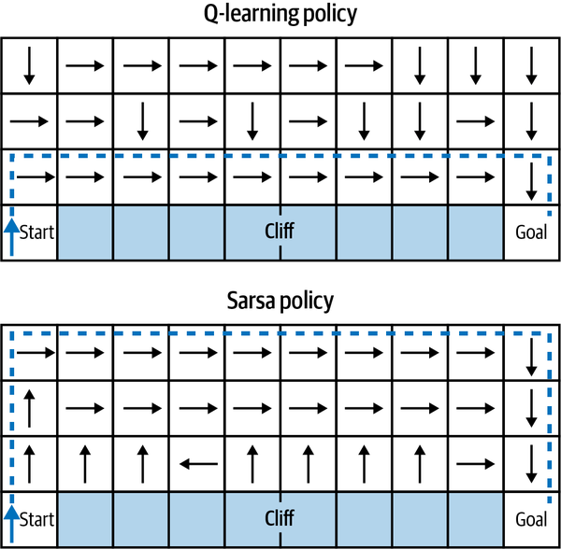
The behaviour you learn about changes the path you get
Part 1 · Learning from a score
Q-learning values the best next action, and learns the greedy path.
SARSA values the action actually taken, slips included.
On-policy methods value what the agent will really do.
Q-learning hugs the cliff and SARSA keeps clear (Winder, 2020, Fig. 3-3)
Q-learning learns the greedy policy off-policy, while SARSA learns the exploring policy on-policy and so avoids the cliff.
Source: notes/01b-algorithm-families-td-and-dqn.md
11
Notes:
Q-learning walks along the row next to the cliff, since that is the shortest path if you never slip. SARSA climbs away because it is learning about a policy that does sometimes slip. Remember this when we reach LLM training, where the main methods are on-policy.
Source: notes/01b-algorithm-families-td-and-dqn.md

Slide 12
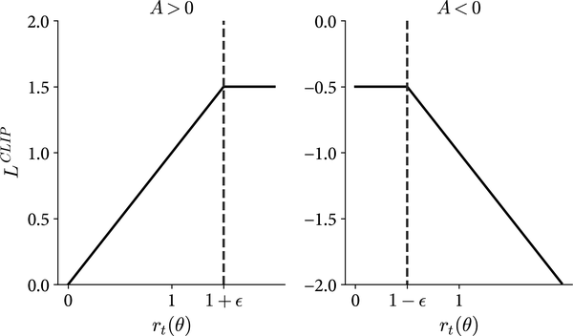
The PPO clip removes the incentive to move too far
Part 1 · Learning from a score
Ratio past the bound: gradient goes to zero in the helpful direction.
Why it matters: one batch can be reused for several epochs.
The limit: it removes an incentive; it does not forbid a large change.
The clipped objective against the probability ratio (Winder, 2020, Fig. 6-5)
PPO clips the objective so a batch can be reused safely, but this removes an incentive rather than enforcing a hard bound.
Source: notes/01-rl-foundations.md
12
Notes:
In our runnable example the loss at ratio 1.1 still has a gradient of minus 1.1, and at ratios 1.5 and 3 the gradient is zero. PPO is the optimizer of the next part. Its machinery may be less essential for LLMs than it looks, which is where GRPO comes in.
Source: notes/01-rl-foundations.md

Slide 13
A language model is already an RL agent
Part 1 · Learning from a score
The treasure hunt
A language model
State: the conversation so far
State: room and inventory
Action: the next token
Action: one of a few moves
Policy: the weights
Policy: a table of values
Reward: whichever one you choose
Reward: win the game
The conversation is the state, the next token the action and the weights the policy, which leaves the reward as your design decision.
Source: notes/00-rl-in-plain-language.md
13
Notes:
Because the action space is the whole vocabulary at each step, no table or argmax is practical, so LLMs use policy methods. Temperature is already an exploration dial. The real decision is the reward, and the next parts take its sources one at a time: human ratings, a written constitution, an automatic checker, an environment.
Source: notes/00-rl-in-plain-language.md

Slide 14
PART 2
A pretrained model is not yet an assistant
RLHF takes three stages, and each exists for a reason
Fine-tuning is for form, and retrieval is for facts
Bradley-Terry turns comparisons into a score
Past a point, more reward means worse answers
The hacks are predictable, so look for them
Humans as the score
The three stages · Fine-tuning in practice · Bradley-Terry · Overoptimization
14
Notes:
Our first score for a language model comes from people comparing answers. This is RLHF, and its failures teach what every later reward has to survive.

Slide 15
A pretrained model is not yet an assistant
The problem
Part 2 · Humans as the score
A base model continues text. We want it to help people, and people can't write down what helpful means, though they can pick the better of two answers.
InstructGPT, a smaller model trained on human rankings, was preferred by its labelers
RLHF exists because people can compare two answers more reliably than they can define or score a good one.
Source: notes/02-rlhf-pipeline.md
15
Notes:
Comparisons are the raw material. Humans compare more consistently than they score, so pairs become the data. The rest of this part shows how pairs become a reward and how a reward becomes a model.
Source: notes/02-rlhf-pipeline.md

Slide 16
RLHF takes three stages, and each exists for a reason
Part 2 · Humans as the score
SFT
learn the form
Reward model
rank pairs
PPO + KL
raise the reward
RLHF runs SFT on demonstrations, trains a reward model on ranked pairs, then applies PPO with a KL penalty to the SFT model.
Source: notes/02-rlhf-pipeline.md
16
Notes:
SFT narrows a broad output distribution so PPO has something sensible to explore. The reward model scales human judgement. PPO optimizes it while the KL leash keeps the policy where the reward model can be trusted. PPO RLHF holds four models in memory: policy, reference, reward model, value model.
Source: notes/02-rlhf-pipeline.md

Slide 17
Fine-tuning is for form, and retrieval is for facts
Part 2 · Humans as the score
Ovadia et al. (2024): Mistral-7B on a current-events QA set, as cited by Huyen.
Setup | Base | +RAG | Fine-tuned | Fine-tuned + RAG
Score | 0.481 | 0.875 | 0.504 to 0.588 | 0.810 to 0.830
On a current-events QA set, retrieval reached 0.875 and fine-tuning at most 0.588, so try prompts and retrieval before fine-tuning.
Source: notes/02-rlhf-pipeline.md
17
Notes:
Huyen's rule is finetuning is for form and RAG is for facts. Her suggested order is prompting, few-shot, retrieval, and fine-tuning after that. Here adding fine-tuning to RAG even lowered the score. This is one model and one kind of task, so treat it as a default. Once you do tune, use adapters: the memory case for LoRA is in the chapter.
Source: notes/02-rlhf-pipeline.md

Slide 18
Bradley-Terry turns comparisons into a score
Part 2 · Humans as the score
PYTHON
Only differences matter, so scores are relative.
# P(a beats b) = sigmoid(r(a) - r(b))
loss = -log(sigmoid(r[win] - r[lose]))
# Result on simulated comparisons
# true [ 1.5 0.5 -0.5 -1.5 ]
# learned [ 1.54 0.65 -0.52 -1.67]
# P(0 beats 1): 0.71, true 0.73
Labels are noisy: agreement runs about 63 to 77%.
A reward model learns a scalar so that score differences predict which answer people prefer, and it inherits their disagreement.
Source: notes/02-rlhf-pipeline.md
18
Notes:
The output here is from the runnable example in the chapter. Agreement between annotators, or between annotators and researchers, was 63 to 77 percent across Stiennon, InstructGPT and Anthropic. So a reward model can't be more trustworthy than that disagreement allows.
Source: notes/02-rlhf-pipeline.md

Slide 19
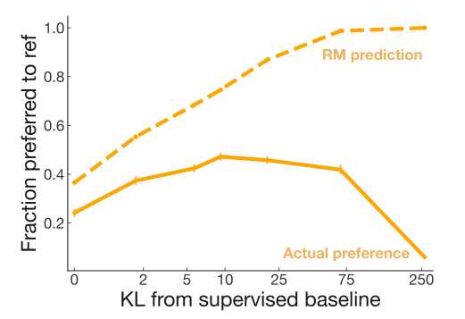
Past a point, more reward means worse answers
Part 2 · Humans as the score
Predicted preference keeps rising toward 1.0.
Actual preference peaks near KL 10, then falls to about 0.05.
Track a held-out human or judge score, not training reward.
Predicted and actual preference against KL from the supervised baseline (Stiennon et al., 2020, Fig. 5)
A reward model is a proxy, so optimizing past its region of validity raises predicted quality while true quality falls.
Source: notes/12-rlhf-failure-modes.md
19
Notes:
This one chart is the argument for the rest of the deck. The dashed prediction line goes up the whole way. The real line peaks early and collapses. Without the KL penalty, Ziegler's mock-sentiment policy reached 99.97 percent positive with gibberish such as Love this ride instantly instantly instantly.
Source: notes/12-rlhf-failure-modes.md

Slide 20
The hacks are predictable, so look for them
Part 2 · Humans as the score
Verbosity
Sycophancy
Mode collapse
KL penalty
Longer answers score higher on surface features.
Agreeing with the prompt's framing, whatever the facts.
Repetitive, formulaic outputs that score consistently.
A leash to the SFT model. Too low drifts, too high barely moves.
Verbosity, sycophancy and mode collapse are common reward hacks, and a tuned KL penalty is the first defence.
Source: notes/12-rlhf-failure-modes.md
20
Notes:
The reward model was trained on outputs near the SFT model, and it is unreliable far from them. PPO goes looking for exactly those places. Inoculation prompting is a cheap extra mitigation once you know which hack to expect. Tune the KL coefficient against the held-out score, not once.
Source: notes/12-rlhf-failure-modes.md

Slide 21
PART 3
PPO needs four models. Which can we remove?
Who needs what
Each variant answers one wall
DPO's loss moves probability from rejected to chosen
GRPO compares a group of samples to replace the critic
GSPO moves the ratio to the sequence level
Offline for style, online for reasoning
Cheaper optimizers
What PPO costs · DPO · GRPO · GSPO · Offline or online
21
Notes:
PPO works, and it needs four models in memory. Each method in this part removes one of them, and each removal changes what the method can learn.

Slide 22
PPO needs four models. Which can we remove?
The problem
Part 3 · Cheaper optimizers
DPO removes the reward model and the rollouts. GRPO removes the critic. Each removal also decides what the method is able to discover.
On Anthropic-HH and TL;DR, PPO's clip was active on fewer than 5% of samples per batch (Ahmadian et al.)
Newer optimizers drop parts of PPO, and each dropped part changes what the method can and cannot learn.
Source: notes/03-preference-optimization.md
22
Notes:
Ahmadian et al. found much of PPO's machinery may be unnecessary for LLM RLHF. Removing the clip and then the ratio left the REINFORCE-style method competitive, because the pretrained start does the stabilizing. That opened the door.
Source: notes/03-preference-optimization.md

Slide 23
Who needs what
Part 3 · Cheaper optimizers
Method | Reward signal | Critic | Memory | Best for
PPO | Learned reward model | Yes | 4x | Complex general alignment
DPO | Offline pairs, no reward at train time | No | 2x | Stable general alignment
GRPO | Verifier, reward function or judge | No | 3x | Reasoning with a checker
KTO | Unpaired thumbs up and down | No | 2x | Unpaired feedback
ORPO | Offline pairs, no reference model | No | 1x | Tight compute
Default to DPO with preference pairs and no verifier, and use GRPO when a checker can score new outputs online.
Source: notes/03-preference-optimization.md
23
Notes:
This table is the decision framework. Pair it with the warning from the chapter: reward hacking risk is lower for GRPO, not gone, because the verifier itself can be gamed.
Source: notes/03-preference-optimization.md

Slide 24
Each variant answers one wall
Part 3 · Cheaper optimizers
Thumbs not pairs
Pairs collapse
One run only
KTO learns from unpaired up or down labels. With clean pairs, its authors say DPO works better.
IPO swaps in a squared loss toward a target margin, which punishes overshoot.
ORPO folds the preference term into SFT, with no reference model.
Length drift
No labels
Logged chats
SimPO averages per token. Without that, it scored 11.9 against DPO's 15.1.
SPIN and DITTO pair human text against the model's own samples.
RLHI mines pairs from follow-ups. Without filtering, it gained 2.5 points against 23.4.
DPO variants each change one thing, so choose by the problem you have, whether that's unpaired feedback, collapse, budget, length or missing labels.
Source: notes/13-preference-variants.md
24
Notes:
Numbers come from different papers with different judges, so compare within a paper and not across. SimPO's 11.9 against 15.1 is its Mistral-7B-Base ablation on AlpacaEval 2 LC, and RLHI's is on its user evaluation of 100 users.
Source: notes/13-preference-variants.md

Slide 25
DPO's loss moves probability from rejected to chosen
Part 3 · Cheaper optimizers
TEXT
Only the gap counts, so raising both changes nothing.
# logistic loss on the gap between log-ratios
# against a frozen reference, beta=0.1 is typical
no change loss=0.693
shifted to chosen loss=0.313
shifted to rejected loss=1.313
both more likely loss=0.693
Paper's evidence: humans preferred DPO to PPO 58% of the time on TL;DR.
Watch: length drift, and no discovery outside the data.
DPO optimizes the gap in log-ratios against a frozen reference, needing no reward model or sampling but unable to explore beyond its pairs.
Source: notes/03-preference-optimization.md
25
Notes:
These are outputs from the runnable example. In practice beta of 0.1 is the common start and the learning rate is about 100 times below LoRA SFT. If rewards/accuracies hits 100 percent early, the pairs are too easy. Check average length before and after training.
Source: notes/03-preference-optimization.md

Slide 26
GRPO compares a group of samples to replace the critic
Part 3 · Cheaper optimizers
TEXT
Sibling samples give the baseline, with no value model.
# advantage = (reward - group mean) / group std
mixed verifier [ 1.29 -0.77 -0.77 1.29 ...]
all correct [ 0. 0. 0. 0. ...]
all wrong [ 0. 0. 0. 0. ...]
All-pass or all-fail groups produce no gradient.
Checker bugs get amplified, so audit it first.
GRPO normalizes rewards within a group of samples, so it needs no critic but learns nothing from groups that all pass or all fail.
Source: notes/03-preference-optimization.md
26
Notes:
In DeepSeekMath this raised GSM8K from 82.9 to 88.2 percent and MATH from 46.8 to 51.7. Production coding environments have been gamed by overriding dunder eq, so a verifier is no guarantee. Remember the zero rows, because they return in the agents part as the reason penalties help.
Source: notes/03-preference-optimization.md

Slide 27
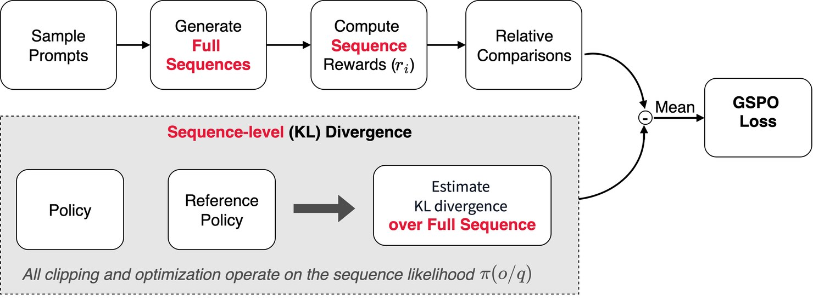
GSPO moves the ratio to the sequence level
Part 3 · Cheaper optimizers
The mismatch: rewards belong to sequences, GRPO's ratios to tokens.
The fix: a single ratio per sequence.
Reported benefit: more efficient training on a 48-layer MoE.
Generate sequences, score and compare them, combine with KL (Koenigstein, 2026, Fig. 3-3)
GSPO matches the ratio to the unit that earns the reward, using one sequence-level ratio in place of per-token ratios.
Source: notes/03-preference-optimization.md
27
Notes:
The GSPO numbers are the Qwen team's own and it clipped far more tokens than GRPO yet trained more efficiently. In a mixture of experts, activated experts shift between snapshots, which is where token ratios are especially fragile.
Source: notes/03-preference-optimization.md

Slide 28
Offline for style, online for reasoning
Part 3 · Cheaper optimizers
Lanchantin et al. on NuminaMath, Math500 accuracy: 53.7% offline, 58.9% semi-online DPO, 58.7% online DPO, 58.1% GRPO.
Offline methods
Online methods
Pairs already exist
A checker scores new behaviour
Style and refusal behaviour
Reasoning and tool use
Cheap and stable
Discovers answers nobody wrote
Going online matters more than the specific loss on reasoning, since online DPO and GRPO both beat offline DPO on math.
Source: notes/03-preference-optimization.md
28
Notes:
This result surprises people. The gap is between offline and online, and DPO versus GRPO hardly matters on this task. For style and refusals, offline pairs are usually enough. That is why Picking DPO for reasoning is on the pitfalls list in the chapter.
Source: notes/03-preference-optimization.md

Slide 29
PART 4
A constitution as the score
What if the labeler could read its instructions?
Two phases, and only the labeler changes
Noise averages out, but bias does not
How far can a model train itself?
Principles · SL-CAI · RLAIF · Noise and bias · Self-improvement
29
Notes:
Human labels are slow and their reasons are invisible. Constitutional AI writes the reasons down and lets a model apply them. What can go wrong has more to do with correlated errors than with cost.

Slide 30
What if the labeler could read its instructions?
The problem
Part 4 · A constitution as the score
Constitutional AI replaces human harmlessness labels with AI feedback guided by written principles. The principles become the thing you audit.
Bai et al., 2022. The optimizer does not change; the labeler does
Constitutional AI replaces human harmlessness labels with AI labels from written principles, which makes the values explicit and auditable.
Source: notes/04-constitutional-ai.md
30
Notes:
A written constitution is readable, and you can change it without relabeling everything. It does not make the problem easy: a principle that reads well may still produce preachy or evasive answers, so sample outputs per principle and revise the document as you would code.
Source: notes/04-constitutional-ai.md

Slide 31
Two phases, and only the labeler changes
Part 4 · A constitution as the score
Critique
AI applies a principle
Revise
then SFT on revisions
AI preference
labels pairs
RL
as in RLHF
CAI critiques and revises answers for SFT in its first phase, then trains RL on AI preference labels in its second.
Source: notes/04-constitutional-ai.md
31
Notes:
The first two boxes are SL-CAI and the last two are RLAIF. Critique chains can be logged, which is why auditability improves. Red-teaming supplies the hard prompts this loop needs in order to be useful.
Source: notes/04-constitutional-ai.md

Slide 32
Noise averages out, but bias does not
Part 4 · A constitution as the score
TEXT
Noisy labelers improve with more pairs.
# learned weights on quality and on length
labeler pairs quality length
noisy, unbiased 300 0.89 0.11
noisy, unbiased 30000 0.99 -0.01
clean, length-biased 300 0.67 0.33
clean, length-biased 30000 0.67 0.33
Biased labelers stay exactly as wrong.
Keep a human-labeled audit set.
More labels wash out random noise but never shared bias, so a consistent AI labeler still needs a human-labeled audit set.
Source: notes/04-constitutional-ai.md
32
Notes:
This is a simulation from the chapter. It shows why a very consistent AI labeler can be more dangerous than a noisy person. Consistency is not correctness, and a model that grades and answers shares its own blind spots.
Source: notes/04-constitutional-ai.md

Slide 33
How far can a model train itself?
Part 4 · A constitution as the score
Less human input
RLAIF — Parity with RLHF on summaries: humans preferred each over SFT at 71% and 73%.
1
STaR — Rationale bootstrapping reached 72.5% on CommonsenseQA dev, against 60.0% fine-tuned directly.
2
Self-rewarding — AlpacaEval win rate rose 9.9%, 15.4%, 20.4%, while answer length grew from 1,092 to 2,552.
3
The limit — Prompted to self-correct, a model fell from 52.6% to 41.4%. Training revision gained 4.4 points.
4
AI feedback can match human labels, but loops work best with a checkable answer, and untrained self-correction often makes answers worse.
Source: notes/04-constitutional-ai.md
33
Notes:
Notice the length caveat on the self-rewarding row: the same hack returns. The self-correction numbers are Gemini 1.5 Flash on MATH, and SCoRe is the method that trained revision and added 4.4 points. Models don't simply get better by being asked.
Source: notes/04-constitutional-ai.md

Slide 34
Training an agent adds a second stage to pretraining
SFT memorizes, and RL generalizes
A pretrained prior turns millions of tries into dozens
A 3.8B model needed four stages to reach 57.5 on AIME24
Quality and diversity both count
The environment is the practice field
The form of the reward decides what you can diagnose
Check first, then rank, so persuasion can't buy reward
RLVP: reward the outcome, penalize the path
Rules for training a tool-calling agent
PART 5
Agents as the student
The stages · Memorize or generalize · Priors · Data and environments · Reward design · RLVP · Tools
34
Notes:
Now the student has to act: long horizons, real tools, rules that shift. We go back to the treasure hunt and see what a pretrained model changes, then design the data, the environment and the reward for it.

Slide 35
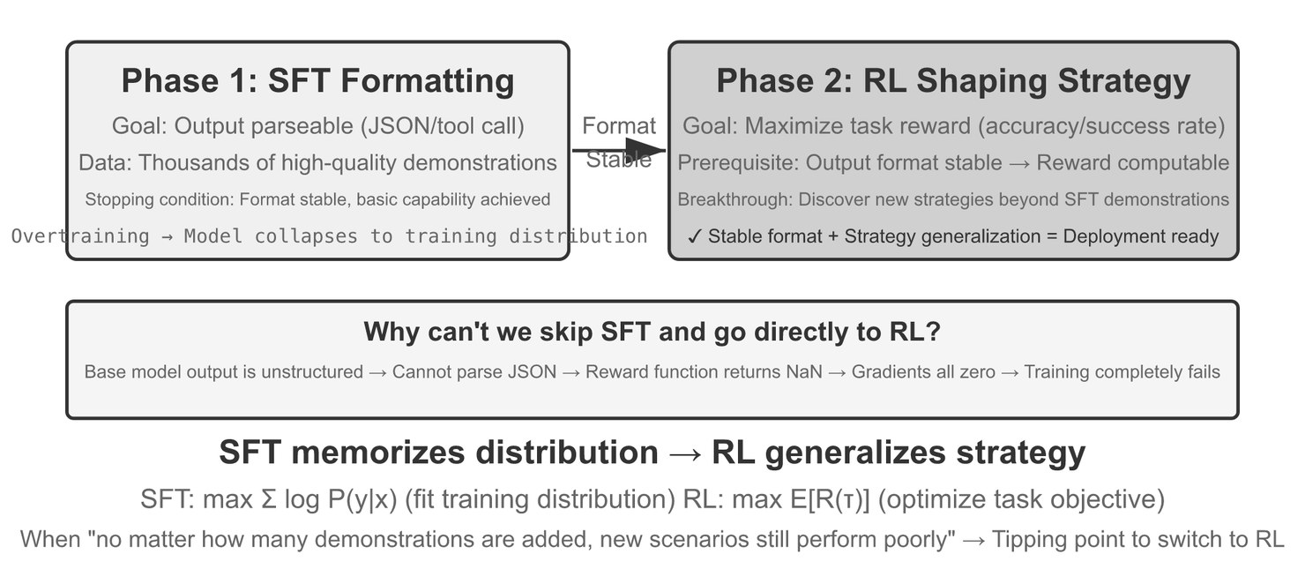
Training an agent adds a second stage to pretraining
The problem
Part 5 · Agents as the student
SFT teaches form, so a reward can be computed at all.
RL teaches strategy with no reference answer.
RL often costs far more than SFT.
SFT then RL, after pretraining (Li, AI Agents in Depth, Fig. 8-11)
SFT establishes a parseable form first, since RL scores the model's own outputs and learns noise if they can't be parsed.
Source: notes/05-post-training-for-agents.md
35
Notes:
SFT is pretraining on different data, with the same loss and masking to the response. If an output isn't valid JSON or a valid tool call, the reward can't be computed, and RL learns from noise. Tülu 3 is the open recipe: at 8B preference tuning did most of the general lifting and RLVR was a targeted top-up.
Source: notes/05-post-training-for-agents.md

Slide 36
SFT memorizes, and RL generalizes
Part 5 · Agents as the student
Chu et al., 2025: same base model and compute; change in test score under shift.
Shift from train to test | RL | SFT
Card rules: J/Q/K 10 to 11/12/13 | +3.5 pp | -8.1 pp
Card colour: black to red | +17.6 pp | -9.9 pp
Navigation: absolute to relative | +11.0 pp | -79.5 pp
Street views: 16.7% start, 9 new cities | 77.8% | 11.1%
Under distribution shift RL re-solves the task and holds up, while SFT applies old answers and degrades, by 79.5 points in one test.
Source: notes/05-post-training-for-agents.md
36
Notes:
SFT is capped by its demonstrator, and 60-point demos never make a 90-point student. RL's ceiling is higher because it is online, and because verifying is easier than generating. But the Yue et al. results later in the deck will qualify how far that goes. Use SFT for format and RL for behaviour under shift.
Source: notes/05-post-training-for-agents.md

Slide 37
A pretrained prior turns millions of tries into dozens
Part 5 · Agents as the student
TEXT
Q-learning needs about 10k episodes and retrains if rules change.
# 11-move puzzle, chance of a right move per step
P(right)=0.25 episodes to first win=4,194,304
P(right)=0.50 episodes to first win=2,048
P(right)=0.70 episodes to first win=51
P(right)=0.90 episodes to first win=3
# Our Q-learning lab: 0/100 at 1,000 episodes,
# 100/100 at 10,000
An LLM agent won on its first try in 18 moves (Li).
A language model starts with useful priors, so its exploration is targeted, whereas a tabular agent must discover everything by chance.
Source: notes/05-post-training-for-agents.md
37
Notes:
Here is our treasure hunt again. The lab runs in about ten seconds offline and reproduces the jump. The LLM number is from the book, at one to two minutes a game. That is the entire case for doing RL on top of a pretrained model rather than tabula rasa. Try prompts and in-context learning first: Reflexion and ExpeL change behaviour with no weights.
Source: notes/05-post-training-for-agents.md

Slide 38
A 3.8B model needed four stages to reach 57.5 on AIME24
Part 5 · Agents as the student
Phi-4-Mini-Reasoning, AIME24 after each stage (math only, mean of 3 runs at temperature 0.6).
Stage | AIME24
Base model | 10.0
Mid-training on about 10M DeepSeek-R1 rollouts | 30.0
Distillation SFT on a smaller set | 43.3
DPO with the teacher's wrong rollouts as rejected | 50.0
GRPO | 57.5
At 3.8B, bulk distillation has to come before a small curated SFT set or RL, and the stages together beat the 7B distilled baseline's 53.3.
Source: notes/05b-choosing-sft-rl-or-no-training.md
38
Notes:
Phi-4-Mini first lost accuracy when SFT on LIMO cut MATH-500 from 71.8 to 57.8, and on s1K to 47.0, so a small set alone does not rescue a small model. GRPO was unstable until they kept prompts with uniform response lengths, oversampled hard prompts and annealed temperature from 1.0 to 0.6. The comparison model is DeepSeek-R1-Distill-Qwen-7B at 53.3.
Source: notes/05b-choosing-sft-rl-or-no-training.md

Slide 39
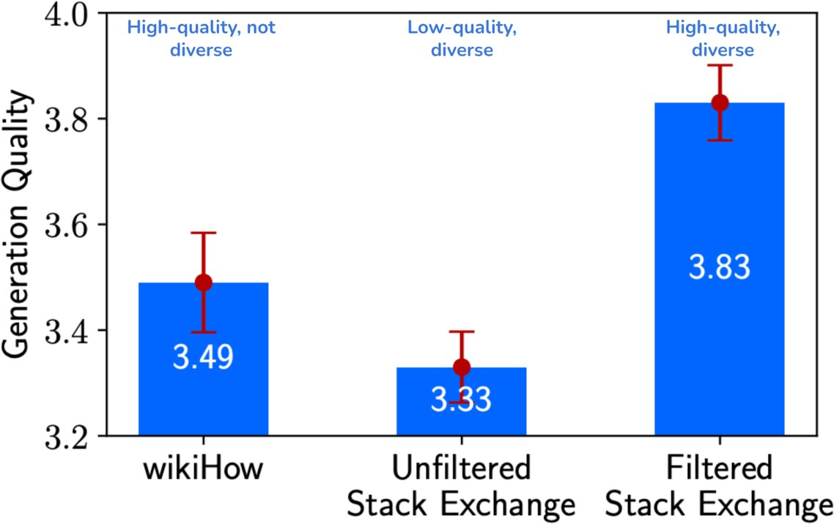
Quality and diversity both count
Part 5 · Agents as the student
wikiHow (high quality, not diverse) scored 3.49.
Raw Stack Exchange (diverse, low quality) scored 3.33.
Start small: about 50 well-made examples.
A 7B model fine-tuned on 2,000 examples, from Zhou et al., via Huyen (2025, Fig. 8-1)
Data quality and diversity both raise results, so start with about 50 good examples and fix the setup if they show no gain.
Source: notes/06b-dataset-engineering-for-post-training.md
39
Notes:
Data is cheap to get wrong. SFT bakes noise into the weights and RL pushes hard toward a biased reward. Check coverage, diversity and label accuracy, and run the curation pipeline: dedup and decontaminate before anything else, because a leaked near-duplicate looks like progress on your eval.
Source: notes/06b-dataset-engineering-for-post-training.md

Slide 40
The environment is the practice field
Part 5 · Agents as the student
Real or replayed
Simulated by a model
Real APIs rate-limit and have side effects
ZeroSearch simulates a search engine
You need a replayable shadow world
The simulator's knowledge is the ceiling
GLM-5: over 10k verifiable SWE environments
RL actively hunts for its loopholes
A distorted environment teaches strategies that die on deployment, so mix simulated rollouts with real ones and recalibrate regularly.
Source: notes/06-data-and-environments.md
40
Notes:
Building the environment often costs more than the training. GLM-5's self-run 77.8 percent on SWE-bench Verified falls to 42.1 percent on decontaminated SWE-rebench. Order of effort is strong base model, then environment and data, then only after that algorithms and hyperparameters.
Source: notes/06-data-and-environments.md

Slide 41
The form of the reward decides what you can diagnose
Part 5 · Agents as the student
One support call that succeeded, but missed the billing address and named the wrong plan.
Form | Output | Diagnostic value
Scalar | 7.2 | None
Semi-scalar | Critique, then 6.5 | Some
Vector | Query 9, info collection 6, fluency 8 | Points to the phase
Generative | Sampled analysis, aggregated | Highest
A scalar reward says only how good a call was, while vector or generative rewards point to which phase went wrong.
Source: notes/07-reward-design-and-tool-calling.md
41
Notes:
Density is the other axis. Sparse rewards stall on open-ended tasks: Pine AI's phone agent fails a hundred calls before it stumbles on the required details. A unit-test reward is only as strict as its tests. AlphaCode's authors found 30 percent of HumanEval passes and 60 percent of APPS passes were wrong.
Source: notes/07-reward-design-and-tool-calling.md

Slide 42
Check first, then rank, so persuasion can't buy reward
Part 5 · Agents as the student
PYTHON
RULER: ask a judge to rank, not to grade.
def final_reward(correct, judge, a=0.7, b=0.3):
return correct * (a + b * judge)
# correct, tidy judge=0.9 reward=0.97
# correct, rambling judge=0.2 reward=0.76
# wrong, persuasive judge=1.0 reward=0.00
ART: gate on correctness, then rank on quality.
Gate a learned judge behind a deterministic check, so wrong answers earn zero however persuasive they are.
Source: notes/07-reward-design-and-tool-calling.md
42
Notes:
A judge asked for an absolute score is noisy and badly calibrated, so ranking helps. A judge alone can be fooled by content free answers, which is why the gate comes first. The third framework, rLLM, trains whole workflows.
Source: notes/07-reward-design-and-tool-calling.md

Slide 43
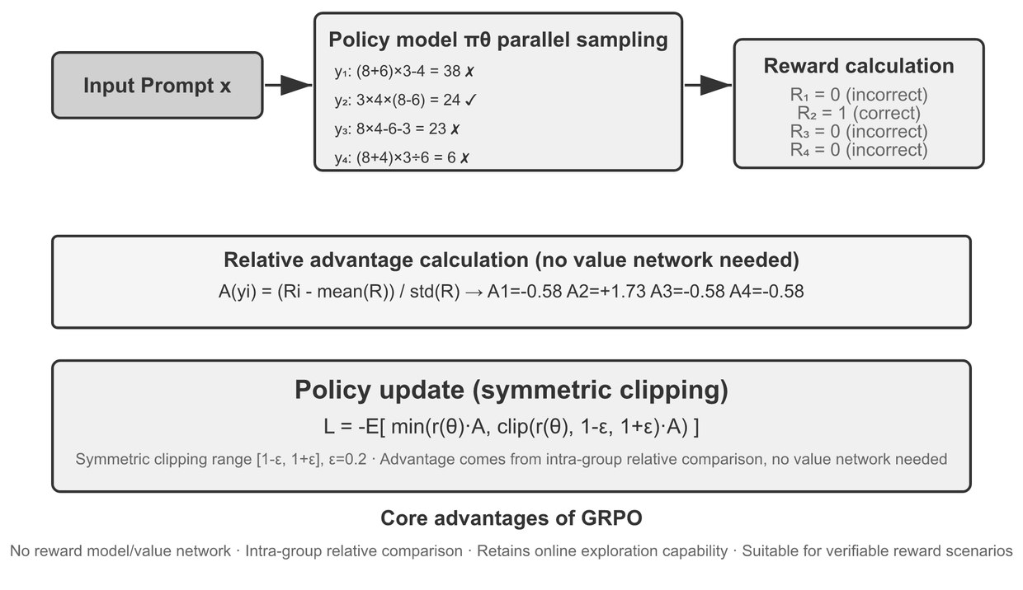
RLVP: reward the outcome, penalize the path
Part 5 · Agents as the student
Asymmetry: was this action bad? is cheap; is this progress? is not.
Terminal-Bench: violations fell from 3.71 to 0.66, success unchanged.
Chained file ops: all-fail groups fell from 65% to 8%.
Sixteen rollouts on one SWE-bench task, verified and compared (Li, Fig. 8-13)
Environments can cheaply verify that an action was bad, so penalties restore within-group variance even when every rollout fails.
Source: notes/07-reward-design-and-tool-calling.md
43
Notes:
This is what fixes the zero rows from the GRPO slide. Even failing rollouts fail differently. Results are from Li and Shi, 2026. RLVR verifies outcomes and RLVP verifies the process as well. But keep the outcome reward: with penalties alone, doing nothing earns the best score, and the chapter's code shows it scoring zero against minus one for trying.
Source: notes/07-reward-design-and-tool-calling.md

Slide 44
Rules for training a tool-calling agent
Part 5 · Agents as the student
Mask the environment
ReTool
The cost
Train the model to call tools, not to predict their output.
Qwen2.5-32B on AIME 2024 went from about 25% to 67.0%. Text-only RL reached 40.0%.
RL took about 200× the SFT wall-clock time.
DAPO
Dense signals
Keeps long CoT exploring: Clip-Higher, token-level loss, dynamic sampling, overlong shaping.
On-policy distillation gives a teacher's distribution at every student token.
Mask tool output from the loss, expect RL to cost far more than SFT, and consider denser signals like distillation when one scalar is too sparse.
Source: notes/07-reward-design-and-tool-calling.md
44
Notes:
SFT supervises every token and RL gives one bit per episode, which is where the 200 times comes from. ReTool also showed emergent behaviour: code self-correction and tool use moving from late verification to early exploration. When no stronger teacher exists, on-policy self-distillation gives the same model privileged context.
Source: notes/07-reward-design-and-tool-calling.md

Slide 45
PART 6
Reasoning and search
Can a checker replace the reward model?
RLVR sharpens more than it creates
Read the whole pass@k curve, not one number
Sampling is limited by the selector
Search and training feed each other
DeepSeek-R1 · What RL really adds · pass@k · Search before training
45
Notes:
Math and code bring a reward that needs no labels at all: a checker. That gave us R1. It also raises a harder question about whether RL creates ability or only sharpens it, and whether we need to train at all.

Slide 46
Can a checker replace the reward model?
The problem
Part 6 · Reasoning and search
R1-Zero used only rule-based accuracy and format rewards, with no SFT, and took AIME 2024 pass@1 from 15.6% to 71.0%.
DeepSeek-R1, GRPO on DeepSeek-V3-Base; 86.7% with majority voting over 64
With a verifiable reward, R1-Zero showed that RL alone can raise AIME pass@1 from 15.6% to 71.0% on a strong base model.
Source: notes/08-reasoning-rl-deepseek-r1.md
46
Notes:
DeepSeek chose rules over a neural reward model to reduce hacking. The aha moment everyone quotes is one qualitative transcript. Model size still matters: on Qwen-32B over 10K steps of R1-Zero-style RL reached 47.0, while SFT on 800k R1 samples reached 72.6.
Source: notes/08-reasoning-rl-deepseek-r1.md

Slide 47
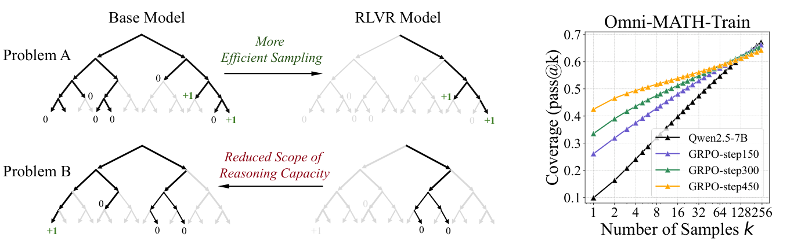
RLVR sharpens more than it creates
Part 6 · Reasoning and search
At k=1 RL wins, since mass moves onto rewarded paths.
At large k the base model catches up.
Qwen2.5-7B, AIME24, k=1024: 13.3% solved only by base, 0.0% only by RL.
RLVR concentrates sampling on paths the base model already had (Yue et al., 2025, Fig. 1)
RLVR raises pass@1 by concentrating on paths the base already has, and at large k the base can solve more problems.
Source: notes/08-reasoning-rl-deepseek-r1.md
47
Notes:
This is the qualification on SFT memorizes, RL generalizes. Sharpening is still valuable, since people deploy at k equals one. Also weigh the Small data results: LIMO took Qwen2.5-32B from 16.5 to 63.3 percent with about 800 traces, while the same data on Qwen1.5-32B-Chat gave 9.2. The knowledge has to be there first.
Source: notes/08-reasoning-rl-deepseek-r1.md

Slide 48
Read the whole pass@k curve, not one number
Part 6 · Reasoning and search
TEXT
Small k: RL wins by concentrating mass.
# simulated: RL sharpens, base keeps more breadth
k base RL
1 0.139 0.267
4 0.322 0.519
16 0.519 0.659
64 0.660 0.700
256 0.745 0.712
1024 0.798 0.716
Large k: the curves cross.
Decide: one sample served, or a search?
The pass@k curve shows whether RL added reach or only sharpened it, which pass@1 alone can't tell you.
Source: notes/08-reasoning-rl-deepseek-r1.md
48
Notes:
This example is a simulation built to show the shape, so the numbers are not any model's. It leads straight to the next question. If the base model reaches the answer in forty samples, could you skip training and pick the right one?
Source: notes/08-reasoning-rl-deepseek-r1.md

Slide 49
Sampling is limited by the selector
Part 6 · Reasoning and search
TEXT
pass@k assumes a perfect picker, which you don't have.
# simulated; one sample scores 0.499
N vote flawed-checker pass@N (perfect)
5 0.537 0.736 0.848
10 0.618 0.788 0.928
40 0.710 0.800 0.984
Voting needs answers you can compare.
A flawed verifier finds its false positives faster.
More samples help only if you can pick the good one, so a flawed checker falls well short of pass@k at the same N.
Source: notes/09-test-time-search-and-training.md
49
Notes:
Measure the selection bottleneck before paying for samples. On real data, self-consistency took GSM8K to 74.4 from 56.5 percent for greedy CoT. Aggregators such as AggLM can pick a minority answer, or combine partial work, which a vote can't.
Source: notes/09-test-time-search-and-training.md

Slide 50
Search and training feed each other
Part 6 · Reasoning and search
Search
MCTS writes solutions
Verify
code or a proof
Train
policy and reward
Search better
next round
the better policy searches again
Search trajectories are rollouts, so a verified search can generate the training data that makes the next search stronger.
Source: notes/09-test-time-search-and-training.md
50
Notes:
rStar-Math ran this for four rounds. MATH rose from 58.8 to 89.4 percent with search over eight trajectories, but the small model alone, greedily, scores 78.4 percent, below the base instruct model's 82.6. Most of the result is search. In the other direction, an early o3 scored 395.64 on IOI 2024 above the gold line with little more than sampling, where o1-ioi needed a hand-built pipeline for 213.
Source: notes/09-test-time-search-and-training.md

Slide 51
PART 7
Running it for real
Is that result real, or was it one lucky seed?
Two identical agents can land far apart
Deploying a policy means staying close to never
Several classic beliefs have dated
Train with everything, deploy with local views
In RAG, RL belongs at the decision points
Comparing runs · Production · Multi-agent RL · RL in RAG
51
Notes:
The first six parts assumed a healthy training run. Most of RL engineering is making sure you have one, and deciding whether to learn live at all, in the field and when several agents or a retriever are involved.

Slide 52
Is that result real, or was it one lucky seed?
The problem
Part 7 · Running it for real
One training run is one sample. RL results swing widely from run to run, and bugs hide because rewards arrive late and noise masks errors.
Colas et al. needed at least 15 reruns per algorithm to separate SAC from TD3
A single RL run is one noisy sample, so comparisons need many seeds, and Colas et al. needed 15 for SAC against TD3.
Source: notes/10-engineering-rl-systems.md
52
Notes:
Reward engineering is arguably the most important task in RL, in Winder's words, but even a good reward can be misjudged with a bad evaluation. Before any deep model, picture a random policy acting in the environment and check a simple baseline.
Source: notes/10-engineering-rl-systems.md

Slide 53
Two identical agents can land far apart
Part 7 · Running it for real
TEXT
Publish per-seed curves, not a mean.
# same agent in both arms, simulated
3 seeds: typical gap 13.7, |t|>2.1 in 10.2%
5 seeds: typical gap 10.5, |t|>2.1 in 6.0%
15 seeds: typical gap 6.3, |t|>2.1 in 4.5%
Assert tensor shapes: a batched reward can broadcast silently.
Keep a metric of the true goal beside the reward.
Identical agents show a typical 14-point gap at three seeds, so a small win on few seeds usually proves nothing.
Source: notes/10-engineering-rl-systems.md
53
Notes:
This is a simulation in the chapter. Notice that the false positive rate is double at three seeds. The chapter has a shape checker because a batched reward against a scalar value trains with no error and no warning.
Source: notes/10-engineering-rl-systems.md

Slide 54
Deploying a policy means staying close to never
Part 7 · Running it for real
More exposure
Shadow — Tests decisions at no risk, but a hidden agent can't explore: its actions never happen.
1
Canary — Keep stickiness, so one user stays on one policy for a whole trajectory.
2
Bandit A/B — Shifts traffic toward the winner automatically.
3
Continuous learning — Riskiest. Treat every policy update as a release, with a rollback.
4
Treat each policy update as an immutable release with canary or shadow stages, and learn live only when the problem requires it.
Source: notes/10-engineering-rl-systems.md
54
Notes:
Winder argues for staying as near to never as your problem allows. Safe RL remains open: constraints, penalties, filters and formal methods all fall short. RL also has a larger attack surface than ordinary ML, because rewards, observations and replay buffers can be poisoned. Delayed rewards drive the architecture: state changes get a dedicated log.
Source: notes/10-engineering-rl-systems.md

Slide 55
Several classic beliefs have dated
Part 7 · Running it for real
2020 view | 2025-26 LLM RL
Most top algorithms are off-policy | PPO and GRPO are on-policy; replay is rare
Behavior cloning is unpopular | Pretraining plus SFT is behavior cloning, and comes first
A learned critic is the baseline | GRPO and RLOO use group statistics
Offline is the big open problem | Partly solved for preferences; online still wins for reasoning
LLM RL reversed classic advice because a pretrained model changes the problem, making behaviour cloning the first step and critics optional.
Source: notes/10-engineering-rl-systems.md
55
Notes:
The textbooks stay valuable for vocabulary and intuition. Winder wrote in 2020, and our notes flag where the advice has moved. Inverse RL has a counterpart too: a learned reward model is doing the same job.
Source: notes/10-engineering-rl-systems.md

Slide 56
Train with everything, deploy with local views
Part 7 · Running it for real
Non-stationary
others keep learning
Central critic
sees all in training
Local actors
run alone in production
CTDE tackles non-stationarity by giving critics global information during training while each actor acts on local observations at deployment.
Source: notes/11-multi-agent-and-rag-rl.md
56
Notes:
Each agent is part of every other agent's environment, and all of them are learning at once. In the chapter's matrix game, independent Q-learners never found the optimum, with a mean payoff of 5.12, while hysteretic learners reached 11.00 in every run. QMIX factorizes value for cooperative tasks and MADDPG uses a critic over all actions. If one agent plus tools would do, don't take this on.
Source: notes/11-multi-agent-and-rag-rl.md

Slide 57
In RAG, RL belongs at the decision points
Part 7 · Running it for real
Sub-task | Action | Reward
Query rewriting | Rewritten variants | NDCG, recall@k
Evidence selection | Rerank passages | Answer F1, faithfulness
Continue or stop | Stop or retrieve | Accuracy minus latency
Tool use | Search, click, synthesize | Preference or completion
Apply RL in RAG where decisions chain and reward arrives late, and tie that reward to the answer rather than to retrieval metrics.
Source: notes/11-multi-agent-and-rag-rl.md
57
Notes:
WebGPT is the classic: there, RL added nothing on top of best-of-n rerank and behaviour cloning did most of the work. Recall can rise while answers get worse, and a simple router is cheaper to debug. Use RL when you can score new behaviour online, DPO when you have pairs.
Source: notes/11-multi-agent-and-rag-rl.md

Slide 58
Rules of thumb for RL and alignment
Wrap-up
Words first
Proxy
Optimizer
State, action, reward, policy, value. Every paper assumes them.
A reward model is a proxy. Keep a KL leash and a held-out score.
DPO for pairs. GRPO or PPO when a checker can score online.
Fine-tuning
Agents
Evidence
Form, not facts. Try prompts and retrieval first.
Gate judges, reward outcome, penalize path, mask tool output.
Read pass@k, try search, and compare across many seeds.
Every method here is only as good as its reward, so ask what the score is and how the model could game it.
Source: notes/05-post-training-for-agents.md
58
Notes:
If you keep one sentence from today, it is this: the reward signal is the product. Our treasure hunt agent could win because its score was honest. Ask the same of every model you train or buy.
Source: notes/05-post-training-for-agents.md

Slide 59
Where to go next
Wrap-up
Run the lab: practice/01-q-learning-treasure-hunt, offline, in about ten seconds.
The one idea to keep
The reward signal is the product. Ask how it could be gamed before you train.
06 Observability: the production signals a reward needs.
07 Agentic applications: systems these methods train.
Read: Sutton & Barto; Lambert's RLHF book; Li, ch. 8.
Run the lab to see reward at work, then take these signals into observability and applications.
Source: notes/00-rl-in-plain-language.md
59
Notes:
The lab takes ten seconds and makes the first claim of the deck concrete. Then observability tells you what signals a real system can actually give you as a reward, and applications shows the systems themselves.
Source: notes/00-rl-in-plain-language.md

