Slide 1
Eval Engineering
Part 1: Foundations
What an eval is · Defining correct · Datasets
Part 2: Grading
Graders · LLM-as-judge and calibration
Measuring a non-deterministic system
Part 3: Applying it
Agents · RAG and grounding · Tracing
Criteria · Datasets · Graders · Judges
Agents · RAG · Traces · Error bars · Gates · Production
Part 4: Deciding
Reading results · CI gates · Production · Failure modes
Notes: ai-engineering/06-eval
Notes:
Pillar 6 of the AI-engineering course. It measures every layer below it: prompts, context, harness, loop. Four parts: what an eval is and what "correct" means, how to grade, how to apply it to agents and RAG, and how to decide from the numbers.

Slide 2
The thesis
Six parts, many names
The core flow
Tests gate merges, evals measure rates
Capability vs. regression suites
Write success down before any code
Find failure modes by reading
The failure taxonomy, ordered by stage
Start small and real, grow by stage
Is this row fair for this gate?
What public benchmarks teach private suites
PART 1
Foundations
What an eval is · Defining correct · Datasets
2
Notes:
Chapters 01–03. Vocabulary first, then the specification problem, then the dataset. Most eval problems are specification problems, not grader problems.

Slide 3
The thesis
Why evals are their own discipline
Part 1 · Foundations
An eval is the definition of "better" for your system, written down so a machine can check it.
Without it, every change to a prompt, model, tool or retrieval config is a guess.
Source: notes/01-what-an-eval-is.md
3
Notes:
Every layer below has its own eval chapter on what to measure. This pillar owns how: the shared machinery. GitHub Copilot built its eval framework before the prompts and the UI.
Source: notes/01-what-an-eval-is.md

Slide 4
Six parts, many names
The vocabulary
Part 1 · Foundations
Anthropic, LangSmith, OpenAI and Inspect use different words for the same parts.
Term | What it is | Also called
Task | One test: an input plus success criteria | case, example, row
Trial | One attempt at a task. Outputs vary, so several per task | run, epoch
Trajectory | The full record: messages, tool calls, intermediate results | trace, transcript
Outcome | The end state: the answer, the file system, the DB row | final response
Grader | Code, a model or a person scoring one aspect of a trial | evaluator, judge, metric
Suite | Tasks run together for a system-level picture | eval set, benchmark
Inspect's split: a Task = dataset + solver (the system) + scorer. Keep the three swappable.
Source: notes/01-what-an-eval-is.md
4
Notes:
The system under test is the whole harness: model, prompts, tools, routing, memory, loop. The eval harness runs the suite and treats the SUT as a black box with an entry point.
Source: notes/01-what-an-eval-is.md

Slide 5
The core flow
Every chapter is one arrow
Part 1 · Foundations
Task
from the suite
Run SUT
k trials
Trajectory + outcome
captured per trial
Graders
one per dimension
Aggregate
± error bar → decision
Chapters 02–12 are each about doing one of these arrows well.
Source: notes/01-what-an-eval-is.md
5
Notes:
The mental model from the README: task × k trials → trajectory + outcome → graders → scores → aggregate ± error bar → decision. Four questions in order: what is correct, which tasks, can the grader be trusted, is the difference real.
Source: notes/01-what-an-eval-is.md

Slide 6
Tests gate merges, evals measure rates
The test / eval seam
Part 1 · Foundations
Draw the line by determinism.
Unit test
Eval
Deterministic behavior: rendering, schemas, retries, routing tables
Non-deterministic behavior: quality, grounding, task success
Asserts exact values. Pass or fail
Many tasks, many trials. A rate with an error bar
Mock the model here
Never mock the model: you'd measure the mock
"retry fires 3 times on 429"
"grounded answer rate ≥ 0.90 on the golden set"
Never assert an exact LLM string in a unit test. It flakes, then gets loosened until it checks nothing.
Source: notes/01-what-an-eval-is.md
6
Notes:
In between sit deterministic graders inside an eval: given an output, is it valid JSON with a citations array. Deterministic check, non-deterministic input.
Source: notes/01-what-an-eval-is.md

Slide 7
Capability vs. regression suites
Two questions, two pass rates
Part 1 · Foundations
 | Capability eval | Regression eval
Question | What can it do? | Does it still do what it used to?
Expected pass rate | Low to medium. Room to climb | Near 100%
Tasks come from | The frontier: hard and new cases | Mastered tasks + every fixed bug
A drop means | Little on its own | Something broke. Block the release
Runs | On demand | Every change, in CI
Tasks graduate. Once a capability task passes reliably, it moves to the regression suite.
Source: notes/01-what-an-eval-is.md
7
Notes:
Keep the frontier moving by adding harder cases as old ones saturate (chapter 12). Also: offline evals are the lab, online evals the field. You need both.
Source: notes/01-what-an-eval-is.md

Slide 8
Write success down before any code
Defining correct
Part 1 · Foundations
Question | Bad answer | Good answer
What does the user need? | A helpful answer | The steps to change their payout account, in their language, citing the article
What must never happen? | Nothing bad | Inventing a menu path. Leaking another customer's data
Unit of success? | It went well | Per turn: grounded + complete. Per conversation: resolved in ≤ 6 turns
Cost of being wrong? | — | Wrong menu path = a ticket. Wrong tax answer = a fine
The two-expert test: if two experts wouldn't reach the same verdict, fix the criteria, not the grader.
Source: notes/02-defining-correct.md
8
Notes:
The fourth answer sets thresholds. Cheap errors can ship at 90%; expensive ones need a lower error rate plus a fallback. Run the two-expert test literally: 20 outputs, two people, the written criteria. One named person (the "benevolent dictator") owns the final definition.
Source: notes/02-defining-correct.md

Slide 9
Find failure modes by reading
Error analysis (Husain & Shankar)
Part 1 · Foundations
1
Collect ~100 traces — Real if you have them, synthetic if you don't yet.
2
Open coding — A free-text note on the first thing that went wrong. No categories yet.
3
Axial coding — Group the notes into categories. Expect 5–15.
4
Count — Rank by frequency × cost. That ranking is your eval roadmap.
5
Repeat to saturation — Until new traces stop producing new categories, usually 50–100.
Don't build a grader for a failure mode you haven't seen.
Source: notes/02-defining-correct.md
9
Notes:
Note the first failure only: later ones are often caused by it and inflate the wrong category. Shankar et al. (2024) found criteria drift as people grade. That's how you discover the spec, so version the criteria.
Source: notes/02-defining-correct.md

Slide 10
The failure taxonomy, ordered by stage
A RAG support agent
Part 1 · Foundations
Stable names, one label per fix, earliest failure wins.
Stage | Labels
Corpus | source_missing · url_unmapped · topic_proxy
Index | index_lag · chunk_fragmented
Retrieval | rank_miss · query_rewrite_miss · reranker_regression
Eval infrastructure | context_missing
Generation | citation_hallucination · unsupported_claim · incomplete_answer
Behavior | wrong_escalation · refusal · schema_violation
Give the eval's own failures a label, so eval bugs aren't counted as system bugs.
Source: notes/02-defining-correct.md
10
Notes:
Dashboards aggregate by label, so renaming one breaks history. If a label could be fixed by retrieval or the prompt, split it. Include negative, boundary, out-of-scope and adversarial cases too: without negatives, "calls the tool more often" looks like an improvement.
Source: notes/02-defining-correct.md

Slide 11
Start small and real, grow by stage
Eval datasets
Part 1 · Foundations
Stage | Size | Purpose
Example suite | 5–20 | Eyeball diffs while iterating on a prompt
First golden set | 20–50 | Real failures, hand-reviewed. Catches big regressions
Working set | 100–300 | ±5–8 point error bars on a pass rate
LLM-graded sample | 50–200 | Cost-capped subset for expensive judges
Large harness | 1,000+ | Small effects. Needs synthetic or logged data
Grow to the next stage when the current one can't separate two versions you need to tell apart.
Source: notes/03-eval-datasets.md
11
Notes:
Synthetic data: generate along dimensions (persona × intent × complexity), tuples first, then queries in a separate call, with a different model family from the one under test. Every production failure becomes a row: discovery set first, regression set once fixed.
Source: notes/03-eval-datasets.md

Slide 12
Is this row fair for this gate?
Row eligibility
Part 1 · Foundations
Each pool is a subset of the one above it.
narrower, fairer for later gates
1
all_gt — Every golden row. Fair for demand analysis.
2
source_mapped_gt — Expected source maps to a known doc. Fair for corpus coverage.
3
retrieval_eligible_gt — That source is actually indexed. Fair for retrieval metrics.
4
generation_eligible_gt — Retrieval found it. Fair for answer quality.
5
quality_sample — Deterministic, cost-capped sample. Fair for LLM judges.
A downstream gate never silently scores rows an upstream gate marked ineligible.
Source: notes/03-eval-datasets.md
12
Notes:
If the expected source isn't in the index, scoring that row on retrieval measures your corpus, not your retriever. Ineligible rows appear only as a separate diagnostic slice.
Source: notes/03-eval-datasets.md

Slide 13
What public benchmarks teach private suites
Li, AI Agents in Depth, ch. 6
Part 1 · Foundations
Budget for rejection
Fixed it, broke nothing
Difficulty as diagnosis
SWE-bench Verified: 93 developers reviewed tasks. Only 500 of 2,294 survived.
FAIL_TO_PASS tests prove the fix. PASS_TO_PASS tests prove no regression.
GAIA L1: humans 93.9%, GPT-4 30.3%. L3: 87.3% vs 0%.
Fresh parameters
Canaries
So…
τ²-bench and AndroidWorld fill templates with new values every run. Memorized paths won't replay.
Terminal-Bench embeds a unique GUID. If a model can produce it, the set leaked.
Split dev and held-out, version the dataset, record the version with every result.
Source: notes/03-eval-datasets.md
13
Notes:
Contamination tactics: unique answers (GAIA), parameterized templates, temporal freshness (SWE-bench-Live), canaries. Each works for a private set. Never paste eval rows into few-shot examples or fine-tuning data.
Source: notes/03-eval-datasets.md

Slide 14
PART 2
Code first, judge above it, humans calibrate
One contract for every grader
Which graders may block a release
Don't let a composite hide a regression
One judge, one criterion, reason before verdict
Known judge biases and their fixes
Calibrate before you gate
Report the two error rates separately
Pairwise votes become a ranking
Grading
Graders · LLM-as-judge and calibration
14
Notes:
Chapters 04–05. Use the simplest grader you can trust. Code first, a judge above that floor, people to calibrate both.

Slide 15
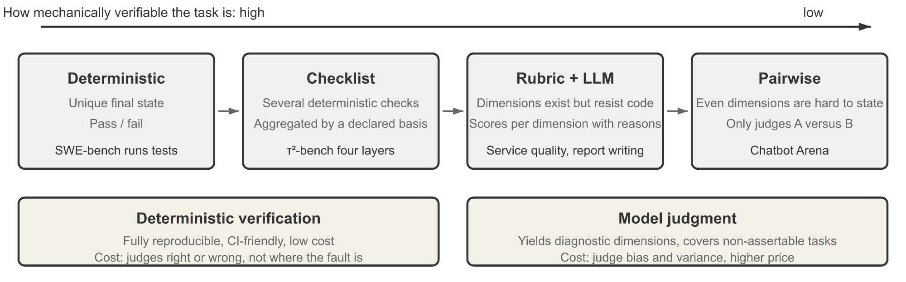
Code first, judge above it, humans calibrate
Three kinds of grader
Part 2 · Grading
Code: deterministic, free, hard to argue with
Separated evaluator: runs the output, doesn't just read it
LLM judge: semantic quality at volume. Biased, needs calibration
Verification modes, deterministic to model judgment (Li, AI Agents in Depth, Fig. 7-4)
Humans: 5–10% of graded rows, to calibrate the judge
Layers, not alternatives. Run code first and stop early, so judge budget goes where judgment is needed.
Source: notes/04-graders.md
15
Notes:
Teams reach for a judge too early. Most systems have more checkable properties than they use: schema, tool names and arguments, citation IDs in the retrieved set, final DB state, language ID, forbidden tools, efficiency from the trace. BLEU and ROUGE correlate poorly with quality for open-ended answers.
Source: notes/04-graders.md

Slide 16
One contract for every grader
The grader interface
Part 2 · Grading
PYTHON
requires: skip with context_missing, don't guess
class Grader(Protocol):
name: str
version: str
# e.g. {"retrieved_context"}: skip if missing
requires: set[str]
def grade(self, task, output,
trajectory=None,
context=None) -> GraderResult: ...
# GraderResult: score, passed, reasoning,
# dimensions, labels, grader_version
reasoning: the judge's explanation, or the failing check
labels: taxonomy labels this trial earned
grader_version: every score traceable
Same input, same output shape. Graders become swappable, composable and reportable the same way.
Source: notes/04-graders.md
16
Notes:
A grounding grader handed URLs instead of passage text should return "can't grade", not a made-up score. That single field prevents the most common grounding eval bug.
Source: notes/04-graders.md

Slide 17
Which graders may block a release
Grader states
Part 2 · Grading
State | Meaning | Can gate?
Heuristic | Deterministic code check | Yes
Calibrated | LLM judge with evidence it agrees with humans | Yes, at the calibrated threshold
Experimental | New or uncalibrated judge | No. Tracking only
A threshold change without fresh calibration evidence moves a grader back to experimental.
Source: notes/04-graders.md
17
Notes:
Release decisions must name which state each cited metric is in. Combining graders: binary all-pass for never-events, weighted where dimensions trade off, hybrid in most production systems, and always report the dimensions separately too.
Source: notes/04-graders.md

Slide 18
Don't let a composite hide a regression
Combining graders
Part 2 · Grading
Weighted composite alone
Hybrid with a veto
+5 relevance, −5 grounding = flat score
Must-pass gates: schema valid, no citation hallucination
Worse for users who need correct answers
A fluent answer with a made-up fact still scores well
Then 0.5 grounding + 0.3 completeness + 0.2 relevance ≥ 0.75
Hallucination is a veto: fires → total is 0
Prefer binary pass/fail per dimension over 1–5 scales. "Is this a 3 or a 4?" has no stable answer.
Source: notes/04-graders.md
18
Notes:
Li, following Scale AI's Rubrics as Rewards: rubric items are expert-grounded, cover pitfalls, are weighted Essential / Important / Optional / Pitfall, and are self-contained so they can be checked without the grader's own expertise.
Source: notes/04-graders.md

Slide 19
One judge, one criterion, reason before verdict
Writing the judge prompt
Part 2 · Grading
TEXT
Grade a third party's work, never "your own"
You are evaluating whether an answer to a query
is clear.
[BEGIN DATA]
Query: {query}
Answer: {response}
[END DATA]
"clear": easy to follow, answers the query.
"unclear": confusing, off-topic, hard to act on.
EXPLANATION: <step-by-step reasoning>
LABEL: "clear" or "unclear"
Precise PASS and FAIL definitions
2–4 few-shot cases near the boundary
Delimited inputs; critique, then a fixed-format label
A CANNOT_GRADE escape, or the judge guesses
Parse strictly. An unparseable verdict is a grader error, not a FAIL.
Source: notes/05-llm-as-judge.md
19
Notes:
The prompt is a compact version of the DeepLearning.AI Evaluating AI Agents course's analysis-clarity judge (Lab 3). Phoenix's llm_classify with rails snaps output to the allowed labels. Decompose hard criteria: grounding claim by claim, completeness question by question.
Source: notes/05-llm-as-judge.md

Slide 20
Known judge biases and their fixes
Zheng et al. 2023 (MT-Bench)
Part 2 · Grading
Bias | What happens | Mitigation
Position | Pairwise judges favor one slot | Run both orders. A win must hold in both
Verbosity | Longer answers score higher | Rubric says length isn't quality. Track score vs. length
Self-preference | Favors its own model family | Judge with a different family
Leniency | Borderline cases pass | Explicit FAIL conditions. Tricky-FAIL few-shots
Format / authority | Confident tone, markdown, citations look right | Check citations in code
Limited capability | Can't verify what it can't do | A reference, a code check, or a stronger judge
Once these are controlled, strong judges agree with humans about as often as humans agree with each other (over 80%).
Source: notes/05-llm-as-judge.md
20
Notes:
Self-preference gets worse when the agent is optimized against the judge: it learns that judge's blind spots. Multi-family judging is the mitigation.
Source: notes/05-llm-as-judge.md

Slide 21
Calibrate before you gate
The procedure
Part 2 · Grading
1
Get human labels — 100–200 outputs labeled PASS/FAIL by your domain expert.
2
Split — Train (few-shots), dev (iterate), test (measure once).
3
Run on dev — Build the confusion matrix against the human labels.
4
Read disagreements — Each is a prompt problem, a criteria problem, or a hard case.
5
Measure on test once — That's the reported number. Record judge model and prompt version.
An uncalibrated judge never gates a release.
Source: notes/05-llm-as-judge.md
21
Notes:
If you tune against the test split, it's a dev set. Re-calibrate when the judge model, judge prompt, system under test or user population changes. Pin the judge version.
Source: notes/05-llm-as-judge.md

Slide 22
Report the two error rates separately
What to measure
Part 2 · Grading
Metric | Meaning | Matters for
TPR | Of human PASSes, how many the judge passed | Not blocking good releases
TNR | Of human FAILs, how many the judge failed | Catching bad outputs
Precision on PASS | Of judge PASSes, how many humans passed | Building golden labels
Cohen's κ | Agreement corrected for chance | Comparing to human–human
Score separation | Mean on human-PASS minus mean on human-FAIL | Does it discriminate at all?
Correct the pass rate: true ≈ (p̂ + TNR − 1) / (TPR + TNR − 1).
Source: notes/05-llm-as-judge.md
22
Notes:
A release gate needs high TNR; a golden-label builder needs high precision on PASS. If one judge can't do both, use two. Separation under 0.05 means the threshold is doing the work. The case study found off-the-shelf judges scoring disliked answers higher: inverted separation. Worked correction: judge passes 80%, TPR 0.95, TNR 0.70 gives 0.50 / 0.65 = 0.77.
Source: notes/05-llm-as-judge.md

Slide 23
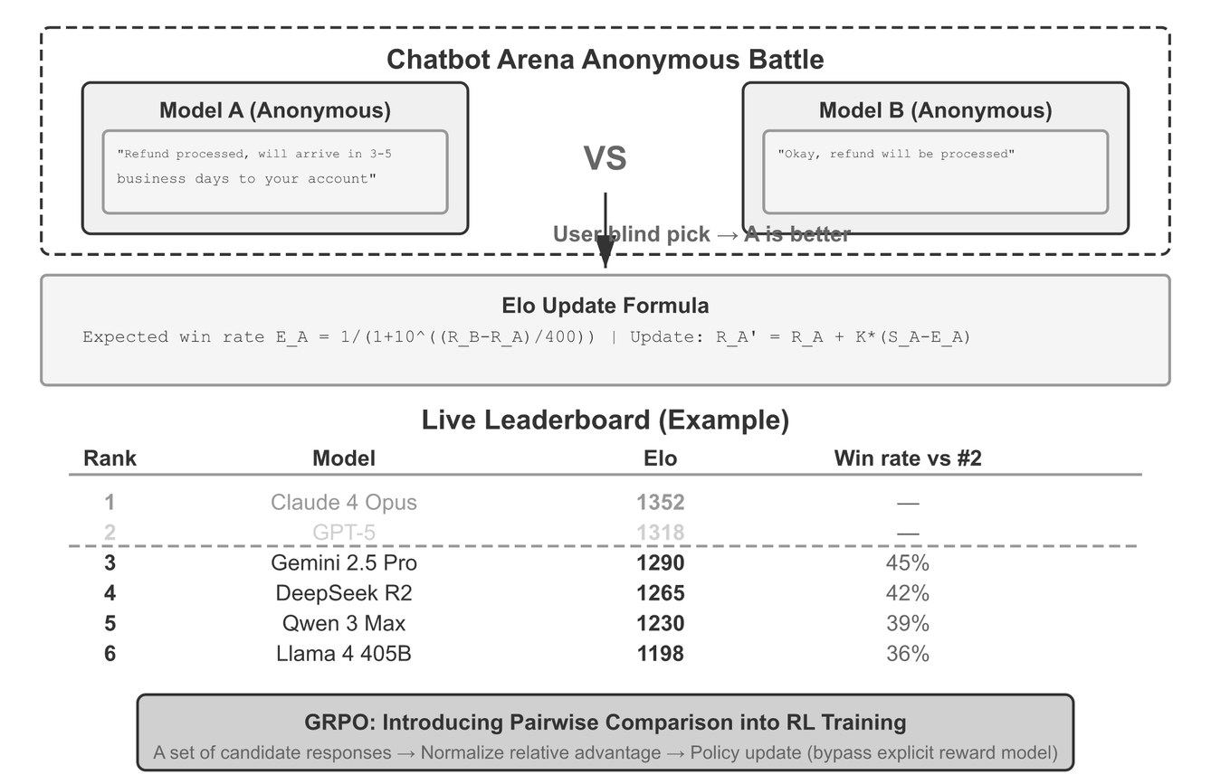
Pairwise votes become a ranking
Elo and Bradley–Terry
Part 2 · Grading
Expected: E = 1 / (1 + 10^((R_B − R_A)/400))
Update: R ← R + K·(S − E)
1200 vs 1000 → expected win 76%
LLM voter: swap the order, count a win only if it holds both ways
Check for cycles; Bradley–Terry assumes transitivity
Elo rating from pairwise comparisons (Li, AI Agents in Depth, Fig. 7-6)
Pairwise is easier for the judge than absolute scoring, but you can't monitor production with it.
Source: notes/05-llm-as-judge.md
23
Notes:
Chatbot Arena ranks models this way from millions of blind votes, but the ranking reflects what users happened to ask. Lab: practice/02-elo-leaderboard.
Source: notes/05-llm-as-judge.md

Slide 24
PART 3
Outcome and trajectory fail independently
Three strictness levels for tool calls
One grader per component
The router judge, in code
pass@k rises, pass^k falls
Convergence is relative to what you observed
Why agent cost grows faster than step count
Score each RAG stage separately
Check grounding claim by claim
A trace is a tree of spans
Traces feed evals, evals feed datasets
Applying it
Agents · RAG and grounding · Tracing
24
Notes:
Chapters 06–08. Agents produce a path, RAG fails in stages, and traces are the raw material every grader reads.

Slide 25
Outcome and trajectory fail independently
Evaluating agents
Part 3 · Applying it
Outcome | Trajectory | What happened | Outcome-only eval says
Pass | Pass | Worked | Pass
Pass | Fail | Right answer by an unsafe or wasteful path: 40 paid API calls | Pass (wrong)
Fail | Pass | Reasonable process, external failure: tool timeout | Fail (not the agent)
Fail | Fail | Broken | Fail
Grade the end state, not what the agent says. "I've issued your refund" with no refund row is the failure to catch.
Source: notes/06-evaluating-agents.md
25
Notes:
Anthropic recommends grading both the final environment state and the transcript. The reverse also happens: a flight agent found a cheaper fare via a policy loophole and failed a strict path check. Let trajectory checks enforce invariants, not one golden path.
Source: notes/06-evaluating-agents.md

Slide 26
Three strictness levels for tool calls
Scoring trajectories
Part 3 · Applying it
Match mode | Passes when | Use for
Exact | Same tools, order and arguments | Strict protocols (auth before action)
In order | Expected calls in order, extras allowed | Required sequence with some freedom
Any order | All expected calls appear | Independent lookups
Subset / superset | Calls ⊆ or ⊇ an allowed set | "Never call outside this set"
No single correct path? Use invariants ("never issue_refund before lookup_order") or a trajectory judge.
Source: notes/06-evaluating-agents.md
26
Notes:
Check arguments separately from tool names, with per-argument rules: exact, normalized, numeric tolerance, any value, or a judge. Label expected calls from human-confirmed good traces, or bootstrap from routing metadata the system already logs.
Source: notes/06-evaluating-agents.md

Slide 27
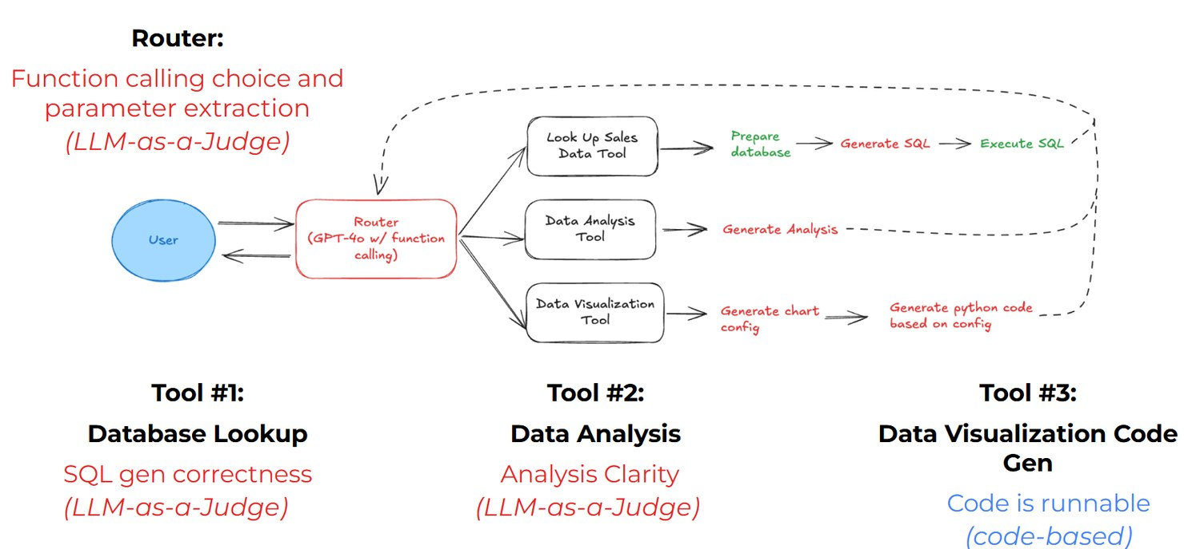
One grader per component
DeepLearning.AI, Evaluating AI Agents
Part 3 · Applying it
Router: right tool, right parameters (LLM judge)
SQL skill: does the query answer the question (judge)
Analysis skill: clear? entities correct? (two judges)
Visualization: does the code run (code)
Router and skill evaluators (DeepLearning.AI & Arize, Lab 3)
Path: converged in few steps (code)
An end-to-end failure doesn't say which part broke. Component evals do.
Source: notes/06-evaluating-agents.md
27
Notes:
The course agent is a GPT-4o-mini router with function calling and three tools over a sales dataset. In multi-agent systems split routing evals (right sub-agent?) from domain evals (given correct routing, right tools and output?). Neither replaces the other.
Source: notes/06-evaluating-agents.md

Slide 28
The router judge, in code
Phoenix, course Lab 3
Part 3 · Applying it
PYTHON
Spans in, labels back onto the same spans
q = SpanQuery().where("span_kind == 'LLM'").select(
question="input.value", tool_call="llm.tools")
df = px.Client().query_spans(q, project_name=P)
df = df.dropna(subset=["tool_call"])
with suppress_tracing():
ev = llm_classify(
dataframe=df,
template=TOOL_CALLING_PROMPT_TEMPLATE,
rails=["correct", "incorrect"],
model=OpenAIModel(model="gpt-4o"),
provide_explanation=True)
px.Client().log_evaluations(SpanEvaluations(
eval_name="Tool Calling Eval", dataframe=ev))
rails snap the output to allowed labels
Moved since: phoenix.client.Client, span annotations
phoenix.evals 2.x: create_classifier, LLM(provider=…)
Grade the trace you already recorded. The score lives one click from the context.
Source: notes/06-evaluating-agents.md
28
Notes:
px.Client, SpanEvaluations and log_evaluations are legacy Phoenix APIs. The course fills the template's tool_definitions slot with string replace calls that turn JSON braces into quotes; pass the definitions as a template variable instead. The visualization check exec()s generated code: sandbox it, and note that "runs without raising" passes an empty chart.
Source: notes/06-evaluating-agents.md

Slide 29
pass@k rises, pass^k falls
Non-determinism
Part 3 · Applying it
Run each task k times (3–10 is typical) and report rates.
Metric | Definition | Question | p = 0.75, k = 3
pass@k | At least one of k succeeds | Can it do this at all, with retries? | 0.98
pass^k | All k succeed | Does it do this every time? | 0.42
Best@k | Best score of k | What's the quality ceiling? | —
Customer-facing agents get one try per user. Report pass^k for them.
Source: notes/06-evaluating-agents.md
29
Notes:
pass@k = 1 − (1 − p)^k, pass^k = p^k. Unbiased pass@k from n samples, c correct: 1 − C(n−c, k) / C(n, k) (Chen et al. 2021). τ-bench (Yao et al. 2024) introduced pass^k and showed agents fine at pass@1 falling sharply at pass^8. Also report the per-task pass-rate distribution: 70% flaky everywhere and 70% of tasks always passing need different fixes.
Source: notes/06-evaluating-agents.md

Slide 30
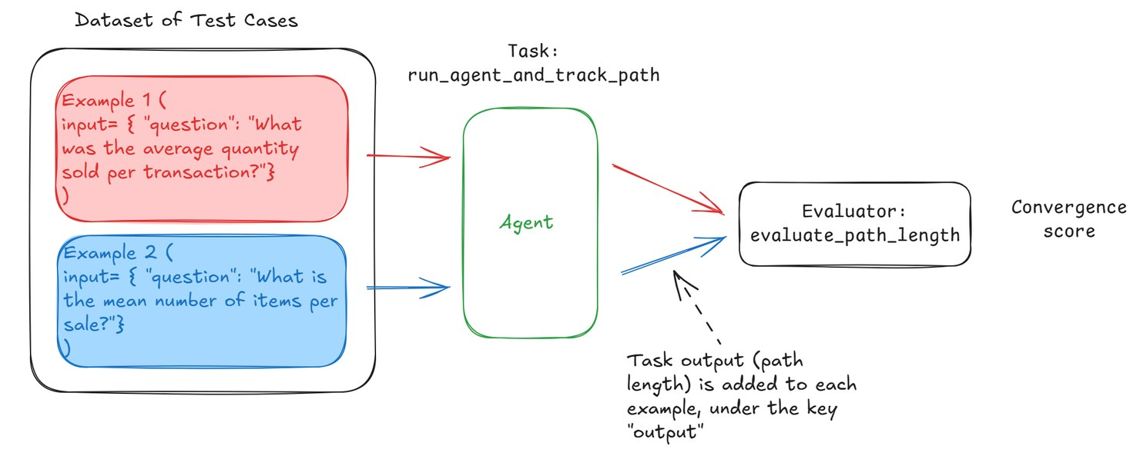
Convergence is relative to what you observed
Course Lab 4
Part 3 · Applying it
17 paraphrases of one question
Score = shortest run seen ÷ this run's length
"Optimal" is the shortest observed, so a thrashing batch still scores near 1.0
Counts messages, not tool calls
Convergence experiment (DeepLearning.AI & Arize, Lab 4)
Fix the reference length before gating on it
Log steps, tokens, latency and cost per success on every trial. Pass rates miss efficiency regressions.
Source: notes/06-evaluating-agents.md
30
Notes:
The task is run_agent_and_track_path, the evaluator a CODE evaluator registered with create_evaluator, run through run_experiment and evaluate_experiment. Because the reference is the batch minimum, scores don't compare across agent versions unless you pin it.
Source: notes/06-evaluating-agents.md

Slide 31
Why agent cost grows faster than step count
Li, AI Agents in Depth, Table 6-4
Part 3 · Applying it
A three-turn refund agent: 9,500 input tokens, 470 output, $0.022. Every turn re-sends the context.
Thinking tokens
Big tool outputs
Detours
So…
500–2,000 extra per turn can multiply cost 3–5×. 2,000 at 50 tok/s is 40 s.
A 5,000-token page from turn 2 is billed again on every later turn.
Ten turns instead of three, and the context passes 20,000 tokens.
Cap cost per task in the harness. Log thinking tokens separately. Report p95 latency, not the mean.
Source: notes/06-evaluating-agents.md
31
Notes:
Prefix caching saves nearly half the input cost. Cost per success is the sustainability metric: at 50% success the real cost is 2× per run. RE-Bench (Wijk et al. 2025): at 2 hours the best agent scored about 4× human experts; at 32 hours humans scored about 2× the agent. Report a budget–capability curve, not one point.
Source: notes/06-evaluating-agents.md

Slide 32
Score each RAG stage separately
Evaluating RAG and grounding
Part 3 · Applying it
Retrieve
recall@k, hit rate
Rerank
MRR, nDCG@k
Context
context precision
Generate
faithful, complete
Cite
citations valid
Pick k to match what enters the prompt. Recall@50 is irrelevant if 5 are passed
Score generation only on generation-eligible rows
Faithful is not correct: faithful-but-wrong points at the corpus
Source: notes/07-evaluating-rag-and-grounding.md
32
Notes:
If the source wasn't retrieved, a bad answer is a retrieval failure. Expected sources are the expensive part: the doc an agent linked in the ticket, the source an approved answer cited, or a judge labeling relevance of retrieved chunks.
Source: notes/07-evaluating-rag-and-grounding.md

Slide 33
Check grounding claim by claim
Faithfulness (RAGAS, case study)
Part 3 · Applying it
Extract claims — Split the answer into atomic statements. "Settings → Payouts, click Edit, 2 days" is three.
1
Verify each — Against passage text: supported, contradicted or not found.
2
Score — Supported ÷ total. Report contradictions separately.
3
Tier the claims — Strict facts need near-verbatim support; paraphrase needs entailment; filler is exempt.
4
Pass the text, not the pointer. A grader handed URLs scores near zero, or from its own knowledge.
Source: notes/07-evaluating-rag-and-grounding.md
33
Notes:
Citations are cheap in code: every cited ID is in the retrieved set, quotes appear in the passage, every strict claim is cited. Then a judge for citation precision and recall (ALCE, Gao et al. 2023). Frameworks (RAGAS, ARES, DeepEval, Phoenix evals) get you started; gate on graders calibrated against your own labels.
Source: notes/07-evaluating-rag-and-grounding.md

Slide 34
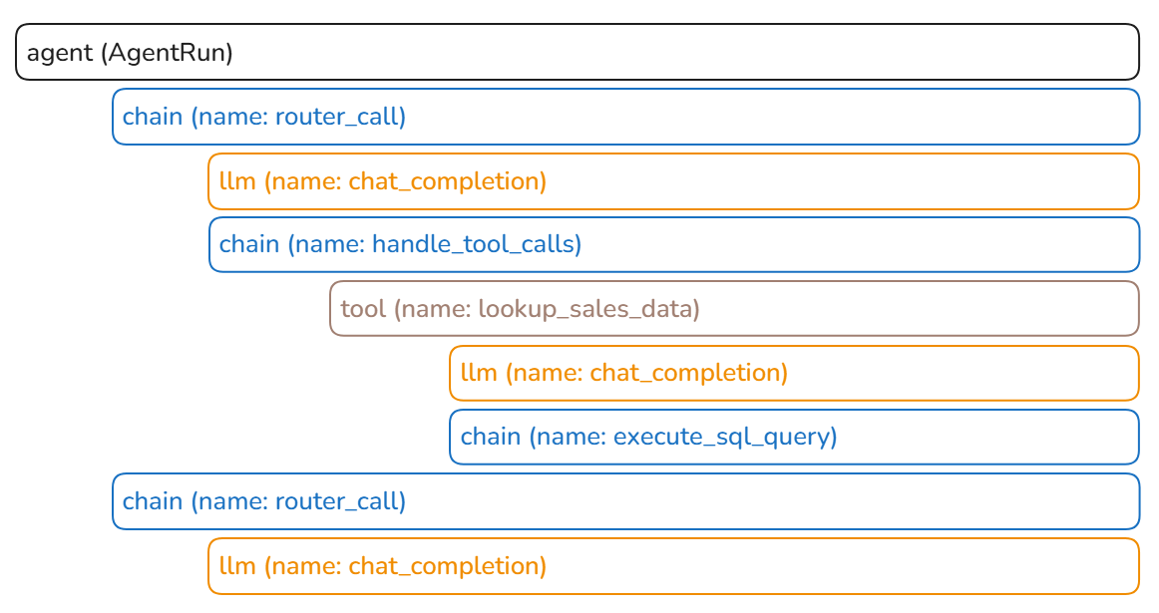
A trace is a tree of spans
Tracing, course Lab 2
Part 3 · Applying it
Model call: model ID, full input, tokens, latency
Tool call: name, arguments, result or error
Retrieval: query, IDs and text, scores
Root: prompt, model, config, index versions
Auto-instrument LLM calls; add agent, chain, tool spans yourself
One agent run in Phoenix (DeepLearning.AI & Arize, Lab 2)
Final-output evals say that something failed. Traces say where.
Source: notes/08-tracing-and-observability.md
34
Notes:
The course makes tracing Lab 2, before any evaluator. Use OpenTelemetry GenAI conventions (invoke_agent, chat, execute_tool; gen_ai.usage.input_tokens) or OpenInference, so you can switch backends. Six questions a trace must answer: what was asked and returned, which steps ran, what the model saw, which tools and results, where time and money went, which versions.
Source: notes/08-tracing-and-observability.md

Slide 35
Traces feed evals, evals feed datasets
The loop that makes traces pay off
Part 3 · Applying it
Production traces
sampled
Graders
same code as CI
Scores on spans
one click to context
Triage
failures, 👎, escalations
New eval rows
offline re-runs
every failure becomes a row
Pick a tool (Phoenix, Langfuse, LangSmith, Braintrust) on four things: evals over stored traces, scores on spans, datasets from traces, side-by-side experiments.
Source: notes/08-tracing-and-observability.md
35
Notes:
Offline and online share graders: two implementations drift apart. Traces are also where cost lives: roll up per span, request, user and feature; watch cache hit rate and tail latency per step. Decide redaction, access and retention up front.
Source: notes/08-tracing-and-observability.md

Slide 36
Every number gets an error bar
Size the suite for the smallest change that matters
Compare versions on the same tasks
A worked example: 7 questions, one run
Slice before you conclude
Slice by difficulty, not just by topic
A report that supports a decision
Cheap suites on every change, expensive ones on a schedule
Run, then assert
Gate against a baseline, on the interval
Gates ordered by pipeline stage
The maturity ladder
Humans calibrate, judges cover
When a score drops, suspect the eval first
Optimize hard and you'll find the eval's gaps
PART 4
Deciding
Reading results · CI gates · Production · Failure modes
36
Notes:
Chapters 09–12. A score is an estimate from a sample. Put an error bar on it, gate on it in CI, keep measuring in production, and suspect the eval before the agent.

Slide 37
Every number gets an error bar
Reading results
Part 4 · Deciding
SE = √(p(1 − p) / n). The 95% CI is p ± 1.96·SE.
Tasks | SE at p = 0.80 | 95% CI
20 | 0.089 | 62% – 98%
50 | 0.057 | 69% – 91%
100 | 0.040 | 72% – 88%
300 | 0.023 | 75% – 85%
1,000 | 0.013 | 77% – 83%
On 50 tasks, 80% and 72% are not distinguishable.
Source: notes/09-reading-results.md
37
Notes:
The most important table in the chapter. For small n or p near 0 or 1 use the Wilson interval. With k trials per task, average within the task first, then compute SE across tasks. Clustered tasks need clustered standard errors.
Source: notes/09-reading-results.md

Slide 38
Size the suite for the smallest change that matters
How many tasks
Part 4 · Deciding
Paired, 80% power, α = 0.05, pass rates around 70–85%.
Smallest difference that matters | Tasks needed
15 points | 50–100
10 points | 100–200
5 points | 400–800
2 points | 2,500+
A 50-task golden set is a smoke detector for big regressions. It can't tell you a tweak gained 3 points.
Source: notes/09-reading-results.md
38
Notes:
The paired range depends on how often the two versions disagree on the same task. Unpaired comparisons need noticeably more. Either grow the suite or stop deciding on 3-point gaps.
Source: notes/09-reading-results.md

Slide 39
Compare versions on the same tasks
Paired differences (Miller, Anthropic 2024)
Part 4 · Deciding
Two independent rates
Per-task differences
A at 84%, B at 85%, each with its own wide interval
Most tasks pass or fail on both, so differences are mostly 0
Task-to-task variation swamps the difference
SE(Δ) = sd(differences) / √n, much smaller
McNemar: only the discordant tasks count
B wins 14–6 is evidence. 11–9 is not
The error bars overlap and you learn nothing
Pairing cuts variance for free
Run both versions on identical tasks and analyze per-task differences.
Source: notes/09-reading-results.md
39
Notes:
Miller, "Adding Error Bars to Evals" (Anthropic, 2024). Testing several fixes at once: at 95% each, the chance at least one of 6 is a false positive is 1 − 0.95^6 ≈ 26%.
Source: notes/09-reading-results.md

Slide 40
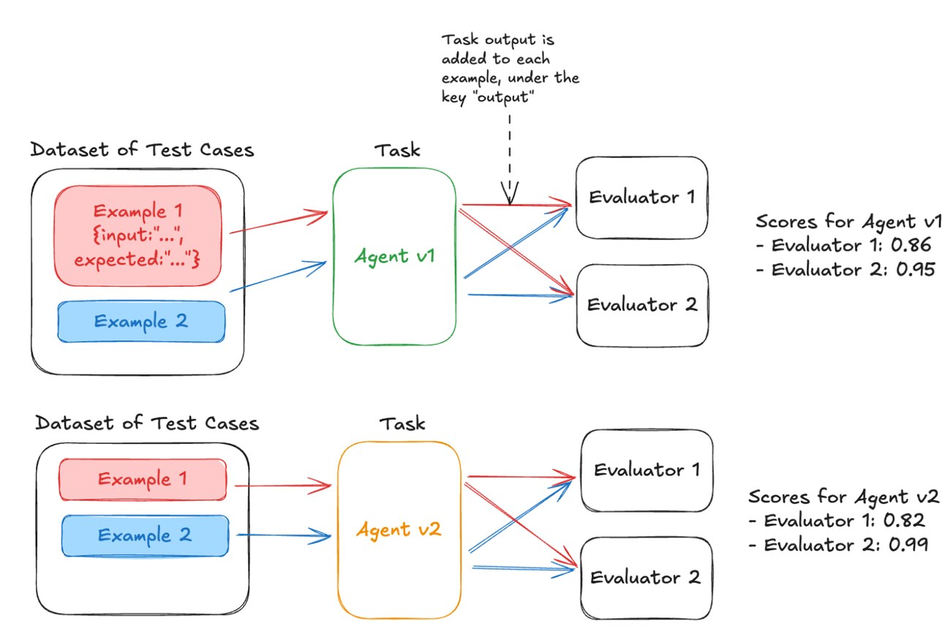
A worked example: 7 questions, one run
Course Lab 5
Part 4 · Deciding
v2 adds "Think before you respond." to the SQL prompt
n = 7: one flipped task moves a rate 14 points
0.82 vs 0.86 is noise. Pair, count discordant tasks, repeat k times
The SQL grader passes when no SQL ran
v1 vs v2 experiment (DeepLearning.AI & Arize, Lab 5)
Check the graders before the agents. A version that skips the tool gets a perfect SQL score.
Source: notes/09-reading-results.md
40
Notes:
The lab's evaluate_sql_result compares only digits in the result, so 1,200 and 12.00 match, and returns True when the lookup tool wasn't called. Five evaluators run per experiment: function calling, SQL result, clarity, entity correctness, code runnable.
Source: notes/09-reading-results.md

Slide 41
Slice before you conclude
A flat headline can hide a loss
Part 4 · Deciding
Slice | n | A | B | Δ
Billing | 120 | 82% | 90% | +8
How-to | 150 | 88% | 89% | +1
Non-English | 40 | 75% | 58% | −17
Overall | 310 | 84% | 85% | +1
"+1 overall" ships a change that breaks non-English users. Show n per slice.
Source: notes/09-reading-results.md
41
Notes:
Watch Simpson's paradox: B can beat A in every slice and lose overall if the slice mix differs. Slice 20 ways and one will be "significant" by chance; pre-register the slices that gate. Then read 10–20 flipped transcripts before accepting any change.
Source: notes/09-reading-results.md

Slide 42
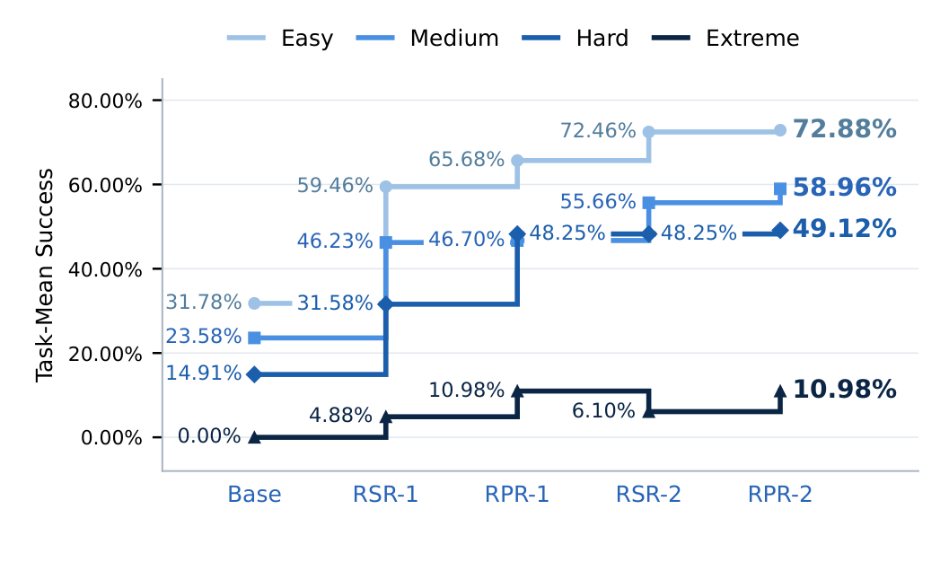
Slice by difficulty, not just by topic
Yang et al. 2026, Terminal-Bench RSI
Part 4 · Deciding
Easy tasks: 32% → 73%. The headline gain lives here
Extreme tasks: 0 → 4.9 → 11.0 → 6.1 → 11.0%
One pooled rate hides where progress stalls
Success by difficulty stratum across self-improvement rounds (Yang et al. 2026, Fig. 10)
Report the strata. A rising average can sit on a flat hard tail.
Source: notes/09-reading-results.md
42
Notes:
The same paper reports Mean@R next to pass@R (chapter 06) and shows partial-credit reward drifting from strict success (chapter 12).
Source: notes/09-reading-results.md

Slide 43
A report that supports a decision
Report template
Part 4 · Deciding
TEXT
Suite: support-golden v4 (n=310, 3 trials/task) Judge: grounding-v2 (TNR 0.88)
A (prod) B (candidate) Δ (paired)
Pass rate 84.2% ±3.9 85.1% ±3.8 +0.9 [−1.6, +3.4]
Non-English (40) 75.0% ±13 57.5% ±15 −17.5 [−29, −6] ⚠
Errors / refusals 1.3% 4.2% ⚠
Cost per success $0.014 $0.016 +14%
Flipped tasks read: 18 / 18. 9 of 11 regressions are refusal on non-English
Decision: do not ship. Investigate refusal behavior for non-English.
Count errors and refusals as failures, or as their own rate. Never let them leave the denominator.
Source: notes/09-reading-results.md
43
Notes:
From the KDD 2017 "Dirty Dozen": sample ratio mismatch (B errored on 8% and those rows were dropped), ratio metrics with changing denominators (grounding rose because B refuses more), novelty effects, ignoring the error bar.
Source: notes/09-reading-results.md

Slide 44
Cheap suites on every change, expensive ones on a schedule
Evals in CI
Part 4 · Deciding
Trigger | Suite | Graders | Blocks?
Every commit / PR | Unit tests + smoke eval (10–30 tasks) | Code only | Yes
PR touching prompts, tools, retrieval | Regression suite | Code + calibrated judges on a sample | Yes
Nightly | Full suite, k trials | All, experimental tracked | Alerts
Pre-release | Full + held-out + adversarial | All calibrated | Release gate
Model change | Everything, paired vs. prod | All | Yes
Use path filters, so a README change doesn't trigger a $40 judge run.
Source: notes/10-evals-in-ci.md
44
Notes:
Give the eval job its own API key with a spend limit. Rate-limit concurrency or you'll grade 429s. Infra failures are their own count, never a task fail. Pin model IDs, judge versions and dataset version in results.jsonl.
Source: notes/10-evals-in-ci.md

Slide 45
Run, then assert
Two phases with an artifact between
Part 4 · Deciding
Phase 1: Run
Phase 2: Assert
For each task × trial: run the SUT, capture the trace, grade
Load results, compute metrics and CIs per slice
Write a row to results.jsonl
Compare to baseline and thresholds
Emit pass/fail per gate + a report
Slow, costly, non-deterministic
Fast, free, deterministic
Change a threshold or add a slice and re-assert in seconds, without re-running a $30 suite.
Source: notes/10-evals-in-ci.md
45
Notes:
Results become an artifact: upload, diff against the last run, attach to the PR. Flakiness is visible because retries and infra errors are recorded in phase 1. The case study's harness splits every suite this way, with pytest assertions reading the rows.
Source: notes/10-evals-in-ci.md

Slide 46
Gate against a baseline, on the interval
The regression gate
Part 4 · Deciding
Rule | Example | Catches
Absolute floor | Schema ≥ 99%. Citation hallucination = 0 | Never-events
Relative to baseline | Grounding ≤ 3 points below prod (paired CI) | Regressions
Per-slice floor | No slice drops > 10 points | Hidden slice losses
Efficiency budget | Cost/success ≤ 1.2× baseline. p95 ≤ 8 s | Silent cost blow-ups
Regression set | Fixed failures ≥ 95% pass | Re-broken bugs
"Block if Δ < 0" blocks on noise half the time. Block when the CI upper bound is below −3.
Source: notes/10-evals-in-ci.md
46
Notes:
Update the baseline deliberately after a release, with the dataset and grader versions. Every gate emits the same JSON shape: metrics with CI and baseline, rows scored and ineligible, top failure labels, worst slices, and a next action. A gate that only says FAILED costs half a day.
Source: notes/10-evals-in-ci.md

Slide 47
Gates ordered by pipeline stage
The gate ladder
Part 4 · Deciding
Data quality
valid, mapped, eligible
Retrieval
retrieval-eligible rows
Generation
generation-eligible rows
Calibration
gating judges calibrated
Release
all pass + budget
A later gate runs only on rows an earlier gate says are fair. The maturity ladder (next) orders building the practice; this orders checks within a run.
Source: notes/10-evals-in-ci.md
47
Notes:
Ownership: an infra owner for the runner, CI, dashboards and cost; a criteria owner for pass/fail definitions and calibration sign-off; every engineer adds a row when they fix a bug.
Source: notes/10-evals-in-ci.md

Slide 48
The maturity ladder
Where most systems sit
Part 4 · Deciding
more signal
0
0 · Vibes — Manual review. Catches what you happen to look at.
1
1 · Deterministic gates — Tests, schemas, hooks. Highest return per effort.
2
2 · Separated evaluator — Fresh context, runs the output. Behavioral failures.
3
3 · Failure evals + tracing — Regressions, and where a run broke. Production needs this.
4
4 · Continuous sampling — Drift alerts against a launch baseline.
"We'll add evals later" means "we'll have no signal when this breaks".
Source: notes/11-production-and-the-maturity-ladder.md
48
Notes:
Most systems sit at level 0. 2 → 3 needs two things together: rows harvested from observed failures, and traces of every step. 3 → 4 runs the same graders on sampled live traffic.
Source: notes/11-production-and-the-maturity-ladder.md

Slide 49
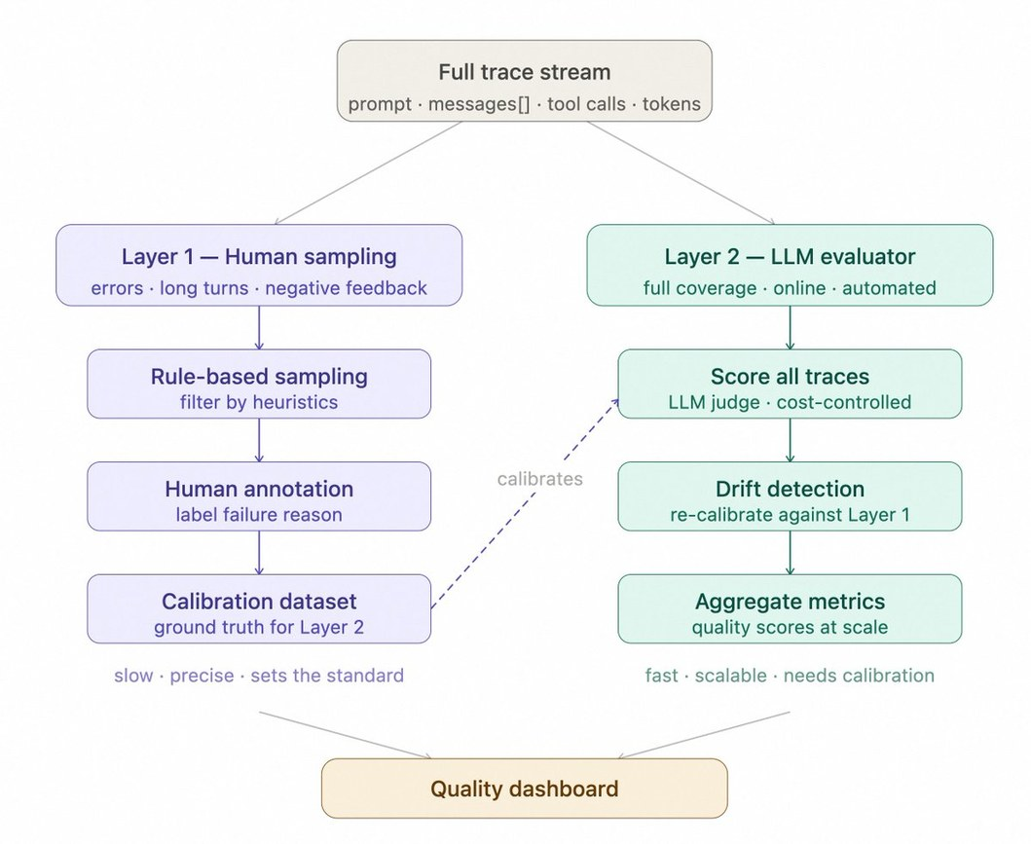
Humans calibrate, judges cover
Two-layer online review
Part 4 · Deciding
Grade 10–20% of traces, chosen by rule
100% of 👎, plus escalations, high cost, long chats
A separate random slice for unbiased rates
Full review for 48 h after any model or prompt change
Track human–judge agreement as its own metric
Two-layer review of the production trace stream
Judges alone drift unnoticed. Humans alone don't cover real traffic.
Source: notes/11-production-and-the-maturity-ladder.md
49
Notes:
Online graders must be reference-free. Drift comes from model updates behind an alias, input shift, upstream API changes and corpus staleness: capture a launch baseline, run continuously, alert on rolling windows, and watch the input mix. Feedback is a sampling rule and a calibration label, not a metric to optimize; optimizing thumbs-up rewards flattery.
Source: notes/11-production-and-the-maturity-ladder.md

Slide 50
When a score drops, suspect the eval first
The debug order
Part 4 · Deciding
1
Infrastructure — Errors, timeouts, 429s, OOM. Are error counts up?
2
Versions — Dataset, grader, judge model or config changed between runs?
3
Traces + grades — Read 10–20 failed transcripts with their grades. Is the grade right?
4
Slices — Is the drop concentrated in one category?
5
Only then the agent — Model, prompt, tools, logic.
Skipping to step 5 "fixes" an agent that wasn't broken, and sometimes breaks it.
Source: notes/12-failure-modes.md
50
Notes:
Eval bugs that look like agent bugs: infra failures, grader bugs (regex too strict, URLs not text), broken tasks at 0% for every version, state leakage, stale references, version mismatch, dropped rows. Treat a 0% task as suspect.
Source: notes/12-failure-modes.md

Slide 51
Optimize hard and you'll find the eval's gaps
Goodhart
Part 4 · Deciding
Gap exploited | Example
Grader leniency | Answers padded until the verbosity-biased judge passes them
Narrow checks | Agent edits the tests, not the code. Valid schema, empty content
Proxy metric | 👍 optimized → flattery. Escalations cut → won't escalate when it should
Visible tests | Overfits to the tests it can see
Defenses: several dimensions, held-out tests, read the biggest gains, refresh from production.
Source: notes/12-failure-modes.md
51
Notes:
Bites hardest in automated loops, where an optimizer runs thousands of iterations against your grader. Saturated suites (near 100%) have stopped measuring: graduate them to regression and add harder tasks. Eval debt: thresholds never revisited, stale rows, a CI grader and a production grader that drifted apart.
Source: notes/12-failure-modes.md

Slide 52
Rules of thumb
The pillar on one slide
Wrap-up
Before any grader
The dataset
Graders
Write success down. Two experts must agree. Read 50–100 traces first.
Start with 20–50 real failures. Negatives and boundaries. Eligible rows only.
Code first. One judge per criterion. Uncalibrated judges never gate.
Agents and RAG
Reading and gating
Production
Outcome and trajectory. k trials, pass^k. Grounding claim by claim.
Error bars, paired comparisons, slices. Run, then assert, against a baseline.
Sample by rule. Humans calibrate the judges. Debug infra before the agent.
Source: README.md#rules-of-thumb
52
Notes:
Source: README.md#rules-of-thumb

Slide 53
Worked example: which judges earned a gate
Case study, chapter 13
Wrap-up
50 tasks, 25 liked and 25 disliked by users. Δ is liked minus disliked mean score.
Grader | Δ | Cohen's d | Verdict
Custom answer_relevancy v3 | +0.214 | 0.75 | Strong: ship
DeepEval answer_relevancy | +0.086 | 0.25 | Weak
Custom completeness | +0.030 | 0.07 | Marginal
DeepEval completeness | −0.042 | — | Inverted
Custom escalation | 0.000 | 0.00 | No signal: don't gate
DeepEval escalation | −0.080 | — | Inverted
Validate judges against users, not against other judges. Calibration doesn't transfer across domains.
Source: notes/13-case-study-support-agent.md
53
Notes:
Custom answer_relevancy went from Δ −0.080 at v2 to +0.214 at v3 on the same sample. The grounding cross-check failed for an eval reason: the judge got URLs, not passages. On the routing agent's staging traffic the same graders separated near zero.
Source: notes/13-case-study-support-agent.md

Slide 54
Where to go next
Measures every layer below
Wrap-up
Practice: practice/exercises.md, eight labs on one system
The one idea to keep
–
Elo leaderboard lab in practice/02-elo-leaderboard, runs offline
An eval is a measurement. Define correct before grading, trust no grader you haven't checked against humans, and put an error bar on every number.
Copy-ready snippets: judge prompt (05), failure taxonomy (02), row schema (03), gate contract and CI workflow (10)
Worked example: chapter 13, a real multi-agent support system's eval design, mistakes included
Course: DeepLearning.AI, Evaluating AI Agents (Arize Phoenix), folded into 05, 06 and 08
Loops: 04-loop-engineering, where an eval becomes the optimizer's target
Source: README.md
54
Notes:
Source: README.md

