Slide 1
Inference Engineering
Part 1: Reading the meters
Two phases · Latency and goodput · Why GPU util lies
Part 2: Inside the machine
The roofline · Memory ladder · The silent platform · Kernels · Compilers
Making a model answer fast enough and cheaply enough to ship
Part 3: Sharing a fleet
Batching · Routing and parallelism · KV budget · Disaggregation · Prefix caching
Meters · The machine · The fleet · Spending the idle compute
Part 4: Spending the idle compute
Speculative decoding · Quantization · Stacking gains · The checklist and AI tuning
Notes: ai-engineering/07-inference-engineering
Notes:
Training is a bill you pay once. Inference is a bill you pay every time a user types. Today we follow one small model on one GPU, a Llama-7B on an A100, and ask at each layer what actually limits it. By the end the same model goes from 25.5 to 244.7 tokens per second, and you will know why each step gave less than the one before.

Slide 2
PART 1
Reading the meters
The GPU reads 100% busy, and users are still waiting
One request is two different workloads
Our running model, priced and measured
Goodput counts only the requests that kept the promise
Replace GPU util with two meters that disagree on purpose
Monday: put the right meters on the wall
Two phases · Latency and goodput · Why GPU util lies
2
Notes:
Before we tune anything we need to be able to tell whether we are winning. The usual dashboard cannot tell us, so this part replaces it.

Slide 3
The GPU reads 100% busy, and users are still waiting
Part 1 · Reading the meters
The dashboard says the GPU is 100% busy. A single tiny kernel running all the time would read exactly the same.
DCGM_FI_DEV_GPU_UTIL counts time, not work
GPU utilization is the share of time at least one kernel runs, not how much of the chip is working.
Source: notes/01-why-inference-is-its-own-discipline.md
3
Notes:
Start with the number everyone looks at. nvidia-smi reports the fraction of time at least one kernel is running. Both Huyen and Fregly warn about this. Meta found on training clusters that 70 to 75 percent of compute could be lost to failures and restarts while dashboards still showed GPUs 100 percent utilized. So if that meter cannot see the problem, what can? We need to know what the request is doing.
Source: notes/01-why-inference-is-its-own-discipline.md

Slide 4
One request is two different workloads
Part 1 · Reading the meters
Each phase sits on a different side of the roofline ridge, so each wants different engineering.
Prefill
all input tokens in parallel; compute-bound; sets TTFT
KV cache
the state that links the phases
Decode
one token per step, re-reads weights + KV; bandwidth-bound; sets TPOT
Output tokens cost 2–4× input tokens at API providers; one adds about the latency of 100 input tokens (Anyscale, 2023).
Prefill is compute-bound and sets TTFT; decode is memory-bandwidth-bound and sets TPOT.
Source: notes/01-why-inference-is-its-own-discipline.md
4
Notes:
This asymmetry drives the rest of the lecture. Batching exists to raise decode's arithmetic intensity. Disaggregation exists because the phases want different hardware. Speculative decoding exists because decode leaves compute idle. The pricing follows too. Total latency is TTFT plus TPOT times output tokens, and Huyen's floor for streamed chat is about 120 ms per token, the pace of a very fast reader. Faster only matters when a machine reads the output, as in agents and chained calls.
Source: notes/01-why-inference-is-its-own-discipline.md

Slide 5
Our running model, priced and measured
Part 1 · Reading the meters
ARITHMETIC
Throughput is cost: it maps directly to dollars per token.
# Cost (Huyen's worked example)
$2/hour at 100 output tok/s = $5.56 per M tok
1,000 requests x 200 tokens = $1.11 decode
prefill, 100 requests/min = $0.33
total = $1.44
# Bandwidth: 7B model, FP16, 100 tokens/s
7B x 2 bytes x 100 = 700 GB/s
A100 rated at 2 TB/s = 70% MBU
Compare per request: tokenizers differ across models.
MBU = bytes moved ÷ peak bandwidth.
Up to 90% of a deployed system's ML cost can be inference (Desislavov, 2023).
A 7B FP16 model at 100 tokens/s reads 700 GB/s, so memory bandwidth limits it long before arithmetic does.
Source: notes/01-why-inference-is-its-own-discipline.md
5
Notes:
Here is the model we will carry through today. Do this arithmetic with me. Every token re-reads all seven billion weights at two bytes each, so a hundred tokens a second is 700 GB per second, or 70 percent of an A100's memory bandwidth. Nothing about the chip's arithmetic appears in that sum. Hold on to that when we reach the hardware. Next question: what number should we promise the user?
Source: notes/01-why-inference-is-its-own-discipline.md

Slide 6
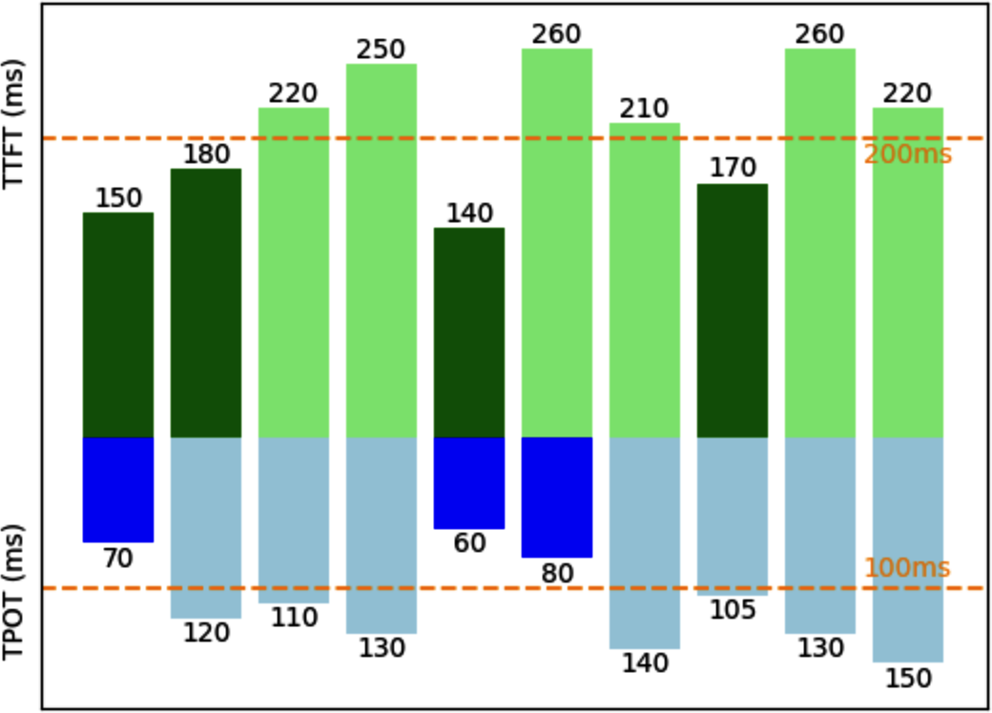
Goodput counts only the requests that kept the promise
Part 1 · Reading the meters
Trading latency can double or triple raw throughput (LinkedIn, 2024).
Caption says 3 of 10 meet the SLO. Read the bars: only 2 clear both.
Report p50, p90, p99: one 3,000 ms outlier makes a 390 ms mean.
SLO: TTFT ≤ 200 ms and TPOT ≤ 100 ms (Huyen, AI Engineering, Fig. 9-4)
Goodput is the request rate that meets every latency SLO, so optimize it rather than raw throughput.
Source: notes/01-why-inference-is-its-own-discipline.md
6
Notes:
Throughput alone is the wrong target, because you can buy it by making everyone wait. Goodput is the definition serving papers such as DistServe use. Be careful: Fregly uses goodput for two other ratios that come from training clusters, so check which one a dashboard means. Even the book's own figure miscounts here. A request at 260 and 80 meets TPOT and misses TTFT. For agents the tail compounds, because a task of ten calls hits a single call's p90 far more often.
Source: notes/01-why-inference-is-its-own-discipline.md

Slide 7
Replace GPU util with two meters that disagree on purpose
Part 1 · Reading the meters
What you have
What to read
DCGM_FI_DEV_GPU_UTIL: any kernel running
MFU: FLOP/s ÷ peak FLOP/s. Prefill's meter
A tiny kernel reads 100%
MBU: bytes/s ÷ peak bandwidth. Decode's meter
Autoscaling on 70% inherits the error
PaLM 540B prefill MFU: 43% at batch 1, 76% at 512
PaLM 540B decode MFU: 14% at batch 64, 33% at 512
time-active, not work
Pope et al., MLSys 2023; 64 TPU v4 chips
Track MFU for prefill, MBU for decode, and SM activity, because GPU util cannot see either bottleneck.
Source: notes/01-why-inference-is-its-own-discipline.md
7
Notes:
Prefill shows high MFU and low MBU, and decode shows the opposite. Pope and colleagues measured both phases of PaLM 540B with a 2,048-token context. The figure in the note also shows Llama 2-70B's MBU falling from around 33 to 43 percent at one user to 14 to 19 percent at 256 users. That is the workload moving toward compute-bound as batches grow, which is expected and not a regression.
Source: notes/01-why-inference-is-its-own-discipline.md

Slide 8
Monday: put the right meters on the wall
Part 1 · Reading the meters
1
Split latency — Measure TTFT and TPOT separately, at p50, p90 and p99, under realistic concurrency.
2
Write the SLO — Optimize goodput against it, not raw throughput.
3
Change the utilization meters — MFU for prefill, MBU for decode, plus SM activity.
4
Price per request — Tokenizers differ, so per-token comparisons across models are approximate.
5
Name the level — Model changes can alter outputs and need an eval. Service changes usually do not.
Before tuning, define the SLO, split TTFT from TPOT, and price each request.
Source: notes/01-why-inference-is-its-own-discipline.md
8
Notes:
That closes the first part. Huyen's three levels help you plan the rest: model, hardware and service. Her ranking of the techniques with the widest impact, across the companies she surveyed, is quantization, tensor parallelism, replica parallelism and attention optimization. Online and batch traffic also get separate plans: providers priced batch at about 50 percent off as of 2024. Now let us see why decode is stuck, by looking at the machine.
Source: notes/01-why-inference-is-its-own-discipline.md

Slide 9
Why adding compute does nothing for a slow decode
The roofline tells you which limit you are under
Every hop down the memory ladder costs more
The platform can cost more than any kernel, and it fails silently
Name the kernel's regime before you change its code
At small batch the GPU idles between launches
The compiler gives you most of this if shapes hold still
Monday: profile, fix the largest bottleneck, profile again
PART 2
Inside the machine
The roofline · Memory ladder · The silent platform · Kernels · Compilers
9
Notes:
Most of you will never write a CUDA kernel. You will still read profiles, so you need the vocabulary and the map of where bytes live. We move from chip to host to kernel to compiler.

Slide 10
Why adding compute does nothing for a slow decode
Part 2 · Inside the machine
A load from HBM costs the time of hundreds of arithmetic instructions. A faster math unit just waits faster.
The whole game is the ratio between the top and bottom of the memory ladder
A kernel must either cover memory latency with other work or do more math per byte moved.
Source: notes/02-the-hardware.md
10
Notes:
Back to our 700 GB per second. A kernel has exactly two ways out of waiting on memory. It can find independent work to run during the wait, through occupancy, instruction parallelism and pipelining. Or it can do more math per byte, through tiling, fusion and lower precision. The next few slides are that one choice, seen at different scales.
Source: notes/02-the-hardware.md

Slide 11
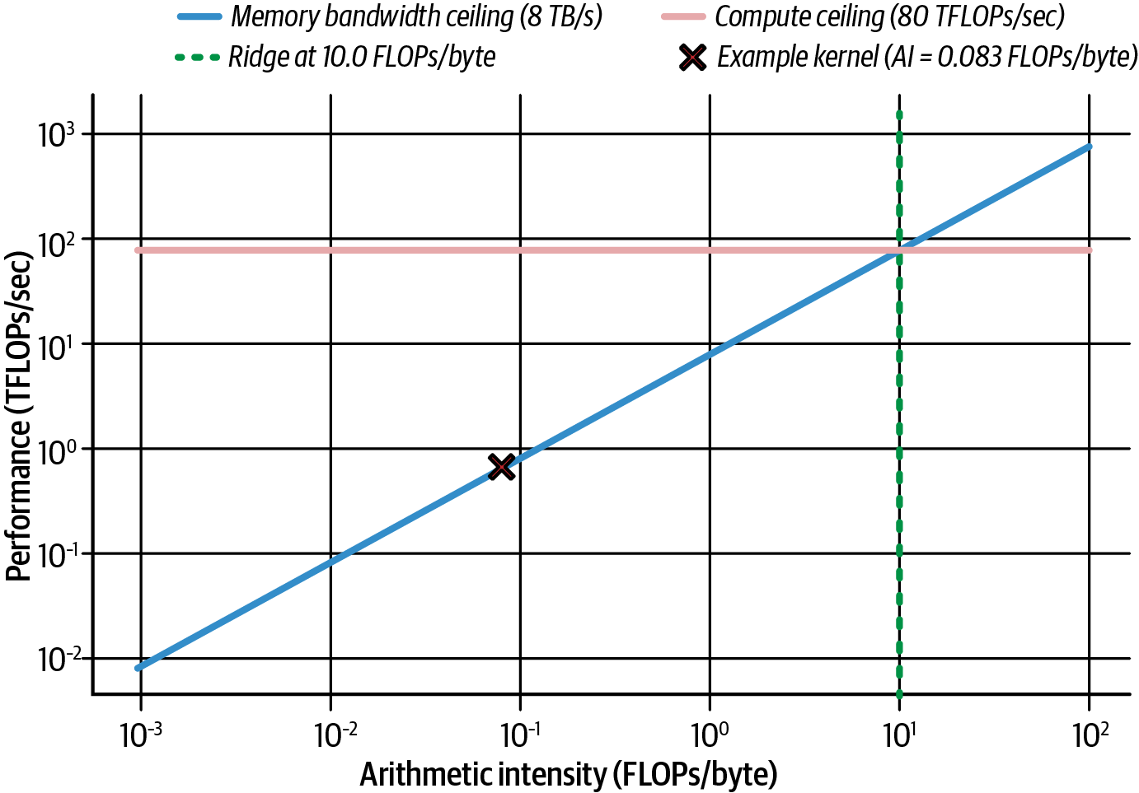
The roofline tells you which limit you are under
Part 2 · Inside the machine
Ridge: 80 ÷ 8 = 10 FLOP/byte.
Vector add: 0.083 FLOP/byte, over 100× left of it.
Tensor-core ridge, dense BF16: about 280 FLOP/byte.
Decode GEMM at batch 1: about 1 FLOP/byte.
Roofline with 8 TB/s HBM and 80 TFLOPS FP32 (Fregly, AISPE, Fig. 6-21)
Left of the roofline ridge only fewer bytes help; decode at batch 1 sits two orders of magnitude left of it.
Source: notes/02-the-hardware.md
11
Notes:
Arithmetic intensity is FLOPs per byte moved. A vector add in FP32 does one FLOP per 12 bytes, two loads and one store. No compute tuning will help it. The figure's ridge is the FP32 ridge. Transformer GEMMs run on tensor cores, where dense BF16 on a B200 is about 2.25 PFLOPS, so the ridge is much further right. That is why decode is so firmly bandwidth-bound, and why batching is the main way to move it right. Always quote dense, not sparse, FLOPS and attach a precision.
Source: notes/02-the-hardware.md

Slide 12
Every hop down the memory ladder costs more
Part 2 · Inside the machine
slower, larger
1
Registers — ~1 cycle. 64K per SM.
2
Shared memory — ~20–30 cycles. Up to 228 KB per SM, managed by the programmer.
3
L2 — ~200 cycles. 126 MB across the GPU.
4
HBM3e — Hundreds to ~1,000 cycles. 192 GB at ~8 TB/s.
5
Grace LPDDR5X — Far higher. 480 GB through NVLink-C2C at ~900 GB/s, coherent but not uniform.
Performance work moves data up the ladder fewer times, and Grace memory is an overflow tier, not HBM.
Source: notes/02-the-hardware.md
12
Notes:
These are approximate, from Fregly's table 6-5. A GB200 superchip gives you about 900 GB in one address space, and that invites a mistake, because can touch is not cheap to touch. Fregly's illustrative example runs one kernel at 48.21 ms demand-paged and 2.17 ms with prefetch. The fabric has the same shape. NVLink gives 1.8 TB/s per GPU at 1 to 2 microseconds. Between racks you get 20 to 80 GB/s at 5 to 10 microseconds. So keep tensor-parallel groups inside one NVLink domain.
Source: notes/02-the-hardware.md

Slide 13
The platform can cost more than any kernel, and it fails silently
Part 2 · Inside the machine
Gloo vs NCCL
Communicator churn
Wrong NUMA node
400 MB all-reduce, 2 ranks: 200 ms vs 4 ms.
Per-iteration group: 48 ms against a 0.5 ms all-reduce.
Local ~80 ns, remote ~139 ns. Binding gains 5–10%.
Unpinned memory
RDMA fell back to TCP
Cold driver
Pinning makes host-to-device copies 2–3× faster.
Look for NET/Socket, not NET/IB, in the NCCL log.
Persistence mode avoids 1–2 s of init per process.
Check the NCCL log and NUMA binding on every deployment, because each of these faults just runs slowly.
Source: notes/03-the-platform.md
13
Notes:
Every item here runs to completion, slowly. Tensor-parallel inference runs an all-reduce in every layer, so NCCL performance is decode latency. Also keep in mind that tokenization and batching are CPU work, so a starved host shows up as gaps between decode steps. Containers are not the problem: Fregly measures under 2 percent overhead, and the real trouble is version skew against the host driver. For sharing, use MIG for tenants with a latency promise and MPS only between trusted processes. Cold start is a storage question: stage weights to local NVMe, read shards sequentially, and let the page cache act as a warm tier.
Source: notes/03-the-platform.md

Slide 14
Name the kernel's regime before you change its code
Part 2 · Inside the machine
Regime | Signature in Nsight Compute | Fix
Underutilized | Few blocks, idle SMs, low occupancy | More parallelism: grid ≥ SMs, smaller tiles
Latency-bound | Low DRAM throughput, high scoreboard stalls | Hide latency: occupancy, ILP, prefetch, pipelining
Memory-bound | DRAM throughput ≳ 80% of peak | Fewer bytes: fusion, tiling, lower precision
Compute-bound | Math pipes busy, Math Pipe Throttle stalls | Tensor cores, lower precision, or stop
A kernel is underutilized, latency-bound, memory-bound or compute-bound, and fixing one usually reveals the next.
Source: notes/04-kernels.md
14
Notes:
The workflow is Nsight Systems for the timeline, then Nsight Compute on the hot kernel. Occupancy is a means, not the goal: aim for about 50 to 75 percent and watch whether stalls fall. FlashAttention is the canonical memory-bound win. On GPT-2 medium on an A100 it does more FLOPs than standard attention, 66.6 against 75.2 GFLOPs, yet moves 9 times fewer HBM bytes, so runtime falls from 41.7 to 7.3 ms. Fregly's metrics tables are labelled illustrative, so trust their direction and not their size.
Source: notes/04-kernels.md

Slide 15
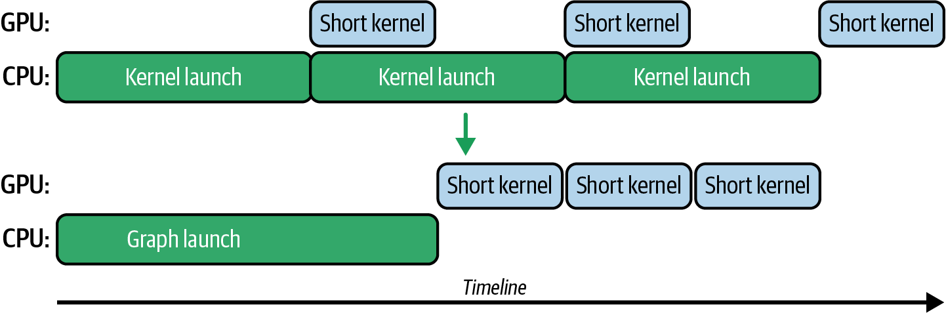
At small batch the GPU idles between launches
Part 2 · Inside the machine
Short kernels run about as long as the CPU takes to launch them.
A graph records once and replays with one launch.
Fregly reports often 20–30% less latency.
Kernel launches with and without a CUDA graph (Fregly, AISPE, Fig. 12-3)
Addresses are fixed: one graph per batch-size bucket.
CUDA graphs make no kernel faster; they remove the launch gaps, so engines capture one per batch-size bucket.
Source: notes/04-kernels.md
15
Notes:
This is the regime our single-user model is in at batch 1. Top row: each short kernel waits for its CPU launch. Bottom row: one launch, then kernels back to back. Capture forbids allocation, synchronization and new shapes, which is why vLLM and TensorRT-LLM capture a graph per bucket at startup and pad batches up to the bucket. And Fregly's own verdict on the fancier features: warp specialization and clusters rarely justify the engineering cost, so reach for them through CUTLASS, FlashAttention or Triton.
Source: notes/04-kernels.md

Slide 16
The compiler gives you most of this if shapes hold still
Part 2 · Inside the machine
PYTHON
Llama-7B, A100, batch 1: 25.5 → 107 tokens/s.
# Decode: fix the KV shape with a static cache
cfg = model.generation_config
cfg.cache_implementation = "static"
model.forward = torch.compile(
model.forward,
mode="reduce-overhead",
fullgraph=True)
# CI: allow known dims, fail on any recompile
torch._dynamo.mark_dynamic(input_ids, 1)
torch.compiler.set_stance("fail_on_recompile")
MoE, max-autotune: 248 → 173 ms.
One big dense GEMM: under 10%.
fullgraph=True catches breaks; the stance catches recompiles.
Expect torch.compile to pay when small kernels and Python dominate, and much less when one big GEMM does.
Source: notes/05-compilers-and-frameworks.md
16
Notes:
The 4.2 times gain on our model comes from removing overhead in a launch-bound regime. It is not typical of large batches. Static cache trades memory for stable shapes, since you reserve for the maximum length. Three things make a compiled model quietly slow: graph breaks, recompiles when a guard fails, and CUDA graph invalidation. Compile time is real too, minutes for a large model, so cache artifacts or export ahead of time.
Source: notes/05-compilers-and-frameworks.md

Slide 17
Monday: profile, fix the largest bottleneck, profile again
Part 2 · Inside the machine
Host first. Fregly's MoE profile: 45% Python forward overhead, 20.5% aten::matmul.
Time it honestly. Call torch.cuda.synchronize(), or you are measuring the launch.
Then one hot kernel, with Nsight Compute and its largest stall bars.
Guard the gain. Fail CI on a slowdown of 5% or more sustained over 3 runs, on pinned versions.
Profile the host before the device, and gate merges on a sustained 5% regression so the gain survives upgrades.
Source: notes/05-compilers-and-frameworks.md
17
Notes:
With that profile, the fix order chooses itself: remove Python overhead and fuse small ops, then tune the big GEMMs. Performance regresses silently, and a framework upgrade is the most common cause. That closes the single machine. Now add users, because one request on one GPU is a demo.
Source: notes/05-compilers-and-frameworks.md

Slide 18
Why does a 10-token answer wait for a 1,000-token one?
Continuous batching gives the slot back at every step
The router decides latency as much as the GPU does
Split the model only as far as you must
Size the KV cache from KV heads, then divide your memory
Splitting prefill from decode doubled goodput on the same GPUs
Stable content first, or the prefix cache cannot help
Monday: scale on signals that see the real limit
PART 3
Sharing a fleet
Batching · Routing and parallelism · KV budget · Disaggregation · Prefix caching
18
Notes:
Serving means many requests of unknown length sharing a fleet, with a latency promise for each. The levers are how you batch, how you route, how you split the model, and where the KV cache lives.

Slide 19
Why does a 10-token answer wait for a 1,000-token one?
Part 3 · Sharing a fleet
One request needs 10 output tokens and its neighbour needs 1,000. In a static or dynamic batch, the short one holds its slot for all 1,000 steps.
Huyen, AI Engineering, ch. 9
Requests of unknown, unequal length waste batch slots unless the scheduler works per decode step.
Source: notes/06-serving-at-scale.md
19
Notes:
Batching is the first lever, because decode reads all the weights each step and a batch amortizes that read over many sequences. So we want big batches. But requests are unequal. Dynamic batching with batch size 4 and a 100 ms window fixes the waiting at low load, not this. What does?
Source: notes/06-serving-at-scale.md

Slide 20
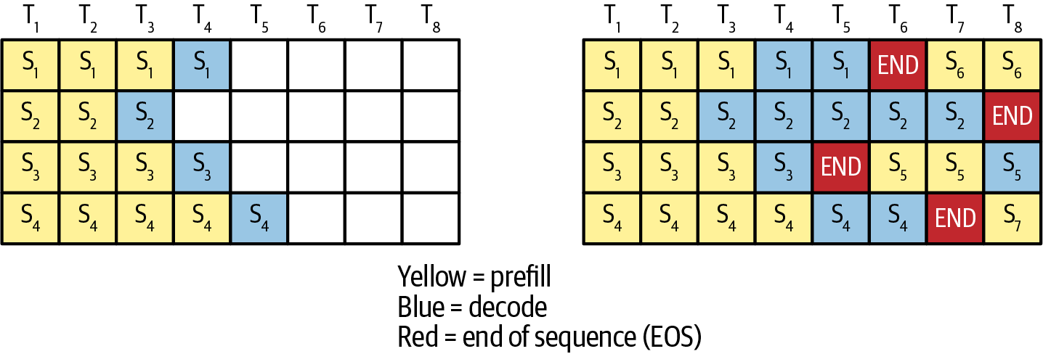
Continuous batching gives the slot back at every step
Part 3 · Sharing a fleet
Introduced by Orca (OSDI 2022), now default in vLLM, SGLang, TGI, TensorRT-LLM.
Paged KV: 20–38% of memory used before, under 4% wasted after (Kwon, 2023).
Cap the batch where p99 TPOT climbs.
Static vs continuous. Yellow prefill, blue decode, red end of sequence (Fregly, AISPE, Fig. 16-6)
Continuous batching swaps sequences in at every decode step, and paged KV memory is what makes that safe.
Source: notes/07-prefill-decode-kv-cache.md
20
Notes:
New sequences take the slots as soon as one ends. Its limits are memory, solved by PagedAttention, and long prefills stalling decodes, which we reach shortly. PagedAttention stores KV in fixed blocks, 16 tokens by default in vLLM, and maps them like an OS maps virtual pages. Clipper had the SLO-tuning idea earlier: on a scikit-learn SVM under a 20 ms SLO, adaptive batches raised throughput up to 26 times.
Source: notes/07-prefill-decode-kv-cache.md

Slide 21
The router decides latency as much as the GPU does
Part 3 · Sharing a fleet
ARITHMETIC
Requests differ in cost by orders of magnitude.
# Length-aware: prefill cost ~ N(N+1)/2
[6K,2K,6K,2K,2K,2K] on two GPUs
both 6K on one GPU: ~38.0M Q*K products
[2K,2K,6K] on each: ~22.0M, 42% less
# Cascade: 60% go to a 10x smaller model
0.6 x 0.1 + 0.4 x 1.0 = 0.46 relative cost
about 2.2x cheaper, not the book's claimed 5x
Replicas differ in which prefixes they hold.
Route on load and cache affinity.
Route on load and cache affinity, not round-robin, because requests and replicas are not interchangeable.
Source: notes/06-serving-at-scale.md
21
Notes:
Two small sums worth doing yourself. First, rebalancing six prompts cuts the critical path 42 percent, and TTFT falls with it. Second, always check cascade arithmetic: escalated queries may pay for both models, so 2.2 times is a ceiling. The idea is still sound. FrugalGPT measured a real cascade over 12 commercial APIs at March 2023 prices and matched GPT-4's accuracy at 98.3 percent lower cost on one task, HEADLINES, and 59 to 73 percent lower on two others.
Source: notes/06-serving-at-scale.md

Slide 22
Split the model only as far as you must
Part 3 · Sharing a fleet
Strategy | Splits | Buys | Costs
Replica (DP) | Nothing, full copies | Linear throughput | Memory × replicas
Tensor (TP) | Each layer's matrices | Lower latency, bigger models | All-reduce every layer; NVLink
Pipeline (PP) | Layers into stages | Capacity | Higher request latency
Expert (EP) | MoE experts | Scales MoE | All-to-all dispatch; imbalance
Context (CP) | The sequence | Prefill for 100k+ prompts | Boundary communication
Compose TP inside one NVLink domain, add PP only for capacity, add EP for MoE, then replicate with DP.
Source: notes/06-serving-at-scale.md
22
Notes:
This is a real choice between options, so it earns a table. Fregly's order is TP, PP, EP, DP. Huyen says PP is typically avoided for strict-latency serving in favour of replicas. The Handbook's claim that data parallelism is mainly for training holds only for models too large for one GPU. Expert parallelism's cost is real: in GShard, going from 128 to 2,048 experts made dispatch and combine about 3.75 times slower. Now let us look at the memory every one of these strategies has to budget for.
Source: notes/06-serving-at-scale.md

Slide 23
Size the KV cache from KV heads, then divide your memory
Part 3 · Sharing a fleet
TEXT
Use n_kv_heads, not attention heads.
bytes/token = 2 x layers x kv_heads
x head_dim x bytes
Llama 2 7B, FP16, MHA 0.5 MB/token
1.07 GB at 2,048 tokens
Llama 2 13B, FP16, MHA 0.82 MB/token
3.36 GB at 4,096 tokens
GQA-8 0.67 GB, MQA 0.084 GB
500B+ MHA, batch 512, 2,048: ~3 TB
70 GB weights on 180 GB: ~110 GB for KV
Budget ÷ bytes per token = tokens in flight.
That usually caps decode batch size, not FLOP/s.
KV bytes per token use KV heads, and free memory divided by that figure usually caps decode batch size.
Source: notes/07-prefill-decode-kv-cache.md
23
Notes:
Three of the sources write this formula differently, and using attention heads overstates GQA and MQA models. Our 7B model needs half a megabyte per token. Shrinking the cache is its own toolbox. MQA and GQA share K and V across heads. MLA stores a latent. Character.AI's cross-layer attention reported over 20 times less KV. FP8 KV halves it. But sharing is not free: DeepSeek's 7B dense ablation shows MMLU falling from 45.2 with MHA to 41.2 with GQA-8 and 37.9 with MQA.
Source: notes/07-prefill-decode-kv-cache.md

Slide 24
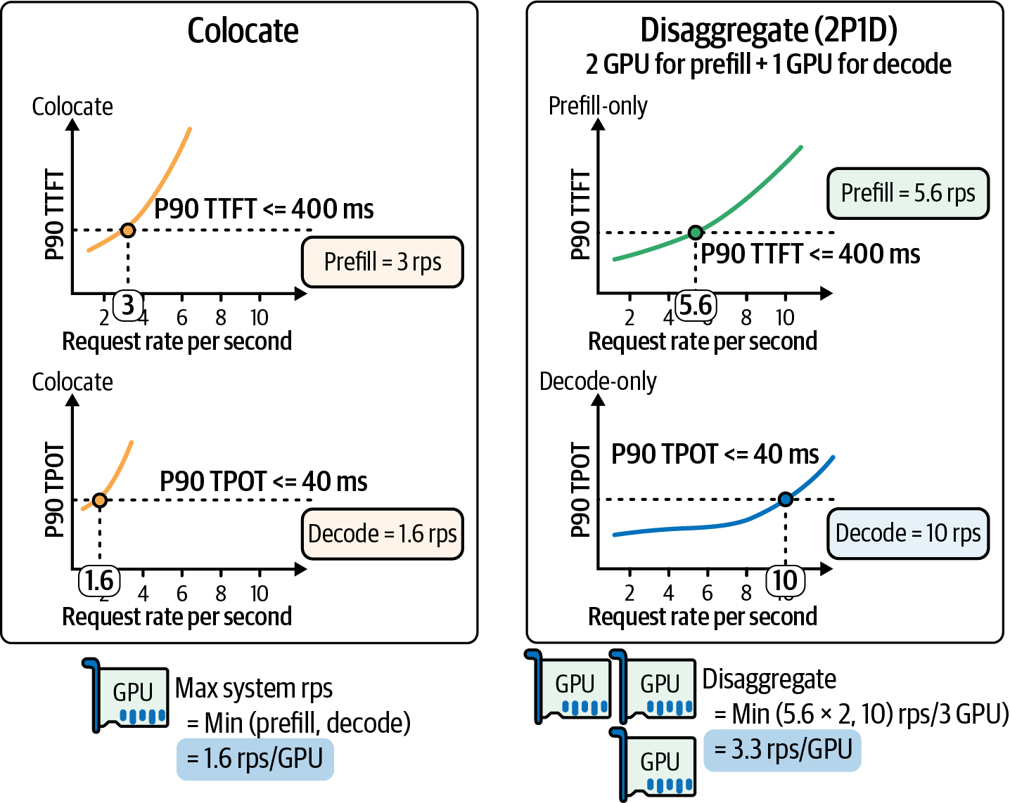
Splitting prefill from decode doubled goodput on the same GPUs
Part 3 · Sharing a fleet
Colocated: 1.6 RPS per GPU, capped by decode.
2 prefill + 1 decode: min(11.2, 10) ÷ 3 = 3.3 RPS per GPU.
Headline: up to 7.4× goodput (DistServe).
First try chunked prefill: ~1.3–1.9× (SARATHI).
P90 TTFT ≤ 400 ms, P90 TPOT ≤ 40 ms (Fregly, AISPE, Fig. 17-2, after DistServe)
Try chunked prefill first; disaggregate only when long prompts and strict TTFT and TPOT SLOs coincide at scale.
Source: notes/07-prefill-decode-kv-cache.md
24
Notes:
A long prefill entering a batch stalls every decode in it. You can slice the prefill so decodes run between chunks, or move prefill to other GPUs. Chunking does not reduce total work; it reorders it, and Fregly's rule of thumb is a chunk of 50 to 100 ms of GPU time. Disaggregation pays when long prompts dominate, SLOs are strict at high load, the interconnect is fast and the fleet can size two pools. Do not offload short prompts or prompts with a large prefix-cache hit. Batch the transfers too: LMCache's example goes from about 20 ms to about 8 ms.
Source: notes/07-prefill-decode-kv-cache.md

Slide 25
Stable content first, or the prefix cache cannot help
Part 3 · Sharing a fleet
Exact match from the first token: one early change invalidates everything after it.
Layout: system prompt, tools, examples and documents first; variable content last.
Anthropic (2024): chat with a book, 100k-token cache, 11.5 s → 2.4 s, −90% cost.
Agents: one session's final step emitted 151 tokens after a 166,721-token input.
Idle gaps outlast cache lifetimes, so the long prefix is prefilled again.
Lay prompts out stable-first and route on prefix affinity, since the cached prefix must match exactly from token one.
Source: notes/07-prefill-decode-kv-cache.md
25
Notes:
vLLM hashes each full 16-token block chained to its prefix. SGLang's RadixAttention uses a radix tree. Either way the rule is the same one that drives API prompt-cache pricing. Those prices are from 2024 and have changed, so check them. The AgentSysBench session is striking: tool calls and observations grew to 84.3 percent of the input. When the cache does hit, the next bottleneck is tokenizing the transcript, which grows from 10 to 64 percent of TTFT as the hit rate rises toward 0.99.
Source: notes/07-prefill-decode-kv-cache.md

Slide 26
Monday: scale on signals that see the real limit
Part 3 · Sharing a fleet
1
Change the scaling metric — Queue depth, KV utilization, or p90 TTFT against the SLO. Not GPU utilization.
2
Keep warm headroom — The Handbook's deploy takes 15–30 min, longer than most spikes.
3
Alert on copy-engine spikes — With flat compute they usually mean KV swapping, and latency is about to jump.
4
Split along the GPU/CPU seam — When load justifies it, so retrieval code never idles the GPU.
5
Stream over SSE — Set TCP_NODELAY, or Nagle's algorithm bursts your tokens.
Autoscale on queue depth, KV use or TTFT, and keep warm capacity because cold starts outlast most spikes.
Source: notes/06-serving-at-scale.md
26
Notes:
The Handbook's recipe of target-tracking at around 70 percent GPU utilization runs straight into the meter problem from part one. A lightly loaded decode loop reads near 100 percent, so scaling on it adds replicas that do not help, or never triggers when KV memory is the limit. Pre-pull weights and cache compiled artifacts. That closes the fleet. One idle resource is left: all that compute decode is not using.
Source: notes/06-serving-at-scale.md

Slide 27
PART 4
What could decode do with FLOPs it already paid for?
A draft guesses, and the target checks in one parallel pass
One outlier can crush a whole tensor's precision
Our model's whole journey, 25.5 to 244.7 tokens per second
Let a model search for kernels only behind a verifier
Monday: walk the checklist in order, measuring each step
Spending the idle compute
Speculative decoding · Quantization · Stacking gains · The checklist and AI tuning
27
Notes:
Decode leaves the GPU's compute mostly idle while it waits on memory. This part spends that idle compute or cuts the bytes. Some of these keep the output distribution exactly, and others trade a little quality.

Slide 28
What could decode do with FLOPs it already paid for?
Part 4 · Spending the idle compute
Each decode step reads every weight to produce one token per sequence, while the tensor cores sit idle. What could you do with that spare compute?
Two answers. Do more work per weight read, or read fewer bytes
Decode can check several candidate tokens per weight read, or shrink the bytes read through quantization.
Source: notes/08-adaptive-inference.md
28
Notes:
At small batch, arithmetic intensity is far below the ridge. So two families of fix follow. The caveat comes from Huyen: if your batches already saturate compute, the idle FLOPs are gone and speculative methods help less or hurt. Long contexts are the exception, because KV reads keep large batches bandwidth-bound.
Source: notes/08-adaptive-inference.md

Slide 29
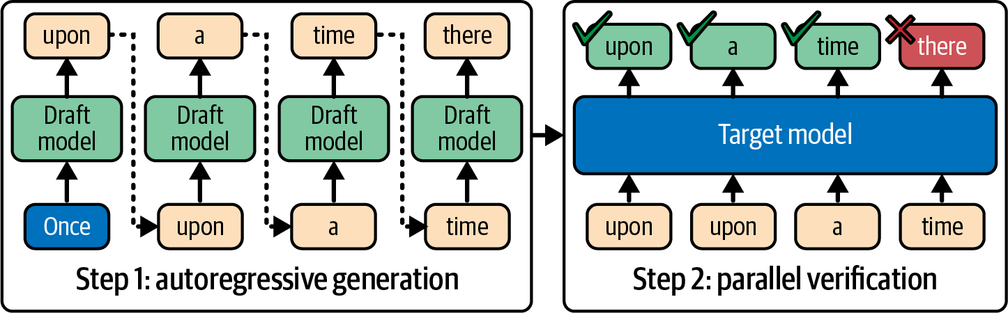
A draft guesses, and the target checks in one parallel pass
Part 4 · Spending the idle compute
Rejection sampling keeps the output identical to the target's.
Plan on about 2× for a well-matched pair.
Draft should be at least ~4× faster than the target.
Draft proposes, target verifies in parallel (Fregly, AISPE, Fig. 15-8)
EAGLE-2: 4.26×, EAGLE 3.07×, Medusa 2.07× on Vicuna-13B.
Speculative decoding is lossless by construction; plan on about 2× and measure acceptance per traffic type.
Source: notes/08-adaptive-inference.md
29
Notes:
Verifying K tokens is parallel like prefill, some tokens are easy, and decode's bandwidth bound makes verification FLOPs nearly free. The books disagree on the speedup because they report different conditions. The Handbook's own demo is the most instructive: a small Qwen target with a 0.5B draft on a T4 gained nothing significant, because the draft was not much cheaper. That EAGLE-2 comparison is at temperature 0 and batch 1. Past a critical sequence length, KV loading dominates, so speculation pays at large batch again; MagicDec measures up to 2.51 times on 8 H100s.
Source: notes/08-adaptive-inference.md

Slide 30
One outlier can crush a whole tensor's precision
Part 4 · Spending the idle compute
PYTHON
One max value sets the scale for the whole tensor.
def absmax_quantize(X):
scale = 127 / X.abs().max()
q = (scale * X).round().to(torch.int8)
return q, scale # dequantize: q / scale
# 0.1 in a tensor spanning [-3.0, 3.2] maps to 4
LLM.int8: outliers in 6 hidden dimensions, up to 20× larger.
PaLM 540B, batch 64: int8 weights 36.9 → 28.5 ms/token.
Safe default: FP8 on Hopper and Blackwell; validate FP4 per model.
Serious quantization methods work around outliers, and every format change needs an eval run, not just perplexity.
Source: notes/08-adaptive-inference.md
30
Notes:
Weight-only quantization is the popular approach, since it works out of the box and decode is bandwidth-bound. Pope's cost benefit is more than double at small batch and near zero at large batch. How well a model survives 4 bits depends on what it was trained to do. Kyutai's 7B Helium scores 52.97 on MMLU against 54.3 at BF16, while the same backbone tuned for speech falls from 49.7 to 42.2 under the same scheme. So re-run the eval on the checkpoint you will actually serve.
Source: notes/08-adaptive-inference.md

Slide 31
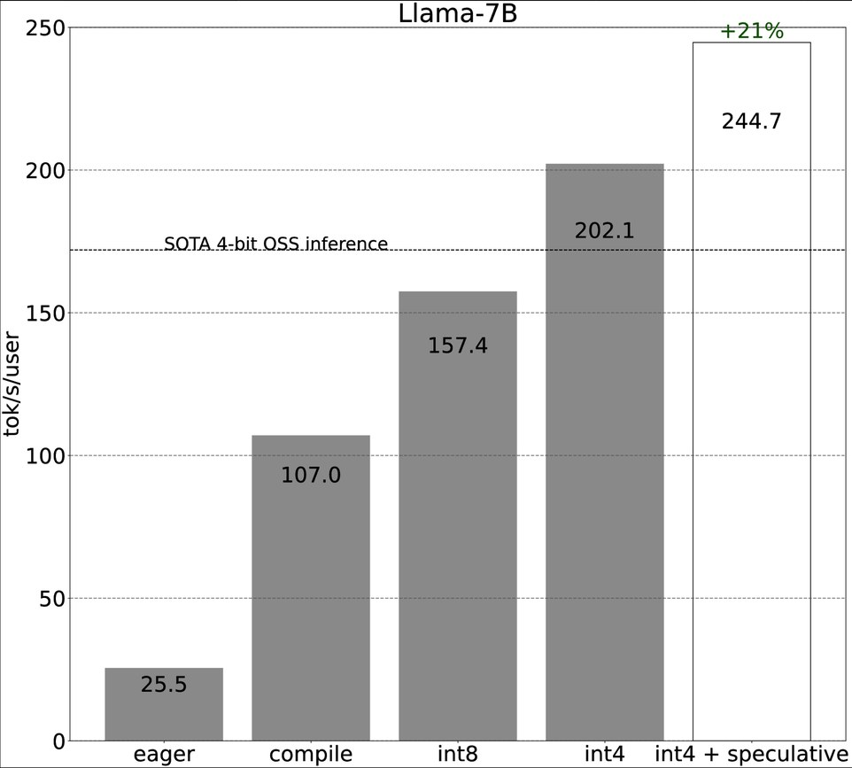
Our model's whole journey, 25.5 to 244.7 tokens per second
Part 4 · Spending the idle compute
torch.compile: 25.5 → 107.0, 4.2×
INT8: → 157.4, 1.5×
INT4: → 202.1, 1.3×
Speculation: → 244.7, 1.2×
Quality was not measured.
Llama-7B, A100-80GB, tokens/s per user, batch 1 (PyTorch 2023, via Huyen, Fig. 9-14)
Gains multiply but shrink because each step attacks a smaller remaining bottleneck, and order matters.
Source: notes/08-adaptive-inference.md
31
Notes:
This is where our running model lands. At batch 1 launch overhead dominates eager PyTorch, so compiling gives the largest single gain. After that, each step works on a smaller remaining bottleneck. Huyen notes it was unclear how these steps affected quality, so INT4 needs an eval before you ship it. At large batch the picture changes: compile helps less, and speculation may not help. Dynamic precision, early exit and RL tuners remain experiments, and they should ship with a kill switch that reverts to a known-good configuration.
Source: notes/08-adaptive-inference.md

Slide 32
Let a model search for kernels only behind a verifier
Part 4 · Spending the idle compute
PYTHON
R1 + verifier, ~15 min on H100: 1.1–2.1× FlexAttention.
for _ in range(max_iters):
code = llm.generate_kernel(prompt)
# compile, test vs reference, time
ok, runtime, feedback = verifier.check(code)
if ok and runtime < target:
break
prompt = refine(prompt, feedback)
FlexAttention itself: about 85–90% of FlashAttention-2.
Predibase GRPO: about 40% of kernels correct.
JAXBench docs: correctness 5.8% → 37.3%.
Trust the verifier and not the model, and compare generated kernels against the best existing kernel.
Source: notes/09-checklist-and-ai-assisted-tuning.md
32
Notes:
Every success here has an automatic, adversarial check between the model and production. The verifier tests correctness against a reference on many shapes and edge cases, times properly with warm-up and synchronization, guards against reward hacking such as caching results, and hands over to human review before merge. Watch the baseline: two times FlexAttention on an exotic mask is not two times the best hand-written kernel. The 40 percent figure means most generated kernels are wrong. That is fine inside a verified search loop and dangerous anywhere else.
Source: notes/09-checklist-and-ai-assisted-tuning.md

Slide 33
Monday: walk the checklist in order, measuring each step
Part 4 · Spending the idle compute
1
Method — Define the SLO. Profile first. Benchmark realistic length distributions. Keep a regression job.
2
Host and GPU — Persistence mode, NUMA pinning, THP madvise.
3
Placement — Smallest TP inside one NVLink domain. Route on prefix affinity. Disaggregate if long prompts block decode.
4
Engine — Continuous batching, chunked prefill, paged KV with prefix caching, warm replicas.
5
Kernels and precision — FP8 first, then validate lower. Add speculation at low-to-moderate batch.
6
Monitoring and power — SM activity, MFU, MBU, thermals, per-request cost. Try a cap around 80% of TDP.
Walk measurement, host, placement, engine, kernels, then monitoring, and treat every printed gain as a hypothesis.
Source: notes/09-checklist-and-ai-assisted-tuning.md
33
Notes:
Fregly's appendix has roughly 175 to 180 items in 18 categories. The note boils it down to 28 lines in these six groups, for inference only. The appendix states its ranges loosely: torch.compile appears as both 10 to 40 percent and 20 to 50 percent. So treat every number as an order of magnitude to test, not a promise. The same verifier pattern works for configuration search over batch caps, TP degree and chunk sizes, which is a smaller and safer space than kernel code.
Source: notes/09-checklist-and-ai-assisted-tuning.md

Slide 34
Rules of thumb for inference engineering
Wrap-up
Meters
Bound
Batch
TTFT, TPOT, goodput at a percentile. Never GPU util alone.
Prefill is compute. Decode is memory bandwidth. Find your side of the ridge.
Continuous, always. Cap it where p99 TPOT climbs.
Budget
Layout
Eval
KV memory, computed from KV heads, usually caps the batch.
Stable prompt content first. Route on prefix affinity.
Quantization changes outputs. Exact speculation does not.
Name the bound, measure goodput against an SLO, and re-run evals whenever a change can alter outputs.
Source: notes/09-checklist-and-ai-assisted-tuning.md
34
Notes:
If you remember one chain from today: decode is bandwidth-bound, so batching, disaggregation, quantization and speculation are all different answers to one sum, the one we did for 700 GB per second at the start.
Source: notes/09-checklist-and-ai-assisted-tuning.md

Slide 35
Where to go next
Wrap-up
Prompt cost as a context decision: 02 context engineering, retrieval and caching.
Fewer calls beat faster calls: 04 loop engineering.
Cost per task as an eval metric: 06 eval.
Hands-on kernels and labs: the book's repository, cfregly/ai-performance-engineering.
This layer can shave a badly sized context or a chatty loop, but only the layers above can remove them.
Source: notes/01-why-inference-is-its-own-discipline.md
35
Notes:
Inference inherits the weaknesses of the layers above. A badly sized context or a loop making ten calls where two would do is a cost this layer can shave but not remove. Before you buy another GPU, check whether the prompt or the loop should change.
Source: notes/01-why-inference-is-its-own-discipline.md

