Slide 1
Statistical Foundations
Part 1: The question behind every model
Last year or next year · What a model is · Every failure is the same failure
Part 2: The problem setting
The vocabulary · Two questions first · Two cultures · The running example
Part 3: Bias, variance and model complexity
The decomposition · A simulation · Train and test · More data
What a model estimates, and why it fails on new data
Part 4: Probability as ML uses it
Four ideas · Negative log-likelihood · The bridge to Bayes
Part 5: Train, validation, test
The one discipline · Three splits · Two ways to break it
The question · The setting · Bias and variance · Probability · Splits · The API · Pitfalls
Part 6: The scikit-learn API in four lines
A first application · Four lines · Look at the data · Every method
Part 7: Pitfalls
Five first mistakes · A rule that loses to guessing · What to carry forward
Notes: data-science/01-classical-ml/notes/01-statistical-foundations.md
Notes:
This is the refresher everything else in classical ML leans on. By the end you should have the words for why a model fails on new data, the habit of hiding data away to measure it, and the four lines of code every later model shares.

Slide 2
Where this lecture sits
Lecture 2 of 17
Where this fits
Before this
This lecture
After this
What a model estimates, and why it fails on new data
Classical Machine Learning
Probability Foundations (data analytics)
Supervised Learning
Lecture 2 of 17 in the series, and each lecture links to its neighbours.
2

Slide 3
PART 1
The question behind every model
Who will earn over $50k next year?
A model is a rule learned from past examples
Three words carry the whole subject
Every failure is a failure to generalise
Last year or next year · What a model is · Every failure is the same failure
3
Notes:
We start with the one question all of classical ML is trying to answer.

Slide 4
Who will earn over $50k next year?
The problem
Part 1 · The question behind every model
A census analyst can tell you who earned over $50k last year. A data scientist is asked who will next year, and whether the answer holds on people the model never saw.
A data scientist predicts who earns over $50k next year, and if that holds on new people.
Source: notes/01-statistical-foundations.md
4
Notes:
Describing last year is a counting problem. Predicting next year is a different kind of claim, because we can't check it on the people we care about. Everything today is about how to make that claim honestly.
Source: notes/01-statistical-foundations.md

Slide 5
A model is a rule learned from past examples
Part 1 · The question behind every model
Picture a new estate agent who has seen a few hundred house sales and now guesses prices.
Sales already studied
Houses never seen
The agent has seen the answers
No answers to lean on
Guesses look sharp
Guesses can be far worse
This score flatters
This is the score that counts
What matters is how well the guesses hold up on data the model has never seen.
Source: notes/01-statistical-foundations.md
5
Notes:
Hold on to this picture. The gap between the two sides is what today's vocabulary names, and hiding some data away is how we measure it. That check sits behind every prediction you will ship at work.
Source: notes/01-statistical-foundations.md

Slide 6
Three words carry the whole subject
Part 1 · The question behind every model
Assume the world works like y = f(x) + ε: some function of x, plus noise.
Model
Learning
Generalisation
An estimate f̂ of the unknown f.
Choosing f̂ from a family of functions.
How close f̂ stays to f on new x.
A model estimates f, learning picks the estimate, and generalisation is closeness to f on new x.
Source: notes/01-statistical-foundations.md
6
Notes:
The rest of the lecture is about that last card. A better fit on the rows you have is not better generalisation. The data generating process note in data analytics makes the same point from the analyst's side.
Source: notes/01-statistical-foundations.md

Slide 7
Every failure is a failure to generalise
Part 1 · The question behind every model
Classical ML is applied statistics with a compute budget, and each technique answers one question: how do I estimate a function from samples so it holds on samples I haven't seen?
1
Overfitting — The fit learned the sample, not the function
2
Leakage — The model saw statistics of the rows it is tested on
3
The wrong metric — The score rewards something you don't want
4
A peeked test set — The check stopped being a check
Overfitting, leakage, a bad metric and a peeked test set all break one promise about unseen data.
Source: notes/01-statistical-foundations.md
7
Notes:
These four will come back as whole lectures. Overfitting today and in supervised learning, leakage in pipelines, metrics in evaluation and choosing a metric. For now, notice that they are one failure wearing four costumes.
Source: notes/01-statistical-foundations.md

Slide 8
PART 2
The problem setting
The words you need before any model
The first split is whether you have a target
Two questions come before any model
Breiman split the field by its measure of success
The running example is one table of people
Is 76% accuracy good?
The vocabulary · Two questions first · Two cultures · The running example
8
Notes:
Before bias and variance, we need shared words and one table to try them on.

Slide 9
The words you need before any model
Part 2 · The problem setting
Term | Meaning | Comes back in
Sample | One row x, with its features | Everywhere
Feature | One column: numeric, categorical, text, image | Feature engineering
Target, label | The y you want to predict | Supervised learning
Supervised | Learn x to y from labelled pairs | Supervised learning, ensembles
Unsupervised | Find structure in x alone | Unsupervised learning
Classification | y is a class from a finite set | Supervised learning
Regression | y is a real number | Supervised learning
Generalisation | Performance on data not used to fit | Model evaluation
A row is a sample, a column is a feature, and the target is the y you want to predict.
Source: notes/01-statistical-foundations.md
9
Notes:
Don't memorise this. It is here so that nobody is lost in the next hour. The right-hand column says where each word gets its own lecture.
Source: notes/01-statistical-foundations.md

Slide 10
The first split is whether you have a target
Part 2 · The problem setting
Supervised
Unsupervised
You have labelled pairs of x and y
You have x alone
You look for structure
You learn to predict y
Supervised learning predicts a labelled y, and unsupervised learning finds structure in x alone.
Source: notes/01-statistical-foundations.md
10
Notes:
Most of this course is supervised, because a held-out score gives us something to believe. The unsupervised lectures come later, once we have the tools to check an answer that has no label.
Source: notes/01-statistical-foundations.md

Slide 11
Two questions come before any model
Müller and Guido, ch. 1
Part 2 · The problem setting
Most failed projects fail here, not in model choice.
What am I answering?
How will I measure success?
Can the data I have answer it?
What counts as success, and what does a wrong answer cost?
Ask what question you are answering with this data, and how you measure success and price a wrong answer.
Source: notes/01-statistical-foundations.md
11
Notes:
These sound too obvious to write down. Müller and Guido open their book with them anyway, because projects die here far more often than they die from the wrong algorithm.
Source: notes/01-statistical-foundations.md

Slide 12
Breiman split the field by its measure of success
Breiman, Statistical Science 2001
Part 2 · The problem setting
Data modelling
Algorithmic modelling
Assume a data model
Judge a model by its predictive accuracy
Validate with goodness-of-fit tests and residuals
One culture validates an assumed data model, and the other judges by predictive accuracy.
Source: notes/01-statistical-foundations.md
12
Notes:
This pillar lives mostly on the right, and data analytics spends more time on the left. Cox's published reply to Breiman is worth remembering: "I would prefer to start with an issue, a question or a scientific hypothesis". That takes us straight back to the first question on the previous slide.
Source: notes/01-statistical-foundations.md

Slide 13
The running example is one table of people
Part 2 · The problem setting
Adult census, from Müller and Guido ch. 4. Each row is a person, and the target is whether they earned over $50k.
PYTHON
adult = pd.read_csv(".../adult.data", header=None, names=cols,
skipinitialspace=True, na_values="?")
print(adult.shape)
print(adult["income"].value_counts(normalize=True).round(3).to_dict())
print(adult[["workclass", "occupation", "native-country"]].isna().sum().to_dict())
# (32561, 15)
# {'<=50K': 0.759, '>50K': 0.241}
# {'workclass': 1836, 'occupation': 1843, 'native-country': 583}
Print the class shares first, because they set the number any model's accuracy has to beat.
Source: notes/01-statistical-foundations.md
13
Notes:
This table returns in the later lectures, where we encode it, evaluate on it, boost on it and explain it. So it is worth two minutes now. There are 32,561 people and 15 columns, and three columns have missing values.
Source: notes/01-statistical-foundations.md

Slide 14
Is 76% accuracy good?
Adult census
Part 2 · The problem setting
Always guessing "<=50K" is right about three times in four. Read a model's accuracy against 0.759, not against zero.
Not on adult census, where always guessing <=50K scores 0.759, so read accuracy against the base rate.
Source: notes/01-statistical-foundations.md
14
Notes:
A model that has learned nothing at all scores 76 percent here. That is the first number we have, and it already changes how every later score reads. With it in hand, we can ask why models fail.
Source: notes/01-statistical-foundations.md

Slide 15
More complexity first helps, then hurts
Error has three parts, and you control two
The decomposition, written out
A simulation can measure each part
Degree 3 to 5 is the sweet spot
Two scores diagnose the fit
More data supports more complexity
Regularisation pulls the fit towards simplicity
Explaining and predicting want different things
PART 3
Bias, variance and model complexity
The decomposition · A simulation · Train and test · More data
15
Notes:
Now the central idea. Why does a model that fits well fail on new rows?

Slide 16
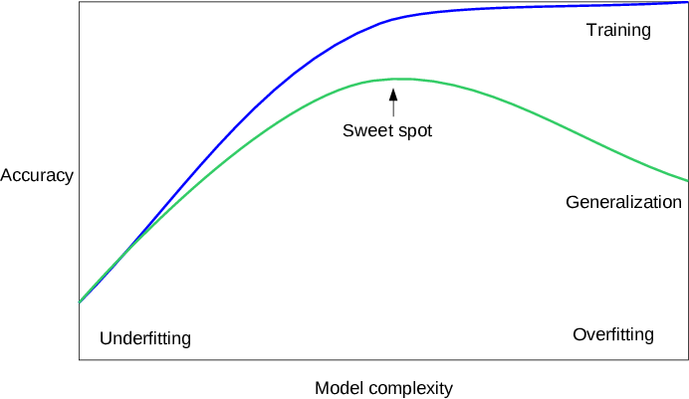
More complexity first helps, then hurts
Müller and Guido, ch. 2
Part 3 · Bias, variance and model complexity
Too simple: underfits, and both scores are low.
Too flexible: overfits, and the two scores pull apart.
In between is the model you want.
Image source: Müller and Guido, Introduction to Machine Learning with Python, ch. 2.
Test accuracy rises with complexity until the model starts fitting the sample, then falls, so aim for the sweet spot.
Source: notes/01-statistical-foundations.md
16
Notes:
Hold this picture in mind. Raising complexity trades one kind of error for another. To say which kind, and how much, we need the decomposition.
Source: notes/01-statistical-foundations.md

Slide 17
Error has three parts, and you control two
Part 3 · Bias, variance and model complexity
Bias
Variance
Irreducible error
The family is too simple: a straight line fit to a curve.
The fit depends too much on the sample: a degree-15 polynomial through 20 points.
The noise in y itself. No model removes it.
Expected error is bias squared plus variance plus noise, and you control only the first two.
Source: notes/01-statistical-foundations.md
17
Notes:
Bias is being wrong in the same way every time. Variance is being wrong in a different way depending on which rows you happened to draw. Noise is the part nobody can fix, so know its size before you spend a week tuning.
Source: notes/01-statistical-foundations.md

Slide 18
The decomposition, written out
Part 3 · Bias, variance and model complexity
MATH
E[(y - f̂(x))²] = (E[f̂(x)] - f(x))² + Var[f̂(x)] + σ²
bias² variance irreducible
E[f̂(x)] the average fit over many training sets
Var[f̂(x)] how far one fit swings around that average
σ² the noise in y, here 0.3² = 0.09 in the simulation to come
E[(y - f̂(x))²] = (E[f̂(x)] - f(x))² + Var[f̂(x)] + σ², which is bias² plus variance plus noise.
Source: notes/01-statistical-foundations.md
18
Notes:
The expectation runs over training sets. That is why you can't compute this on real data: you only ever drew one training set. A simulation, where we know the true function, lets us see each term directly.
Source: notes/01-statistical-foundations.md

Slide 19
A simulation can measure each part
Part 3 · Bias, variance and model complexity
f(x) = sin(2πx), noise sd 0.3, 30 points per training set, 200 training sets. Polynomial degree is the knob.
PYTHON
for degree in [1, 3, 5, 7, 9]:
preds = []
for _ in range(200):
x = rng.uniform(0, 1, 30)
y = f(x) + rng.normal(0, 0.3, 30)
preds.append(np.polyval(np.polyfit(x, y, degree), x_grid))
preds = np.array(preds)
bias2 = ((preds.mean(0) - f(x_grid)) ** 2).mean()
var = preds.var(0).mean()
Only a simulation lets you draw many training sets from a known function, so only it can show each term.
Source: notes/01-statistical-foundations.md
19
Notes:
Read the loop from the inside. We draw a fresh training set, fit it, and predict on a fixed grid. Bias compares the average prediction with the truth, and variance is how far predictions spread around their own average.
Source: notes/01-statistical-foundations.md

Slide 20
Degree 3 to 5 is the sweet spot
Part 3 · Bias, variance and model complexity
Simulated data: f(x) = sin(2πx), noise sd 0.3, 30 points per training set, mean over 200 training sets.
Degree | Bias² | Variance | Test MSE
1 | 0.157 | 0.021 | 0.268
3 | 0.003 | 0.013 | 0.106
5 | 0.000 | 0.025 | 0.115
7 | 0.001 | 0.196 | 0.287
9 | 0.010 | 17.864 | 17.963
Bias falls and variance rises, so degree 1 is mostly bias, and at degree 9 variance reaches 17.9.
Source: notes/01-statistical-foundations.md
20
Notes:
Test MSE is bias squared plus variance plus 0.09, the noise. Look at degree 9. Its bias is tiny, so the average of many fits is near the truth, but no one ever gets the average. You get one fit, and that fit swings wildly.
Source: notes/01-statistical-foundations.md

Slide 21
Two scores diagnose the fit
Part 3 · Bias, variance and model complexity
Symptom | Train | Test | Diagnosis | Fix
Underfitting | Low | Low, close to train | High bias | More features, a more flexible model, less regularisation
Overfitting | High | Much lower | High variance | More data, a simpler model, more regularisation, early stopping
Good fit | High | Close to train | None | Stop tuning, and check the test set once
Low train and low test is underfitting, and high train with a much lower test is overfitting.
Source: notes/01-statistical-foundations.md
21
Notes:
This is the table to keep. The fixes point in opposite directions, so applying the wrong one makes things worse. A bigger model helps only with high bias.
Source: notes/01-statistical-foundations.md

Slide 22
More data supports more complexity
Part 3 · Bias, variance and model complexity
Same simulation, degree 9, with ten times the points in each training set.
30 points
300 points
Variance 0.003 at degree 9
Variance 17.9 at degree 9
Best degree moves to 5, with 7 and 9 nearly as good
Best degree is 3
At degree 9, variance collapses from 17.9 to 0.003, so more data supports more complexity.
Source: notes/01-statistical-foundations.md
22
Notes:
Bias barely moves here, and variance collapses. This is the "complexity relative to data size" point from Müller and Guido chapter 2. Andrew Ng's learning curves make it measurable, and they come up in the model evaluation lecture.
Source: notes/01-statistical-foundations.md

Slide 23
Regularisation pulls the fit towards simplicity
Part 3 · Bias, variance and model complexity
It is any constraint that makes the model simpler than the data would otherwise allow.
L2 penalty on weights: ridge.
L1 penalty on weights: lasso, which also zeros features.
A maximum tree depth in trees.
A minimum number of neighbours in kNN.
Regularisation is any constraint pulling the fit towards simplicity, and every model family has one main knob.
Source: notes/01-statistical-foundations.md
23
Notes:
These look like four separate tricks, and they are one idea. The next lecture names the main complexity knob for each family, so when a model overfits you know which dial to turn.
Source: notes/01-statistical-foundations.md

Slide 24
Explaining and predicting want different things
Shmueli, Statistical Science 2010
Part 3 · Bias, variance and model complexity
Explanatory modelling
Predictive modelling
Focuses on bias and variance together
Focuses on minimising bias
Prediction weighs bias and variance together, so "the 'wrong' model can sometimes predict better than the correct one".
Source: notes/01-statistical-foundations.md
24
Notes:
This is why you can't read a good predictive model as a true account of the world, and it comes back in the interpretability lecture. Estimation in data analytics shows the same split on a single estimator.
Source: notes/01-statistical-foundations.md

Slide 25
PART 4
Probability as ML uses it
Four probability ideas keep coming back
Cross-entropy is maximum likelihood in disguise
Regularisation is a prior in another language
Four ideas · Negative log-likelihood · The bridge to Bayes
25
Notes:
You need far less probability to use these models than the textbooks cover. Four ideas keep coming back.

Slide 26
Four probability ideas keep coming back
Part 4 · Probability as ML uses it
Idea | Used in | One line
Likelihood | Logistic regression, naive Bayes | How probable the data is under the parameters. Training maximises it
Negative log-likelihood | Cross-entropy loss | Minimising it is maximum likelihood
Gaussian | Anomaly detection, weight initialisation | Mean and variance describe it fully
Conditional independence | Naive Bayes | Assume features are independent given the class. Wrong, and often still good
The four recurring ideas are likelihood, negative log-likelihood, the Gaussian and conditional independence.
Source: notes/01-statistical-foundations.md
26
Notes:
If any of these feel shaky, the probability foundations and estimation notes in data analytics are the place to go. For using these models, this table is most of what you need.
Source: notes/01-statistical-foundations.md

Slide 27
Cross-entropy is maximum likelihood in disguise
Part 4 · Probability as ML uses it
MATH
NLL(θ) = -(1/n) Σᵢ log p_θ(yᵢ | xᵢ)
maximise the likelihood = minimise the negative log-likelihood
For classes, this NLL is the cross-entropy loss.
The same line trains logistic regression and a language model.
Minimising cross-entropy is maximum likelihood of the labels under the model.
Source: notes/01-statistical-foundations.md
27
Notes:
This one line runs from the next lecture all the way to nanoGPT later in the course. When you meet a loss function, ask what probability model it is the likelihood of.
Source: notes/01-statistical-foundations.md

Slide 28
Regularisation is a prior in another language
Part 4 · Probability as ML uses it
Ridge
Lasso
L2 penalty
L1 penalty
MAP estimate under a Gaussian prior on the weights
MAP estimate under a Laplace prior on the weights
Ridge is MAP under a Gaussian prior, and lasso is MAP under a Laplace prior.
Source: notes/01-statistical-foundations.md
28
Notes:
That is the bridge between this subject and the Bayesian pillar in data analytics. Priors become regularisers, and posteriors replace point estimates. We won't cross that bridge here, but you should know it is there.
Source: notes/01-statistical-foundations.md

Slide 29
PART 5
Train, validation, test
The one discipline
Each split answers its own question
Two arguments make a split trustworthy
Two ways to fool yourself with a split
The one discipline · Three splits · Two ways to break it
29
Notes:
Now the habit that makes all of this measurable.

Slide 30
The one discipline
The rule
Part 5 · Train, validation, test
The test set is touched once, at the end. Everything you tune is tuned on data the test set never saw.
Once, at the end, and tune only on data the test set never saw.
Source: notes/01-statistical-foundations.md
30
Notes:
This separates a real result from a fooled one. Every look at the test set is a small decision made with it, and those decisions add up until the score is no longer a test.
Source: notes/01-statistical-foundations.md

Slide 31
Each split answers its own question
Part 5 · Train, validation, test
Training
Fit. 60-80%
Validation or CV
Choose. 10-20% or k-fold
Test
Final estimate. 10-20%
Typical shares. Validation can be k-fold over the training part instead.
A split used to choose stops being honest, so choose on validation and take the final estimate from test, once.
Source: notes/01-statistical-foundations.md
31
Notes:
Two splits are not enough, because the moment you use one to choose, it stops being honest. So you need one to choose with, and another that stays out of every decision.
Source: notes/01-statistical-foundations.md

Slide 32
Two arguments make a split trustworthy
Part 5 · Train, validation, test
PYTHON
Default: shuffles, holds out 25%.
split = train_test_split(
X, y,
random_state=0, # same split every run
stratify=y, # class shares match
)
X_train, X_test, y_train, y_test = split
random_state: same split each run.
stratify=y: keeps class shares.
Fix random_state so the split reproduces, and pass stratify=y so the class balance matches.
Source: notes/01-statistical-foundations.md
32
Notes:
Shuffling is a default, not a truth. For data with an order, it is the wrong thing to do, and we come to that in the pitfalls at the end.
Source: notes/01-statistical-foundations.md

Slide 33
Two ways to fool yourself with a split
Part 5 · Train, validation, test
Tuning on the test set
Leakage
Choosing C for an SVM by test score
Fitting a scaler or selector on all the data before splitting
The test set becomes a validation set
The model has seen statistics of the test rows
The reported score is optimistic
Choosing by test score and fitting preprocessing before the split both make the score optimistic.
Source: notes/01-statistical-foundations.md
33
Notes:
Both of these are covered properly later. Leakage gets its treatment in feature engineering and pipelines, and tuning in model evaluation and in training and tuning, which runs the whole loop on real data.
Source: notes/01-statistical-foundations.md

Slide 34
PART 6
The first application classifies iris flowers
Every supervised model follows the same four lines
Before fitting, look at the data
Six methods and what they return
The uniform API is a design decision
Which estimators have which methods
Writing your own estimator takes three rules
The scikit-learn API in four lines
A first application · Four lines · Look at the data · Every method
34
Notes:
One last piece of foundation. Every classical model you meet has the same shape in code.

Slide 35
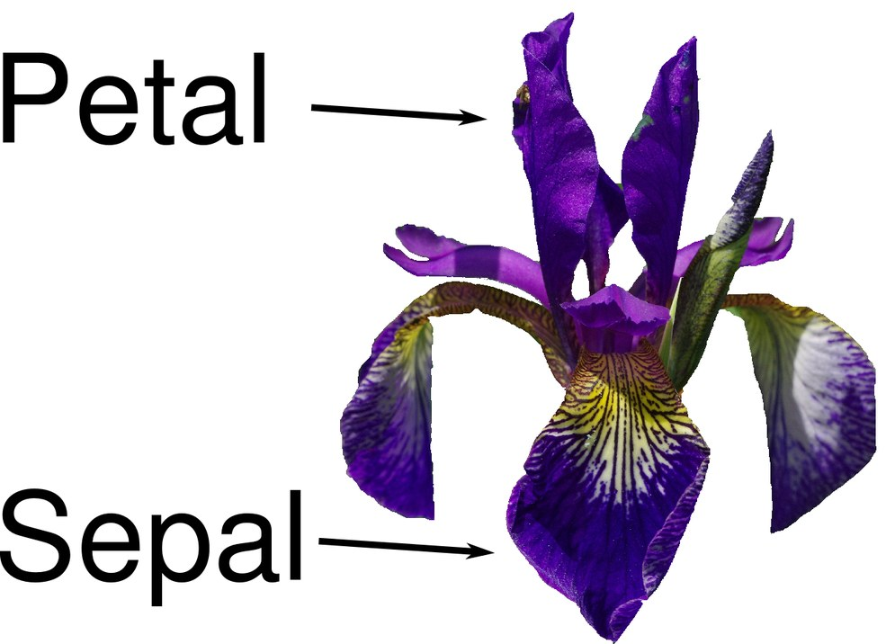
The first application classifies iris flowers
Müller and Guido, ch. 1
Part 6 · The scikit-learn API in four lines
150 flowers, four measurements.
Predict the species.
112 train, 38 test by default.
Image source: Müller and Guido, Introduction to Machine Learning with Python, ch. 1.
Iris has 150 rows and four measurements, and the default split gives 112 to train and 38 to test.
Source: notes/01-statistical-foundations.md
35
Notes:
It is a small and easy problem, which is the point. We want to see the shape of the code without any of the data getting in the way.
Source: notes/01-statistical-foundations.md

Slide 36
Every supervised model follows the same four lines
Part 6 · The scikit-learn API in four lines
PYTHON
knn = KNeighborsClassifier(n_neighbors=1) # 1. instantiate with hyperparameters
knn.fit(X_train, y_train) # 2. fit on training data
y_pred = knn.predict(X_test) # 3. predict
print(knn.score(X_test, y_test)) # 4. score
# 0.9736842105263158
Instantiate, fit, predict and score, and every supervised model in this pillar has this shape.
Source: notes/01-statistical-foundations.md
36
Notes:
Learned state ends in an underscore, like coef_. The default score is accuracy for classifiers and R squared for regressors. Swap the first line for any other model and the other three stay exactly the same.
Source: notes/01-statistical-foundations.md

Slide 37
Before fitting, look at the data
Part 6 · The scikit-learn API in four lines
One line first: pd.plotting.scatter_matrix(df, c=y_train)
Do the classes separate on the raw features at all?
Unit errors show up as odd scales.
Outliers show up before they cost you a day.
A scatter matrix shows if classes separate on raw features, and catches unit errors and outliers.
Source: notes/01-statistical-foundations.md
37
Notes:
One line of code, and it comes before fit in any real project. It is the cheapest check in this whole lecture.
Source: notes/01-statistical-foundations.md

Slide 38
Six methods and what they return
Part 6 · The scikit-learn API in four lines
Method | On | Returns
fit(X, y) | Every estimator | self, with learned attributes ending in _
predict(X) | Supervised models, some clusterers | Labels or values
predict_proba(X) | Most classifiers | Class probabilities
transform(X) | Preprocessors, PCA, vectorisers | A new feature matrix
fit_transform(X) | Transformers | Fit then transform, sometimes faster
score(X, y) | Supervised models | Default metric
fit returns self with learned attributes, predict returns answers, and transform returns a new feature matrix.
Source: notes/01-statistical-foundations.md
38
Notes:
decision_function sits next to predict_proba and returns signed margins. Because every estimator has this shape, you can chain them into pipelines and search over them. Both come in later lectures.
Source: notes/01-statistical-foundations.md

Slide 39
The uniform API is a design decision
Pedregosa et al., JMLR 2011
Part 6 · The scikit-learn API in four lines
What the paper claims
What it doesn't show
API consistency over many algorithms
It reports no usability study
For non-specialists
Its one benchmark table measures time on a single dataset
By code convention, not inheritance
API consistency is a stated design goal of scikit-learn, and the paper doesn't measure usability.
Source: notes/01-statistical-foundations.md
39
Notes:
Anything with a fit method can join in. That convention is the reason the ecosystem around scikit-learn fits together. Read it as a design claim, because that is all the paper offers for it.
Source: notes/01-statistical-foundations.md

Slide 40
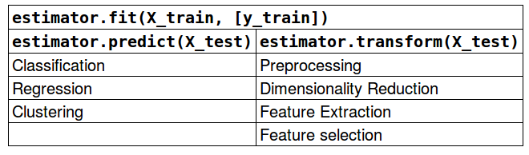
Which estimators have which methods
Müller and Guido, ch. 8
Part 6 · The scikit-learn API in four lines
Image source: Müller and Guido, Introduction to Machine Learning with Python, ch. 8.
Classifiers, regressors and some clusterers predict, preprocessors and feature extractors transform, and all of them fit.
Source: notes/01-statistical-foundations.md
40
Notes:
A reference slide, to come back to when you're unsure which method a given object offers.
Source: notes/01-statistical-foundations.md

Slide 41
Writing your own estimator takes three rules
Part 6 · The scikit-learn API in four lines
PYTHON
Inherit a mixin, BaseEstimator.
class Ranked(ClassifierMixin, BaseEstimator):
def __init__(self, rank=0):
self.rank = rank # store it, no logic
def fit(self, X, y):
c, n = np.unique(y, return_counts=True)
self.classes_ = c # state ends in _
self.label_ = c[np.argsort(-n)[self.rank]]
return self
def predict(self, X):
return np.full(len(X), self.label_)
__init__ only stores hyperparameters.
fit returns self.
Subclass BaseEstimator and a mixin, keep logic out of __init__, and return self from fit.
Source: notes/01-statistical-foundations.md
41
Notes:
An illustration written for this slide and run on iris, following the rules in Müller and Guido chapter 8. Follow those rules and your object works in pipelines and grid search.
Source: notes/01-statistical-foundations.md

Slide 42
PART 7
Pitfalls
Five ways a first model misleads you
A sensible rule can lose to guessing
What to carry into the next lecture
Five first mistakes · A rule that loses to guessing · What to carry forward
42
Notes:
Each of these is a mistake with a symptom you can spot, and a fix you can apply on Monday.

Slide 43
Five ways a first model misleads you
Part 7 · Pitfalls
Pitfall | Symptom | Fix
Accuracy without the base rate | 76% on adult census is what always saying <=50K gets | Print the class shares before fitting
Treating noise as bias | The test score stops improving with any model or feature | Estimate the noise from repeat labels or human agreement
Reading the test set while developing | The score drops the day it meets real data | Tune on validation or CV
Fixing variance with a bigger model | Train rises, test falls | Regularise, simplify or add data
Shuffling data that has an order | Great offline, poor live, on time-stamped or grouped rows | Split by time or group, as production meets the data
A bigger model raises train and lowers test when the problem is variance, so regularise, simplify or add data.
Source: notes/01-statistical-foundations.md
43
Notes:
Treating noise as bias is the expensive one. If human labellers disagree with each other on a fifth of the rows, no amount of tuning gets you past that. Measure the noise before you spend the week.
Source: notes/01-statistical-foundations.md

Slide 44
A sensible rule can lose to guessing
Part 7 · Pitfalls
On adult census: predict over $50k if education-num is 13 or more.
PYTHON
((adult["education-num"] >= 13) == (adult["income"] == ">50K")).mean()
# 0.752 the rule
# 0.759 always guessing <=50K
On accuracy, a sensible-looking rule at 0.752 loses to the base rate of 0.759, so check before you believe it.
Source: notes/01-statistical-foundations.md
44
Notes:
More education does go with higher income, and the rule still loses on accuracy to knowing nothing. That doesn't make education useless. It says you need a better question and a better measure, which is where the next lectures go.
Source: notes/01-statistical-foundations.md

Slide 45
What to carry into the next lecture
Part 7 · Pitfalls
Print the base rate — Every score is read against it
1
Read train and test together — Together they name bias or variance, and that picks the fix
2
Keep the test set back — Touch it once, at the end
3
Use the four lines — Every model next lecture has this shape, and its own complexity knob
4
Read scores against the base rate, diagnose with train and test, touch the test set once, and use the four lines.
Source: notes/01-statistical-foundations.md
45
Notes:
You now have what you need to compare models fairly. Next we meet the families themselves: linear models, kNN, trees, kernels. Each one gets its complexity knob, its strengths and its failure mode.
Source: notes/01-statistical-foundations.md

Slide 46
Where this leads
Lecture 2 of 17
Where this leads
Next
Connected
Estimation (data analytics)
The data generating process: fit, specification and generalisation (data analytics)
Supervised Learning
Model Evaluation
46

